Slide 1
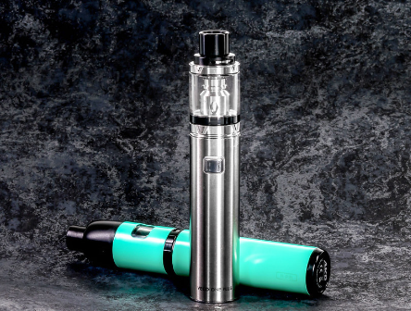
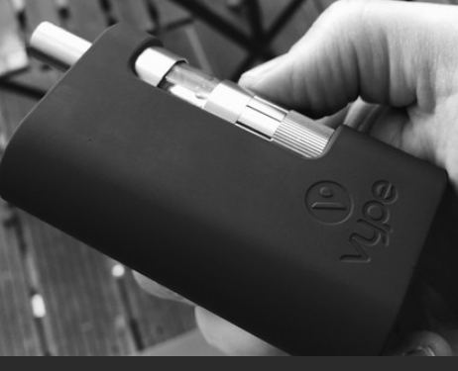
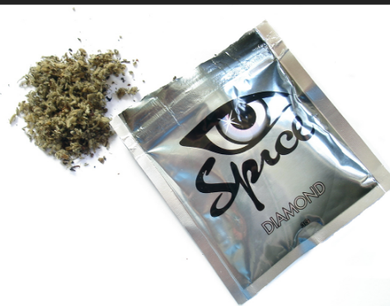
vaping
What is it?

Slide 2
Vaping – what is it?
E-cigarettes are electronic devices that heat liquid which then produces smoke when inhaled. This is called vaping
The liquid mostly contains nicotine which is an addictive substance often found in tobacco products
The liquid is available in many flavours
It can also be used to vape liquid cannabis & synthetic cannabinoids

Slide 3
Vaping
Designed to give nicotine without the chemicals contained in tobacco
While vaping may be less harmful than smoking, it is not without harm and the long-term effects are still unknown
Recommendations support the use of Nicotine Replacement Therapy (NRT) and support from a stop smoking advisor along with a quit plan.

Slide 4
young people and vaping – the risks
E-cigarettes are currently not regulated in Ireland
Some that claimed to have no nicotine, have been tested and found to have nicotine
Vapes may contain: Nicotine
Volatile organic compounds (human made chemicals typically made in pharmaceutical manufacturing lab)
Ultra fine particles
Cancer causing chemicals
Heavy metals (tin, nickel and lead)
Flavouring, such as diacetyl, a chemical linked to serious lung disease

Slide 5
The Risks continued…
High risk of developing a nicotine addiction leading to smoking traditional cigarettes
Short term physical damage to heart and lungs – long term effects remain unknown
The effects of nicotine on the young brain can manifest as problems with attention, impulse control, learning and mood
Addiction to anything at a young age can increase the risks associated with problem substance use later
Some e-cigarette batteries have caught fire and/or exploded causing serious physical injuries

Slide 6
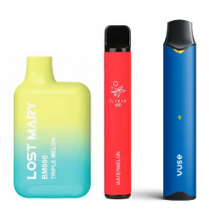
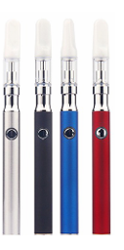
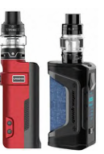
Three types of vapes
Disposable vapes
Vape pens
Vape tanks/modifiable tanks
Disposable Pens Tanks

Slide 7
The latest data
The latest data on youth vaping has been developed from the Planet Youth survey data collected in 2023. Findings included;
41% of teens vaped in their lifetime
This is an increase of 8% from the last 2021 survey
Girls are more likely than boys to have vaped in their lifetimes
56% of vapers believed their parents would be totally against vaping
85% of non-vapers believed their parents would be totally against vaping

Slide 8
data continued…
66% got them from friends or schoolmates
47% bought their vapes in a shop
7% got them from a parent/care giver
74% believe vaping to be addictive and damaging to the lungs

Slide 9
Vaping of synthetic cannabinoids; spice; ging & the risks
Synthetic cannabinoids were introduced in Europe with the head shops and were sold as a “legal alternative replacement” to cannabis. It is not cannabis and does not contain cannabis but intended to be potent and the effects are much stronger
While Head Shops closed, the product remained and has been increasingly turning up in other cannabis products
It is sometimes called Spice or Ging and has been associated with many serious outbreaks of poisonings and deaths internationally

Slide 10
Signs for concern
Dizziness
Confusion
Sweating
Difficulty breathing
Chest pain/rapid heartbeat
Nausea/vomiting
Agitation/aggression
Psychotic behaviour/delusions
Hallucinations
Seizures/fits
Seek medical assistance if you or someone you know, are experiencing these symptoms

Slide 11
Harm reduction
Be aware that the product could be present
Consider the risks if buying from an unknown/untrusted source
It is always safest not to use but in the case of using; use less than you would regularly and less frequently
Try to avoid using alone and/or let someone know
If you notice unexpected effects, avoid taking any more and seek medical assistance if necessary
Don’t be afraid to seek help if you or a friend become unwell
If taking edible products, look at packaging - be aware of counterfeit products and only take a very small amount

Slide 12
If you need help
Call your local service if you think you need help to stop smoking, vaping or using cannabis
Contact the Quit team to stop smoking - HSE.ie
www.drugs.ie
cris@mqi.ie
tiglin.ie
livinglifecounselling.com

Slide 13
Sources/references
HSE drugs.ie (n.d.)
Vaping (using e-cigarettes) - HSE.ie E-Cigarette Resources - HSE.ie
Synthetic Cannabinoids in Ireland: HSE update - Drug and Alcohol Information and Support in Ireland - Drugs.ie[Accessed on 11/09/24]
Images free to use and share commercially: google.ie
For more information, follow the link below
Vaping (using e-cigarettes) - HSE.ie

