Slide 1
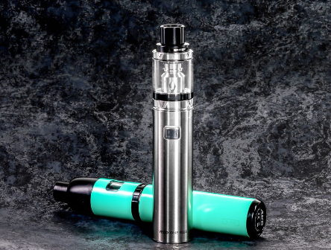
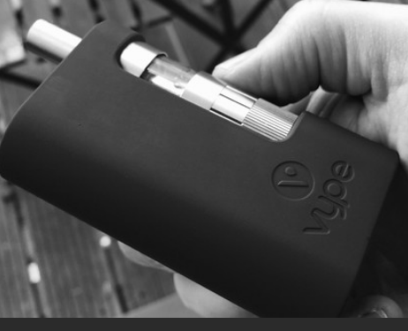
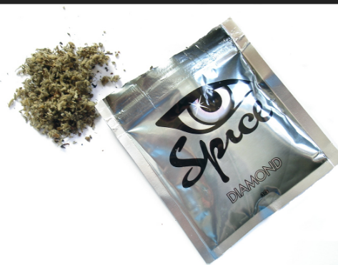
Hhc/vaping
What is it?

Slide 2
Vaping – what is it?
E-cigarettes are electronic devices that heat liquid which then produces smoke when inhaled. This is called vaping
The liquid mostly contains nicotine which is an addictive substance often found in tobacco products
The liquid is available in many flavours
It can also be used to vape liquid cannabis & synthetic cannabinoids

Slide 3
Hhc (Hexahydrocannabino)– what is it?
It is a new cannabinoid product that has quickly emerged in Europe and Ireland since 2022.
The cannabis plant contains hundreds of chemicals such as CBD and THC. THC is the psychoactive chemical in cannabis and varies in potency between plants.
CBD is the non-psychoactive chemical in cannabis.
HHC is a man-made chemical (not natural/semi-synthetic form) developed from CBD.

Slide 4
Hhc – what does it look like ~& how is it taken?
Very similar in appearance to cannabis.
Can be smoked or consumed by eating.
Sold in shops legally currently in the form of e-cigarettes, vape pens, herbal mixtures, edibles (Jellies/baked goods) and in liquid form.
Some products have been found to have HHC sprayed on them.
Other products are available alongside HHC such as CBG – a product also new to the market with limited information available on the health effects.

Slide 5
Vaping of synthetic cannabinoids; spice; ging & the risks
Dependent on personal factors and potency levels, the risks vary.
Some people will feel similarly to when they consume cannabis.
Early reports of anecdotal evidence are finding:
Strong or ‘different’ intoxication compared with cannabis
General feelings of being unwell
Confusion
Unconsciousness
Depression
Withdrawal symptoms following frequent use

Slide 6
Risks continued…
The long-term effects are not fully understood
“Emerging information from Irish hospitals has highlighted two case studies of regular cannabis smokers who experienced psychotic episodes as a potential result of vaping HHC. Psychosis can be short or longer term where people experience a series of symptoms where they lose touch with reality. Irish cases from HHC use have experienced extreme distress, delusions (beliefs), auditory hallucinations (hearing what is not there) paranoia, detachment from reality and self-harm.”

Slide 7
Signs for concern
Dizziness
Confusion
Sweating
Difficulty breathing
Chest pain/rapid heartbeat
Nausea/vomiting
Agitation/aggression
Psychotic behaviour/delusions
Hallucinations
Seizures/fits
Seek medical assistance if you or someone you know, are experiencing these symptoms

Slide 8
Harm reduction
Be aware that the product could be present
Consider the risks if buying from an unknown/untrusted source
It is always safest not to use but in the case of using; use less than you would regularly and less frequently
Try to avoid using alone and/or let someone know
If you notice unexpected effects, avoid taking any more and seek medical assistance if necessary
Don’t be afraid to seek help if you or a friend become unwell
If taking edible products, look at packaging - be aware of counterfeit products and only take a very small amount

Slide 9
If you need help
Call your local service if you think you need help to stop smoking, vaping or using cannabis OR if you are worried about your child vaping/smoking
FREEPHONE: 1800 201 203 HSE Quit line
Contact the Quit team to stop smoking - HSE.ie
www.drugs.ie
cris@mqi.ie
tiglin.ie
livinglifecounselling.com

Slide 10
Sources/references
HSE drugs.ie (n.d.)
Vaping (using e-cigarettes) - HSE.ie E-Cigarette Resources - HSE.ie
Synthetic Cannabinoids in Ireland: HSE update - Drug and Alcohol Information and Support in Ireland - Drugs.ie[Accessed on 11/09/24 & 10/10/24]
Images free to use and share commercially: google.ie
For more information, follow the link below
Hexahydrocannabinol (HHC) - Drug and Alcohol Information and Support in Ireland - Drugs.ie
Drugs-HSE_Risk_Communication-Factsheet_V1.pdf

