Slide 1

LSD
What is it?

Slide 2
LSD
Also called lysergic acid diethylamide, acid, blotter, cheer, dots, flash, hawk, L, lightening flash, liquid acid, lucy, micro dot, trips, tabs.
A hallucinogenic drugs, it comes from the fungus ergot growing wild on rye and other grasses.
It comes as a piece of paper that can be swallowed or sucked.
Effects begin after approximately 30 minutes and can last up to 20 hours.
Short-term effects depend on how much you take and on how you are feeling. Can be a good or bad experience.
Visual and audio hallucinations, distortion of sounds, changes in sense of time and place which is known as tripping.

Slide 3
LSD
Long-term effects include paranoia, phobia and suicidal ideation.
LSD can trigger underlying mental health problems.
Flashbacks can occur up to two years after taking LSD.
LSD effects judgement and so can make someone vulnerable to making choices they would not usually make.
Because of its hallucinogenic nature, it can result in serious accidents due to people believing they can fly or other such delusions.
It is not advised to take LSD if pregnant as there is no evidence to determine the harms to a baby.
While LSD is not addictive, you can still build up tolerance creating the need for more of the drug and higher amounts of the drug to get the same feeling.

Slide 4
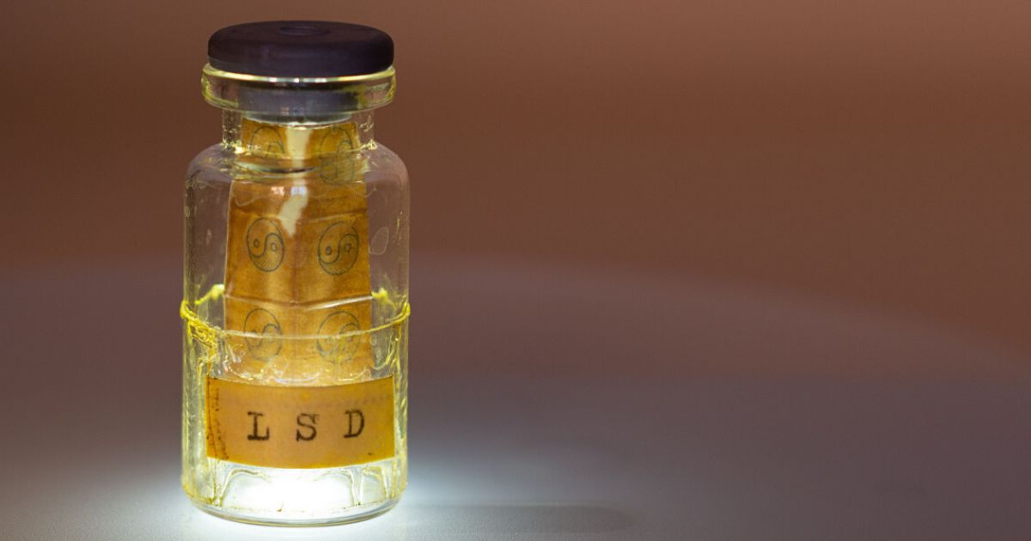
LSD
There are no withdrawal symptoms.
LSD can show up in a urine test up to three days after taking. This is a guideline only as it depends on the amount consumed, other medical issues and your own metabolism.

Slide 5
What it looks like when someone is taking lsd
Dilated pupils.
Lack of appetite.
They may see and hear things that aren’t there.
They describe mystical experiences.
They lose track of time.
They are disconnected from reality.
They are having a bad trip and experience panic attacks, are paranoid or frightened.
If taken regularly, even one dose can take five days for feelings to subside.

Slide 6
LSD – harm reduction
If someone is experiencing a bad trip, you can do what is referred to as “psychedelic first aid”.
  Approach them with kindness and acceptance. Tell them they are safe, reassure them and invite them to explain what they are feeling.
  Get the person to a safe space – a calm, quiet, comfortable space that is away from noise, lights, music and crowds.
  Ask permission to touch the person.
  Offer them a blanket and water.
  Help them to integrate back into society when they can.
  There are three occasions when you should seek medical help:
    Serious mental health episodes.
    Potential violence.
    Medical emergency.

Slide 7
If you need help
Call your local service if you think you need help to stop taking LSD.
Services map: https://www.drugsandalcohol.ie/services_map
www.drugs.ie
cris@mqi.ie
tiglin.ie
livinglifecounselling.com

Slide 8
Sources/references
HSE drugs.ie (n.d.) LSD. https://www.drugs.ie/drugtypes/drug/lsd_hallucinogen [Accessed on 05/01/24]
Image used on first slide is from https://www.dea.gov/factsheets/lsd, which has other images of LSD.
Other images free to use and share commercially: Google.ie
For more information follow the link below;
HRB National Drugs Library (2024) Drugs and alcohol factsheets

