Slide 1
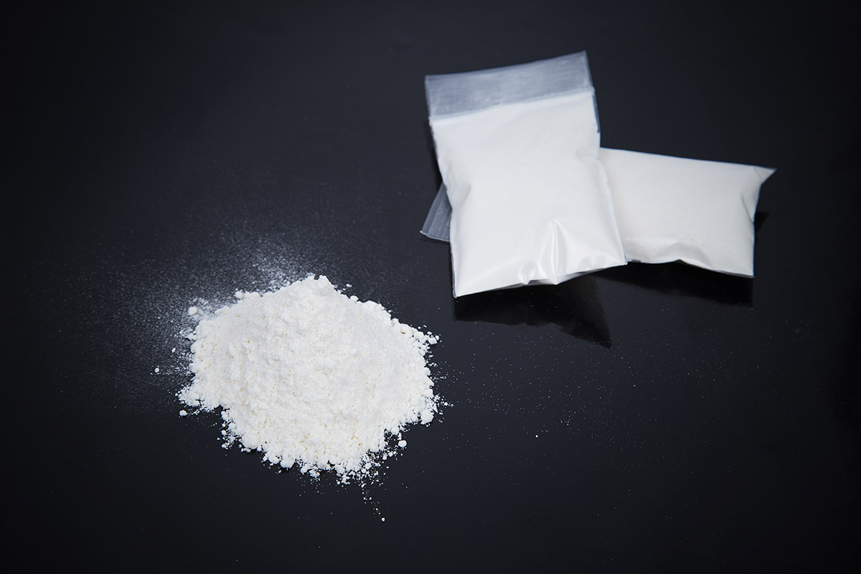
Speed
What is it?

Slide 2
What is speed?
Also known as amphetamine, upper, sulphate, phet, billy, whizz, base, Dexedrine, dexamphetamine.
Speed is a stimulant drug or “upper.”
It comes in powder or tablet form.
It can be snorted, swallowed or injected.
It is off-white/pinkish in colour.
Can sometimes look like crystals.
“Base speed” is purer, has a greyish/pinkish colour and feels like putty.

Slide 3
How is it used?
It can be dabbed on the gums.
It can be sniffed in lines like cocaine.
It can be rolled up in a cigarette paper and swallowed which is known as a “speedbomb.”
It can be mixed in drinks or injected.
It can be smoked in its crystal form.
Its effects begin after approximately 20 minutes and lasts between four and six hours.

Slide 4
Short-term effects
Exhilaration, confidence and increased energy.
Decreased need for food and sleep.
Pupils are wide and face is pale.
Breathing, blood pressure and heart rate increase.
Increased urination and diarrhoea.
Dry mouth.
Talkative/aggressive.
High doses can cause flushing, sweating, headaches, jaw clenching, teeth grinding and racing heartbeat.
Can induce amphetamine psychosis.

Slide 5
Long-term effects
Increased tolerance leading to increased and higher dosing.
Anxiety.
Depression.
Irritability/aggression.
Powerful cravings.
Mood swings and potential violence.
Paranoia, delusions, hallucinations and psychosis.
Weight loss and itchy skin.
Sniffing can damage the nasal cavity.
Injecting carries the risk of disease and infection.

Slide 6
Further risks
Risk of overdose.
Heart failure.
Very dangerous if mixed with alcohol and/or anti-depressants.
May trigger underlying mental health problems.
Increase in sex drive in conjunction with decreased judgement leaves people vulnerable to STI’s and pregnancy.
It is psychically and psychologically addictive, requiring higher amounts and dosage the more frequently it is used.
Depending on use, it remains in the system for up to three days.

Slide 7
Harm reduction
Consider how you are feeling mentally and avoid if feeling low.
Take in a safe place with trusted people.
Try to eat and drink before use.
Avoid using other drugs/alcohol/prescription drugs.
Avoid sharing paraphernalia.
If you think someone may be overdosing, seek medical help immediately.
Put them in the recovery position or on their side and wait until help arrives.
Note:
Speed is not amphetamine. While they have similar effects, speed can be referred to as amphetamine, can be legally prescribed and is typically less potent than methamphetamine.

Slide 8
If you need help
There are local services available.
Services map: https://www.drugsandalcohol.ie/services_map
www.drugs.ie
cris@mqi.ie
Tiglin.ie
Livinglifecounselling.com

Slide 9
Sources/references
HSE drugs.ie (n.d.) Speed. https://www.drugs.ie/drugtypes/drug/speed_stimulant [Accessed on 05/01/24]
Images free to use and share commercially: Google.ie
For more information follow the link below;
HRB National Drugs Library (2024) Drugs and alcohol factsheets

