Slide 1


Nitrous Oxide
What is it?

Slide 2
Laughing gas
Nitrous Oxide is used to provide pain relief during childbirth.
It is also used for pain relief in dentistry.
It is a colourless gas that is described as being sweet smelling.
It comes in a many forms, such as, whipped cream canister chargers known as “whippets” which are small silver canisters.
Also known as Chargers, N²O, Nos and ballons. Media have termed it “hippy crack.”
It can come as crackers with ballons attached or;
In large canisters that are different colours used to fill ballons.
It is NOT helium.

Slide 3
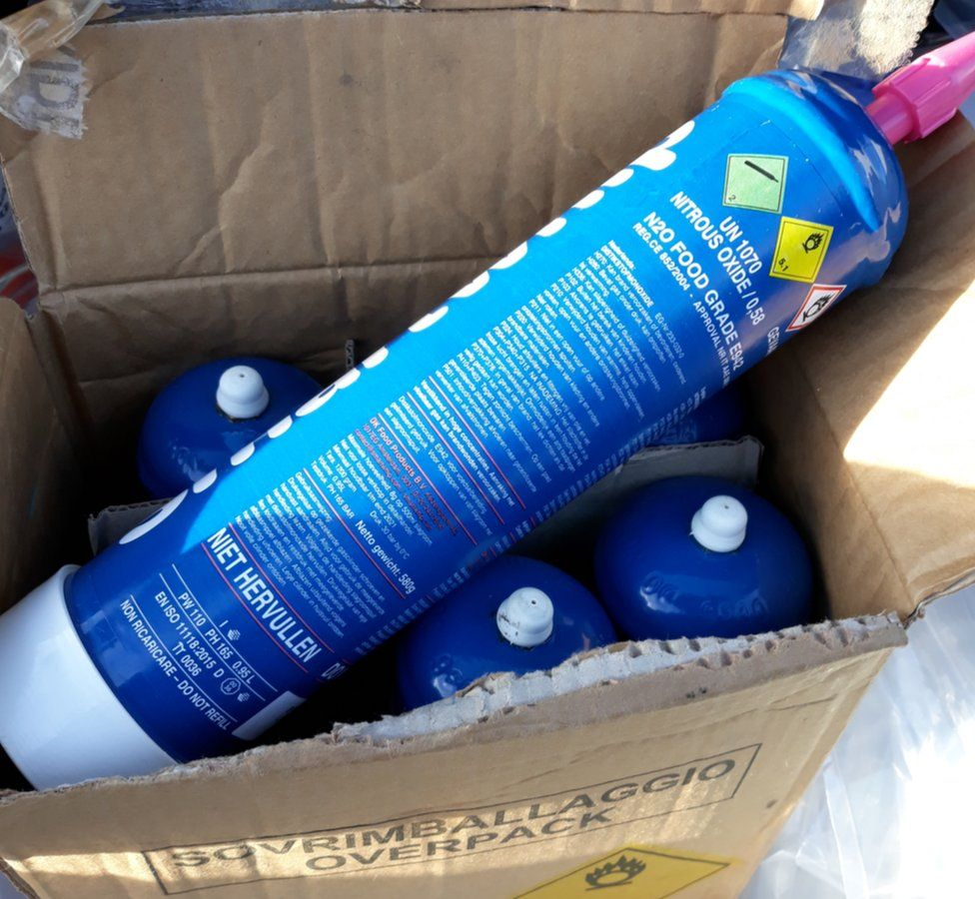
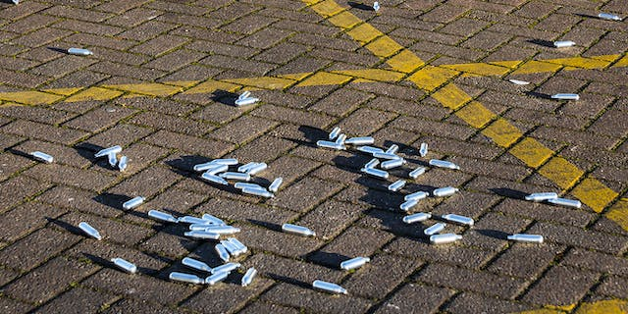
How is it taken?
It is inhaled from a balloon that is filled with the gas – sometimes referred to as “nagging.”
To release gas from “whippet” canisters, they must be fitted into a cream canister or other object known as a “cracker.”
Larger containers release the gas directly into ballons.

Slide 4
How does it affect the person?
Begins to take effect between 10 and 30 seconds after taking.
It has a quick, short-lived euphoric high.
A person will feel giddy and have a sense of relaxation.
Visual patterning or hallucinations can have an impact on sound or visual senses.
It is referred to as a depressant drug.
It slows the body down.
It is a dissociative type drug that causes detatchment from yourself and others.

Slide 5
Unwanted affects
Headache, dizziness and blurred vision.
Loss of balance/disorientation.
Irritated respiratory tract.
Tight chest after heavy use.
Short-lived paranoia.
Nausea.
Change in blood pressure for some.
Sudden death due to lack of oxygen.

Slide 6
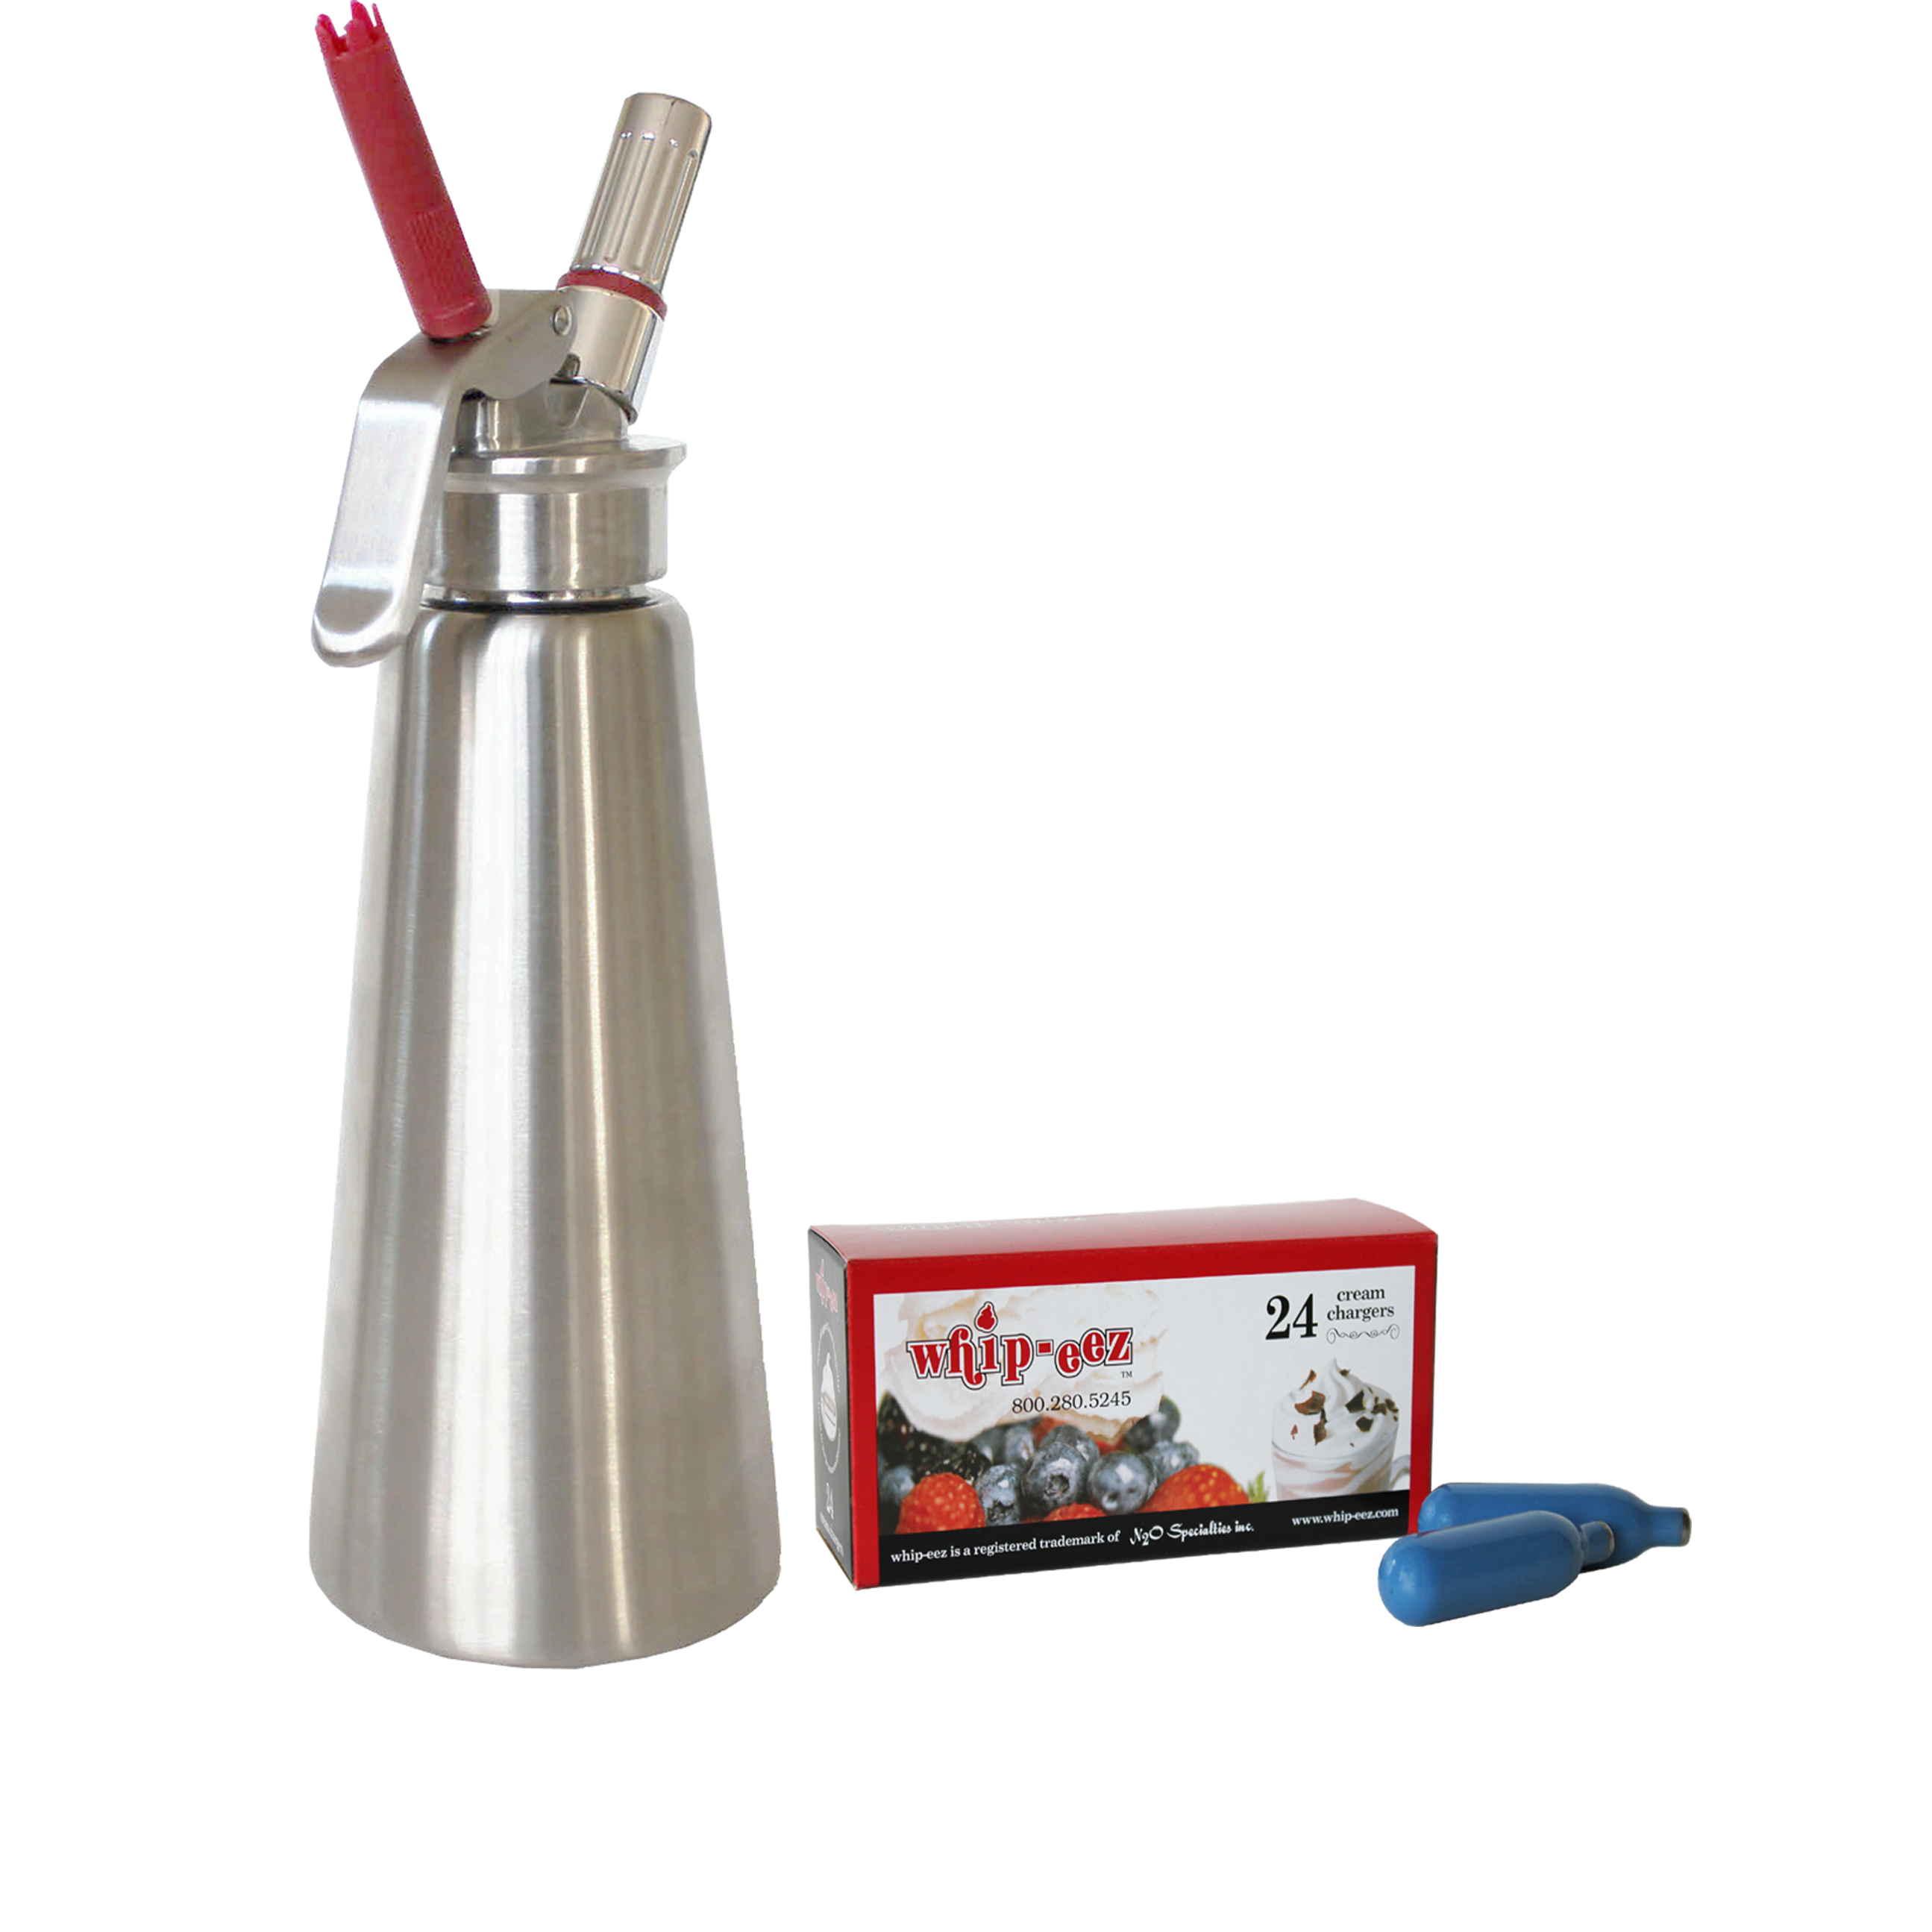
risks
How it is taken.
How much is taken.
How often it is taken.

Slide 7
risks
Falling after use – near bodies of water/roads or other dangerous environments.
Nitrous oxide is freezing and if taken straight from the canister without a ballon, can cause frost bite of the mouth and can damage the throat and lungs.
Those with heart, blood pressure or mental health issues will be at greater risk of adverse effects.
Mixed drug use- using with alcohol or other prescription medication, can increase heart rate and blood pressure and increases risks.
Litter risk from canisters left behind.
LONG TERM RISKS
Vitamin B12 deficiency which can cause nerve damage pain/tingling in the fingers, hands and toes.
Suffocation/lack of oxygen when taken persistently without taking breaths.

Slide 8
Harm reduction
Don’t inhale directly from the canister. Always use a device to release the canister and a balloon to inhale.
Don’t use in a way that causes extra risks, such as taking in confined spaces and unventilated areas.
Don’t use near roads or water.
Sit down to minimise the risk of falling.
Avoid using with other substances.
Limit the number of balloons consumed per session. Don’t use multiple balloons, one after the other. The more used, the higher the risk.
Limit the frequency of use and don’t share balloons.
Look out for long term harms.
Seek medical attention if someone becomes unwell.
Pick up litter after use.

Slide 9
If you need help
In an emergency call 999/112
Treatment services map: https://www.drugsandalcohol.ie/services_map
www.drugs.ie
tiglin.ie
cris@mqi.ie
livinglifecounselling.com

Slide 10
Sources/references
HSE drugs.ie (n.d.) Nitrous Oxide ‘Laughing Gas’. https://www.drugs.ie/drugtypes/drug/nitrous_oxide_laughing_gas [Accessed on 02/01/24]
Images free to use and share commercially: Google.ie
For more information follow the link below;
HRB National Drugs Library (2024) Drugs and alcohol factsheets

