Slide 1
NALOXONE
WHAT IS IT?

Slide 2
NALOXONE
Naloxone is a prescription medication that is used to temporarily reverse the effects of opioid drugs, such as heroin, methadone, morphine, codeine and fentanyl.
Naloxone helps to keep a person alive until an ambulance arrives.
Naloxone displaces opioid molecules from their receptors in the body and brain.
Many services have been trained to use Naloxone.

Slide 3
naloxone
There are two types of Naloxone available in Ireland.
Intramuscular Naloxone (Prenoxad).
A pre-filled syringe and needle that is injected into the middle, outer thigh.
Each pack is a single-use, individual dose only.
5 doses of 0.4mg per dose.
Intranasal Naloxone (Nyxoid)
Needle-free, single-use, individual dose device.
Each pack contains two nasal sprays which contain one dose each.
If both doses are required, they are sprayed into alternative nostrils.
1.8mg dose.

Slide 4
Naloxone administration
The HSE encourages drug users and concerned other, family members and friends, to view videos on the safe administration of Naloxone.
www.drugs.ie/naloxone
The two key risk factors for overdose are polydrug use (mixing drugs) and reduced tolerance.
These risks are heightened when using alone as there is none there to help.

Slide 5
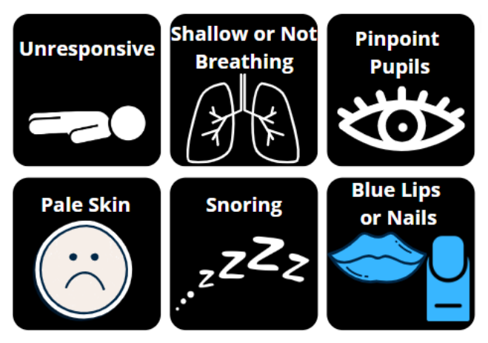
Signs of an overdose

Slide 6
Overdose myths
Shooting salty water or a stimulant.
Let them sleep it off.
Putting the person into a cold shower, ice bath, etc.
Trying to make the person vomit.
Slapping them.
Shaking them vigorously.
Trying to walk them around to walk it off.
None of these are going to reverse an overdose, remember you may be the difference between a person living and dying.
Death following opioid overdose can be preventable if the person receives basic life support and the timely administration of the drug naloxone.

Slide 7
If you need help
Call 999/112.
Treatment services map: https://www.drugsandalcohol.ie/services_map
www.drugs.ie
tiglin.ie
cris@mqi.ie
Livinglifecounselling.com

Slide 8
Sources/references
HSE drugs.ie (n.d.) Naloxone. https://www.drugs.ie/resources/naloxone/ [Accessed on 08/01/24]
Images free to use and share commercially: Google.ie
For more information follow the link below;
HRB National Drugs Library (2024) Drugs and alcohol factsheets

