Slide 1
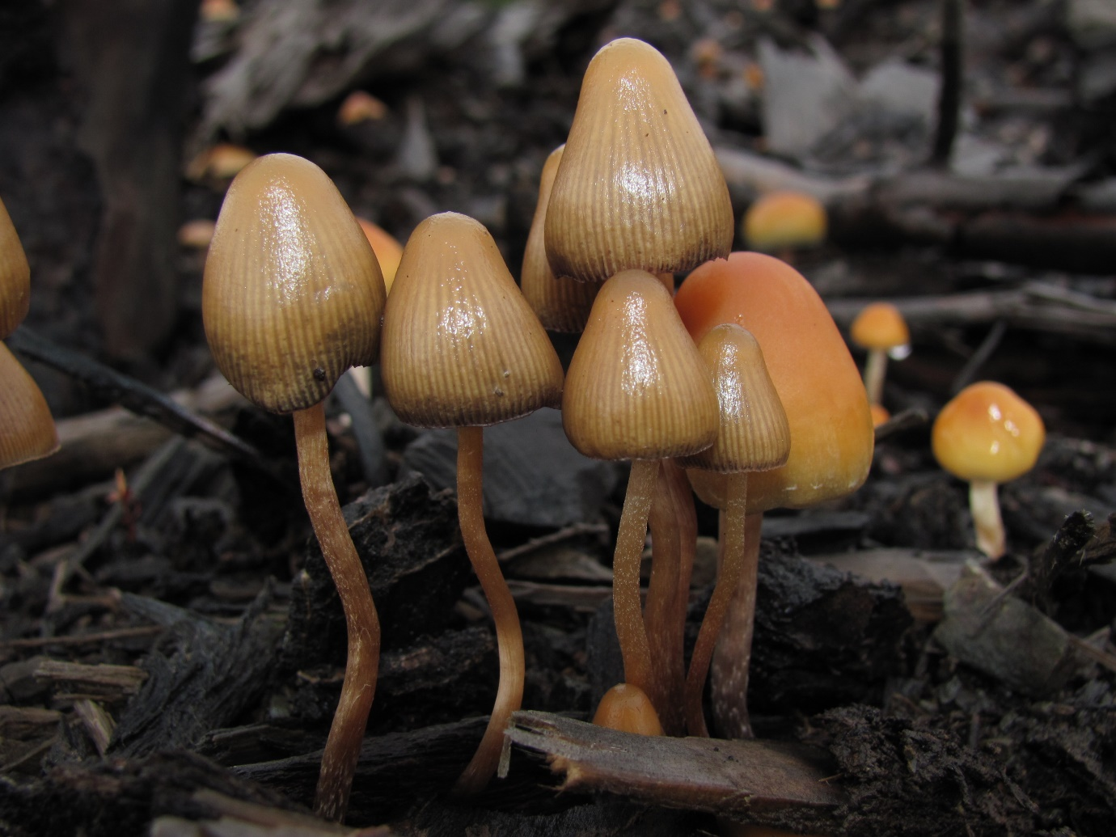
Magic mushrooms
What are they?

Slide 2
What are they?
They are hallucinogenic mushrooms that contain the psychoactive compound “psilocybin” or “psilocin”.
Following ingestion, psilocybin is converted into psilocin in the body.
There are many different kinds of magic mushrooms, some of which grow in the wild in Ireland, usually in Autumn time.
Picking wild mushrooms comes with risks and there have been cases of misidentifying the edible wild magic mushroom for poisonous mushrooms. Some can cause irreversible damage.
Mushrooms are usually sold raw or dried.
They can also be sold in capsules or small bottles.

Slide 3
Magic mushrooms
They can be eaten raw or dried, cooked, stewed or brewed.
Effects vary. Similar to LSD, the mood and mental health of the person will determine if the person experiences a “good or bad” trip.
It can take an hour or more to feel the effects of magic mushrooms.
They can cause a change in perception, sound, time and colour.
Some people may feel euphoric, giddy, have uncontrollable laughter, feel creative and have lots of energy.
It can speed up or slow down time and movement.
Some feel stomach discomfort and are nauseous.

Slide 4
Magic mushrooms
Some people experience high body temperature which is often followed by shivering and chills.
Impaired judgement and hallucinations can cause a person to do things they wouldn’t normally do and cause traumatic injuries and psychosis-like states.
Can cause anxiety, sense of a lack of reality and depersonalisation/disconnected.
It can take numerous days to “come down” from a bad trip.
It is important to take breaks from taking magic mushrooms as taking frequently, can cause changes in perception and mood.
“Fly agaric” magic mushrooms are more toxic and have increased risks

Slide 5
Fly agaric mushroom

Slide 6
risks
There are so many different types of mushrooms, and so many that are poisonous, that it is risky to pick them in general as you could pick the wrong ones.
The potency of mushrooms depends on many factors, such as, species, origin, growing conditions and harvest period. You can never really know how strong or weak the mushrooms will be each time you take them.
Tolerance can develop with frequent use, meaning higher amounts are required to give the same effect.

Slide 7
Harm reduction
If you believe someone may have eaten poisonous mushrooms, do not wait for symptoms to develop.
Call the National Poisons Information Centre:
(01) 809 2166. (8.00 a.m. to 10.00 p.m. 7 days a week)
Or 999/112 immediately.
Services map: https://www.drugsandalcohol.ie/services_map
www.drugs.ie
cris@mqi.ie
tiglin.ie
livinglifecounselling.com

Slide 8
Sources/references
HSE drugs.ie (n.d.) Magic mushrooms. https://www.drugs.ie/drugtypes/drug/magic_mushrooms_hallucinogen [Accessed on 05/01/24]
Images free to use and share commercially: Google.ie
For more information follow the link below;
HRB National Drugs Library (2024) Drugs and alcohol factsheets

