Slide 1

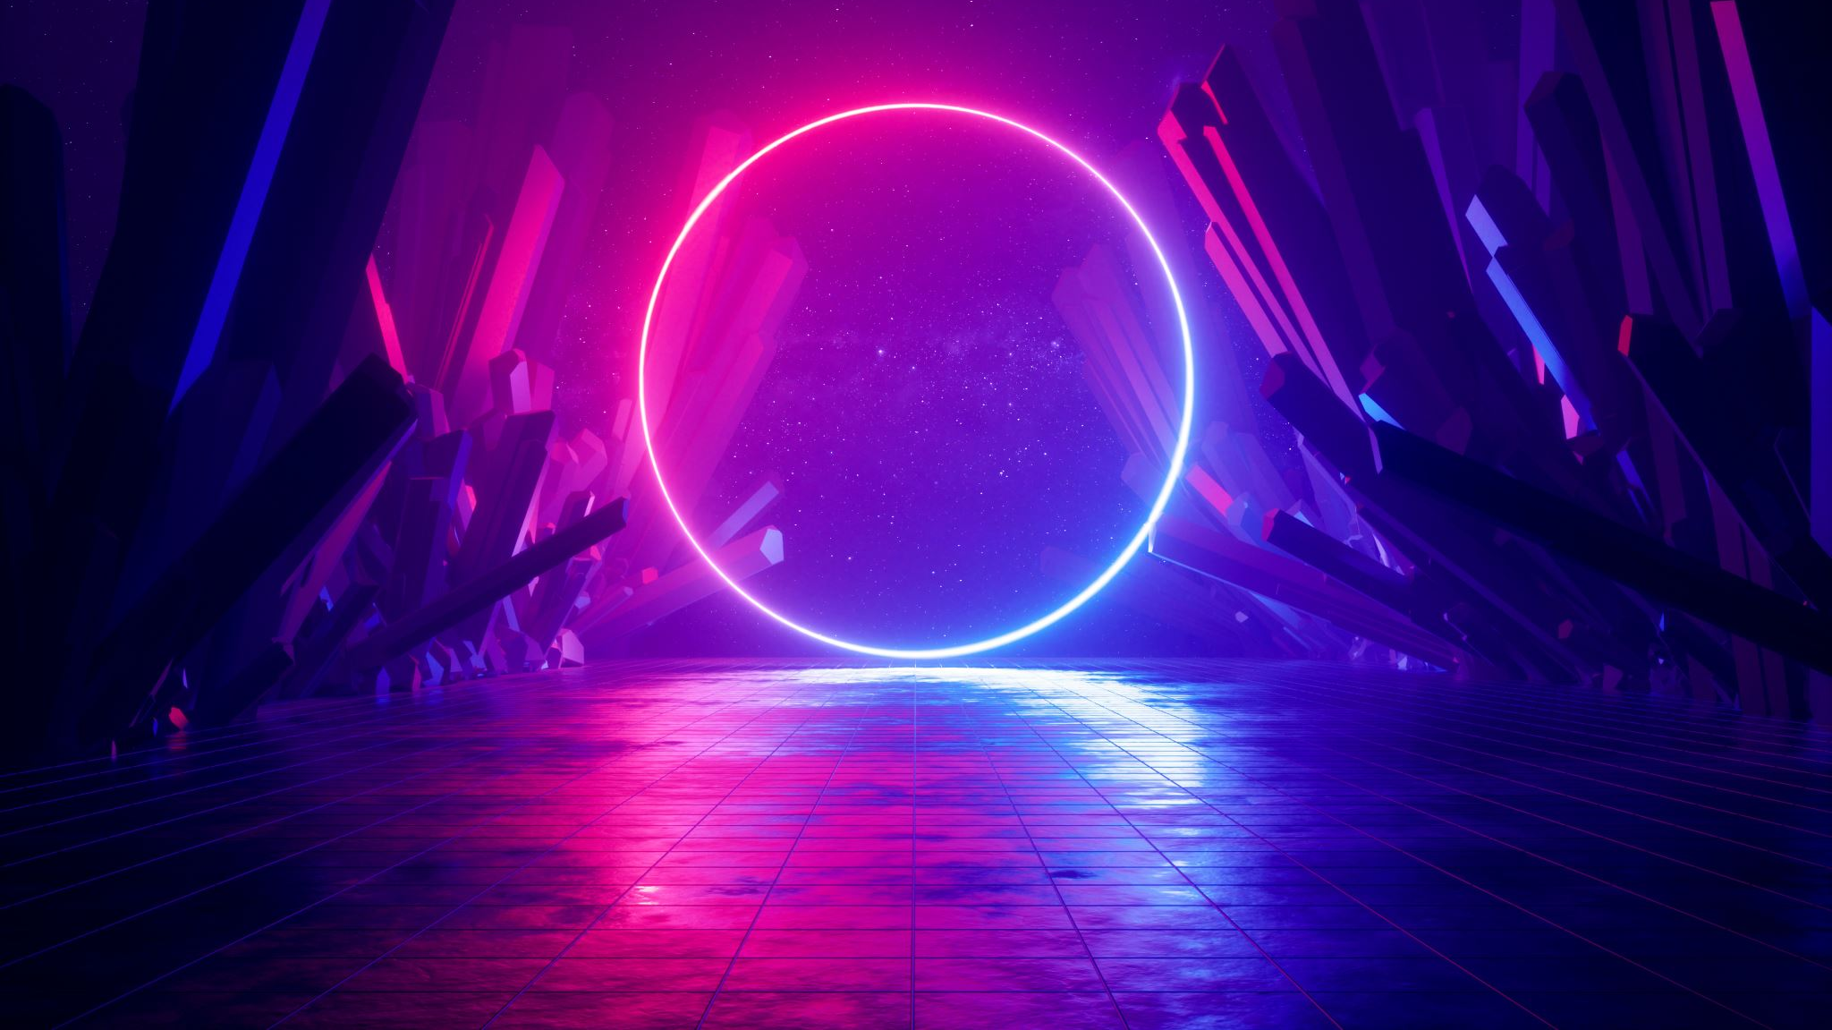
Ecstasy
What is it?

Slide 2
Ecstasy
Also called “molly, pills, yokes, E” and its chemical name is MDMA.
It is both a stimulant and a hallucinogenic drug.
Typically comes in pills identified by logos. It can also come in capsules, powder or crystals which can vary in colour.
Most commonly taken orally but can be snorted. Powders can be “dabbed” and swallowed.
Creates feelings of warmth, energy and pleasure and distorts time and sensory perceptions.
High doses can cause hallucinations, floating sensations, vomiting and seizures.
The effects take approximately 20-70 minutes plus to come on and last around four to six hours.

Slide 3
Short-term effects
Eurphoric feelings – makes music and lights more intense.
Intense emotions and empathy are felt for those around the person.
Body temperature, blood pressure and heart rate increase.
Hallucinations can occur for some.
Feeling nauseous or unwell and/or feeling anxious.
Sweating and feeling warm.
Loss of appetite.
A tight jaw and dry throat and mouth.
Difficulty urinating.
Intense comedown for days afterwards leading to feeling very down.

Slide 4
Long-term effects and other risks
Ecstasy effects serotonin levels in the body and, therefore, frequent use can lead a person to become very depressed and feel very low.
Prolonged use affects ability to sleep and can lead to insomnia.
Hospitalisations and deaths can occur as a result of unknown compounds found in ecstasy.
Very high risk for those with heart conditions, epilepsy, asthma or blood pressure issues.
Using with other drugs can be especially risky, particularly other serotonin inducing drugs such as anti-depressants or other SSRI medications.
Too much serotonin can develop into “serotonin syndrome” which can be life-threatening if left untreated.

Slide 5
Other risks continued …
Links to heart, liver and kidney problems.
Affects body temperature. Dancing in hot club can unknowingly cause overheating and dehydration.
Dehydration can lead to drinking too much water, known as “water intoxication.” one pint an hour is recommended.
Women may be at greater risk of adverse reactions to MDMA.
Not physically addictive but psychologically addictive – making you feel you need it to enjoy yourself and need to take increasingly higher amounts.
If using regularly, you could experience serious bouts of depression and low feelings.

Slide 6
Harm reduction
Start slow and go very low.
Think about your own physical and mental health.
Take in a safe place and with trusted friends.
Avoid use if you have other underlying health issues, such as epilepsy, depression, high blood pressure, heart problems, anxiety or panic attacks or history of psychosis.
Avoid using other drugs or alcohol, including prescription medications for anti-depression or anxiety.
MDMA purity is increasing and found to contain three times the adult dose at times. This can cause death and there is no way of knowing what else the drug has been cut with.
Take breaks from dancing, stay cool and stick to one pint of water per hour.
Keep your eyes out for friends and seek help if any concern arises.

Slide 7
If concerned about yourself or someone else…
https://www.drugs.ie/
Seek out local services.
Services map: https://www.drugsandalcohol.ie/services_map
cris@mqi.ie
tiglin.ie
livinglifecounselling.ie

Slide 8
Sources/references
HSE drugs.ie (n.d.) Ecstasy. https://www.drugs.ie/drugtypes/drug/ecstasy [Accessed on 04/01/24]
Images free to use and share commercially: Google
For more information follow the link below;
HRB National Drugs Library (2024) Drugs and alcohol factsheets

