Slide 1
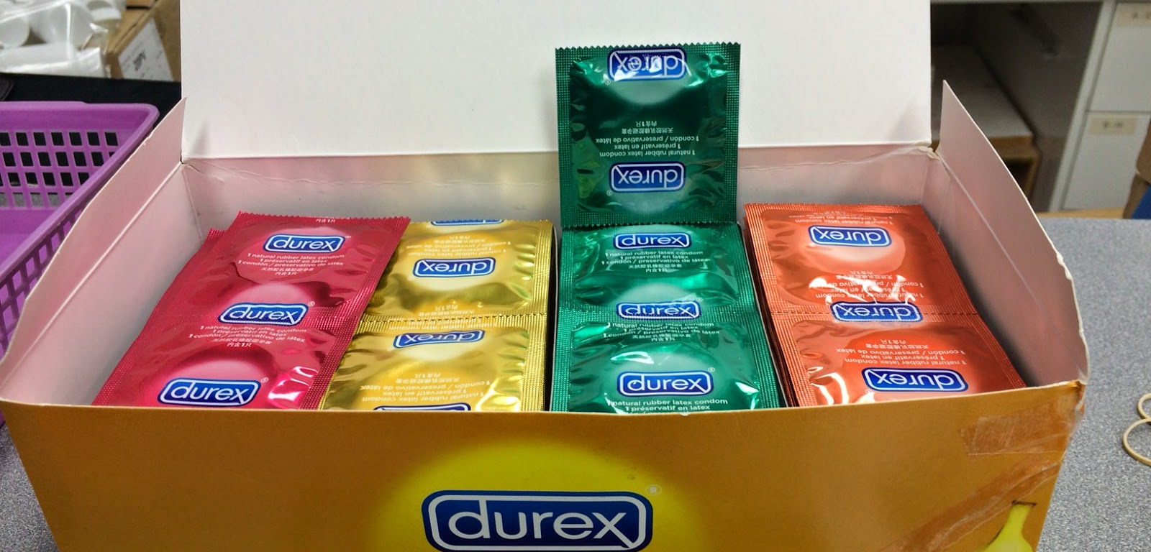
Chemsex drugs
What are they?

Slide 2
Chemsex = a specific form of use
It involves the use of one or more drugs for the specific purpose of facilitating, enhancing and prolonging, sexual intercourse.
There are three main drugs associated with chemsex:
Methamphetamine (crystal, crystal meth, meth, Tina)
Mephedrone (meph, drone, M-Cat, Meow-Meow)
GHB/GHL (G, Gina, Liquid E)
In Ireland, the stimulant cocaine and the depressant ketamine, is also used.
It is associated with extreme disinhibition and, therefore, safe practices are not followed, greatly increasing the risk of the spread of sexually transmitted infections.

Slide 3
Short and long-term effects
Paranoia
Psychosis
Chronic depression
Anxiety
Withdrawal (withdrawal from GHB can be severe)
Dependency
Going under/out of consciousness/overdose
Coma/death

Slide 4
Harm reduction
Sometimes people feel they cannot give consent while taking chemsex drugs – know your limits and remember you always have the right to say no. A good way to manage this issue, is to lay out your boundaries before taking the drug/engaging in sexual activity.
Always carry condoms and lubrication.
Always have clean injection equipment and avoid sharing equipment.
Drug interactions are difficult to predict. Taking alcohol with GHB/GBL can be extremely dangerous.

Slide 5
For more information…
See the information on G.
Look up your local services.
Services map: https://www.drugsandalcohol.ie/services_map
www.drugs.ie
cris@mqi.ie
tiglin.ie
livinglifecounselling.com

Slide 6
Sources/references
HSE drugs.ie (n.d.) Chemsex. https://www.drugs.ie/drugs_info/about_drugs/chemsex/ [Accessed on 04/01/24]
Clarke, David (2018) LGBT South East regional fact file 2019. Wexford: Health Service Executive; FDYS; LGBTI Health. Available at https://www.drugsandalcohol.ie/41297/
Images free to use and share commercially: Google.ie
For more information follow the link below;
HRB National Drugs Library (2024) Drugs and alcohol factsheets

