Slide 1

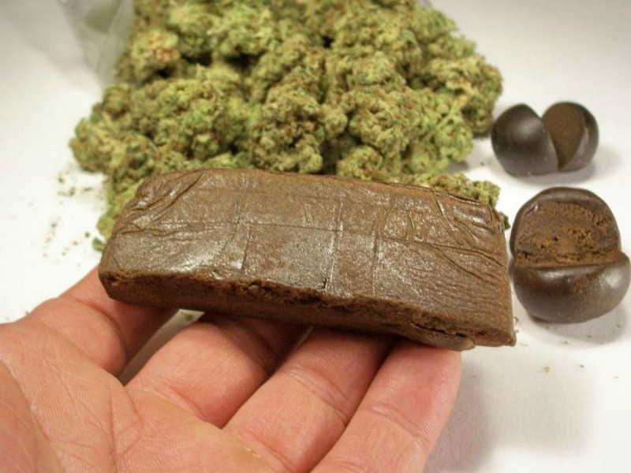
Cannabis what is it?
What is it?

Slide 2
Categorised as both a depressant and psychedelic substance
Contains hundreds of compounds named “Cannabinoids.”
Main psychoactive compound is THC (delta9 tetrahydrocannabinol). Another compound is CBD.
A depressant that stimulates the heart, increasing blood pressure and pulse rate.
It comes in the form of leaf or buds, “weed,” resin/hash or oil.
Usually smoked or vaped but can be consumed via food and drink known as “edibles.”
Foods include baked goods, jellies, sweets, chocolate and lozenges.
There is a drink on the Irish market called “THC Lean.”

Slide 3
Effects and Risks
Everyone reacts differently to cannabis and every batch of cannabis is different.
Response also depends on individual mood.
Response affected by setting.
Risks also vary by gender, weight and metabolism and how soon before someone consumed food.
Risk is also in whatever else is added to the cannabis – unknown compounds.

Slide 4
Why do people use cannabis?
To feel relaxed.
To feel high and euphoric.
As a self-medication.
Happiness and enjoyment with friends.

Slide 5
risks/affects
Feeling too high.
Anxiety/panic.
Paranoia and negative thoughts.
Hallucinations.
Increased heart rate/palpitations.
Risk of getting into the hands of small children.
Risk of synthetic Cannabinoids and other unknown compounds that can fatal consequences.

Slide 6
Smoking versus edibles
Smoking/vaping | Edibles
Feel the effects in three-five minutes. | Feel the effects within 30-90 mins.
Peak effect: 15-30 minutes. | Peak effect: two-three hours.
Duration of effect: two-four hours. | Duration of effect: 4-12 hours.
Ability to slow down effects: relatively easy. | Ability to slow down effects: difficult.
Predictability of effect (knowing how you will react.) | Predictability of effect (knowing how you will react.)
Good. | Poor.

Slide 7
HARM REDUCTION – cannabis/edibles
Avoid use under the age of 18 – as your brain is still developing.
Think about the set and the setting. Where are you? how are you feeling?
Avoid use if you are feeling low, anxious, depressed, have mental health concerns or a family history of low mental health.
Eat in advance.
Think about how often you use and determine use accordingly. If you don’t use much, try not to suddenly use more.
If you are unsure of the product, packaging or place it came from, consider not taking it or binning it.

Slide 8
Harm reduction – cannabis
Start low and go slow. Don’t take all at once.
Avoid taking more and re-dosing. Wait until you feel the effects to consider re-dosing.
If you don’t feel as expected, consider not taking any more.
Avoid using other substances.
Avoid driving.
Store safely to reduce risk to young children and pets.
Seek medical help if you or a friend become unwell or suicidal.

Slide 9
Safe use
A dose of 2.5-5mg THC is considered a low-dose.
25mg + THC is considered high risk.
SIGNS OF OVER CONSUMPTION INCLUDE:
Chest pain.
Rapid heartbeat.
Nausea/vomiting.
Slow breathing.
Severe anxiety and/or panic attacks.
Mental health effects or psychotic episode.

Slide 10
Synthetic Cannabinoids
These are man-made chemicals found in edibles, herbal and vape products in Ireland.
You can be exposed without knowing.
They are not cannabis but a growing family of highly potent chemicals that can cause poisoning or death.
Referred to sometimes as “Spice” or “Ging”.

Slide 11
Signs for Concern of consumption of Synthetic Cannabinoids
Intense/strong effects.
Feeling dizzy/confused.
Abnormal sweating/respiratory issues (difficulty breathing), chest pain/rapid heartbeat.
Nausea/vomiting.
Agitation/aggression, psychotic behaviour, delusions, hallucinations, seizures or fits.
Sudden loss of consciousness and can lead to death.
If you think you or a friend are affected, call 999/112.

Slide 12
If you need help
There are local services there to help you.
www.drugs.ie
cris@mqi.ie
tiglin.ie
livinglifecounselling.com
Services map: https://www.drugsandalcohol.ie/services_map

Slide 13
Sources/references
HSE drugs.ie. (2022) Cannabis edible products. Dublin: HSE drugs.ie. Available at https://www.drugsandalcohol.ie/36020/
Health Service Executive. (2016) Cannabis and you. Dublin: Health Service Executive. Available at https://www.drugsandalcohol.ie/27640/
Drugs.ie [last accessed] 02/01/2024
Images free to use and share commercially: Google.ie
For more information follow the link below;
HRB National Drugs Library (2024) Drugs and alcohol factsheets

