Slide 1
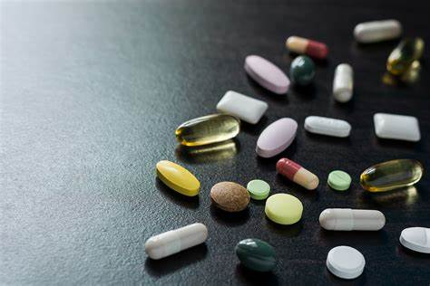
Benzodiazepines
What are they?

Slide 2
Benzodiazepines
Also known as Diazepine, Valium, benzos, roofies, moggies, sleepers, downers, eggs, rugby balls, D5s, D10s, roch, Xan, street tablets and Xanax sticks.
They are a set of prescription drugs that are commonly used to treat insomnia, anxiety, acute muscle spasms and managing alcohol withdrawal.
Typically prescribed for a two-four-week period.
Highly addictive and easily accessible on the street.
They come as a tablet, capsule, suppository, injections or “sticks”.
They come in a wide variety of colours and doses.
In Ireland, the changing market has led to falsified medication and mixing the drug with other, more risky compounds.

Slide 3
Short-term effects
Effects depend on physical and mental health and level of dose and potency.
Effects begin ten to fifteen minutes after taking and can last for a number of hours.
They have a sedative effect, slowing down the body, breathing, heart rate, nervous system and thinking.
They can relieve stress and make you feel relaxed and help you sleep.
They can make you feel euphoric.
The slowing down of your thoughts, can make you drowsy, forgetful and confused which can lead to accidents.
They can cause blurred vision and slurred speech.
Some people experience black outs.

Slide 4
long-term effects
Short-term memory loss.
Regular use will lead to the drug having no effect on insomnia and anxiety and other ailments it is used to treat.
People can experience anxiety, feel irritable, groggy and experience vivid dreams.
Dependency can occur quickly.
Physical dependency requires weaning off the drug and it must not be suddenly stopped.
Mixing with other downers such as heroin or alcohol, increases the risk of fatal overdosing.
Some people crush the tablet to inject, which is very dangerous and can cause septicaemia, abscesses, thrombosis, gangrene, loss of limbs or death.

Slide 5
Other risks
Using benzodiazepines during pregnancy increases the risk of a child being born with a cleft palette.
Using high doses before delivery can affect the baby’s breathing at birth and there is a risk of the baby dying.
The baby may suffer withdrawals for two to four weeks after delivery.
Higher risk of cot death.
Dependency on diazepines increases the risk of overdose.

Slide 6
New “fake” benzodiazepines
Usually bought online or from a dealer.
Look like regular drug and packaging but can contain other compounds and are more potent.
Often more risky, new benzodiazepines can contain newly developed substances or diazepines that were created years ago but not used medically.
Higher overdose risk especially when mixed with other drugs or alcohol.

Slide 7
What might an overdose look like?
Blue or pale lips and hands.
Nausea and vomiting.
Difficulty breathing.
Confusion.
Limp body.
Slow pulse.
Awake but unresponsive.
Fitting/seizures or unconsciousness.

Slide 8
Risk of overdose and naloxone
You risk overdose if you take too much, too soon.
You take more benzos or other drugs on top of what you have taken.
The tablet contains a high dose unknowingly.
The tablet is compressed to contain more than one drug within the tablet.
Naloxone DOES NOT WORK for benzodiazepine overdosing.
Use naloxone if you know the person has consumed heroin, methadone, tramadol or oxycodone.

Slide 9
If you think someone has overdosed…
Don’t doubt or wait for further symptoms if someone is not well.
Call 999/112 immediately.
Put the person in the recovery position or on their side.
Stay with the person until help arrives.
Do not give the person anything to eat or drink.
Do not give the person other drugs or try to induce vomiting.
www.drugs.ie
cris@mqi.ie
tiglin.ie
Llivinglifecounselling.com
Treatment services map: https://www.drugsandalcohol.ie/services_map

Slide 10
Sources/references
Health Service Executive. (2021) Health A to Z: Diazepam. https://www2.hse.ie/conditions/diazepam/
HSE drugs.ie (n.d). Benzodiazepines search results. drugs.ie. Available at https://www.drugs.ie/search/results/ee9c0cf1b09fb5900e69478b357aab6c/ [Accessed on 08/01/24]
Images free to use and share commercially: Google.ie
For more information follow the link below;
HRB National Drugs Library (2024) Drugs and alcohol factsheets

