Slide 1
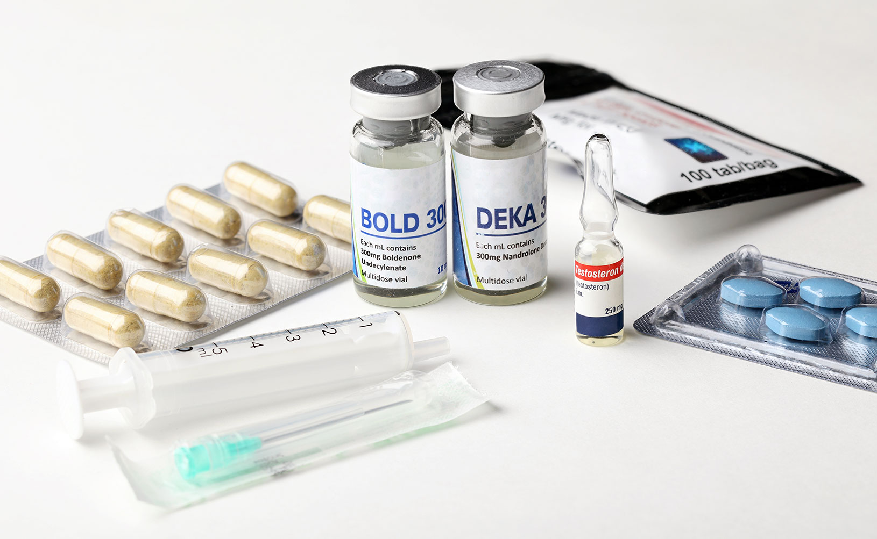
Anabolic
Steroids
What are they?

Slide 2
What are anabolic steroids and why would someone use them?
Steroids can act as life-saving drugs. They allow the lungs to open to allow breathing during an asthma attack. There are many different types of steroids.
Anabolic steroids are extremely damaging to health.
They mimic testosterone in the body, requiring the body to take in more protein, which increases muscle mass. This is what drives the desire to abuse them, which is typically observed in body building and other specific sports that require longevity, strength and endurance.
Steroids are very important for assisting with people suffering from wasting diseases, however, there is a cost as it comes with major side-affects and unwanted health issues.

Slide 3
Steroids signs & short term effects
Tends to be used by men in their 20’s.
Rapid and lean muscle gain in a short period of time. i.e. within a ten-week period.
Working out a lot and receiving a lot of packages in the post.
If in bottle form, there may be a rattling sound from carrying them around.
If in vials/small bottles, the packaging may arrive marked as “fragile.”
The ordering of syringes and needles.
Injectable steroids leave holes in the skin and track marks that can look red and inflamed.
If in pill form, there may be packaging in waste bins or gym bags.

Slide 4
Steroids continued…
Acne is a major sign of steroid use.
Although acne is normal in teenagers, if once clear skin suddenly seems to be breaking out for no reason, it may be a sign of steroid use.
Strange odours are present if using steroid cream.
Steroids affect sex-specific characteristics, such as the development in men of breast tissue and the shrinking of testicles. This can also lead to infertility. This is because in men, steroids convert to estradiol.
In women, steroids convert to testosterone. This results in hair growth, irregular periods and permanently deepening the voice.

Slide 5
Long-term risks
For both males and females, long-term use increases cholesterol levels and increases blood pressure.
Steroids increase the risk of developing diabetes.
Increases acne and baldness.
People are prone to mood swings resulting in the term “roid rage.”
The effects of steroids are cumulative, meaning over time, they increase the risk of stroke or heart attack.
Withdrawal symptoms require that steroids are weaned off gradually allowing the body to adapt over time.

Slide 6
withdrawals
Depression.
Anxiety.
Concentration problems.
Sleeping problems.
Pain.
Headaches.
Lowered libido.

Slide 7
treatment
Steroid use can begin because of body dysmorphia. This underlying issue requires specific psychotherapy/counselling.
Extra support can be needed because steroids are so easily accessible.
TEENS are particularly susceptible to steroid use. This can stunt their growth and weaken bones.
www.drugs.ie
tiglin.ie
cris@mqi.ie
Livinglifecounselling.com
Services map: https://www.drugsandalcohol.ie/services_map

Slide 8
Sources/references
HSE drugs.ie (n.d). Anabolic steroids. drugs.ie. https://www.drugs.ie/drugtypes/drug/anabolic_steroids [Accessed on 5/01/24]
Health Service Executive. (2021) Anabolic steroid misuse. Available at https://www2.hse.ie/conditions/anabolic-steroid-misuse/
Images free to use and share commercially: Google.ie
For more information follow the link below;
HRB National Drugs Library (2024) Drugs and alcohol factsheets

