Slide 1
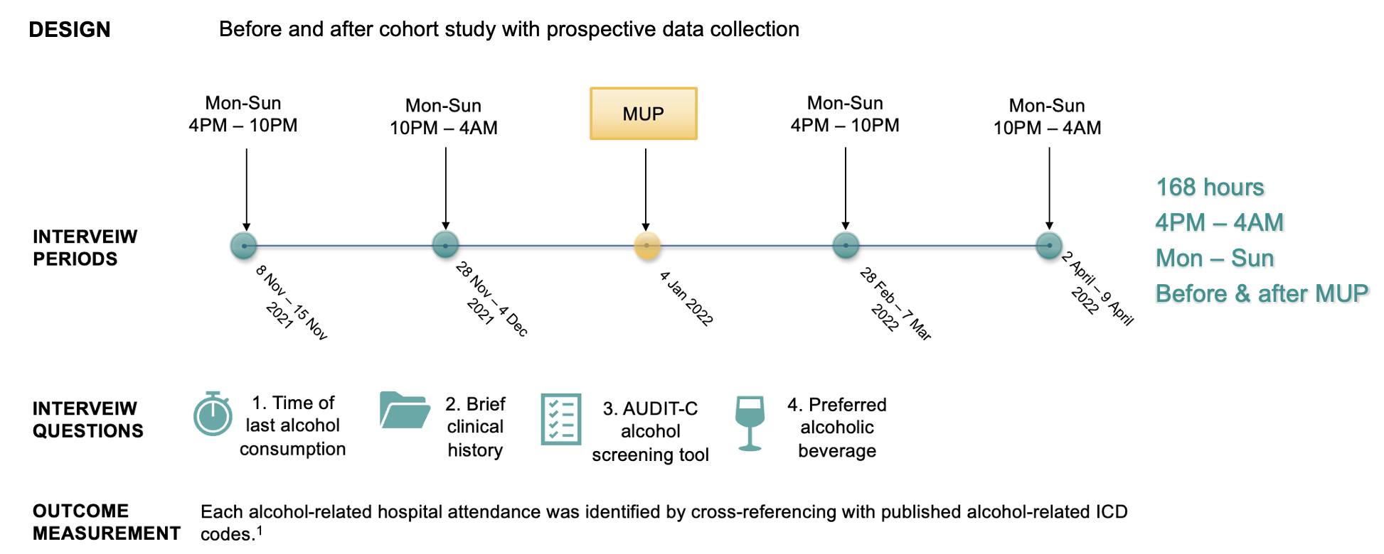
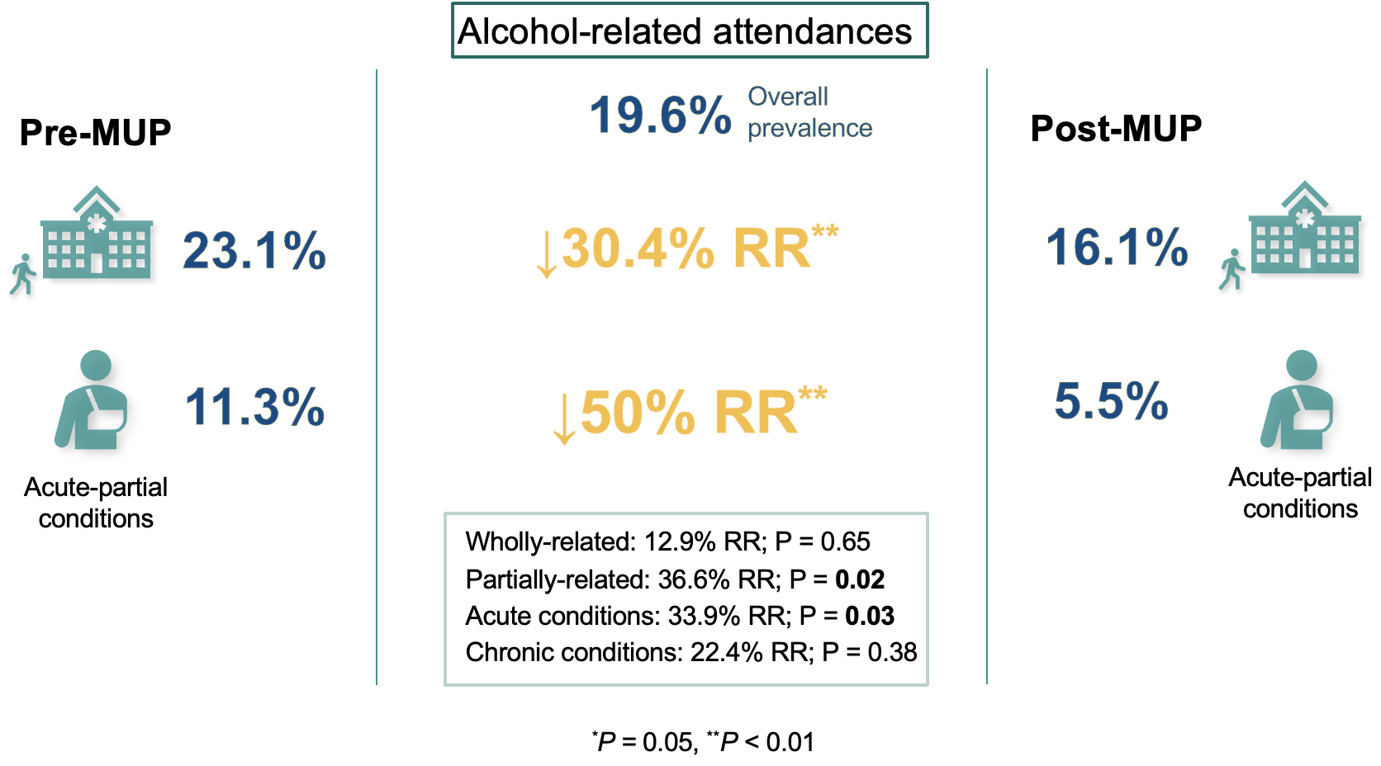
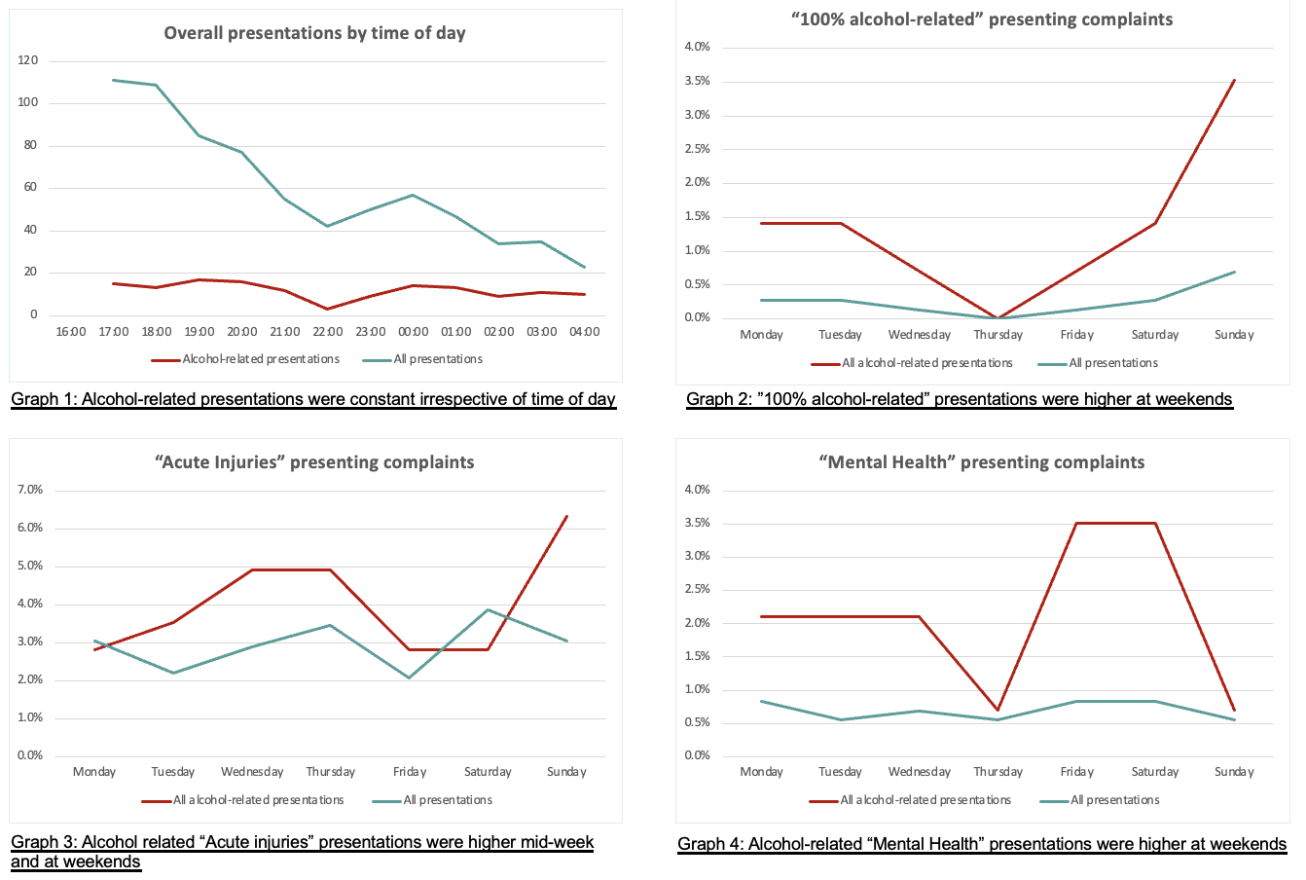
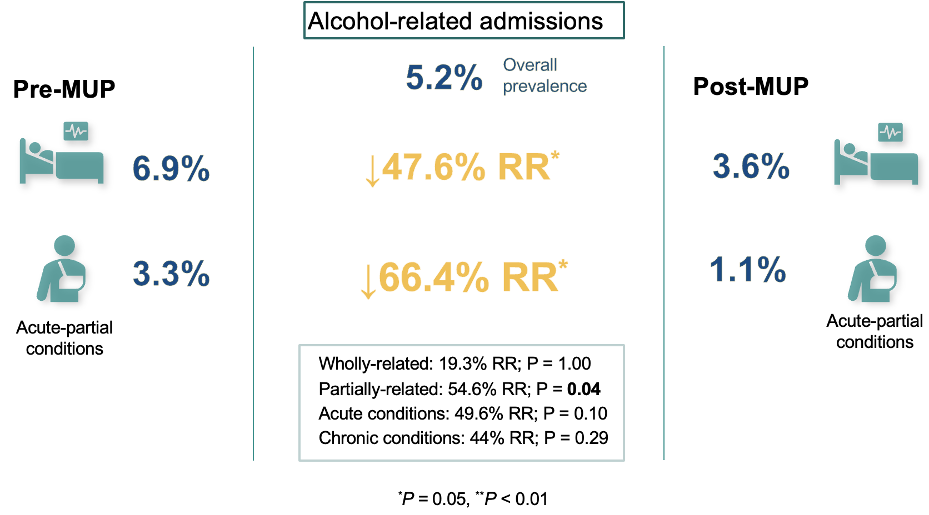
National Drug Forum 2022
Impact of Minimum Unit Pricing on alcohol-related hospital burden
T. Maharaj,^{1,4} E. Gilligan,² M. Quirke,³ S. MacHale,^{2,4} J.D. Ryan^{1,4}
1Hepatology Unit, Beaumont Hospital Dublin
2 Department of Liaison Psychiatry, Beaumont Hospital Dublin
3 Emergency Department, Beaumont Hospital Dublin
4 Royal College of Surgeons in Ireland
Contact information:
Tobias Maharaj; tobiasmaharaj@beaumont.ie
Prof. John D Ryan; johnryan2@beaumont.ie
Synopsis
On 04 January 2022, Ireland introduced Minimum Unit Pricing (MUP) via the Public Health Alcohol Act, which sets a legally required floor price of €1.00 per standard drink (10 grams) of alcohol. The literature estimates that minimum pricing could result in immediate reductions in alcohol-related hospital burden.¹⁻³
Application
This study provides preliminary data to inform the national evaluation and monitoring of MUP in Ireland. It will be of interest to policy makers, public health officials, researchers, and clinicians.
Purpose
This was a novel opportunity to evaluate the impact of MUP on alcohol-related hospital burden in Ireland.
Method
Discussion
One-in-five ED attendances were alcohol-related and one-in-twenty resulted in an alcohol-related admission, representing a significant burden to health services from alcohol harms. With the introduction of a €1.00 MUP there was a reduction in both alcohol-related attendances and admissions within the first four months, and the greatest reductions were from the sub-group ‘acute partially alcohol-related conditions’ which represents alcohol-related injuries, road traffic accidents, and deliberate self-harm as examples. These findings are consistent with the existing literature and make sense, as a reduction in aggregate alcohol consumption in the population from an intervention such as minimum pricing should result in proportionally fewer acute harms due to alcohol.
Conclusion
This study’s findings were consistent with the existing literature that minimum pricing would reduce alcohol-related hospital burden, and it highlights the high burden of alcohol-related harms in the Irish healthcare system.
References
Stockwell T, Zhao J, Martin G. Minimum Alcohol Prices and Outlet Densities in British Columbia, Canada: Estimated Impacts on Alcohol-Attributable Hospital Admissions. American Journal of Public Health 2013; 1033(November 2013).
Zhao J, Stockwell T. The impacts of minimum alcohol pricing on alcohol attributable morbidity in regions of British Colombia, Canada with low, medium and high mean family income. Addiction 2017; 112(11): 1942-51.
Angus C, Brennan A, Meng Y. Model-based appraisal of minimum unit pricing for alcohol in the Republic of Ireland. University of Sheffield 2014.
Results

