Slide 1
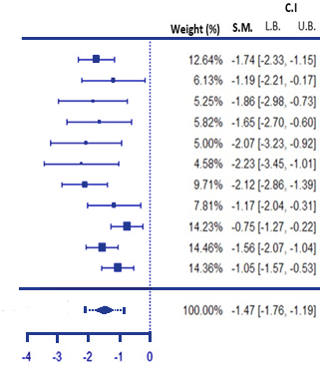
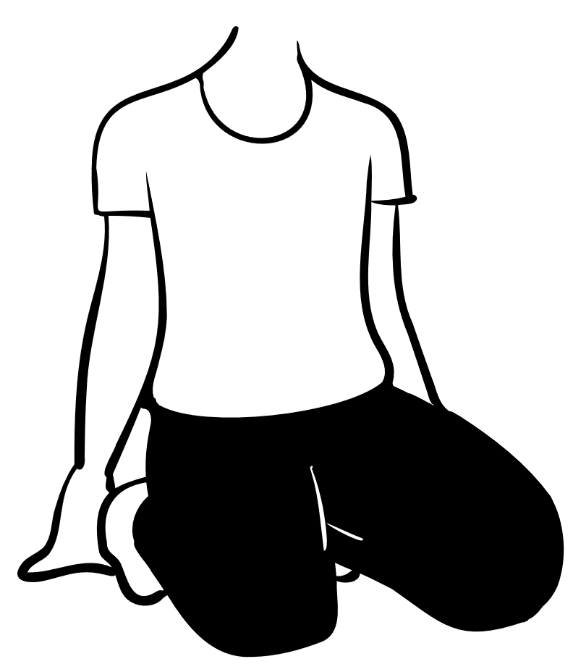
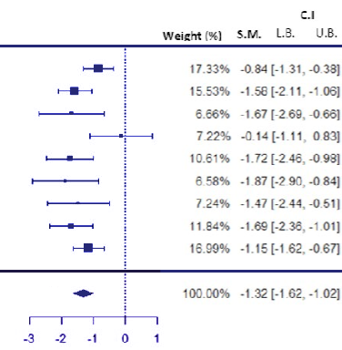
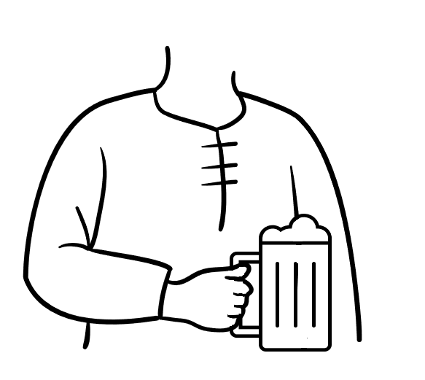
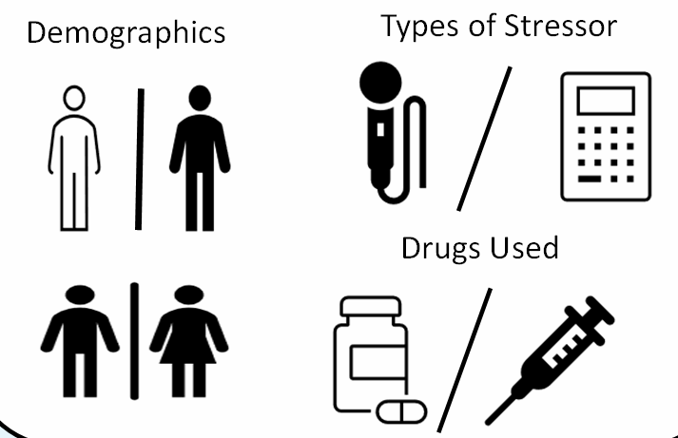
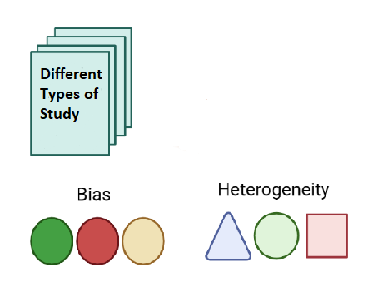
HPA Axis Function in Alcohol Use Disorder: A Systematic Review and Meta-Analysis
Mr. Neil Dunne & Prof. Jo-Hanna Ivers.
Synopsis
Results
Stress is a well known trigger for relapse in alcohol use disorder (AUD)
Significantly less ACTH produced in response to stress in early abstinent AUD compared to controls.
(k=11, I²⁼ 35.68%)
The stress response is governed by the hypothalamic-pituitary-adrenal axis (HPA-Axis).
Stress may be a major trigger due to dysfunction in the HPA axis response to stress.
Significantly less cortisol produced in response to stress in early abstinent AUD compared to controls.
(k=9, I²⁼ 38.97%)
Rise in Cortisol
Allostatic Adaption
Acute alcohol consumption increases cortisol. Chronic alcohol consumption leads to allostatic adaption, changing HPA axis functioning.
Current AUD
During Withdrawal
Mixed Results (k= 8)
Higher Cortisol (k=11)
Systematic review of 72 studies and meta-analysis was performed. Early-Abstinent (2-8 weeks) AUD patients were found to have a blunted HPA axis response to stress
(reduced cortisol and ACTH)
Abstinence (>6 months)
Family Relation to AUD
Control
Stress
Abstinent AUD
HPA axis alterations are blunted in early abstinence and stabilise over time (k= 8)
Alterations in HPA axis functioning may be inherited from parental AUD (k= 10)
Overall, HPA axis hypoactivity was associated with a higher risk of relapse.
Discussion
Heterogeneity
Limitations
Application and Purpose
Male Focused Studies
This study was performed to further investigate novel ways of treating AUD.
Abstinent AUD
Methods of Inducing HPA axis Sensitisation
Normalisation
Conclusion
1. HPA axis function is altered in all stages of AUD.
2. The stress response is blunted in early abstinence.
3. Normalizing a blunted response may reduce the ability of stress to trigger a relapse.
4. Future researchers should examine all demographics, sustained abstinence and follow-up on participants.
Normalisation of the HPA axis response to stress may reduce its ability to trigger a relapse in early abstinence
Method
Databases
Search Strategy
Building-Block Method
AUD
AND
HPA AXIS
NOTS & FILTERS

