Slide 1
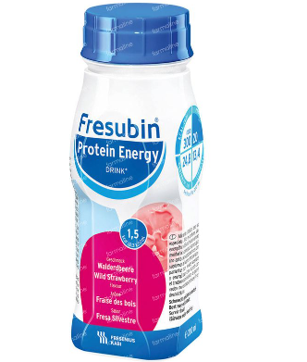
Protocol of an Intervention to Evaluate the Effects of an Optimised Exercise Programme with Protein Supplementation to Target Physical Functioning Deficits and Frailty in people Experiencing Addiction Issues and Homelessness.
Kennedy F¹, Ní Cheallaigh C², Romero-Ortuno R², Doyle S³, Broderick J¹, ^{-1,2}School of Medicine, Trinity College Dublin, The University of Dublin, ³School of Biological and Health Sciences, Technical University of Dublin
Synopsis
People experiencing homelessness (PEH) & who have addiction issues are more likely to experience poor health & age acceleration earlier¹.
Exercise & nutritional supplementation can delay or even reverse frailty².
Purpose
To test the feasibility & preliminary effectiveness of a physical rehabilitation programme with dietary supplementation to target frailty
Application
This study applies to people accessing Ballyfermot Advance Project, a centre providing support to people with problematic drug and alcohol use, many of whom are homeless.
An immediate impact may be an improvement in physical health, which can be a conduit for the emergence of other positive behaviours & recovery.
This study will provide preliminary data to inform the design of a randomised controlled trial.
Results can have local impact, by enabling community workers & clinicians to encourage healthy lifestyle behaviours in clients.
Method
This will be a single arm feasibility cohort study.
12- week programme
October 2022 – March 2023
twice weekly exercise and nutritional intervention
plus, once weekly supervised ‘Park Walk’
To promote post-exercise muscle protein synthesis, a high protein nutritional supplement will be offered to participants immediately post exercise.
Feasibility outcomes will be numbers recruited, retention & adherence.
Adverse events will be recorded.
Effectiveness will be measured by evaluating results of physical functioning and performance tests, nutritional, frailty tests & self-rated pain.
Conclusion
This research is novel & pragmatic and aims to address the known poor physical health condition of people who are experiencing addiction challenges & homelessness.
It is hoped that this study will provide preliminary data to shape future physical rehabilitation & inform the design of a definitive randomised controlled trial.
References 1. Kiernan S, C NC, Murphy N, Dowds J, Broderick J. Markedly poor physical functioning status of people experiencing homelessness admitted to an acute hospital setting. Sci Rep. 2021;11(1):9911. 2.Liao CD, Lee PH, Hsiao DJ, Huang SW, Tsauo JY, Chen HC, et al. Effects of Protein Supplementation Combined with Exercise Intervention on Frailty Indices, Body Composition, and Physical Function in Frail Older Adults. Nutrients. 2018;10(12).

