Slide 1
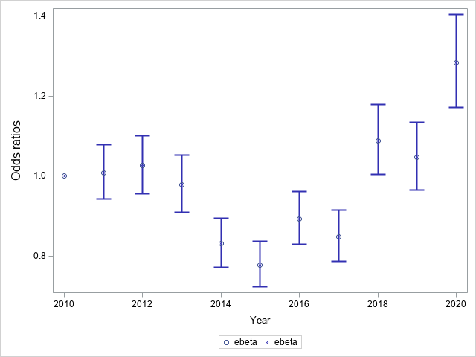
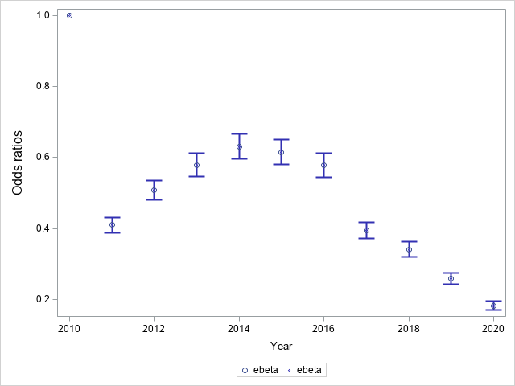
Analysis of urine drug test results from the National Drug Treatment Centre between 2010 and 2020
Aoife O’Kane, Louise Durand, Siobhan Stokes, Eamon Keenan, Gráinne Cousins
Synopsis
The European Commission has stressed the importance of being better prepared for future drug trends, to inform proactive drug policy and strengthen national monitoring and intervention capacity. Urine drug testing represents a potentially useful means of surveillance, allowing for the detection of drug use trends over time. In this study, we examined trends in detection rates for prescription drugs with potential for misuse (opioids, benzodiazepines), and cocaine among people attending the National Drug Treatment Centre between 2010 and 2020. Preliminary age adjusted models indicated significant time changes in the detection of benzodiazepines, opioids and cocaine. A yearly decrease was observed for alcohol. Further analysis will consider detection rates for concurrent drug use over time.
Application
People with an opioid use disorder; health-care professionals working in the area of opioid agonist treatment; drug policy units; department of health.
Purpose
Urine drug testing represents a potentially useful means of surveillance, allowing for the detection of drug use trends over time. In this study, we examined trends in detection rates for prescription drugs with potential for misuse (opioids, benzodiazepines), and cocaine among people attending the National Drug Treatment Centre between 2010 and 2020.
Method
The HSE National Drug Treatment Centre (NDTC) laboratory is the largest specialist provider of urine drug screening for drug treatment services in Ireland. The NDTC laboratory uses immunoassay screening methods. Most people attend the NDTC for opioid agonist treatment (OAT). Clinical guidelines for OAT recommend at least one random drug test per month. Anonymised individual-level drug screening data, for people attending the NDTC between 2010 and 2019, was used to evaluate trends in the detection rates for opioids, benzodiazepines, and cocaine. Time trends were assessed using mixed logistic regressions, accounting for the correlation within subjects. Age-adjusted odds ratios (AOR) and 95% Confidence Intervals are reported.
Results
A total of 2,537 people attended the NDTC between 2010 and 2020. The median age increased from 31 years in 2010, to 39 years in 2020. People attended the NDTC for a median of 2 years (IQR, 1-4), with a median of 37 (IQR, 7 – 120) drug tests during that period. Ninety four percent of samples are positive for methadone, therefore these trends represent concurrent use with methadone in most cases. Age adjusted models indicated non linear trend patterns with an increase in cocaine detection since 2015. Trends for benzodiazepine detections also appear to be increasing in recent years (fig A). By contrast, opioids show a marked and constant decline over the second half of the study period (fig B).
Conclusion
Urine drug testing represents a potentially useful means of surveillance for drug use among people who use opioids. Immunoassay data is important for identifying presence of individual drug classes, such as benzodiazepines, but it does not allow for an examination of individual drugs within the class. Routine analysis of samples using LC-MS-MS would provide detailed information on individual drugs, and on New Psychoactive Substances.
References
This research was funded by the Health Research Board under the Secondary Data Analysis Projects SDAP-2021-009
(A) Benzodiazepines
(B) Opioids
Adjusted odds ratios and 95% CI for Benzodiazepines (A) and Prescription Opioids (B) positive screening, by year (reference year: 2010)

