Slide 1
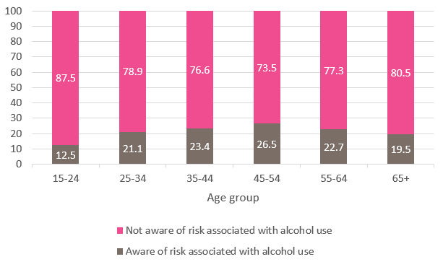
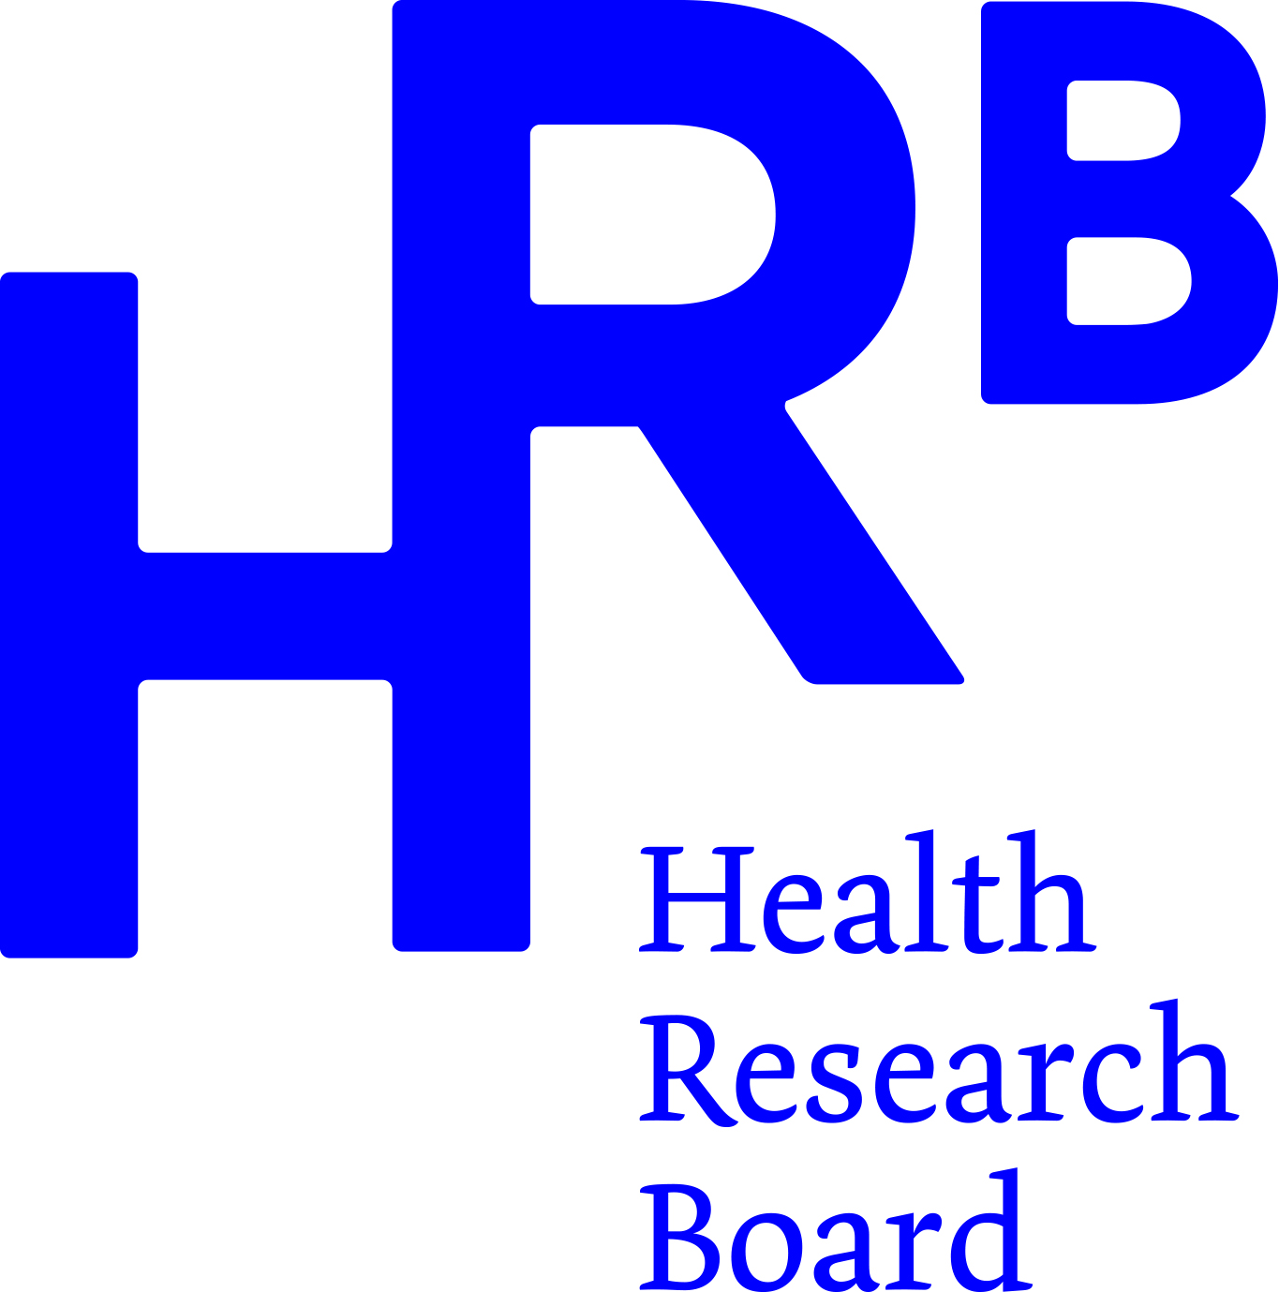
Public awareness of the positive association between alcohol use and breast cancer risk
Anne Doyleª and Deirdre Monganª
ªHealth Research Board, Dublin
Synopsis
Alcohol is a Group 1 carcinogen and causes seven types of cancer, including female breast cancer. Of approximately 3,700 female breast cancer diagnoses in Ireland each year, 260 are attributable to alcohol^{1,2}. Using Healthy Ireland survey data, this study examined if the Irish public are aware of this association. The level of awareness was low among all groups examined indicating that much needs to be done to increase this knowledge. Commencement of Section 12 of the Public Health (Alcohol) Act 2018³ would increase public awareness of the risk and potentially reduce hazardous alcohol use.
Application
This study can be used by stakeholders to highlight the public health issue of alcohol-related harms and those advocating for the remaining components of the Public Health (Alcohol) Act 2018 to be commenced, particularly health-warning labels.
Purpose
This study was carried out to increase understanding of the level of public knowledge regarding the risks associated with alcohol use, specifically in relation to breast cancer risk.
Method
Using data from wave 2 of the Healthy Ireland survey, analysis was undertaken to examine if respondents were aware of the increased risk of developing breast cancer as a result of drinking more than the recommended low-risk guidelines⁴ and regression analysis examined the socio-demographic characteristics associated with being aware of this link.
Results
There was a poor level of awareness of the association of alcohol consumption and the risk of developing female breast cancer, just 21% of respondents correctly identified the association. Females were significantly more likely to know of the risk between alcohol use and breast cancer (26.7%), along with those aged 45—54 years (26.5%) (Figure 1), those educated to degree level or higher (29.4%) and non-drinkers (20.9%) or those who did not report hazardous drinking (22.9%).
Figure 1 Awareness of association between alcohol use and breast cancer risk by age group
Discussion
Breast cancer is the most common cancer among women in Ireland and approximately one in every eight female breast cancers is caused by alcohol consumption. However, public knowledge that alcohol use increases the risk of developing breast cancer is low with less than one-quarter of the public being aware of the association.
Conclusion
It is clear that the general public are not aware of the risk of developing breast cancer associated with increased alcohol consumption. With the commencement of several sections of the Public Health (Alcohol) Act (2018) in recent years, further research will determine if awareness increases but the findings from this study support the timely implementation of health warning labels on alcohol products as set out in the Act.
References
Irish Cancer Society. Irish Cancer Society. 2022. https://www.cancer.ie/cancer-information and-support/cancer-information/about-cancer/cancer-statistics.
HSE. HSE Alcohol Factsheets. 2022. https://www2.hse.ie/wellbeing/alcohol/physical-health/alcohol-and-cancer.html.
Office of the Attorney General. Public Health (Alcohol) Act. Dublin: Irish Statute Book 2018. https://www.drugsandalcohol.ie/33698/
Health Service Executive. HSE Weekly low-risk alcohol guidelines. https://www2.hse.ie/wellbeing/alcohol/improve-your-health/weekly-low-risk-alcohol-guidelines.html

