Slide 1
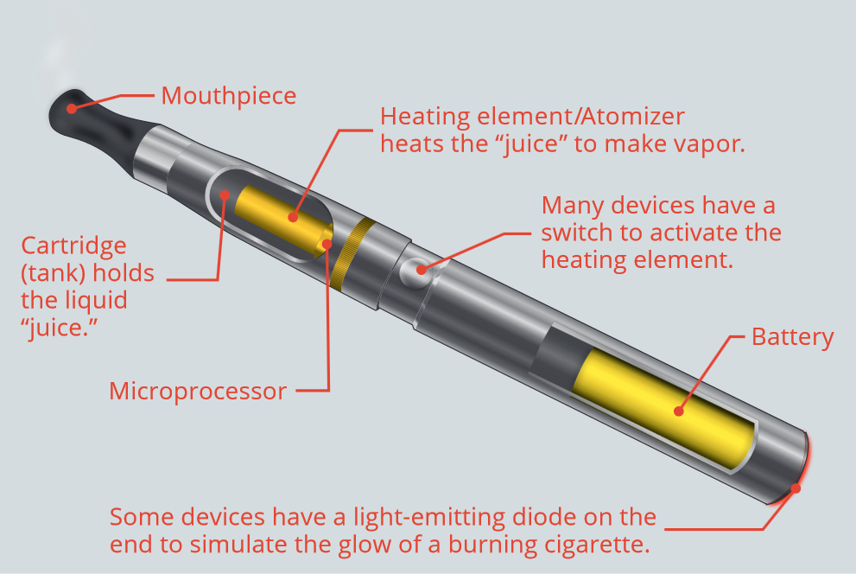
Electronic cigarette use in pregnancy is not
associated with low birth weight or preterm delivery.
Brendan P. McDonnell^{1,2}, Evan Bergin¹ and Carmen Regan^{1,2}
¹Coombe Women and Infants University Hospital, Dublin. ²Royal College of Surgeons in Ireland
Background
Objective
Results
Electronic cigarettes are nicotine delivery devices which use a battery element to heat a solution of water, propylene glycol or glycerine, nicotine and flavourings to produce an aerosol. This aerosol is inhaled by the user and provides a peak plasma nicotine concentration of 15-20ng/ml within five mins, a dose similar to that achieved by smoking a cigarette.
Cigarette smoking produces carbon monoxide, which when inhaled by pregnant women causes a ‘left shift’ in the oxygen-hemoglobin dissociation curve. This impairs oxygen delivery to the myometrium and fetoplacental unit. Electronic cigarettes do not produce carbon monoxide.
Cigarette smoke also contains carcinogenic compounds, such as polycyclic aromatic hydrocarbons, aromatic amines, and nitrosamines. The fetotoxic and teratogenic nature of these compounds has been established in animal studies. Electronic cigarettes do produce these compounds, but at a lower level than cigarette smoking. For example, formaldehyde is produced at approximately 1/50th of the concentration of cigarettes.
Nicotine is an addictive alkaloid which acts as a potent stimulant of the parasympathetic system, producing a chronic relapsing compulsive craving for cigarettes. nicotine crosses the placenta and has a direct effect on both the fetus and the placental vasculature and has been labelled a neuro-teratogen for its effects on fetal brain development.¹
Electronic cigarette use has increased significantly in recent years. Research suggests that pregnant women perceive it to be healthier than cigarette smoking, and a useful way of cutting down or stopping.²
However significant concern remains over their use in pregnancy due to a lack of data on safety and on maternal and fetal outcomes.³
This study sought to identify women who exclusively ‘vape’ in pregnancy and measure their obstetric and neonatal outcomes. These were then compared to those of smokers and non-smokers.
129 women booked with a history of exclusive electronic cigarette use during the study period. Of these, 85 had a livebirth, 39 remain pregnant, and 1 patient had a second trimester miscarriage. Infants born to users of electronic cigarettes had a mean birth weight of 3482g (+/- 549g), which was similar to non-smokers (3471g +/-504g, p=0.75) and significantly greater than that of smokers (3166g +/- 502g, p=0.001). Mean gestation at delivery was similar in electronic cigarette users, non-smokers, and smokers (39.3, 39.8, and 39.3 weeks respectively). The mean birth centile of electronic cigarette users was similar to non-smokers (51st centile vs. 47th centile, p=0.28) and significantly greater than that of smokers (27th centile, p<0.001). There were no cases of serious maternal morbidity. Delivery outcomes including need for induction, mode of delivery, perineal trauma and post-partum haemorrhage were all similar to those of non-smokers, as were admission rates to the SCBU/NICU. There were no cases of neonatal respiratory distress syndrome.
Study Design
We conducted a prospective cohort study of pregnant users of electronic cigarettes attending a large urban maternity hospital delivering over 8500 infants per year. Women were identified via the electronic booking system at first visit to the hospital. This booking history interview is conducted by trained midwives who use a standardised questionnaire to assess smoking habits. Pregnant users of electronic cigarettes who concurrently smoked cigarettes or tobacco were excluded. Maternal and neonatal outcomes were collected after delivery and compared to a contemporaneous group of smokers and non-smokers.
51st
=
Non-smokers
47th
Smokers
*
27th
3482g
3471g
Centile
Conclusions
3166g
*
The use of electronic cigarettes in pregnancy is not associated with low birth weight or preterm delivery. Both maternal and neonatal outcomes appear to be similar to non-smokers. To our knowledge, this is the first prospective study on the relationship between electronic cigarette use and maternal and fetal outcomes.
Figure 1: Birth weight in EC users, non-smokers and smokers. EC users had a similar birthweight to non-smokers.
Smokers had a significantly lower birthweight than both EC users and non-smokers.
References:
Rogers, J. (2009) Tobacco and pregnancy. Reproductive Toxicology 28 (2):152–160
Bowker et al. (2018) Views on and experiences of electronic cigarettes: a qualitative study of women who are pregnant or have recently given birth. BMC Pregnancy and Childbirth 18(1):233
National Academies of Sciences, Engineering, and Medicine. (2018) Public health consequences of e-cigarettes. Washington, DC: The National Academies Press.

