Slide 1

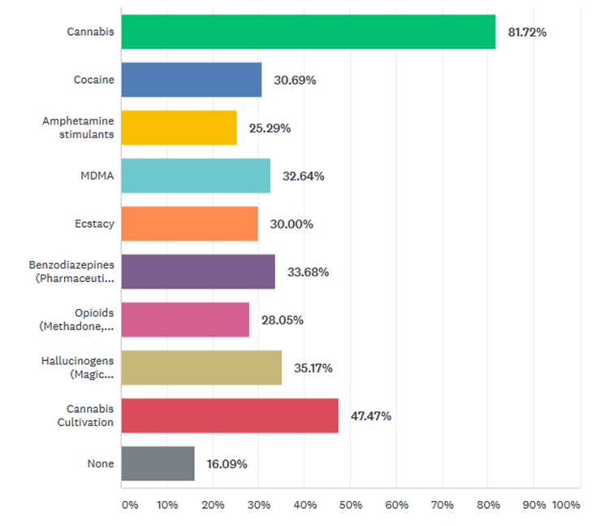
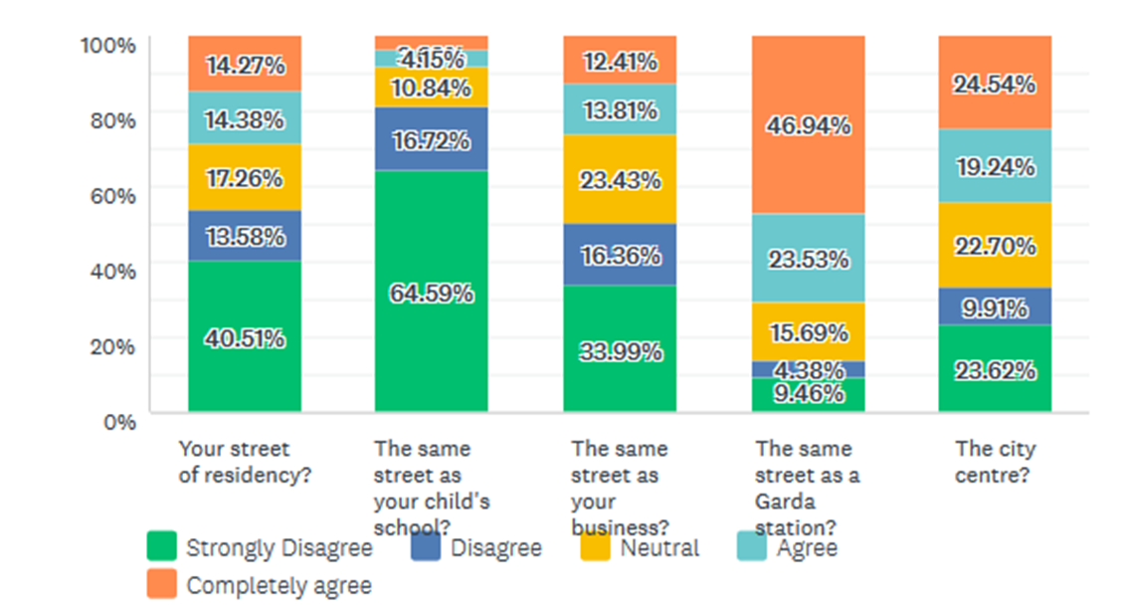
The Public ’s Perceptions of Supervised Injecting Facilities and the Decriminalisation of Drugs for Personal Use
By Múireann McCarthy
75% had a good general knowledge of Supervised Injecting Facilities (SIF) and Decriminalisation
There were objections to SIFs opening near schools or near participants homes
However, there was strong support for SIFs opening on the same street as Garda station
16% expressed their support for no drugs to be decrimilnalised.
82% supported the decriminalisation of cannabis
Yet, only 25% supported the decriminalisation of heroin
Respondents were evenly divided as to whether they thought that decriminalisation might lead to increased drug use.
Respondents indicated general support for a public health approach to reduce harm, which could include decriminalisation and the use of SIF.
The results suggests that the public remain warry of SIFs, preferring them to be away from children and homes.
In the future, or with increased knowledge about the benefits, the public might support decriminalisation as well as the ability to locate SIF in the community. At this point, however, it is clear that this is not the case, and a public health approach will continue to be hampered by beliefs to the continued fear of drug use and drug users.
What is this Study About?
Results of the Survey
Discussion and Conclusion
An online survey of 849 participants designed to investigate:
The level of public support for a public health approach to drug policy?
The public perception of SIF and drug decriminalisation?
The level of public knowledge and understanding of SIF, and the difference between drug decriminalisation and legalisation?
Whether the public would support a SIF opening up in their hometown in the future?
Ethical approval was granted from the UCC Social research Ethics Committee
Conducted as part of my MA Criminology
On a scale of 1 to 5, would you support the opening of a Supervised Injecting Facility (SIF) ?
Which drugs should be decriminalised?

