Slide 1
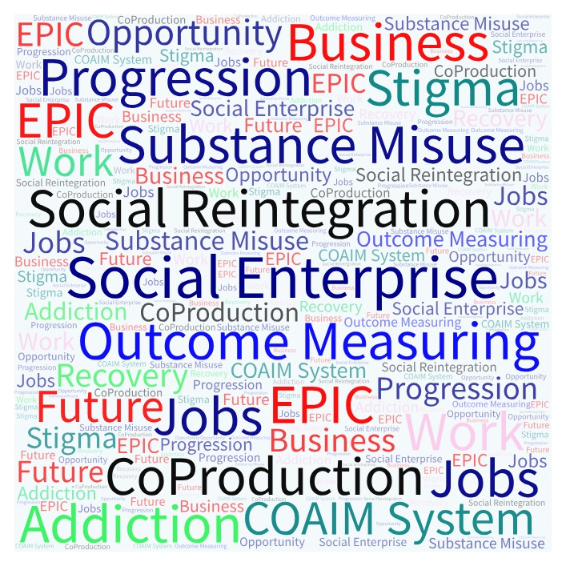
Social Enterprise and Co-Production – A Synergy Promoting Social Reintegration
EPIC Social Enterprise – Enhancing Progress Inspiring Change

Slide 2
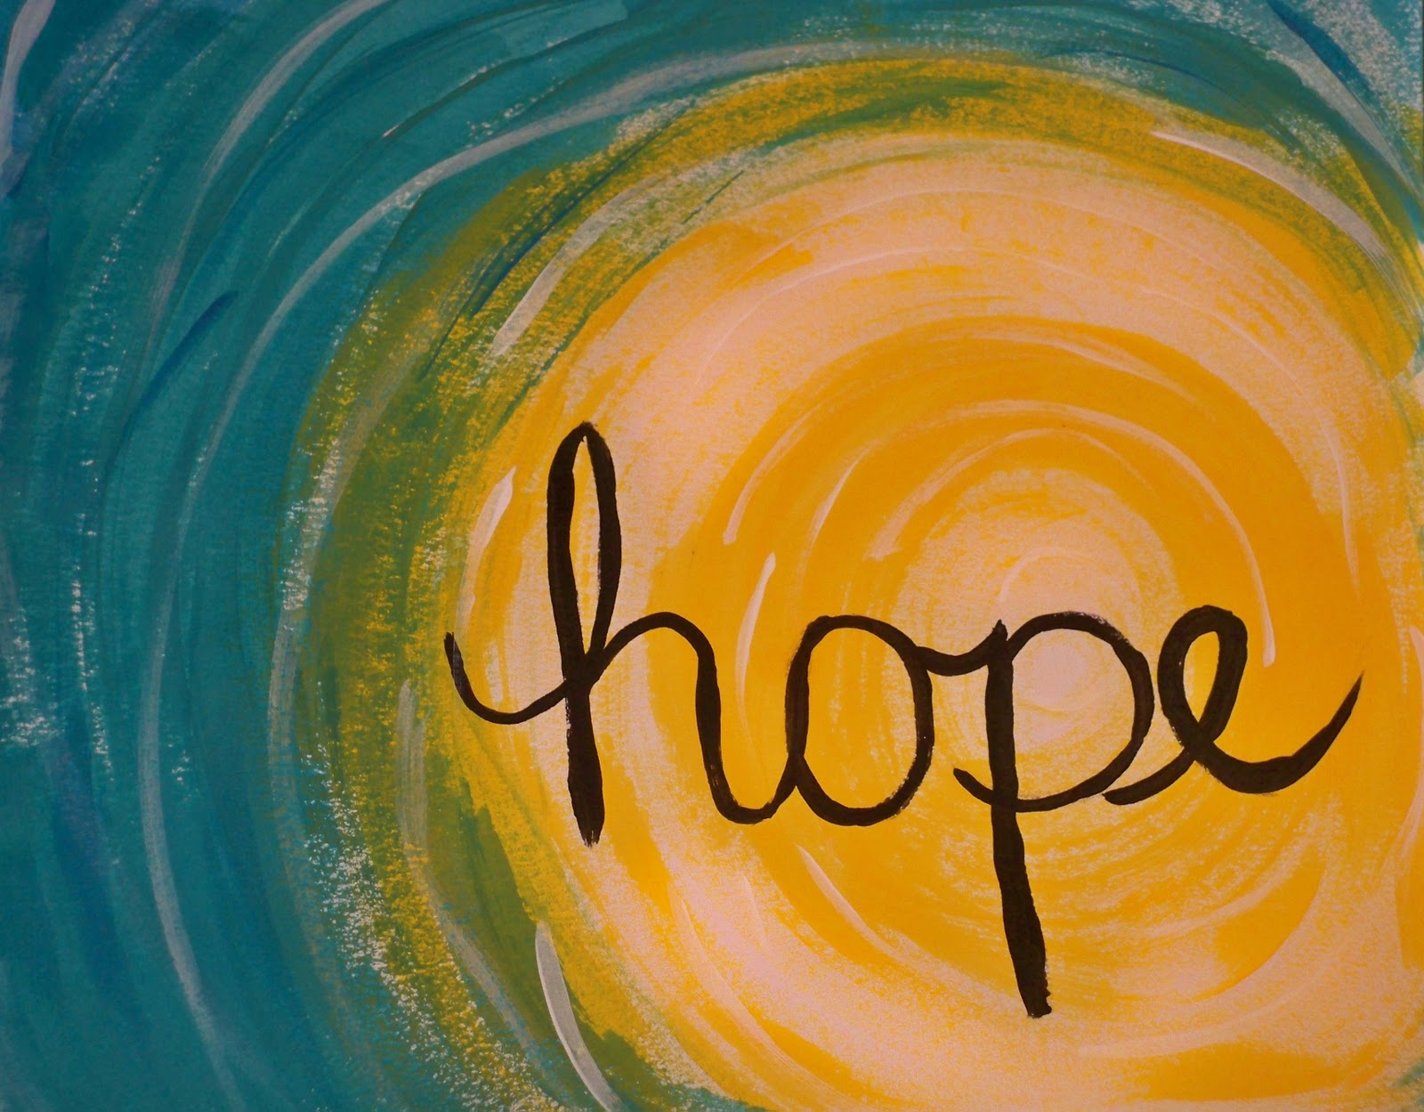
What is:
The Cornmarket Project
Our EPIC Social Enterprise
Co-Production and Wrap Around Supports
The COAIM Outcome Measurement System
EPIC Social Enterprise – Enhancing Progress Inspiring Change

Slide 3
Our EPIC Social Enterprise: Printed Promotional Materials Production
Preparing T Shirt Designs
An order for a major conference

Slide 4
Awarded a place on the Social Innovation Fund’s social enterprise development accelerator programme 2018

Slide 5
Evidence based:
Using the COAIM – Change Outcome And Impact Measurement system
Stages of Change Model
Motivational Interviewing
Functional Analysis – from CBT
Maintenance
9 or 10
Precontemplation
1 or 2
Action
7 or 8
Contemplation
3 or 4
Preparation
5 or 6
EPIC Social Enterprise – Enhancing Progress Inspiring Change

Slide 6
Co-Production and the COAIM system
Co-production is not just a word, it’s not just a concept, it is a meeting of minds coming together to find a shared solution. In practice, it involves people who use services being consulted, included and working together from the start to the end of any project that affects them.
EPIC Social Enterprise – Enhancing Progress Inspiring Change

Slide 7
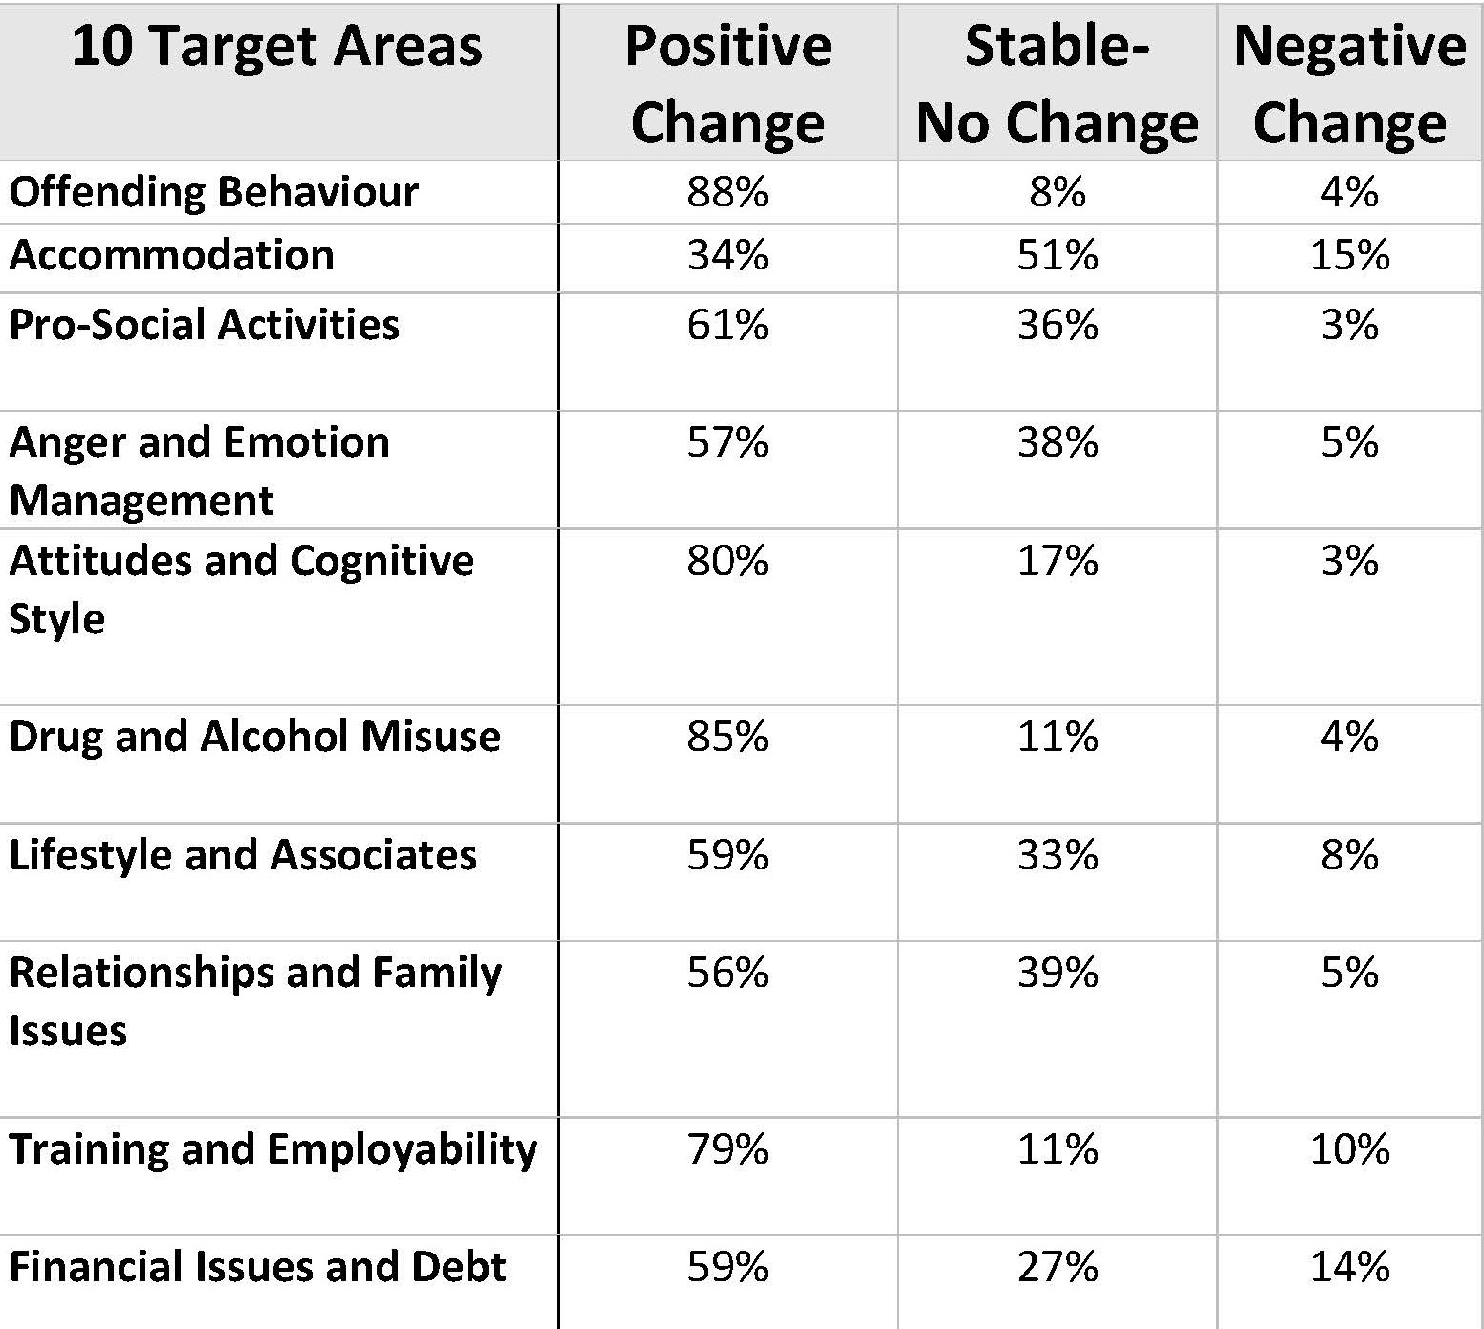
The COAIM – Change Outcome And Impact Measurement system
EPIC Social Enterprise – Enhancing Progress Inspiring Change

Slide 8
Thank You The Cornmarket Project Supporting Social Reintegration Through Social Enterprise

