Slide 1
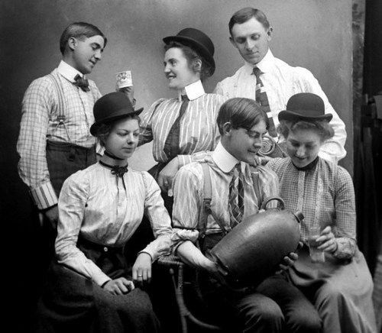

Responding to excessive alcohol consumption in third-level (REACT):
Design and evaluation of a pilot programme to reduce student drinking
Susan Calnan
PhD student
School of Public Health
University College Cork
National Drugs Forum
12th November 2018

Slide 2

What’s the problem?
Alcohol and third-level sector
Alcohol is deemed the number one public health problem facing third-level institutions today (Wechsler et al, 2002)
College Lifestyle Attitudinal National (CLAN) Survey 2002-2003 – a pattern of high-risk drinking is now the norm among college students in Ireland (Hope et al, 2015)
UCC study (Davoren et al, 2015) – two-thirds of students showed signs of hazardous drinking (66.4%), with similar levels for female students (67.3%) and male students (65.2%) – indicating that the gender gap is narrowing among students
While ad hoc measures exist in third-level institutions (e.g. college alcohol policy, late night transport for students), there is no standard multi-component programme for third-level institutions in Ireland
Notes:
Wechsler, H., Lee, J.E. and Kuo, M. (2002) ‘Trends in college binge drinking during a period of increased prevention efforts – Findings from 4 Harvard School of Public Health College Alcohol Study Surveys: 1993–2001, Journal of American College Health, Vo. 50, No. 5.
Hope, A., Dring C. and Dring J. (2005) College Lifestyle and Attitudinal National (CLAN) Survey. The Health of Irish Students, Dublin: Health Service Executive.
Davoren, M.P., Shiely, F., Byrne, M. and Perry, I.J. (2015) ‘Hazardous alcohol consumption among university students in Ireland: A cross-sectional study’, BMJ Open, 2015:5: e006045.

Slide 3

REACT programme
REACT – which stands for Responding to Excessive Alcohol Consumption in Third-level – was launched in 2015
Programme comprises a suite of mandatory and optional action points which institutions must implement and for which they will receive an award and accreditation
First programme of its kind in Ireland – developed by UCC Health Matters in conjunction with USI and Irish Student Health Association, with funding by the HSE and Tomar Trust
Based on a settings approach, whereby strategic focus is on the whole community and population, policies and environment rather than solely individuals and problem behaviours
Currently around 15 third-level institutions taking part in REACT at present
Epistemology/ontology
Notes:
Further details on REACT are available online at: http://reactalcohol.ie/

Slide 4
Design of REACT – 3-step process
Systematic review
Knowledge exchange forum
Expert consultation
Epistemology/ontology

Slide 5
Epistemology/ontology
Protocol paper
Notes:
Davoren, M.P., Calnan, S., Mulcahy, J., Lynch, E., Perry, I.J. and Byrne, M. (2018) Responding to excessive alcohol consumption in third-level (REACT): A study protocol, BMC Health Services Research, 18: 364.

Slide 6
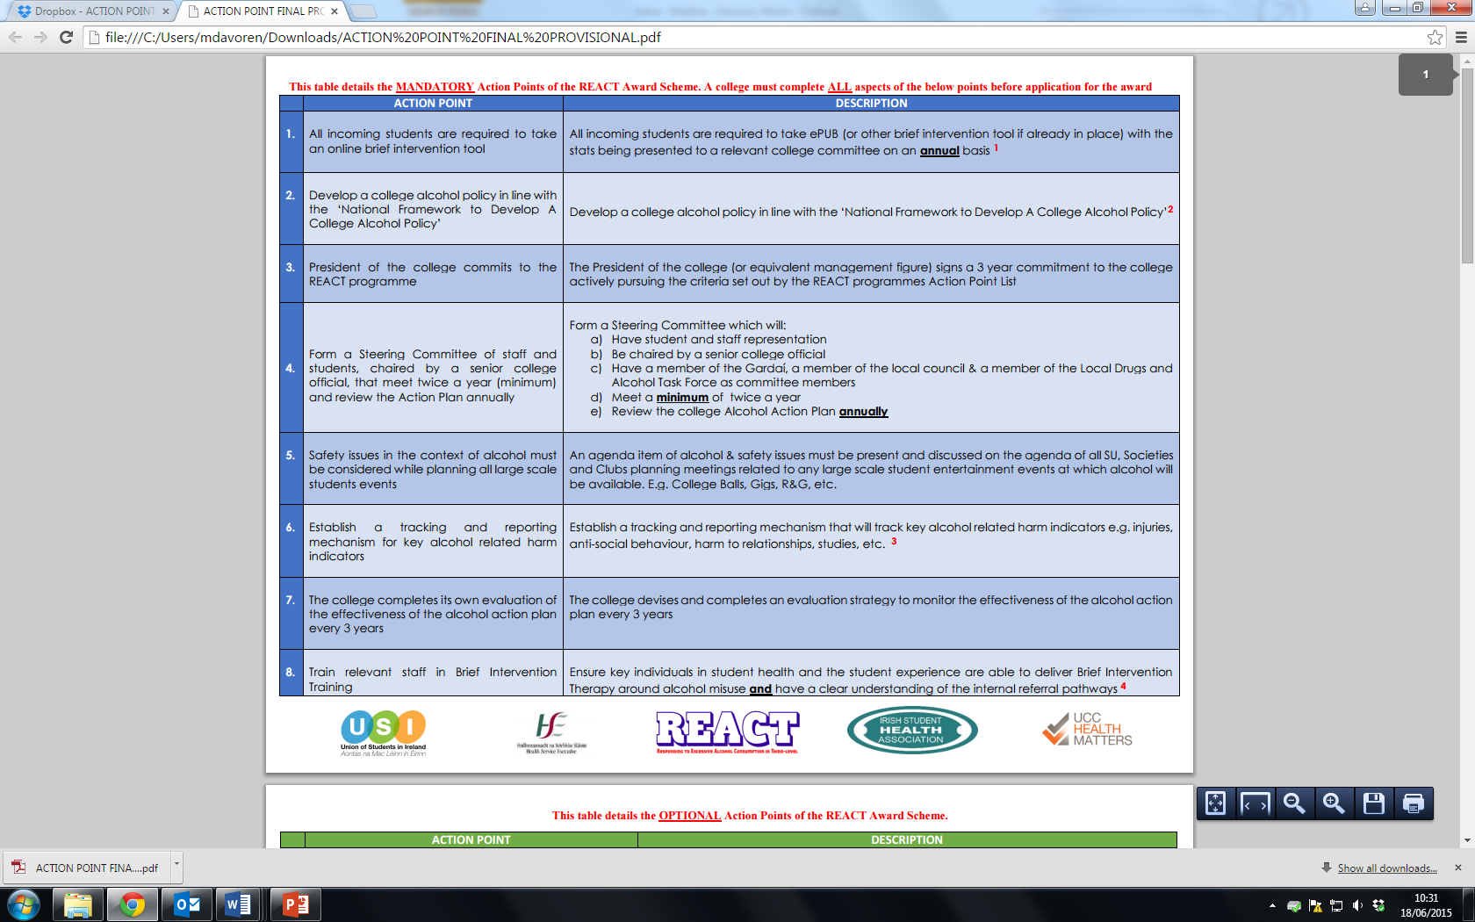
Mandatory action points
Notes:
Further details on REACT are available online at: http://reactalcohol.ie/

Slide 7
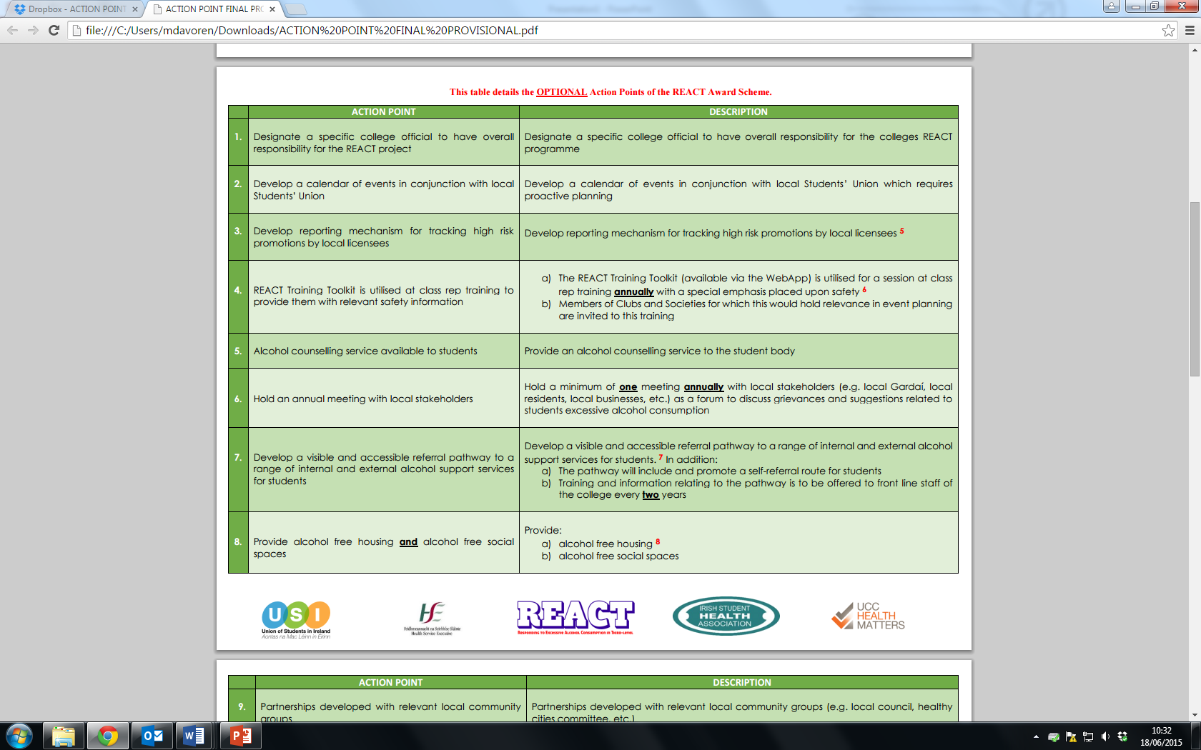
Optional action points (page 1)
Notes:
Further details on REACT are available online at: http://reactalcohol.ie/

Slide 8
Evaluation
Student perceptions
Explore students’ perceptions regarding the REACT programme and alcohol more generally
Implementation
Examine factors influencing take-up and implementation of REACT among third-level institutions
Outcomes
Conduct a baseline and follow-up survey (incl. AUDIT*) to determine any changes (e.g. consumption, attitudes, etc.)
Policy context
Examine the wider policy context regarding alcohol regulation at time of REACT
Notes:
* AUDIT refers to the Alcohol Use Disorders Identification Test – a 10-item screening tool developed by the WHO to assess alcohol consumption, drinking behaviours and alcohol-related problems. See http://auditscreen.org/

Slide 9

Some findings: Baseline study on student alcohol consumption
n = 1,873, average response rate 21%
Nearly two-thirds (63%) of students who answered the full AUDIT showed signs of hazardous or harmful alcohol consumption (HHAC)
By gender, 66.3% of males and 60.4% of females showed signs of HHAC
Majority of HHAC drinkers incorrectly described their own drinking as ‘low risk’ (72.8% of females, 63.4% of males)
Motives for drinking, the most commonly cited reasons among all respondents were drinking for enjoyment and drinking to be sociable
Concerns about own drinking, ‘spending too much money on alcohol’ emerged as the biggest concern, negative impact on physical health as the second biggest
Notes:
Further details on REACT are available online at: http://reactalcohol.ie/

Slide 10
Some findings: Qualitative study on implementation of REACT
(Institutions: 6 participating, 5 non-participating; project team x 4)
Advantages perceived
Recognition for work already done in this area
Provides a structure/proactive
Fits with ethos (e.g. Healthy Campus)
Accreditation an incentive
Steering Committee – sharing of info/different people coming together
Action points – make it more manageable/easier to track progress
Challenges experienced
Communication/lack of clarity
ePub too long and costly
Lack of resources to implement – personnel, time
Need a driver to implement
Drugs not included – programme needs to be broader, although some felt alcohol-only focus better
Reasons for non-participation
Lack of resources to implement
Better to put limited resources elsewhere
Not evidence based
Too research driven - action better than data collection
Drugs not included

Slide 11
Some findings: Qualitative study on student perspectives on REACT
Some preliminary findings
Students were generally in favour of an alcohol programme in third-level institutions
However, a considerable proportion felt it was responsibility of students alone to control own drinking
All of the groups pointed to dramatic increase in use of other drugs (cocaine, prescription)
Among younger students, problem drinking perceived not in terms of quantity but interfering with daily life

Slide 12

Learning points
Hazardous or harmful alcohol consumption still a leading public health issue for third-level institutions (two-thirds of students drinking at hazardous/harmful levels)
Majority in this category defined their drinking as low-risk – indicating low levels of awareness of own drinking among students
Importance of context in implementing a programme – in this case, the third-level sector is characterised by a dearth of resources, but rising student numbers
Many of the students see alcohol consumption as their personal responsibility rather than that of the third-level institution they are attending

Slide 13

Susan Calnan
E: susan.calnan@ucc.ie

