Slide 1


Slide 2
Based on the Icelandic Prevention Model
From highest to lowest in substance use – 15/16 year old students
In 1998 Iceland scored highest in adolescent substance use in Europe
In 2016 Iceland scores lowest in adolescent substance use in Europe

Slide 3





Slide 4
The focus is primary prevention
Primary prevention, preventing the
development of substance use before it
starts
Secondary prevention, that refers to
measures that detect substance use
Tertiary prevention efforts that focus on
people already abusing substances

Slide 5
Risk and Protective Factors
Time spent with parents
Parental Support
Parental Monitoring
Parental Control
Family
factors
Peer group effect
General well being
Frequency and quality
Organised vs.
unorganised
Positive and negative effects.
How we approach the peer group
Staying outside late
Unsupervised idle time
Extracurricular
activities, sports
Inside and outside of school, at home, bullying e.t.c.

Slide 6
Percentage of students in 9th and 10th grade who spend time (often/almost always) with their parents during weekdays
Parents and children spend more time together

Slide 7
Percentage of students in 9th and 10th grade who have been out after 10 pm (3 times or more) in the past week

Slide 8
Percentage of students in 9th grade that participate in sports in a sports club four times per week or more
Increased participation in organized leisure time activities
Increased participation in organized sports

Slide 9
Not just a drug and alcohol programme
Lower suicide rate
Lowered obesity rates
Less alcohol use at university age
Improved general mental health and wellbeing
Improved youth facilities and services
Less early school leaving
Less crime and imprisonment

Slide 10


Slide 11
Survey Indicators
Health status indicators, anxiety, depressive symptoms, physical health status, lifestyle and leisure time activities, local community networks, negative life events and strain, parents and family, peer group economic and psychological issues, internet gambling, studies and school, substance use, values and attitudes, violence and delinquency, and more…
Notes:
The questionnaires cover everything of importance in the childrens lives.
We don´t just ask them about how much they drink and smoke but about everything of importance in their lives and envirponment.
Mental and physical health, leisure time activities, family and friends, school, gambling, their neigbourhood and more and more
The questionnaires include about 80 questions in 350 variables and take around 50 minutes to fill out.
Lesa dæmi
Laboratory

Slide 12
Steps taken by WRDATF to date
Source funding and partners for each of the three sites
Apply for approval from RCPI REC
Localise and print survey
Agree 5-year IMOU with ICSRA
Recruit and organise schools
Conduct the survey
Freight to ICSRA

Slide 13
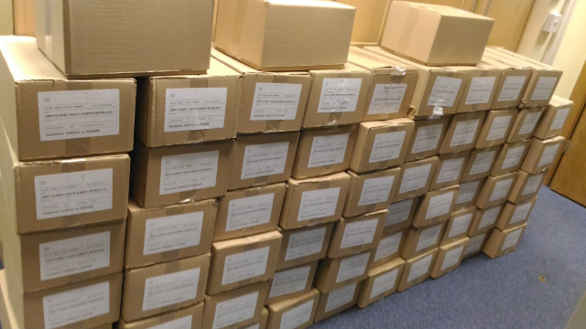

Slide 14


Slide 15
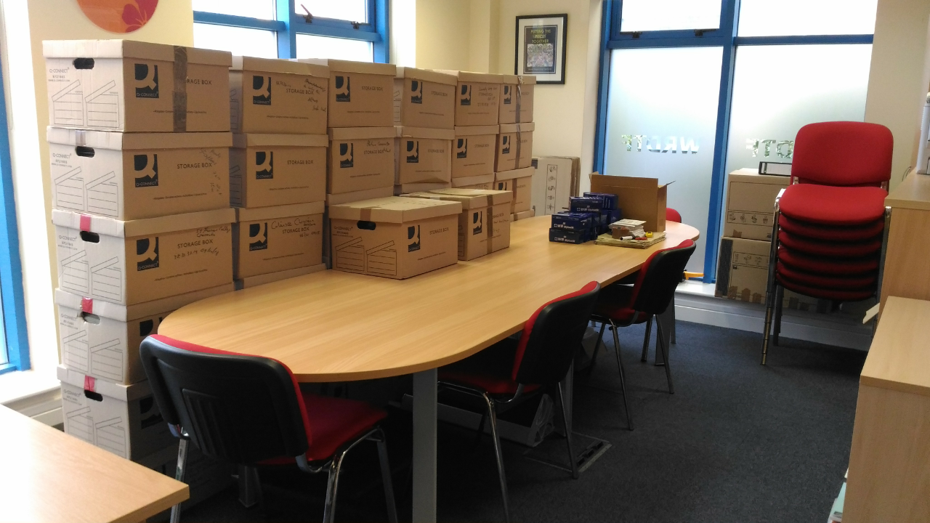

Slide 16
Survey outcomes
4600 Forms returned
2,601 in Galway, 533 in Roscommon and 1,511 in Mayo
100% Participation of Schools and Youthreach Centres
43 in Galway, 11 in Roscommon and 29 in Mayo
Forms have gone to Reykjavik for processing

Slide 17
The To-Do list
Identify the local situation via the Planet Youth Survey
From the data find the local risk and protective factors
Give immediate, practical information out quickly
Form local networks with all stakeholders in the region
Address these factors through local community work
Measure regularly
First site reports will be presented on February 25th & 26th 2018

Slide 18

Thank you!

