Slide 1
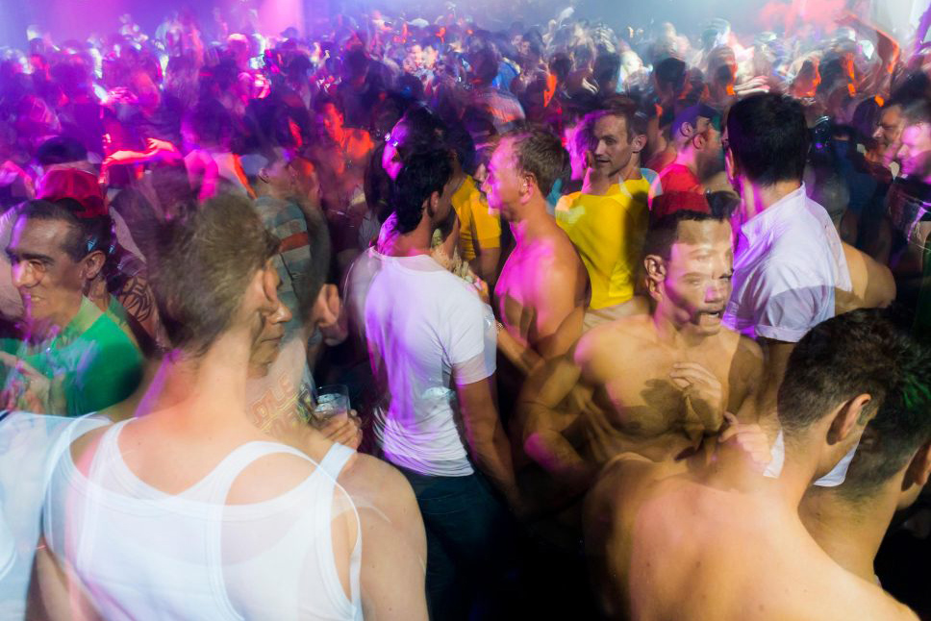
CHEMSEX
A Collaborative Response
Kiran Santlal & Adam Shanley

Slide 2
What is Chemsex?
The use of substances to facilitate or enhance sexual experience
Typically involves several participants
Mainly but not exclusively among gay, bisexual, MSM population
3 most commonly used drugs in a sexual context include:
  GHB/GBL (Liquid Ecstasy, Gina, G)*
  Methamphetamine (Crystal Meth, Tina)
  Mephedrone (Meph)
*Evidence firmly places GHB/GBL as currently the most pronounced issue in Dublin/Ireland in terms of problematic use and negative outcomes.

Slide 3
What’s happening?
Extended sex for many hours, sometimes days.
  It can be common not to sleep.
Sometimes just two people but often multiple partners, multiple times.
People engage in Chemsex for a number of reasons; most would cite as a means of escapism.
  Safer sex may not be a priority.
Not being able to consent to sex when unconscious or highly intoxicated:
Sexual assault / rape
Negative Outcomes: Addiction, overdose, mental health issues, STIs & HIV/HCV

Slide 4
Why are people doing it?
sexual freedom loneliness internalised homophobia
better sex longer sex
intimacy
community
peer pressure
fear of rejection
sexual shame
HIV/HCV stigma
“The drug is not the problem; the drug is the attempt to solve the problem”
-Gabor Maté

Slide 5
Evidence base
90% response rate (510/568)
1 in 4 (27%) reported engaging in Chemsex in the previous 12 months.
Half had taken 2 or more drugs at their last session
1 in 5 (23%) reported losing consciousness as a result of Chemsex
1 in 4 reported that Chemsex was impacting negatively on their lives
Almost a third would like help or advice about chemsex
Those engaging in Chemsex were more likely to:
  Have had more sexual partners (p< 0.001)
  More partners for anal sex (p< 0.001)
  Have had condomless anal sex (p< 0.041)
Glynn, R. (2018) International Journal of Drug Policy, 52, pp.9-15.

Slide 6








Collaborative approach

Slide 7
Addressing chemsex
Competently addressing Chemsex is challenging, because though it may be perceived as a drug problem, it’s more of a sex/psychological problem;
  Cultural issue associated with how people understand & pursue sex, intimacy and relationships
Drug-related interventions may need to be adapted to ensure:
  Specific forms of high-risk behaviour, such as Chemsex, are addressed
  Treatment goals relevant to these behaviours are included
Harm-reduction measures and treatment interventions must tackle drug use together with sexual health and mental health
Current evidence firmly places G use as the most pronounced issue in Ireland’s chemsex scene and so our intervention efforts have centred on G.

Slide 8
Intervention Settings – Chemsex Working Group
Primary – harm reduction advice & information on GHB/GBL
  Universities
  Clubs
  LGBT & other Community Centres
  Conferences & Discussion with community (HSE Communications)
  Phone apps, social media & websites (Future)
Secondary – detecting the harmful use of G
  Gay Men’s Health Service & Sexual Health Clinics
  GP Clinics
  Ana Liffey Drug Project & Rialto Community Drug Team
  Alcohol & Drugs Helpline
  Afterparty Engagement Worker (Future)

Slide 9
Intervention Settings – Chemsex Working Group
Tertiary – managing harmful effects, detoxification & rehabilitation
  HSE National Drug Treatment Centre
  Emergency Departments & Medical Wards
  Psychiatric Outpatient Departments
  GHB Support Group (Future) & AA Meetings

Slide 10
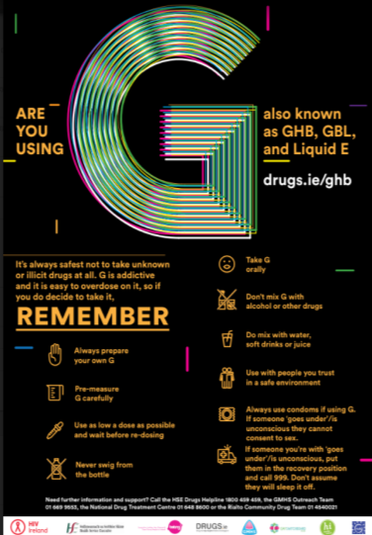
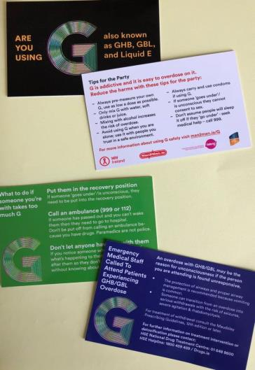
Primary interventions
Screening of the Chemsex Documentary
Community Discussion
G Harm Reduction Campaign
  Posters
  ‘Tips for the party’ flyer
  ‘Tips for the party’ video
  ‘G Card’
  Emergency Management Information Packs

Slide 11


Secondary interventions
Sexual Health & Drug Addiction Staff Training
Increasing awareness in Emergency Medicine & General Medical and Psychiatric Departments
Changing Policy
  Chemsex Working Group established to examine the evidence in relation to early harm reduction responses, (drug testing, amnesty bins and media campaigns), to current and emerging trends including:
    Use of new psychoactive substances
    Use of image and performance enhancing drugs
    Other high risk behaviours, including chemsex.
  Considering the need for specialist referral pathways for specific groups who may not otherwise attend traditional addiction services (i.e. those who engage in chemsex)

Slide 12
Tertiary Interventions
The GHB Detoxification Clinic
98 referrals since 2014
  2014 – 2 referral
  2015 – 5 referrals
  2016 – 5 referrals
  2017 – 47 referrals
  2018 – 38 referrals

Slide 13
Tertiary interventions
Out of 98 detoxification management episodes:
  6 completed as an inpatient in St. Michael’s Ward
  16 admissions under Medical team & detoxed
  on the medical ward; continued detoxification
  as an outpatient in NDTC
  76 completed outpatient detoxifications

Slide 14
Key learnings
The Chemsex Working Group
  established to address the harms associated with the increasing trend of Chemsex and drug use
  multidisciplinary cooperation of governmental and non-governmental agencies
Multiple substances typically used during Chemsex
  Increased likelihood of losing consciousness – possibility of non-consensual sex
Combined treatment of medical supportive/medication management (short term) and psychological therapy (long term)
  The GHB Detoxification Clinic – managing GHB withdrawals and recently including treatment of Crystal Meth withdrawals
Future plans – “thinking outside the box” and utilising technology to target high-risk populations

