Slide 1
THE POWER OF COMMUNITIES OF PRACTICE: Engaging to create excellence and integrate the system
Karen Minyard, Ph.D., CEO
Brigitte Manteuffel, Ph.D., Senior Research Associate
Georgia Health Policy Center
Georgia State University
USA

Slide 2
Agenda for Today
Why Do We Need Communities of Practice?
What are Communities of Practice?
GHPC’s Experience with Communities of Practice as a Way of Work:
Rapid Whole-ScaleTM Change
Technical Assistance
Evaluation
The Value of Different Methods and Modes
The Importance of Stewardship
Building Your Own Community of Practice

Slide 3
GEORGIA HEALTH POLICY CENTER Integrating research, policy, and programs to advance health and well-being
A research center within the Andrew Young School of Policy Studies at Georgia State University in Atlanta, Georgia
Provides evidence-based research, program development, and policy guidance locally, statewide, and nationally
For more than two decades, we have worked in 1,400+ U.S. communities, states, and territories to achieve health improvement
New global portfolio, including work in Nigeria, Sudan, Ireland, and Jamaica

Slide 4
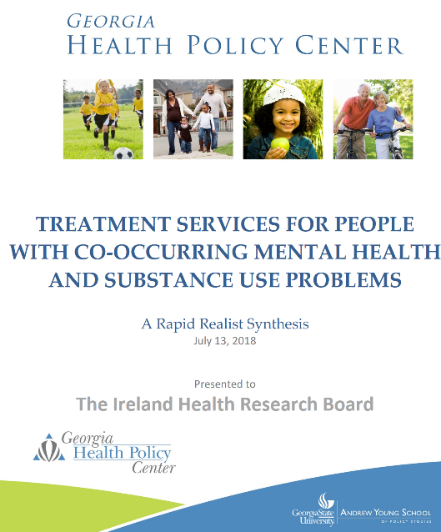
OUR WORK WITH The HRB Evidence Centre

Slide 5
Why do we need Communities of Practice?

Slide 6
Notes:
Complex adaptive systems
Systems in motion
Complicated and entangled component of a transforming system
Integration of systems practitioners and evaluators
Why Realist
The change processes are complex adaptive and context dependent
The engagements and outcomes vary across sites, and are unstable, nonlinear, and unpredictable
Program theories are often implicit, incomplete, and emergent
There is limited evidence to inform catalytic practice

Slide 7
Notes:
Rather than speaking of trial and error, human intuition, and muddling through, catalyst and their evaluation partners will be armed with evidence about what works for whom in what circumstances – swampy lowlands (Schon) This is true for many of our engagements – policy, ta
Realist Evaluation provides a framework to systematically learn what works for whom in what circumstances
Findings Practice/Evaluation Iteration – an intimate and mutually-reinforcing relationship between the evolution of catalytic practice an the practice and refinement of realist evaluation
Realist evaluation improved catalysts’ theory of change
Realist evaluation allowed the discovery of unanticipated mechanisms of HST that shaped the catalysts’ theory of intervention
Realist evaluation promoted the development of a more integrated theory of intervention
The work of applying the realist frame to HST shaped the practice of realist evaluation itself
Practice-Evaluation Iteration provides a guide for catalysts and evaluators to navigate the complex environment, structure and learn from emerging evidence, rapidly make sense of their experiences and more confidently and effectively support health system transformation

Slide 8
Technical vs. Adaptive* Challenges
Technical Challenges
Adaptive Challenges
Ready made solution exists
Someone has The Answer
Standard Operating Procedures (SOPs)
Even if they require intense skills, some expert knows exactly what to do…
Examples
Building a hospital
Fixing a broken computer
Brain surgery
Never solved issue
Perhaps new, never seen before
No one’s got The Answer
Must be solved by collaboration
Examples
Poverty
Reforming public education
Health reform
Adapted from Ronald A. Heifetz and Marty Linsky, “A Survival Guide for Leaders,”
Harvard Business Review, June 2002, pp. 65-74.
Notes:
Some of the biggest challenges exist when we try to apply technical solutions to adaptive challenges.

Slide 9
What Are Communities of Practice?

Slide 10
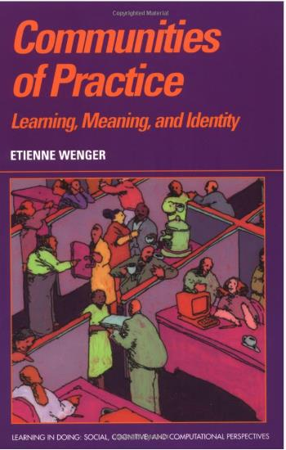
Communities of practice are groups of people who share a concern or a passion for something they do and learn how to do it better as they interact regularly.
Source: http://wenger-trayner.com
Notes:
The term was initially coined by anthropologist Jean Lave and educational theorist Etienne Wenger in their 1991 book Situated Learning. The concept was then subsequently expanded by Wenger in his 1998 book Communities of Practice.
The idea of communities of practice is that learning occurs by groups of people that emerge when they have a common concern or passion and interact regularly as they strive towards shared goals. Initially, the term was coined in terms of apprenticeship programs, but communities of practice have taken on broader meaning and this concept of collective learning has been applied to organizational development and to build large-scale social learning to address complex societal challenges.

Slide 11
COMMUNITIES OF PRACTICE
Successful and sustainable communities of practice share some common elements. Werner identifies the top three elements as:
Shared Goal
Leadership
Time
Source: http://wenger-trayner.com
Notes:
"Passion for the domain" (or belief in a shared goal)
Leadership (or strong facilitation and/or backbone support)
Time (or valuing the time required for meaningful personal investment)

Slide 12
GHPC’S EXPERIENCE WITH COMMUNITIES OF PRACTICE AS A WAY OF WORK

Slide 13
Rapid Whole System ChangeTM
Technical Assistance
Evaluation
Notes:
From the beginning, GHPC has used a combination of rapid, whole-system change principles, technical assistance, and evaluation to accelerate progress and build successful communities of practice. We also recognize the importance of collective impact and teaching the principles of stewardship to enable participants to build and maintain a community of practice that values a systems perspective.

Slide 14
RAPID WHOLE-SCALETM CHANGE
Notes:
Our Whole-Scale™ Change methodology has been used to create rapid and sustainable change in organizations and communities around the world. We believe the wisdom needed to create successful change is in the people, and our role is to help them uncover, combine, and apply that wisdom to accomplish the results they are seeking
Our core competencies include engaging large and small microcosms of the organization as the key elements of the change process. We work with groups as small as ten and as large as 1,000. These interactions of large and small groups allow a “critical mass” of the organization (or a sub-system within the organization) to build a common database and form a common intention for action. Whole-Scale™ processes are robust: they work in many different circumstances with people from all parts of the organization.
The Whole-Scale™ approach is a flexible methodology that can be used at different levels and at different stages of the change process. We stress that Whole-Scale™ is a journey and each step can create “critical moments” in the process but only in the context of a sound change strategy that includes clear strategic goals, strong leadership alignment, adequate training and concerted implementation follow-through.

Slide 15
WHOLE-SCALETM CHANGE
Core Beliefs and Values:
Creating Empowerment and Participation
Creating Community
Using Reality as a Key Driver
Building and Maintaining a Common Database
Creating a Shared Preferred Future
Creating Change in Real Time
Practicing Action Research
Transferring Learning
Notes:
Core Beliefs and Values
Creating Empowerment and Participation We believe in engaging the entire organization in ways that lead to ownership of and commitment to a shared purpose and future direction.
Creating Community We believe that when you foster an environment where employees can come together, they can create and believe in something larger than themselves.
Using Reality as a Key Driver We believe the change process must keep a continual focus on the simultaneous and sometimes conflicting realities that exist in the internal and external environments of the organization.
Building and Maintaining a Common Database We believe that a “level playing field” of information and common understanding of the strategic issues informs the discretion of people at all levels so that they can make wise decisions, individually and collectively.
Creating a Shared Preferred Future We believe creating a collective “image of potential” for the future forms the basis for action today.
Creating Change in Real Time We believe in simultaneous planning and implementation of individual, group and organizational changes.
Practicing Action Research We believe that only through continuous re-examination throughout the process can our clients adjust their approach to ensure reaching their vision of success.
Transferring Learning We have a strong value for creating self-sufficiency and against creating dependency on us in our client systems. Our goal for the completion of a project is that participants will make our methods their own so they can feel confident and capable of carrying on with or without Dannemiller Tyson Associates.

Slide 16
Technical Assistance
GHPC’s History:
1997-2003 to support fragile healthcare systems in 26 counties in Georgia
Providing Technical Assistance to FORHP grantees continuously since 2002
FORHP Sustainability Technical Assistance Contract from 2008-2011
Diverse portfolio of technical assistance projects supporting local, state, and national entities
Notes:
Early 1990’s in Georgia- the GHPC was engaged to work in some of Georgia’s rural counties where their hospitals were shaky- to develop vertical network approaches to strengthening the local hospital. From that work, we moved to working with the federal office of Rural health policy to provide technical assistance to rural and frontier cmties funded through their Community –based division grant programs- have worked with rural communities for 16 years through relationship with FORHP
GHPC has been supporting community health system change through technical assistance since its founding in 1995. GHPC has provided technical assistance and capacity building support to more than 1,000 communities throughout the country. Clients include local, state, and national organizations.

Slide 17
Technical Assistance Principles
Focused on sustainability and sustained impact
Systematic but flexible
Relationship-based
Technical and adaptive
Refined through continuous learning and evaluation
Notes:
GHPC’s technical assistance approach supports system change and strives to improve the health status of local communities. We believe that communities benefit most from support that is:
Relationship-based
Systematic, but flexible
Technical and adaptive
Systems-oriented
Sustainability-focused
These principles and other attributes identified by GHPC associated with long-term viability of community-based health initiatives are unified in GHPC’s custom Sustainability Framework©, which guides technical assistance around the areas of strategic vision, collaboration, leadership, relevance and practicality, evaluation and return on investment, communication, efficiency and effectiveness, organizational capacity, and resource diversification.

Slide 18
Models of Support Matched To Stage of Development
Leadership Assembly
and
Will-Building
Catalytic, Intensive,
Formative
Support and Coaching
Broad Learning system,
peer-led
Intensity of Support– Time, $
Replication of
Effective Practices
Resource
Clearinghouse
Audit , investor or standard- driven
Least Mature
Weak
Strength Of Relationships
Most Mature
Strong
Low
Degree Of System Integration
High
Limited
Experience with collective impact
Extensive
© 2002 by Board of Regents of the University System of Georgia by and on behalf of Georgia State University and its Networks for Rural Health-SM

Slide 19
Realist Evaluation

Slide 20
What works for whom? How? And in what circumstances?

Slide 21
REALIST EVALUATION CYCLE
Eliciting and formalizing program theories to be tested
Collecting context, mechanism, and outcome (C-M-O) data
Analyzing C-M-O data for patterns, testing initial theory
Revising initial program theory

Slide 22
Hypotheses Stated As “Configurations”
C + M = O
“The sign of a good evaluation is that it is able to explain the complex signature of outcomes”
(Mark et al 2000)
Notes:
Configurational Thinking
Key to program building
Describes how different components of a program need to be HARMONIZED
Approach to causality
Outcomes follow from alignment of a specific combination of attributes
RE develops and tests CMOCs
Recipes and Slot machines as examples

Slide 23
Context
The Four I’s:
Individual
Interpersonal
Institutional
Infrastructure

Slide 24
Observable
1.
Program
Activities
3.
Program
Outcomes
Resources
Opportunities
Constraints
Decisions
Choices
Not Observable
2.
e.g. Reasoning, preferences, norms, collective beliefs
Adapted from Wong, G., Westhorp, G., and Greenbaugh, T. (2012) Realist Synthesis RAMESES Training Materials.

Slide 26
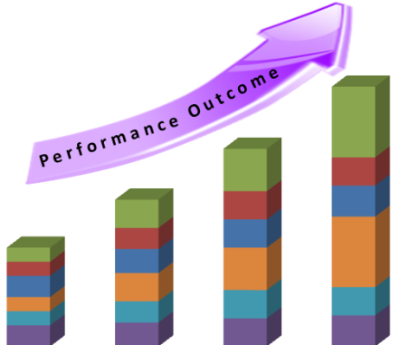

Slide 28
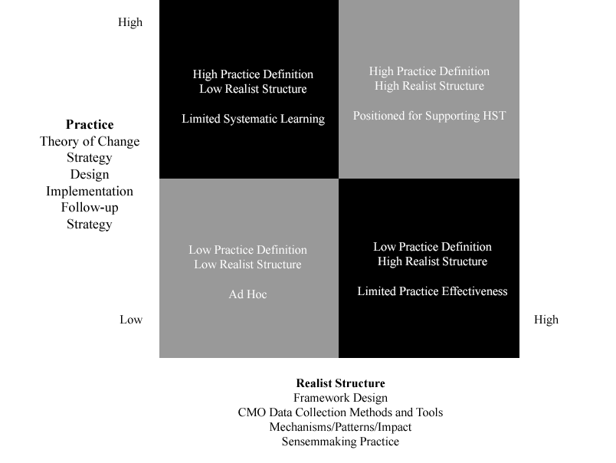
PRACTICE – EVALUATION ITERATION FRAMEWORK

Slide 29
EXAMPLES AND STORIES FROM THE FIELD
Notes:
GHPC frequently builds learning journeys into our work with communities of practice. Share examples that follow.
There are many other examples of internal and external communities of practice at GHPC—Georgia's Interagency Director's Team, our legislative education initiative, Trinity Health's Transforming Communities grantees, health reform workgroup, the data-sharing workgroup, and Lunch-n-Map group sessions.

Slide 30
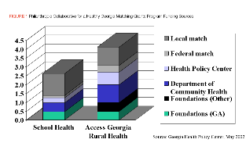
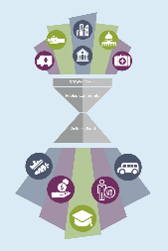
 | Shared Goal | Leadership | Time | Methods | Outcome
Philanthropic Collaborative for a Healthy GA | School Health | 25 Foundations | 3 years | GHPC backbone support, learning journey, CDC expert
Rural Community Health Grantees | Strategy, Capacity, and Sustainability | GHPC and Government | 3 years | GHPC backbone support, individualized and generalized technical assistance, “just-in-time” and “bite-sized” learning, monthly calls, peer learning seminars, webinars
Bridging for Health | Pooled Community Wellness Funds to Improve Health | GHPC, Foundation, and Advisory Board | 4 years | GHPC backbone support, technical assistance, evaluation support, group learning (webinars, online platform, peer meetings, cross-site evaluation calls)

Slide 31
The Value of Different Methods and Modes
Notes:
Brigitte’s part

Slide 32
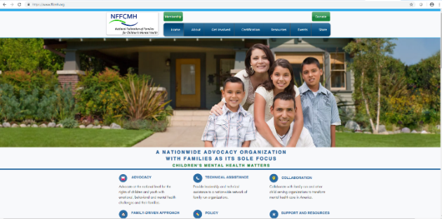
Communities of Practice: Building Evaluation Capacity of Family Organizations
Purpose and motivation
Demonstrate accomplishments and value
Make progress in challenging area
Build skills
Common goals
Learning community – learning together, learning from each other
Building relationships and resources
Bringing together research knowledge with community organizations

Slide 33
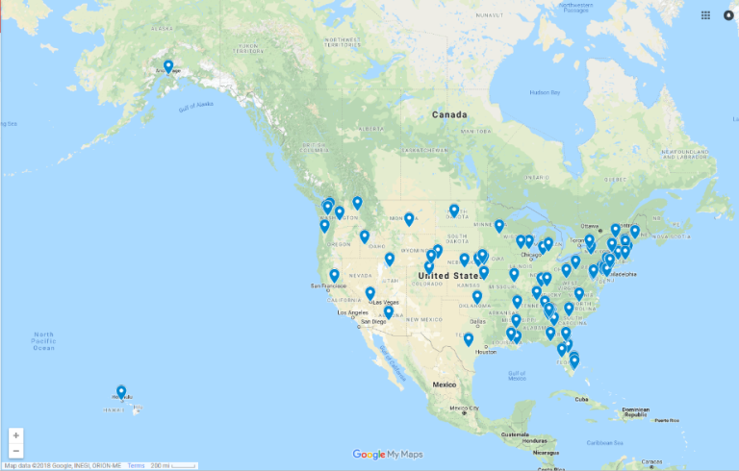
Communities - In many places
Children’s Mental Health Initiative grantees each have to establish family organizations
Anywhere in U.S. or territories – including Guam!
Rural, urban, state, counties, cities, Native American and Alaska Native communities
Grantee program with meetings once or twice a year
Need for virtual communities
Federation of Families for Children’s Mental Health –
Affiliate Locations

Slide 34
Creating the Space to Work Together
Small enough groups so everyone can participate
Schedule and commitment that works for community organizations
Invitation and application process
Come with a project
Affinity – Similar interests
Developed three groups around three different interest areas
Setting structure for groups – agenda, agreed on rules for interaction, accountability to the group, reporting on progress on projects, etc.
Facilitated by a neutral party
Photo: Brigitte Manteuffel

Slide 35
Virtual Communities
Many Ways to Connect
Phone – with and without video
Internet – with and without video
Skype
Zoom
Webinars
SharePoint
Drop Box
Cloud workspaces
Google Drive
One Drive
What’s app
Messenger
Others

Slide 36
Building Communities Together
Groups meet in person when they can…
conferences, other meetings
Members……
connect to problem solve on new projects
share information and experiences
submit grants together
teach others
build lasting relationships
Photo: Brigitte Manteuffel

Slide 37
The importance of Stewardship
Notes:
Back to Karen

Slide 38
Stewardship
Notes:
Use this slide to establish context regarding the GHPC approach to stewardship mindset – that it is based (roughly) on the ideas and principles of Elinor Ostrum.
To establish a base for our work in collaborative stewardship, we spent time studying Nobel Laureate Elinor Ostrom’s landmark work on economic governance. She traveled the world and saw that, indeed, people can collaborate to succeed on difficult social issues. She defined collaborative as having Common-pool Resources. These resources can be utilized in a way that increases the overall value in the long term, or they can be exploited for short-term gain, but long-term depletion.

Slide 39
Stewardship:
The acceptance or assignment of responsibility to shepherd and safeguard the valuables of others.
Notes:
Note that this is the definition of stewardship we will use as part of our work session today.

Slide 40
Eight Design Principles
Clearly defined boundaries
Rules adapted to local conditions
Collective decision making process
Monitoring by those involved
Graduated sanctions for rule violators
Cheap and accessible conflict resolution
Power recognized by higher-level authorities
Organization in layers of nested enterprises
Notes:
These are the eight design principles that Ostrum has identified in her work.
Briefly review each and ask for volunteers to interpret how these principles apply to their collaboration.
Note that these principles are useful to understand effective, stewardship-minded collaborative, but GHPC has translated these principles into a sample set of tactics that can be applied in a practical sense.

Slide 41
Building your own community of practice

Slide 42
Building your own community of practice
 | Shared Goal | Leadership | Time | Methods | Outcome
Notes:
Include information from rapid synthesis; (Glenn, Colleen and Karen – due 10/31)
Weave in points from summary of first version discussion and recommendations (Lori)
What your Community of Practice might look like. Bring in components to imagine what they might look like.
Blank table for them to fill out together. Add something generic about Ireland as example. what passionate about? Examples about what they might do.

Slide 43
Considerations for Service Integration

Slide 44
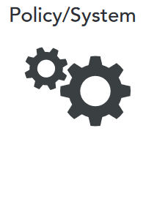
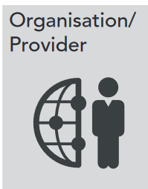
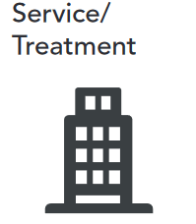
Considerations for Service Integration
Notes:
Policy/System
• Create incentives in payment to providers for integrating care of individuals with co-occurring diagnosis
• When developing service payment agreements, include deliverables that recognise the long path to recovery
• Analyze the system as it relates to access to psychological services and align providers with service needs
• Examine payment structure for peer mentors, coaches, and instructors
• Explore how resources can be allocated to support a holistic approach to care (e.g., housing, supportive employment)
Organisation/Provider
•Build a knowledgeable, integrated workforce that keeps the individual at the centre
•Develop a common language among different provider types, consumers, and families
•Examine training modes and build in time to support provider training and cross-training to build competence and confidence
•Build a culture of hope
Service/Treatment
• Create a learning community among the current integrated programmes
• Conduct a realist evaluation of the current work and use the learnings to improve current programmes and build others
• Allocate resources to support the creation of new integration pilot programmes
that include resources for programmes, technical assistance, and peer support from current integrated programmes
• Use the evidence from this review to guide future programme development
Individual/Family
• Build systems for co-production at each level of the system: policy, provider, treatment design, and individual care
• Recognise the importance of favorable attitudes toward recovery, social support, self-management behaviors, socioeconomic stability, and incentives for engagement in treatment
• Include service users and families in care decisions, use peer support, and take a holistic view of treatment to support trust, flexibility, and hope in work with service

Slide 45
Contact Information
Karen J. Minyard, Ph.D.
CEO
kminyard@gsu.edu
Brigitte Manteuffel, Ph.D.
Senior Research Associate
bmanteuffel@gsu.edu
Georgia Health Policy Center
Georgia State University
55 Park Place
Atlanta, GA 30303
USA
ghpc.gsu.edu

