Slide 1
What is the evidence for effectiveness in drug prevention and social reintegration?
Prof Harry Sumnall

Slide 2
declarations
Professor in Substance Use, Public Health Institute, Liverpool John Moores University
Member – (UK) Advisory Council on the Misuse of Drugs
Board Member – European Society for Prevention Research
Trustee – Mentor UK
Advisor – MIND Foundation
Receive grant funding for research into alcohol and other drugs

Slide 3
About this talk
Broadening horizons - what part does drug prevention play in supporting healthy development for young people and adults?
What does the evidence tell us about ‘what works’ in prevention and social reintegration activities

Slide 4
What are young people’s priorities?
Rank | Issue
1 | Lack of employment opportunities
2 | Failing to succeed within the education system
3 | Issues of body image
4 | Family breakdown
5 | Substance use
6 | Pressures of materialism
7 | Lack of affordable housing
8 | Negative stereotyping
9 | Social network sites
10 | Being a victim of crime
Central YMCA – A World of Good
The Challenge of Being Young in Modern Britain 2016

Slide 5
What is prevention – classic definition
Prevention can be defined broadly as policies, programmes and practices designed to reduce the incidence and prevalence of drug use (including alcohol, tobacco, illegal drugs) and associated health, behavioural and social problems.
ACMD, 2015

Slide 6
Why do we want to prevent the onset of drug use?
Drug use or specific patterns of drug use should be prevented not necessarily because drugs (possession) are illegal, but because we want to reduce the probability of adverse health and social outcomes directly or indirectly associated with use.
Notes:
Deliberately excludes legal implication
Personal view because it is the role of wider society to determine what outcomes and objectives we should prioritise

Slide 7
cannabis
Early onset of regular cannabis use associated with:
Greater likelihood of dependence and other use disorders
Increase in general risk propensity (common liability model)
Poorer educational outcomes → reduced economic performance
Impaired cognitive functioning
Psychopathology...?
Greater years of ill health
Tobacco use
Multiple vulnerabilities

Slide 8
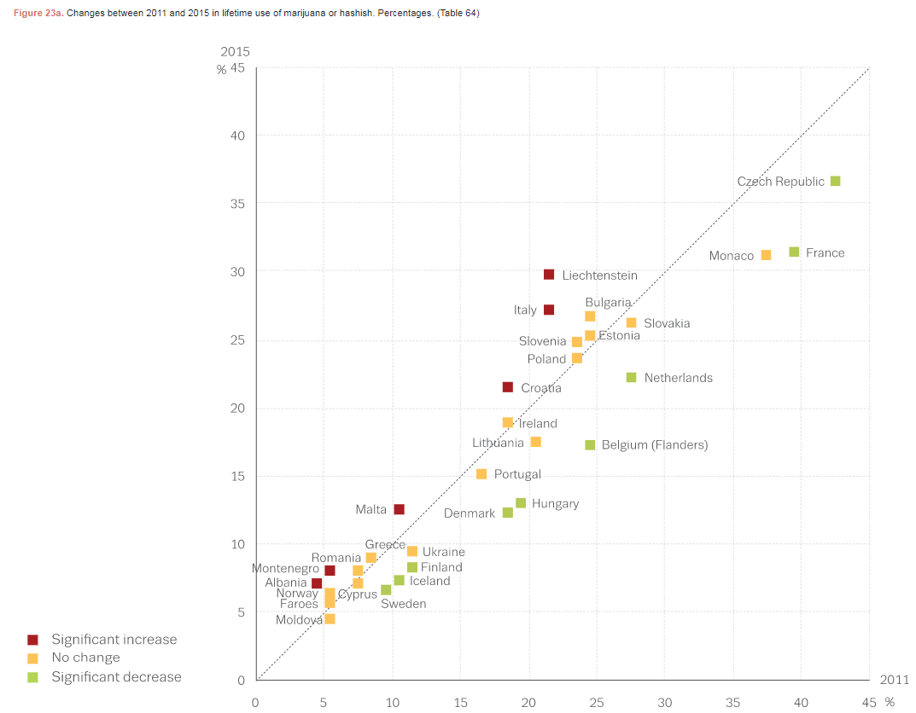
No major changes in EU youth cannabis use…
ESPAD, 2016

Slide 9
…but more adults are presenting at treatment services for cannabis
EMCDDA, 2017

Slide 10
Universal
intervention
Selective prevention
70 Million Europeans ever used (LTP)
Indicated prevention
13 Million in last month
Cannabis users
3 Million daily
Substance use disorders
Mental ill health
Behavioural disorders
Violence
Problem escalation
Slide courtesy of G.Burkhart

Slide 11
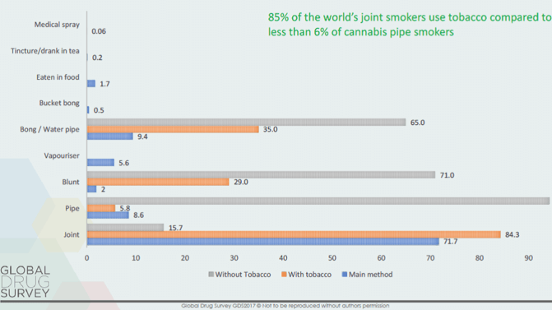
GDS, 2017; Hindocha et al., 2017; Patton et al., 2005; Tashkin, 2015; Van Dam & Earleywine, 2010

Slide 12
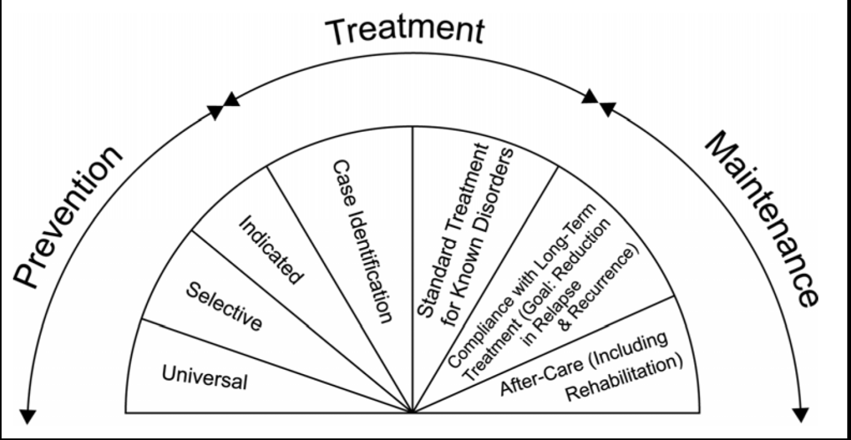
USA Institute of Medicine Model of Prevention (1994; 2009)

Slide 13
Tiered system of prevention delivery
High need
Indicated
2-5%
10-15%
100%
Low need
Universal

Slide 14
Life Course perspective
Risk and severity of
harm
More harmful use categories (frequency,
use disorder,
polysubstance, risky practices)
Turning points
Infrequent use
Onset
Fluctuating use
Regular use
Fluctuating use
Age
Remission/cessation
Early
risk-factors
‘Immediate’ risk factors

Slide 15
Top 10 alternative tips for health
Don’t be poor. If you can, stop. If you can’t, try not to be poor for long.
Don’t have poor parents, or be a lone parent.
Don’t live in a deprived area. If you do, move
Don’t work in a stressful, low paid manual job.
Practice not losing your job and don’t become unemployed.
Don’t live in damp, low quality housing or be homeless.
Be able to afford to pay for social activities and annual holidays.
Be able to afford a car.
Take up all benefits to which you are entitled.
Use education to improve your socio-economic position.
after David Gordon, 1999

Slide 16
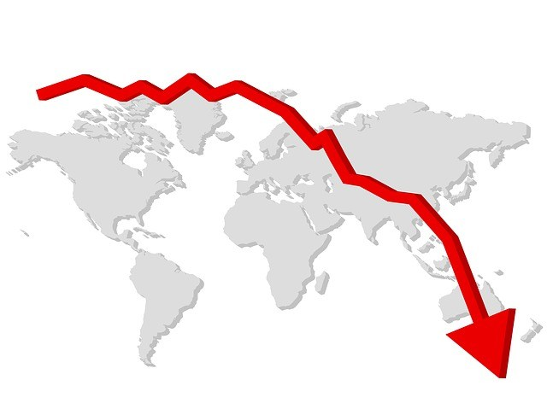
Economic recession
Since 2008, in the EU, an increase of 1% in regional unemployment rate →
⇧ 0.7 percentage point increase in lifetime reports of youth (15-24) cannabis
⇧ 0.5 percentage point increase in lifetime reports of youth NPS
Austerity & preventative impact of policies supporting economic and workforce development
Ayllón & Ferreira-Batista, 2017
Notes:
Controlling for perceived availability. Do we take into account wider societal determinants of drug use

Slide 17
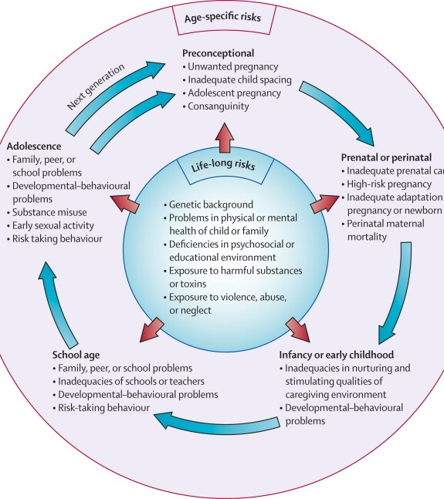
Many ‘risk factors’ for substance use are also implicated in other challenges to healthy development

Slide 18
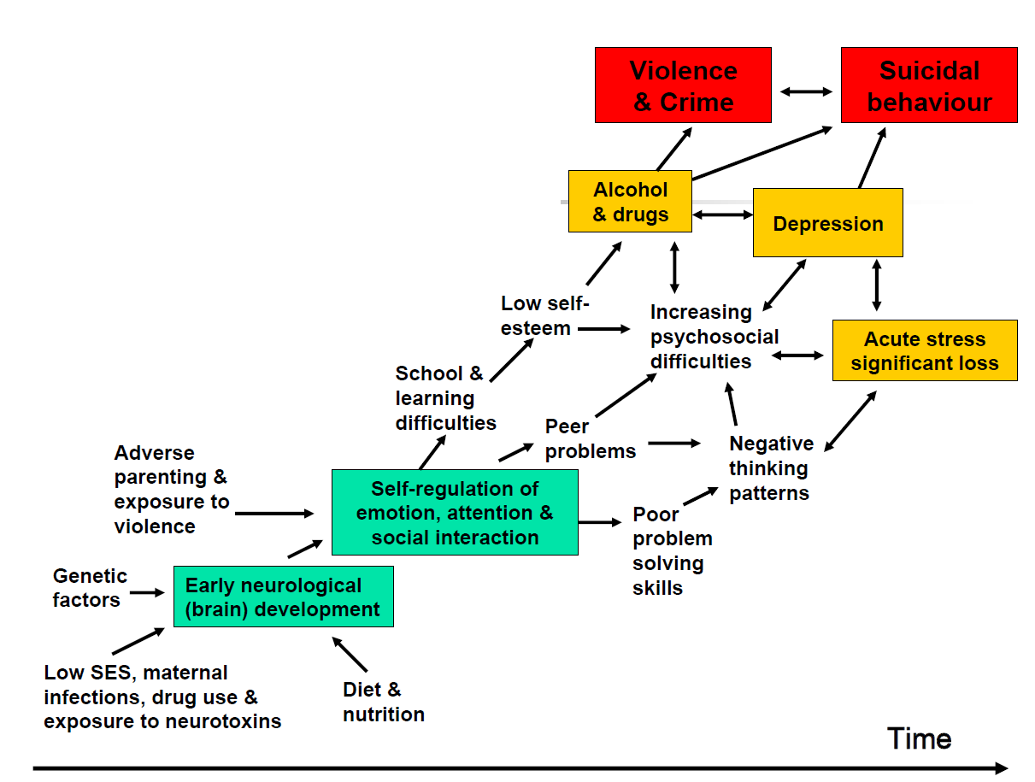
Pathways to Vulnerability (Silburn, 2001)

Slide 19
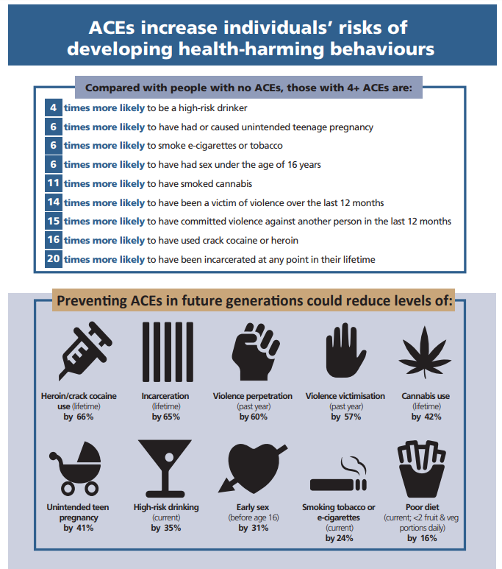
Adverse Childhood Experiences
Adverse Childhood Experiences (ACEs) are co-occurring family events or conditions causing chronic stress responses in the child’s immediate environment
These can lead to adverse physiological and psychological response to chronic stress, adoption of harmful adult coping behaviours such as substance use, and (parents’) reduced ability to access goods and services that would otherwise facilitate healthy (child) development
This can lead to a self-perpetuating cycle of adversity
Bellis et al., 2015

Slide 20
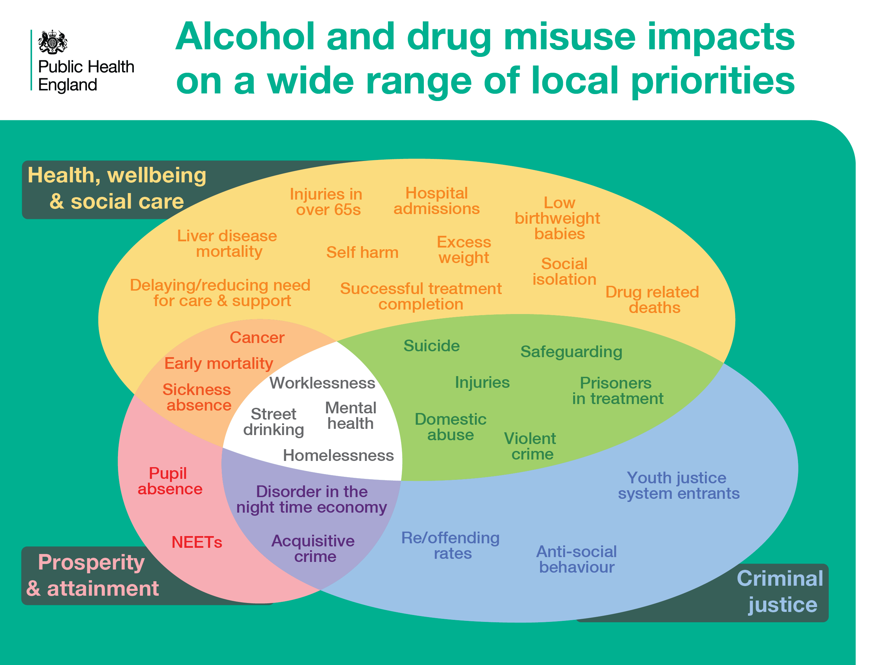
Notes:
Shared Outcomes
Investing in drug and alcohol interventions and treatment contributes to the achievement of priority outcomes for all local stakeholders and partners. For example, local authorities (PHOF & ASCOF), Education, Police, PCCs, CCGs and Health Trusts.

Slide 21
Public policy
Institutional
Community
Interpersonal
Individual
Socioecological approach to prevention and social reintegration

Slide 22
Drug use example
Policy
Housing and employment, drug laws…
Community
Availability of substances, social cohesion…
Organisational
Availability of prevention & recovery services…
Interpersonal
Relationships, peer influences and norms, ACEs…
Individual
Genetics, personality, mental health…

Slide 24
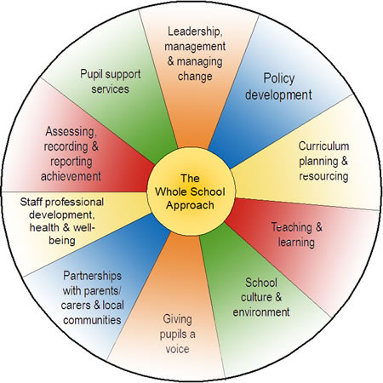
Swindon Health Schools
https://www.swindonhealthyschools.org/swindon-healthy-schools/gaining-and-maintaining-hss-in-swindon/the-whole-school-approach/

Slide 25
By focusing on factors beyond the individual, we are…
Reminded that individual behaviours and the risk of harm associated with those behaviours, are not just determined by individual choices, but are shaped by the opportunities, constraints and influences of a wider system
Less likely to ‘blame’ the individual for ‘failings’
More likely to address the underlying determinants of drug use, health & health behaviour
More likely to acknowledge that responses are needed across multiple levels at the same time, and that responsibility for reduction of harm must include the social and political institutions which played a role in producing that harm
ACMD, 2018

Slide 26
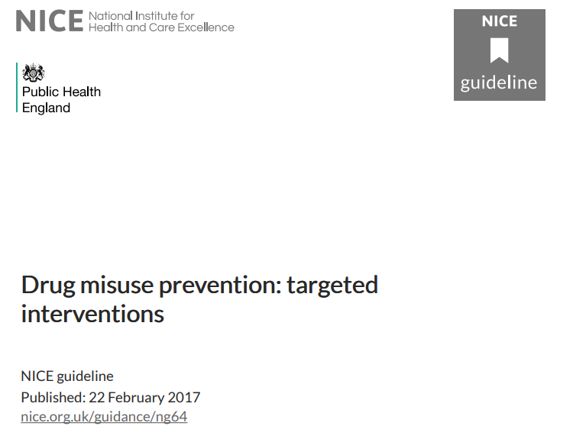
BROAD AREAS OF RECOMMENDATION
NICE provide evidence-based guidance and advice for health, public health and social care practitioners.
National Health Service (NHS) must demonstrate compliance with clinical guidelines; whilst implementing public health and social care guidelines is recommended
Deliver drug misuse prevention activities as part of existing services
Undertake assessment, screening, and referral
Prevention should be based on skills training approaches
Give information to older young people in targeted settings

Slide 27
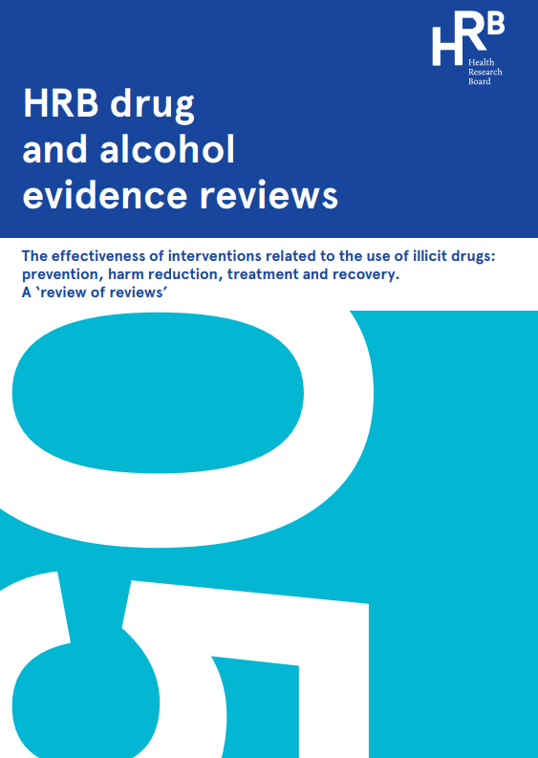
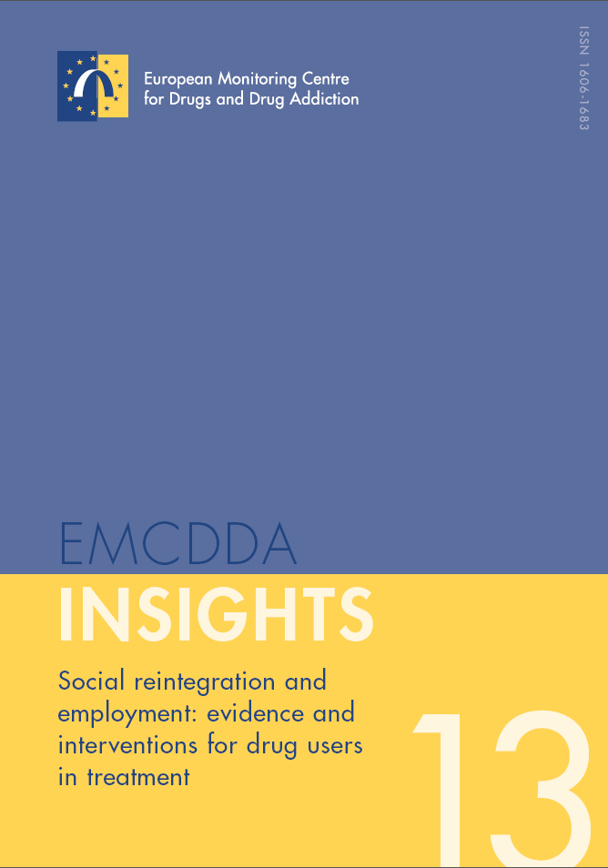
Reviews of international evidence identifying the types of interventions are effective and ineffective in:
Drug treatment
Recovery/ reintegration following/ alongside drug treatment
Drug prevention
Harm reduction
Sumnall & Brotherhood, 2012; http://www.emcdda.europa.eu/publications/insights/social-reintegration Bates et al., 2017
https://www.drugsandalcohol.ie/27253/

Slide 28
NICE provide evidence-based guidance and advice for health, public health and social care practitioners in England and Wales.
https://www.nice.org.uk/guidance/ng64

Slide 29
What do we mean by “Evidence-Based”?
Evidence Based Prevention (EBP) is the use of systematic decision-making processes or provision of services which have been shown, through available [scientific] evidence, to improve outcomes.
Accounts for target group experiences and characteristics, social environments, and practitioner expertise.
Good intentions aren’t good enough
Notes:
So what does ‘evidence-based’ prevention mean. Drawing from the definition of the Evidence-Based Practice Institute of the University of Washington, it is the use of systematic decision making processes using available scientific evidence to improve measureable client outcomes. The systematic decision process relies on the findings of experimental research and not on tradition, single observations, or intuition.

Slide 30
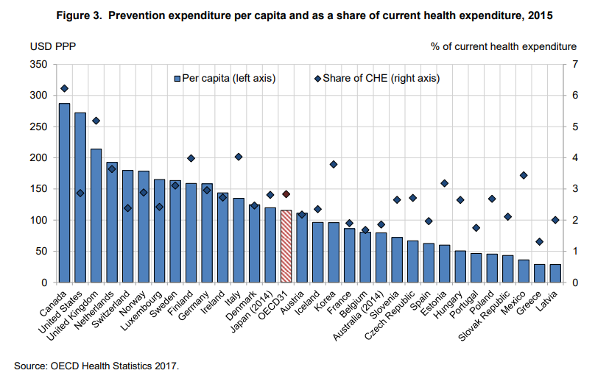

Slide 31
Interventions Are often Invisible
They may be called something else: e.g., counseling, parenting education, school policies on substance use, laws regarding age restrictions on access to tobacco or alcohol
They may be called prevention but are ‘hidden’ within an organisation: e.g., school-based curriculum, substance use as part of a workplace wellness program

Slide 32
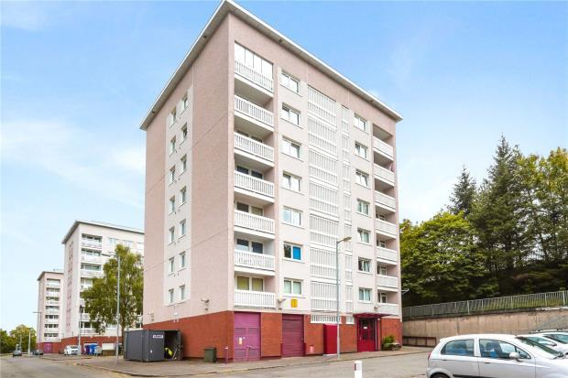
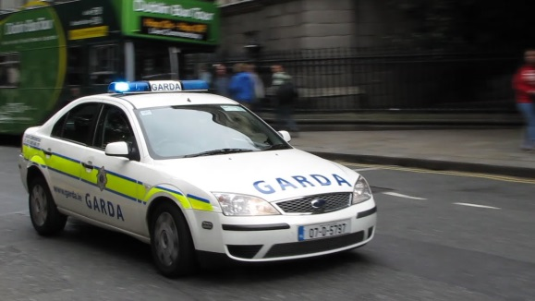
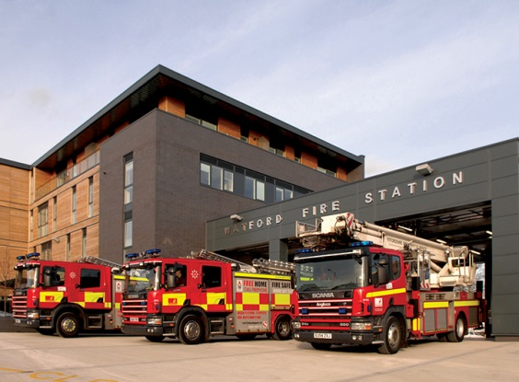
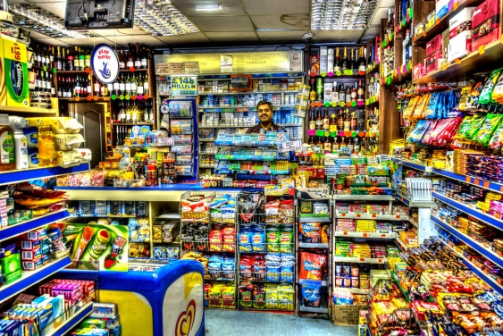
Where’s Prevention?
Slide courtesy Dr Z. Sloboda
Notes:
Not so with prevention.

Slide 33
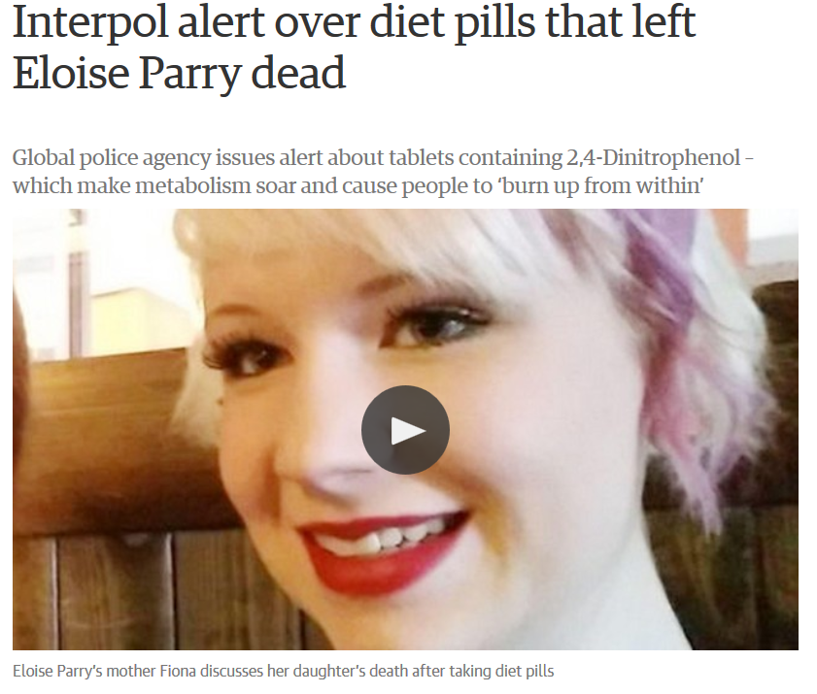
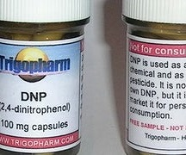

Slide 34
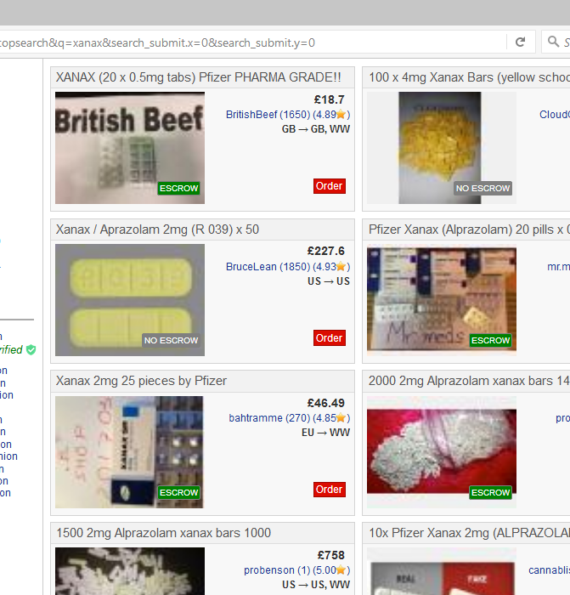

Slide 35
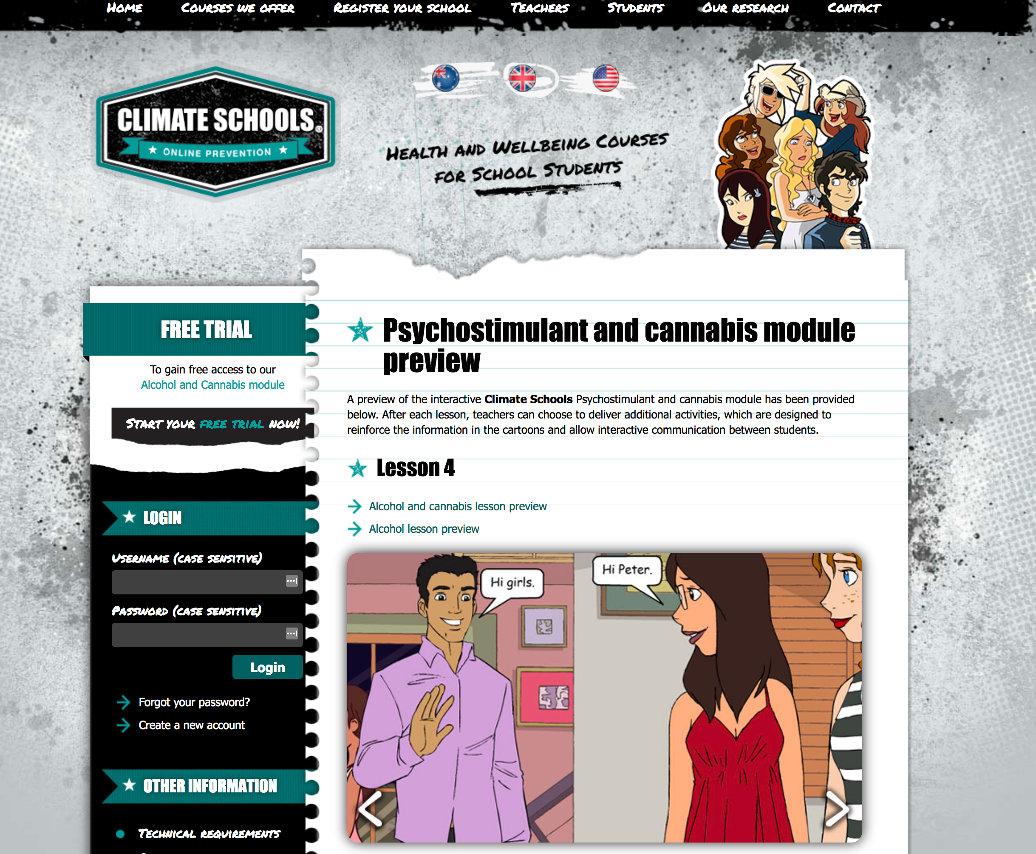

Slide 36
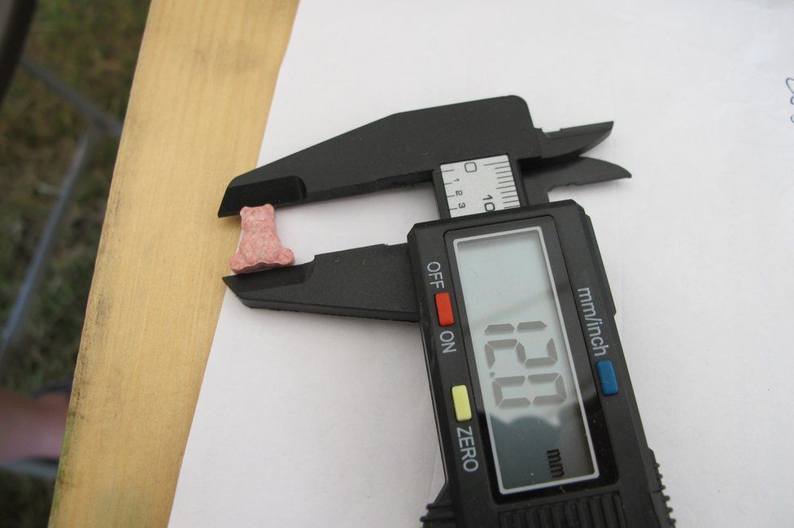
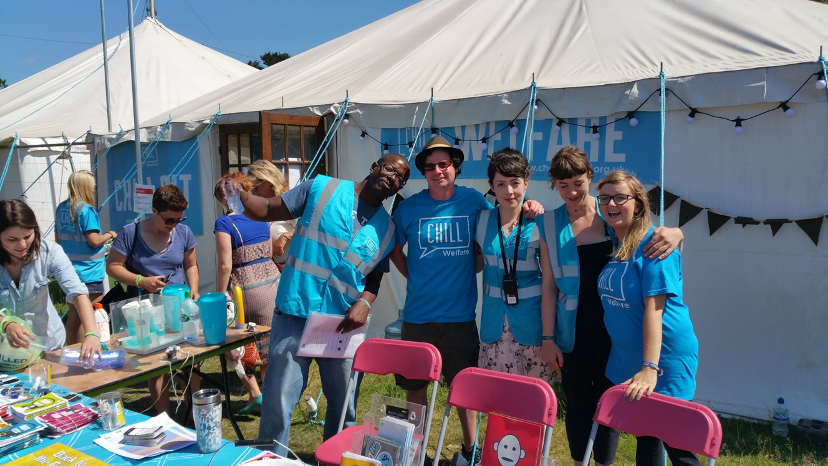

Slide 37
Prevention
May be effective | Unlikely to be effective | Inconclusive/ lacking evidence
Interventions set within multiple domains with multiple components | Brief interventions in school settings | Brief/ motivational interventions in healthcare settings
Comprehensive school-based programmes (skills and social influence-based programmes) | School-based programmes focussing on increasing knowledge alone | Universal family-based interventions for drugs other than cannabis
Skills-development school based programmes | Mass-media campaigns alone (not as part of a multicomponent intervention) | Family-based interventions targeting high risk groups
Universal family interventions including parents and children for cannabis use |  | School-based programmes focussing on social influences alone
 |  | Interventions for people with mental health disorders
 |  | Mentoring interventions

Slide 38
Harm reduction
May be effective |  | Inconclusive/ lacking evidence
Needle and syringe programmes (enhanced by OST) in the community and prisons |  | Education in recreational/ nightlife settings
Drug consumption rooms |  | Drug checking in recreational/ nightlife settings
Overdose prevention with naloxone distribution |  | Staff training interventions in recreational/ nightlife settings
Peer education training to prevent injection initiation |  | Targeted case finding for BBV testing
Multisession psychosocial/ educational interventions |  | Provision of dry blood spot BBV testing
Prison-based onsite HIV testing |  | Media campaigns
 |  | Education for sex workers
 |  | HIV risk reduction in prisons

Slide 39
Treatment/ Recovery
May be effective | Unlikely to be effective | Inconclusive/ lacking evidence
OST (Methadone, buprenorphine) in community and prison settings | Pharmacological treatment for non opiate drug use | Mindfulness-based treatments
Naltrexone implants | Acupuncture (alone) | Motivational interviewing
Multidimensional family therapy (young people’s cannabis use) |  | Continuing care programmes
Couples-based therapy |  | Residential programmes (therapeutic community, 12-step)
Contingency management (short-term only benefits) |  | Physical activity interventions
CBT for people with PTSD |  | Boot camps
Peer-supported recovery eg peer-coaching, recovery hosing, mutual aid |  | Drug diversion courts
Prison-based therapeutic communities |  | Psychosocial interventions for people with severe mental illness
 |  | Pharmacological treatments for pregnant opiate users

Slide 40
EMCCDA definition of social reintegration
Used by WHO, UNODC (included in 1961 Single Convention)
Limited EMCCDA definition:
Social reintegration is defined as any social intervention with the aim of integrating former or current ‘problem’ drug users into the community. The three pillars are i) housing; ii) education; iii) employment (including vocational training)

Slide 41
Considerations
Across the EU, 8% of community treatment clients are in unstable accommodation (range: 2-33%)
37% have only completed primary education; 2% no education at all
56% of community clients, and 75% of inpatient (2009 data) unemployed or economically inactive.
Less likely to find work after successful treatment, even in those countries with anti-discrimination policies.
Recession affects treatment entry. When there are fewer jobs available, people less likely to present to treatment, and vice versa – incentivising effects of treatment
Effects on low skilled jobs, and YP involvement in dealing/drug crime

Slide 42
Considerations
Purpose: social reintegration seeks to support initial treatment process; prevent relapse; facilitate recovery; improvements in non-drug relate outcomes
Timing: should not be seen as a ‘last step’ in treatment process, social reintegration is an integral, not separate, part of the treatment process. Progress on social reintegration outcomes is not necessarily dependent on abstention from drug use, although is often a condition of some services (e.g. supported housing), and some clients express preference.
Content: differ from most treatment interventions in that they are not necessarily psychosocial or medical
Provision: frequently provided outside of the mainstream treatment system or by non-specialist agencies

Slide 43
General approaches identified
General vocational rehabilitation
Drug treatment – substitute prescribing; psychosocial interventions (case management; residential treatment; community reinforcement; contingency management)
Criminal justice – prison treatment; vocational education, training and aftercare; parole management; referrals into community-based treatment; drug (treatment) courts
Housing – temporary and emergency accommodation; supported housing (incl. halfway houses and supported living); housing support
Education and (vocational) training – vocational training; qualifications; volunteering and temporary work experience placements
Employment – intermediate labour market; simulated work and contingency management; supported employment; pre-employment and workplace drug screening; employee assistance programmes
General policy – Welfare (benefits) and welfare to work; disability discrimination acts
Advocacy and reducing stigma – guidance to prevent discrimination and stigma; education targeted at general public; training treatment, employment and other support centre staff; managing physical signs of problem drug use (e.g. injecting site injuries)

Slide 44
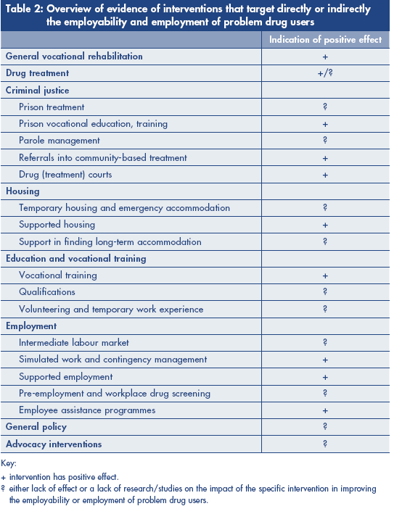
NB Lack of effect of most approaches probably represents a lack of high quality research in the area, rather than that these approaches are ineffective

Slide 45
Promising approaches – general vocational rehabilitation
Processes, ideas, and interventions that enable people with “functional, psychological, developmental, cognitive and/or emotional impairments or health conditions” to overcome barriers to accessing, maintaining, or returning to employment.
Specifically address human and social capital
Provision of temporary provision of modified work duties linked to supportive health and safety policies
Early intervention key
Staged introduction = low intensity activity → intensive and structured interventions
Supported employment more effective than extended training schemes on employment outcomes

Slide 46
Drug treatment
Structured treatment has a number of direct benefits:
Reduction in illegal employment
Increase in number actively looking for work
Improvement in stable housing status (e.g. DTORS 60-→77%)
Strongest predictor of post-treatment employment is pre-treatment employment!
Treatment modality not predictive of employment outcomes

Slide 47
Drug treatment and employment 1
No systematic review has included employment outcomes in investigations of OST
However, individual studies suggest likelihood of gaining and retaining employment in increased for clients in OST
Case management approaches including ‘brokerage’ activities, successful at establishing links between services but no strong evidence this lead to meaningful positive outcomes for clients

Slide 48
Drug treatment and employment 2
No strong review level evidence to suggest residential treatment rehabilitation improves employment outcomes, but some individual studies report positive results
Community Reinforcement model (including e.g. skills training, family relationships, vocational and employment counselling) in combination with contingency management has been shown to be effective in improving employment outcomes in a number of EU studies.
Lack of studies on effects of making treatment services ‘work friendly’

Slide 49
Criminal justice interventions
In general, prison vocational programmes effective in combination with aftercare or throughcare activities. However, prisoners are particularly influenced by external economic/employment environment
CJ referrals into community based treatment (pre-charge or referral at arrest) or as a condition of parole – EU quasi compulsory drug treatment study (Schaub et al., 2010) showed general improvement in employment outcomes across a range of treatment modalities.
NB presence of (court mandated) unmotivated clients can negatively affect other clients in a treatment group/service.

Slide 50
Supported housing
Housing provision for substance users leads to a variety of positive outcomes, including employment – not possible to identify which housing model is most useful
However, emerging EU evidence for usefulness of ‘housing first’ model which are offered without the condition of abstinence or being in treatment

Slide 51
Vocational training
Designed to help clients achieve employment readiness and/or skills for a particular job/trade
Important that successful completion leads to a labour market qualification recognised by the competent authorities
Best evidence comes from vocational training attached to comprehensive suite of residential services – also found to be cost effective
Methadone clients – individual counselling, job search, supported employment, case management
However, highly dependent on external employment environment

Slide 52
Simulated work and contingency management
Similar to traditional contingency management but the reinforcer is employment specific (e.g. reinforcer salary, contingent behaviour is work performance and abstinence)
Real and simulated workplaces
Research outcomes usually abstinence but US research has shown can also lead to improved labour market outcomes and improvement in employability skills
More controversial in EU where social protection (including support to help find a job) is considered a fundamental right rather than a reward.
Some advocates suggest contingency extended into mainstream workforce to assist recovery – again, controversial

Slide 53
Supported employment
Goal is competitive employment in community work settings
Clients obtain jobs directly rather than following pre-employment training (‘on the job’ training)
Seen as integral part of treatment rather than a separate service
Services are individualised and based on clients’ preferences and choices
Assessment is continuous and based on real world experiences
Follow on support continued after starting a job

Slide 54
Barriers to employment
Personal level: lack of qualifications; poor employment histories; criminal records; chronic poor health; insecure housing; limited interpersonal skills; complex personal needs; chaotic lifestyle; family problems; low expectations
Structural level: treatment regime; service hours incompatible with working life; lack of interagency coordination; stigma and discrimination; recession; inability to open bank account; greater probability of being in temporary or insecure work; perceived ‘benefit traps’; criminal record checks; poor public transport; lack of affordable childcare.

Slide 55
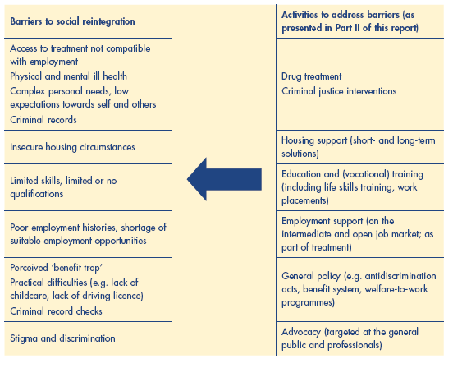

Slide 56
Contact
Professor Harry Sumnall
Public Health Institute
Liverpool
UK
h.sumnall@ljmu.ac.uk
@profhrs
@euspr

