Slide 1
A model for Dual Diagnosis treatment: Emotional Regulation Skills Training Programme – Exploring the link between Trauma/Dual Diagnosis and Emotion Regulation KELTOI Substance Misuse and Trauma Residential Rehabilitation Centre
Peter Sherry
and
Ruth Ann Buckley

Slide 2
Keltoi Treatment Model
Keltoi Treatment 2018
Drug misuse is viewed as an inability to self soothe; hence, the development of the Emotional Regulation Skills Training Programme
Trauma Informed Approach
Emotional Regulation Skills Training
Life Skills
CBT
Seeking Safety Therapy
Mindfulness
Somatic Experiencing

Slide 3
Some of the challenges in the treatment of Trauma/Mental Illness and Substance Misuse • The relationship between trauma and substance misuse is significant, complex and often mutually reinforcing. • Clients present with difficulties including mental illness, PTSD. • Substances often form part of the trauma cycle. • Outcome studies show that clients with Trauma and Substance use have poorer outcomes with substance misuse interventions if the trauma is not also addressed. • Misidentified or misdiagnosed trauma related symptoms interfere with help seeking, hamper engagement in substance misuse treatment, lead to early dropout and make relapse more likely.

Slide 4
Defining Dual Diagnosis The co-existence of both mental health and substance misuse problems including both drugs and alcohol (Royal College of Psychiatry 2002).
Prof Doug Sellman (NZ National Addiction Centre); 2010 stated –
“it is somewhat unusual to encounter a person presenting to outpatient addiction services with addiction problems alone. It is the rule rather than the exception that they would have a co-morbid mental disorder”.

Slide 5
Defining Emotional Regulation.
Emotional regulation incorporates individuals’ attempts to manage their emotionally charged states such as; low mood, anxiety, depression, stress, PTSD and positive or negative affect.
Gratz & Roemer (2004) referred to emotion regulation as the ability to experience, modulate and respond effectively to emotions.

Slide 6
Emotion Dysregulation and Dual Diagnosis. Difficulties with emotion regulation characterise the vast majority of the diagnosis categories of psychopathology in the DSM-V (American Psychiatric Association 2013). For example, in substance abuse, borderline personality disorder and post -traumatic stress disorder, emotional regulation difficulties are seen as pervasive. Fox et al (2008) carried out one of the first studies looking at the link between emotion regulation difficulties in early abstinence for alcohol dependency. Their findings suggested that patients suffering from alcohol dependency had a more pronounced problem with emotion regulation when compared with a control group of social drinkers.

Slide 7
Observations in Keltoi In the treatment of substance dependent persons with mental illness and/ or a history of trauma, it was observed that many residents displayed behaviours of a disconnected nature through hyper or hypo arousal states. Through clinical dialogue, case studies and collaborative therapeutic engagement with our clients, it became clear that these behaviours were related to the challenge of tolerating certain emotions without the use of a substance. Qualitative research was conducted with clients of their experience of making use of a conceptual model for teaching emotional regulation

Slide 8
Development of Trauma Informed/Dual Diagnosis Programme.
Emotional Regulation Skills Training Programme (ERST).
The Key aspects of this Programme are;
Using the Window of Tolerance (Dan Siegel) as a conceptual model for self-monitoring of emotion regulation.
Viewing emotions as part of a bundled experience made up of thinking, feeling, body sensation and behaviour.
Finding a balance in auto and relational regulation skills.
Mindful awareness – noticing your body and where you are within your Optimal Window of Tolerance
Development of individualised coping strategies for managing emotional dysregulation – Grounding and breathing techniques

Slide 9
Development of Trauma Informed/Dual Diagnosis Programme. Conceptual Model – Window of Tolerance

Slide 10
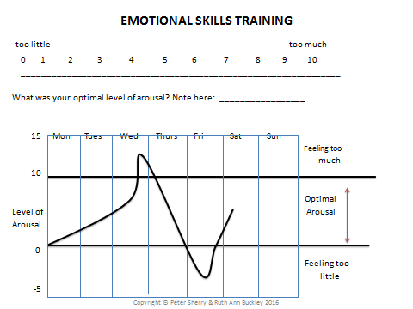
Development of Trauma Informed/Dual Diagnosis Programme. Check- in Sheet: Self-Monitoring

Slide 11
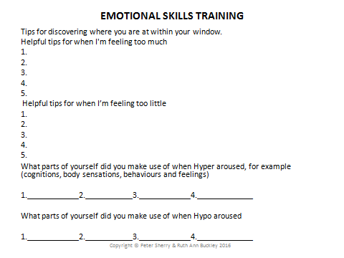
Development of Trauma Informed/Dual Diagnosis Programme. Check- in Sheet: Self-Monitoring

Slide 12
Emotional Regulation Skills Training (ERST) programme research findings
A qualitative piece of research was conducted – Interviews - Thematic analysis – of the experiences of a group of Keltoi aftercare clients who had participated in the ERST programme. This piece of research was a pilot study for its introduction into the Keltoi residential programme.
The research findings pointed to
How emotional dysregulation featured largely as a contributory factor for participants decisions to use drugs.
Other contributory factors were Attachment issues, Distress intolerance, Low self-esteem
There was a consensus amongst all participants of the positive benefits from the programme in relation to emotional regulation skills development.

Slide 13
Emotional Regulation Skills Training (ERST) programme research findings
A further significant finding was that participants’ spoke of never developing a language to describe how they were feeling. Furthermore, participants pointed to how the development of a language for describing emotions impacted on their normalisation of emotions that had, in the past, caused them to feel abnormal and often led them to relapse.
Participants experience of hyper arousal related to hyper-vigilance, impulsivity and anger
Participants experience of hypo arousal related to depression and disassociation
Impact of the programme on participants;
Progress – marked increase in self-esteem, self-regulation, normalisation of emotions and increased quality of life
Internalisation – having a map or a matrix
Resources – coping skills for managing emotions

Slide 14
Key Learning from the implementation of the ERST Programme
A strength of this intervention is its capacity to be delivered in different formats for example groups, one to one setting and peer support mentoring.
Training in this programme was rolled out for free for staff working within the addiction service and other HSE funded community services. The programme when given to staff as a self-care tool or used in clinical supervision, has the potential to reduce sick leave and encourage better mental health and wellbeing.
This programme/project aims to equip clients to better tolerate and manage their emotions hence reducing relapses on alcohol and drugs.

Slide 15
Key Learning from the implementation of the ERST Programme
Some specific challenges were encountered in the delivery of the Emotional Regulation Skills Training Programme (ERST). When the ERST Programme was rolled out in different Addiction/Mental Health and community based settings the programme needed to be adapted to suit the specific timeframes and /or clinical settings for example stabilisation, detoxification, residential, day programme and community peer support projects.

Slide 16
Future Plans for the implementation of the ERST programme
Further research of the model in its effectiveness for the treatment of Dual Diagnosis for example Substance Misuse and Depression, Anxiety, PTSD and Complex Trauma. Expand the use of the model to include working with families.
Utilise as an assessment tool for those seeking treatment for substance dependency with mental illness and/or a history of trauma
A further aim of Keltoi, as a result of the development and roll out of the ERST programme, is to establish an Education, Training and Research College.
Mobile App is in the development stages, the application aims to help clients identify potential triggers and would be programmed to suggest emotional regulation resources.

