Slide 1

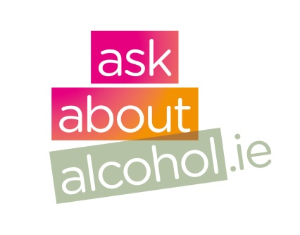
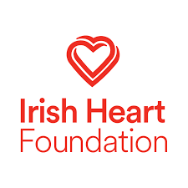
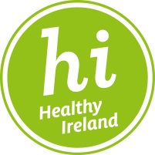

Partner Pack
July 2018 www.askaboutalcohol.ie
Heart Health
and Alcohol

Slide 2
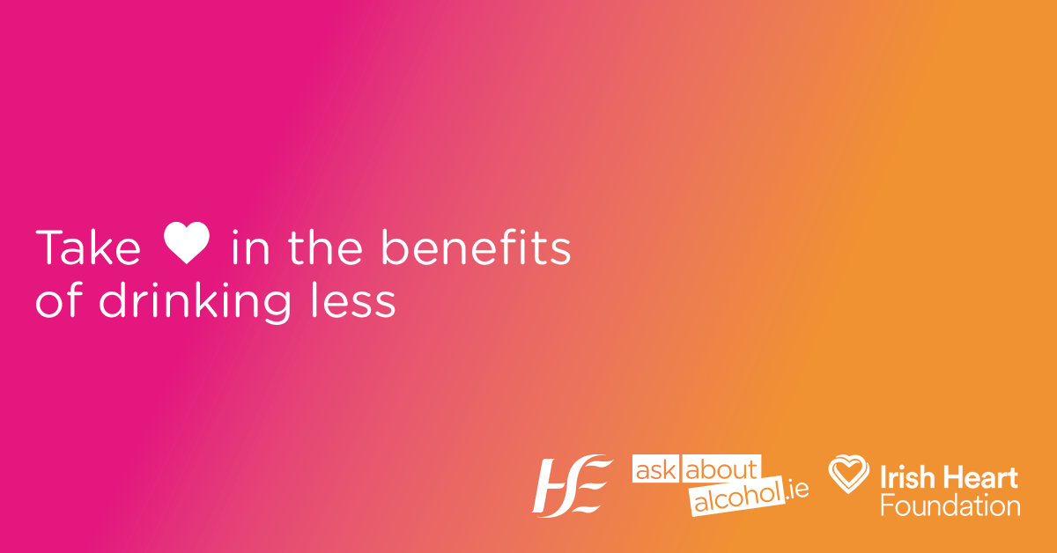
Drink Less - Your Heart will love you for it
The HSE’s AskAboutAlcohol.ie and the Irish Heart Foundation have embarked on a campaign to raise awareness of the links between alcohol and heart health. Among the range of harms caused by alcohol, it hurts our hearts too. You can look after your heart and reduce your risk of heart disease and stroke by drinking less alcohol and asking your GP or pharmacist to check your blood pressure.
Right click and select ‘Save as’ to download.
This graphic is a gif so will animate when posted on social media
Key Messages
Alcohol can raise your blood pressure and increase the risk of suffering a heart attack of stroke
Nearly one million people in Ireland have high blood pressure and most have no symptoms
- Ask your GP or pharmacist to check your blood pressure regularly
- Use this Drinks Calculator to find out if your drinking level might be putting you at risk

Slide 3
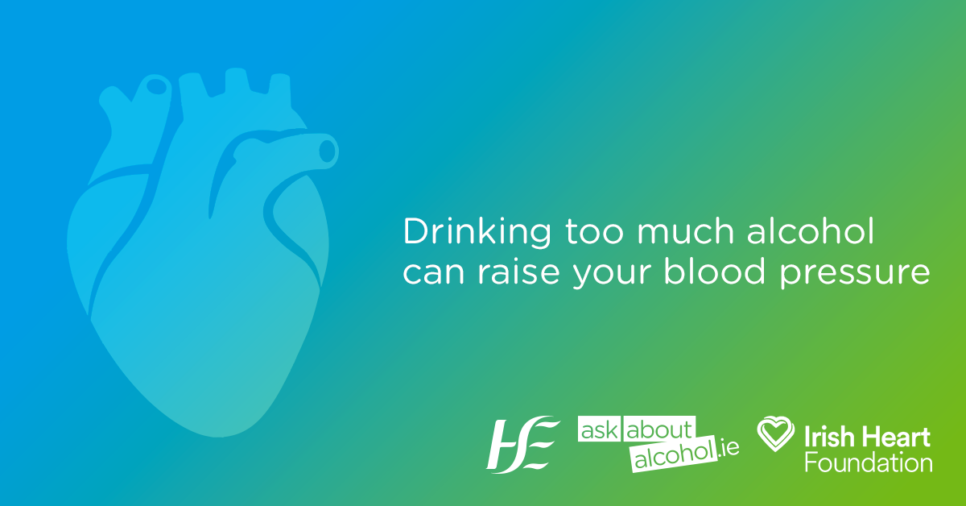
Nearly one million people in Ireland have high blood pressure, a major cause of heart attack or stroke, and last year almost 9,000 people died from cardiovascular disease in Ireland.
High blood pressure usually comes with an even bigger problem — a lack of symptoms. High blood pressure is one of the most common alcohol-related health problems, but many people don’t realise they have it.
Dr Angie Brown, Consultant Cardiologist and Medical Director of the Irish Heart Foundation, explains:
“It’s so important to have your blood pressure checked regularly, as high blood pressure can be dangerous if left untreated. Three in five adults over the age of 45 have high blood pressure but the good news is that it is one of the most preventable alcohol-related problems – once detected it can be effectively managed through lifestyle changes such as drinking less and possibly medication. Ask your GP or pharmacist to check your blood pressure or visit the Irish Heart Foundation’s mobile health unit for a free heart health check.”

Slide 4
Drinking too much alcohol over time raises your blood pressure, which means your heart has to work harder to pump blood around the body. High blood pressure can significantly increase your risk of stroke and heart disease; it can affect how quickly a heart beats (arrhythmias); and can even cause the heart muscles to weaken (alcoholic cardiomyopathy).
Often, there can be a gap between people’s perception of what they drink and what they actually drink. The more alcohol you drink the higher the risk of developing high blood pressure, but even one drink a day can increase your risk. You can use the Drinks Calculator on AskAboutAlcohol.ie to find out if your drinking level might be putting you at risk.
Marion Rackard from the HSE Alcohol Programme says it’s important for everyone to be informed:
“You don’t need to be dependent on alcohol for it to affect your health. The purpose of AskAboutAlcohol.ie is to improve people’s knowledge about alcohol - how much we're drinking, how it affects our health, and how we can gain more by drinking less. Health care professionals are also encouraged to screen their patients to make sure they are aware of the risks linked to the amount they are drinking"
HSE Radio Advertisements will run nationally for the next two weeks encouraging people to get their blood pressure checked and to visit askaboutalcohol.ie to find out more about how alcohol affects their heart and health. Reducing the amount you drink to low-risk levels doesn’t just protect your heart - it can help you feel healthier and happier all round.
Visit: http://askaboutalcohol.ie/health/effects-on-the-body/heart-health/

Slide 5
Spokespeople:
Dr Angie Brown
Dr Angie Brown (FRCPI, MD, MRCP, BSC, MB Bchir) is the Medical Director of the Irish Heart Foundation and works as a Consultant Cardiologist at Bons Secours Hospital, Hermitage Clinic and Beacon Hospital.
Janis Morrissey
Janis Morrissey is a Registered Dietitian and Head of Health Promotion, Information & Training at Irish Heart Foundation.
Marion Rackard
Marion Rackard is Project Manager at HSE Alcohol Programme, an Alcohol & Drug Counsellor (ACI), Psychotherapist (IAHIP) and an advocate for early & effective treatment of alcohol and drug problems.
All queries to the HSE Press Office:
Email : press@hse.ie / emma.lynam@hse.ie
Phone: 01 92 13912

Slide 6
Suggested Social Media Messages
Did you know? Alcohol can cause high blood pressure, which causes heart disease and heart attacks. Drinking less = a healthier heart. #AskAboutAlcohol #HeartHealth
Heart disease is one of Ireland’s biggest killers – and alcohol is a proven cause of many heart problems. Cutting down or quitting drinking helps lower your blood pressure, which means a happier, healthier heart! #HeartHealth #AskAboutAlcohol
Drinking too much = high blood pressure = many heart problems. Give your heart some love and reduce your drinking #AskAboutAlcohol #HeartHealth
Please feel free to use the images in this document to accompany messages Please tag @askaboutalcohol and @irishheart where possible Please use #AskAboutAlcohol and #HeartHealth hashtags where possible

Slide 7
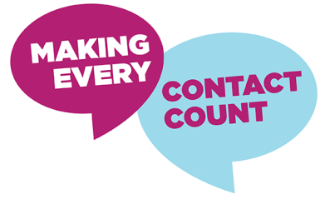
Making Every Contact Count?
Making Every Contact Count was established by the HSE in 2016 to support the implementation of Healthy Ireland in our health services and help people to make healthier lifestyle choices.
By Making Every Contact Count health professionals can encourage patients to make healthier lifestyle choices during routine contacts to help prevent and manage chronic diseases.
Irish Heart Foundation’s Mobile Health Unit
Find out more about Irish Heart Foundation’s Mobile Health Unit here

Slide 8

Contacts:
Roisin Guiry, HSE, Programme and Campaigns
roisin.guiry@hse.ie
Emma Lynam, HSE Press Office
emma.lynam@hse.ie

