Slide 1
DAPHNE
International Conference
Responding to Child-to-Parent Violence
Challenges for Practitioners
“Working with Adolescent’s who Engage in Substance Misuse”
NUI Galway
12th June 2014
Denis Murray M.A.
Family/Systemic Therapist
Registered with FTAI/ICP & EAP
Challenge
Change

Slide 2
Presentation Overview
Agency Context
CPV - Challenges for Practitioners
Approaches to Intervention
Case Examples
“In Search of Solutions”

Slide 3
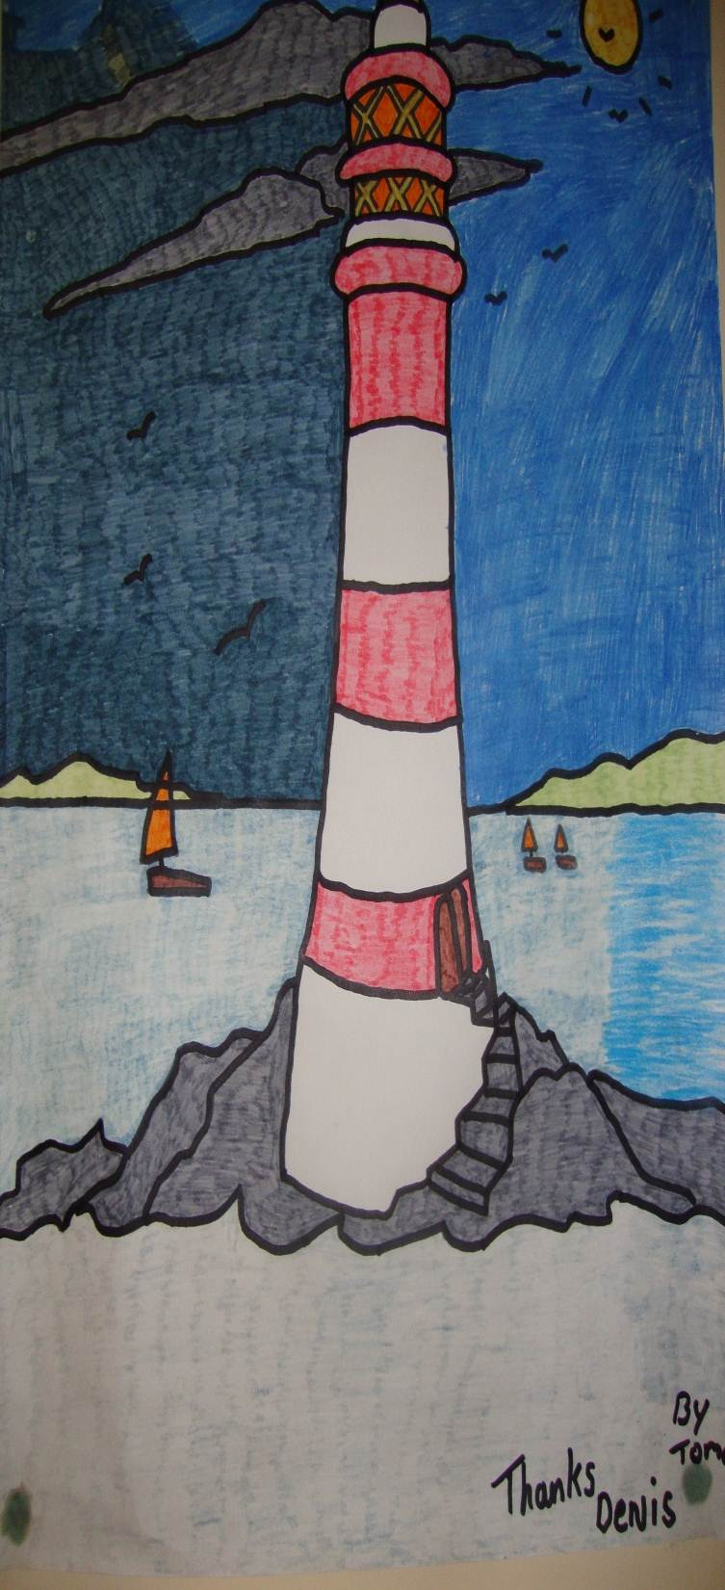
Adolescent Addiction Service
Established in 1997 by Health Service Executive in the South Western area of Dublin City (covering five communities) Operated initially as a structured outpatient detoxification programme involving methadone prescription for under 18yr olds who were experiencing problems in relation to heroin use.
In 2003 as the use of heroin decreased the service broadened its criteria to include young people who are abusing any substance including alcohol.
In 2004 the medical and therapeutic components of service separated. Family therapy is now provided outside of clinic setting.
In 2013 92% (N=49) seen by family therapist only. 8% (N=4) Psychiatric Assessment with 4% (N=2) receiving medication for treatment of ADHD.
Average age of attendees 2013 (15 years old, Range 12-18years)
© Denis Murray 2014

Slide 4
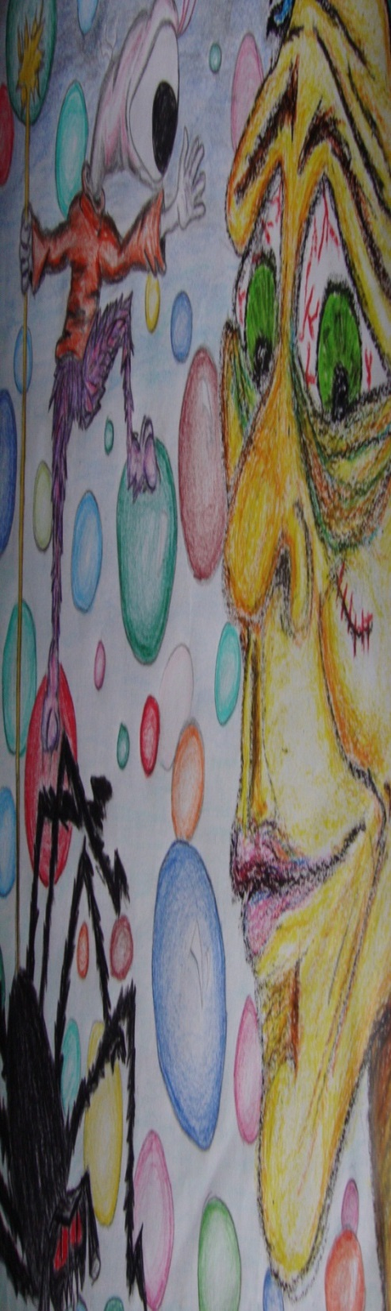
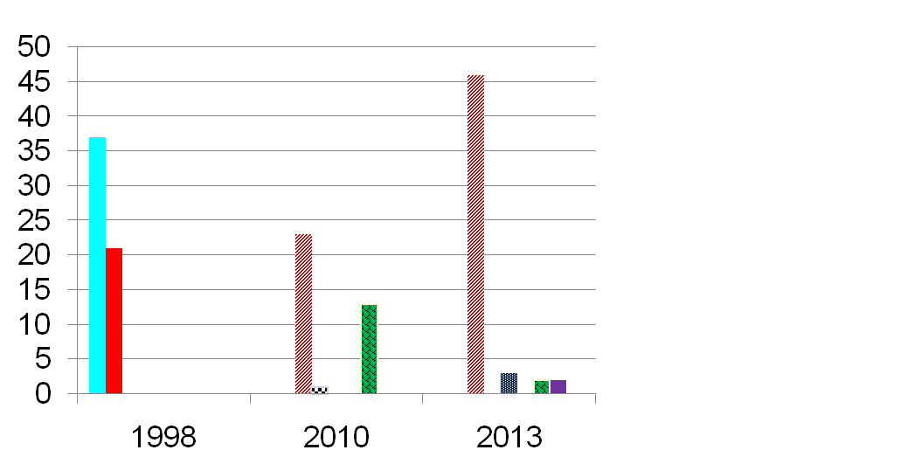
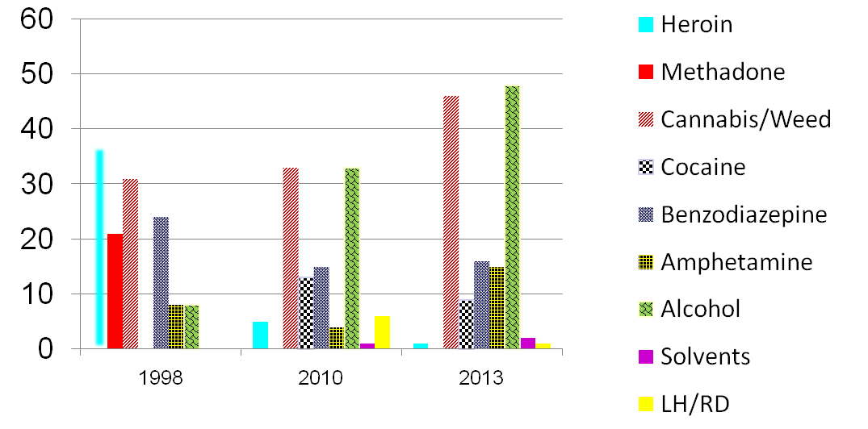
Average Age
1998 = 16.5yrs
2010 = 15.5yrs
2013 = 15 years
Percentage Female
1998 = 36.5%
2010 = 27%
2013 = 37%
Primary Drug Use
All Types of Drugs Used
© Denis Murray 2014

Slide 5
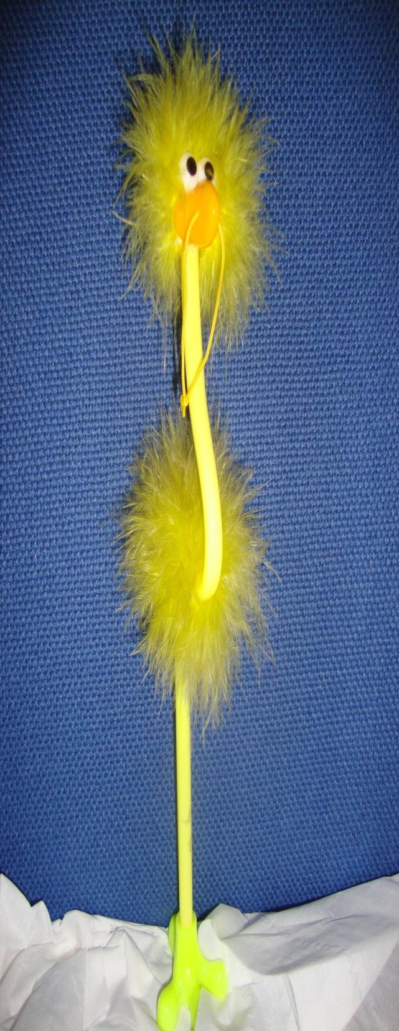
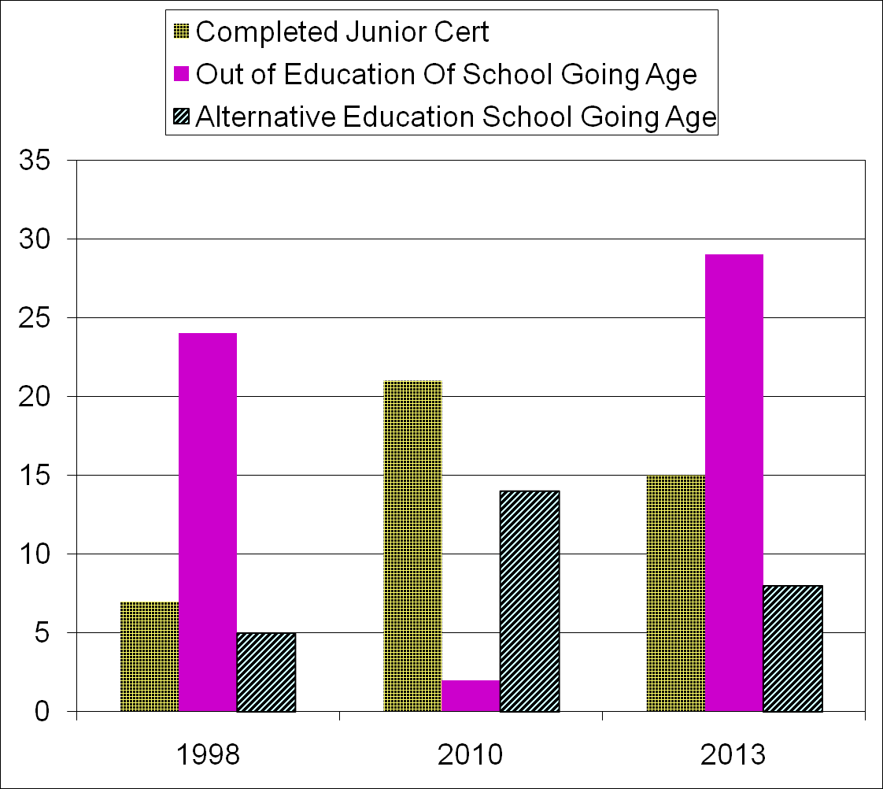
Participation in Education

Slide 6
Trends
© Denis Murray 2014

Slide 7

Challenges
For
Practitioners
Sexuality
Absconding
Indebtedness
Childhood Abuse/Neglect
Early School Leaving
Homelessness
8% CPV (2013)
Self-harm/Suicide ideation
Offending Behaviour
Challenging Behaviour
Adolescent Mental Health
Parental Separation
Parental Substance Use
Parental ill Health
Family Conflict
Poverty
Criminality
Prevalence Rates CPV
USA, Canada & Europe 5% - 13%
Calvete et al 2012.
Statistics Adolescent Addiction Service 2013
68% Parental SU (Including Alcohol)
26% Parents linked to Adult Addiction Service
29% Linked to Social Work
12% Child Protection
73% CAMHS ODB, OCD, ADD, Depression, Self-Harm
Attempted Suicide or Suicide Ideation
© Denis Murray 2014

Slide 8

Challenges
For
Practitioners
Indulgent
Family Types
Nuclear Family
Single Parent
Re-Constituted
Extended
Blended
Violent
Placating
Substance Using
Loving
Neglecting
Financially Stable
Impoverished
Overcrowding
Weak/Powerless
No Limits
Caring
© Denis Murray 2014

Slide 9
Child
Parent Violence
Parent
Abuse
Challenging
Behaviour
Physical
Slapping
Throwing
Verbal
Shouting
Challenging
Psychological
Lying
Threatening
Kicking
Hitting
Punching Walls
Swearing
Name Calling
Demanding
Discrediting
Mind Games
Financial
  Indebtedness
  Stealing
  Selling personal Items
CPV is a challenging concept as it does not fit within family violence discourse.
Belief that violent/abusive behaviour by children is a result of poor parenting or that it takes place only in poor and uneducated families?
Perception that substance abuse is the cause of CPV and family violence in general?
Within a Child Protection framework there is absence of guidelines and inconsistency of response

Slide 10
Challenges
For
Practitioners
Proactive Aggression
Egalitarian
Marital Disharmony
Get
Needs
Met
Sense
Of
Entitlement
Demanding
Parental Child
Distant
Or
Harsh
Parenting
Indulged
Parenting
Marginalised
Avoid
Harm
Survivor
Avoid
Limits
Parental Depression
Substance Use
Absent Parenting
Reactive
Aggression
© Denis Murray 2014

Slide 11
Challenges
For
Practitioners
Young Person
Absence of Parental Authority
Control
Empowered
Frustrated
Guilt
Shame
Lack of Belief/Skills
Parent
Fearful
Anger
Meeting Needs
Solves Problems
Powerless
Entitlement
Depressed
Self Preservation
Understanding Violent & Abusive Behaviour within Families

Slide 12
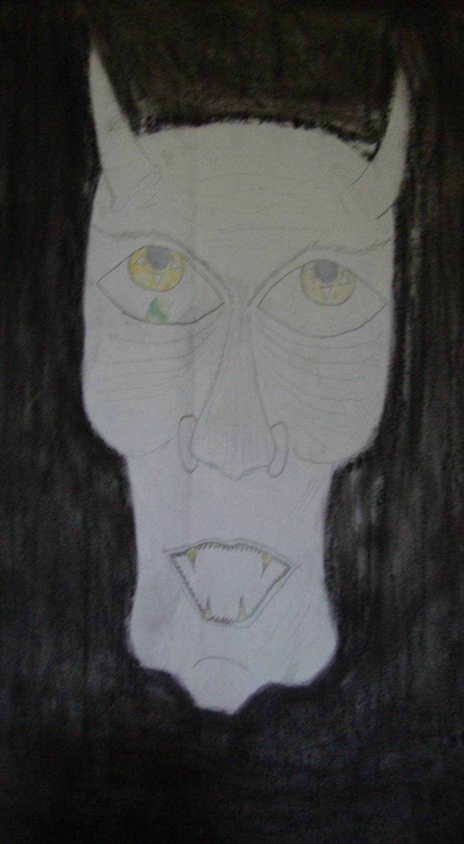
Challenges
For
Practitioners
Managing
Risk/Harm
Deaths of Young people Known to Social Services 2000-2010 (N=197) (Shannon & Gibbons 2012)
2010 - 2012 . There were 60 deaths of YPP in State Care (16 Suicides),(6 Drugs) (14 Accidents) (3 Murdered) (20 Natural Causes)
(National Review Panel, 2013)
Incidents of Suicide 2010 (495) 82% Male (Highest among 20-25 year olds and 15-20year olds.
Incidents of self-harm increasing (2012 shows a 20% increase on 2007 for males) (NSOP, 2012)
The challenge for professionals is to empower parents and to protect siblings in ways that does not result in youth perpetrators internalising anger and rage that may lead to it finding expression in suicide, self-harm or other risk behaviour

Slide 13
Approaches to Intervention
Young Person
Family
Avoid Blame
Address Ambivalence
Identify Child/Parent Patterns of Interaction
Address Substance use
Encourage Expression
Feelings/Emotions
Encourage Self Discipline
Anti- escalation strategies
Introduce Choice
Avoid internalisation
of Anger and Rage
Communication
Between Parents /Family
Behaviour not Person
Exceptions to
Behaviour
Reward -Responsibility
Reduce Entitlement
Encourage Achievement
Rewards/Consequences
Pro-social
Activity
Managing Expectations
Maintaining
Engagement
Empowerment
Relationship

Slide 14
Approaches to Intervention
First Order Change
Community
Of
Interest
Increase Awareness
among
Significant Others
Identify
and
Remove
Risk
Skills
Knowledge
Promote Stability
New
Experiences
Modelling Relationships
Second Order Change
Awareness
of Choice
Access
To
resources
Introduce
Protective
Supports
Improve
Communication
Building
coping
Capacity
Trust
Interrupt
Patterns
of
Interaction
Humour
Flexibility
Direct
Intervention
Imagination
Creativity
Hope
Understanding
Behaviour
Beliefs
Relationships
Perceptions
© Denis Murray 2014

Slide 15
X
X
X
Estranged
Illnesses
Sessions
Parents & YPP
Family without YPP
YPP alone
Family without YPP
YPP Alone
Mother + youngest
Father Alone
YPP alone
Parents together x 2
YPP alone
YPP alone
Family without YPP
Entire family
(Timeline 7months)
45
46
Employed
Employed
21
19
17
14
Now Sharing Room
Were Sharing Room
Interventions
Protect Youngest Child (Safe Sleeping Space)
Consider consequences for YPP if assault repeated
Elevate Concern for Behaviour (Anti-escalation steps)
Reconciliation (Acknowledge Absence of Care – Black Sheep Role)
Distinguish between Parenting Role/Parent Relationship
Establish Parental Authority - Communication – Agreed Approach
Boundaries RE Drug Use /Possession in home
Reward Positive Behaviour
School Contract
Family approach to bring YPP in from Margins
Expectation that all siblings do chores appropriate to their age
Increase Fathers Participation in Home/Time out for Mother
ISSUES
YPP assaulted youngest sibling
YPP 3year history daily Cannabis/Weed usage
Parents had ignored cannabis use even in home
YPP Challenging – Verbally abusive & Damaging Property
Absence of parental Authority/Supervision
YPP Poor Attendance at School and Challenging Behaviour
YPP Assaulted other within Community
History of YPP not safe in Community (age 14yrs)
Parents distracted by Bereavements/Illnesses
Parents distancing/Not Communicating (Lifecycle Issues)
Eldest Have sense of Entitlement (Were Indulged)

Slide 16
Case Example
X
X
X
X
X
43
38
Parent Support Group
House Move
2002
House Move
2004
House Move
2010
15
11
Respite
(Agreed with YPP
CAMHS
Social Work
Addiction Service
Interventions
Naming what is happening
Acknowledging past events (Grief, Loss, Moves etc.)
Expectation that abusive behaviour will stop
Respite for sibling (Safety – Space – Personal Needs)
Mother Parent Support Group (In absence of informal support)
Mother non – confrontational /de-escalatory approach
Report YPP when missing(to Garda – Social Work)
Reality Check Family Finances (Budgeting)
YPP Access alternative Education (Dropped Out)
YPP reacting to structure/expectation
YAP worker (Re-engage interests, Break Cycle SU)
YPP dropped out Adolescent Addiction Service
Letter to YPP CC; Parent & others (Reflect Patterns)
YPP Accessed 2nd Alternative Education Programme
(Receives payment- Expected Pay own debts)
YPP returned further sessions AAS (Reflective )
Expectation that YPP reduce SU (Allowance pay for own debts)
YPP Responsibilities appropriate to their age
ISSUES
YPP History of Self-harm (CAMHS 4yrs)
Sibling overdose Referred CAMHS leading to referral AAS
Sibling withdrawn & missing school
YPP Cannabis use in family home (2yrs)
Absence of parental authority/supervision YPP out over night
YPP Expectation that parent pays drug debts and funds habit
YPP Challenging – Verbally/ Physically destructive of Property
Absence of parental supports (No Extended Family)
Mother Conflicted - funding YPP SU out of fear of self-harm
YPP Non Attendance at School(10months)
Family finances strained

Slide 17
Case Example
History of Substance abuse
History of Substance abuse
35
Alcohol Abuse
(Methadone Maintenance)
Not Revealed for 5 months
Died as a result of drug use
(when YPP age 3yrs old)
2
Community
Addiction Support
1
Interventions
Address Behaviour
Elevate Concern for YPP
Engage Extended Family
Engage Social Work
Security of Accommodation
Expect YPP return home
Adult presence in home
Reporting when Missing
Attendance Education
Regular Screens SU
Parent stability/support
Explore Past Events
Envision Future
Awareness of Choices
ISSUES
YPP Cannabis-Cocaine-Ecstasy-Alcohol
YPP Challenging-Verbally /Physically Abusive (Mother)
Absence of parental authority/Supervision
Absent parenting (drinking - meeting friends)
YPP not returning or returning to empty house
YPP Non School Attendance
Parent Guilt/Indulgence
Family Secrets (Mothers SU/Maintenance)
14
Adolescent
Addiction
Service
Community
Ed-Project
Youth
Service
Social Work

Slide 18
Case Example
3
Engaging and Supportive
Non-Engaging
4
35
30
38
34
2
10
1
11
6
3
16
INTERVENTIONS
Decisions re-debts (Not giving into demands)
Shared Care (Father) - (Grandparents) - (Mother)
Adults not participating in Retaliatory Behaviour
(No Put Downs or Name Calling, e.g. Scum, Junkie)
Communication – Community of Interest
Expectation Return Home (Report Missing)
Making Presence (Grandparent at party)
Expectation School
Expectation re self care
Reward Positive Behaviours
Individual meetings - Parents/Concerned Adults
Reflect on impact of Parental Separation
ISSUES
Smoking Cannabis/Weed daily
Physically Destructive – Verbally Abusive
Indebted/Sense of Entitlement (Demanding Money)
People calling to home (intimidating)
Poor School Attendance
Staying out over-night and for days
Rejecting mothers partner
Alienated from Father
Parents Estranged (No Joint Consultations)

Slide 19
References
Calvete, E. Orue, I & Gamez-Guadix, M. (2012) ‘Child-to-parent Violence: Emotional and Behavioural Predictors’ Journal of Interpersonal Violence, 28 (4) pp. 755-772.
Coogan, D. (2011) ‘Child-to parent Violence: Challenging Perspectives on Family Violence’, Child Care in Practice, 17 (4) , pp. 347-358.
Gallagher, E. (2004) ‘Parents Victimised by their Children’ Australian & New Zealand Journal of Family Therapy (ANZJFT) 25 (1), pp. 1-12.
Gallagher, E. (2004) ‘Youth Who Victimise Their Parents’ Australian & New Zealand Journal of Family Therapy (ANZJFT) 25 (2), pp. 94-105.
Ibabe, I. & Jaureguizar, J. (2010) ‘Child-to parent Violence: Profile of abusive adolescents and their families’ Journal of Criminal Justice, 38, pp. 616-624.
National Office for Suicide Prevention (2012), Annual Report. Available at: http://www.nosp.ie/
National Review Panel (2013) Annual Report 2012. Available at: http://www.lenus.ie/hse/bitstream/10147/313498/1/nrpannrpt12.pdf
Shannon, G. & Gibbons, N. (2012) Report of the Independent Child Death Review Group 2000-2010. Dublin : Government Publications. Available at: www.drugsandalcohol.ie/17774
Stott, J. McKenna, M. & O’Connor, R. (2013) The Walking on Eggshells Project “Child and adolescent violence and abuse in the family” Enhancing Justice – Empowering Victims, Victim-Support-Service, Conference, Adelaide, Australia, 26-27 September, Available at: http://www.victimsa.org/files/mary-mckenna,-jeannette-stott--rosalie-oconnor.pdf
Weinblatt, U. & Omer, H. (2008) ‘Nonviolent Resistance: A Treatment for Parents of Children with Acute Behaviour Problems’, Journal of Marital & Family Therapy, 34 (1), pp. 75-92.
Wilcox, P. (2012) ‘Is Parent Abuse a Form of Domestic Violence?’ Social Policy & Society, 11 (2), pp. 277-288.

Slide 20

Thank you for your attention.
© Denis Murray 2014

