Slide 1
Fetal Alcohol Spectrum Disorders: A Whole Body
Diagnosis
Dr Moira Plant
Emeritus Professor of
Alcohol Studies
University of the West of England
Bristol
Adjunct Professor
Curtin University
Perth
Australia

Slide 2
Outline of Presentation
International View
Brief Overview of Diagnosis
Behavioural Problems by Age
Physical Problems
Transgenerational Aspects

Slide 3
Pooled prevalence of alcohol use during pregnancy in general population for select countries
(Any amount of alcohol consumed and at any point during pregnancy)
*The prevalence for countries with an asterisk are based on actual data
With kind permission Popova et al., submitted
Notes:
3
This slide presents data on alcohol use during pregnancy in GENERAL POPULATION by select countries (high-risk populations (Aboriginal populations, heavy drinking women, etc., were excluded!)

Slide 4
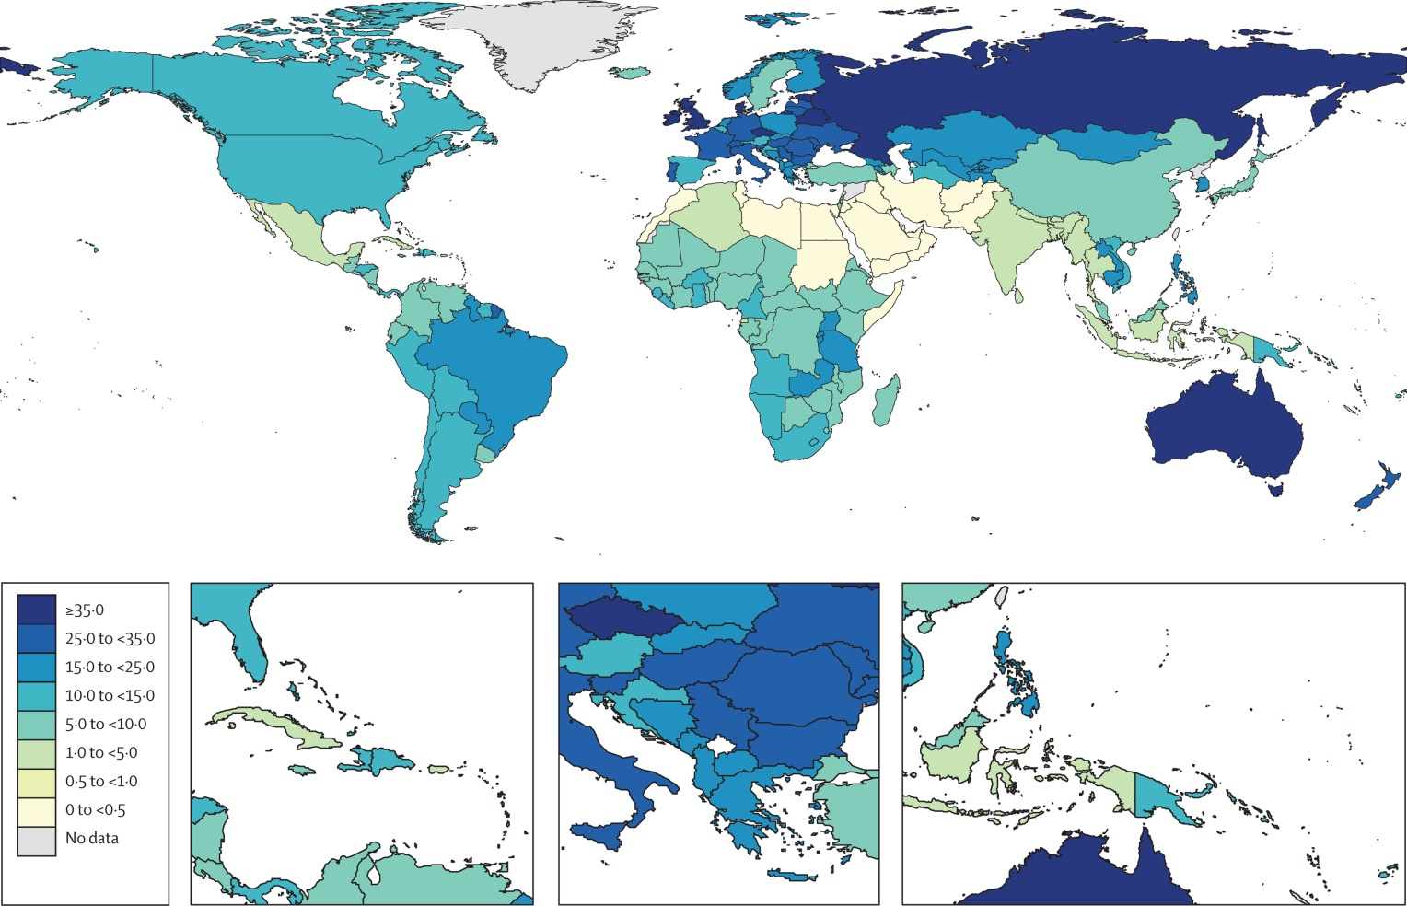
Estimation of national, regional, and global prevalence of alcohol use during
pregnancy and fetal alcohol syndrome: systematic review and meta-analysis
Figure 2
Popova et al 2017 The Lancet Global Health Open Access article
Notes:
Global prevalence (%) of alcohol use (any amount) during pregnancy among the general population in 2012

Slide 5
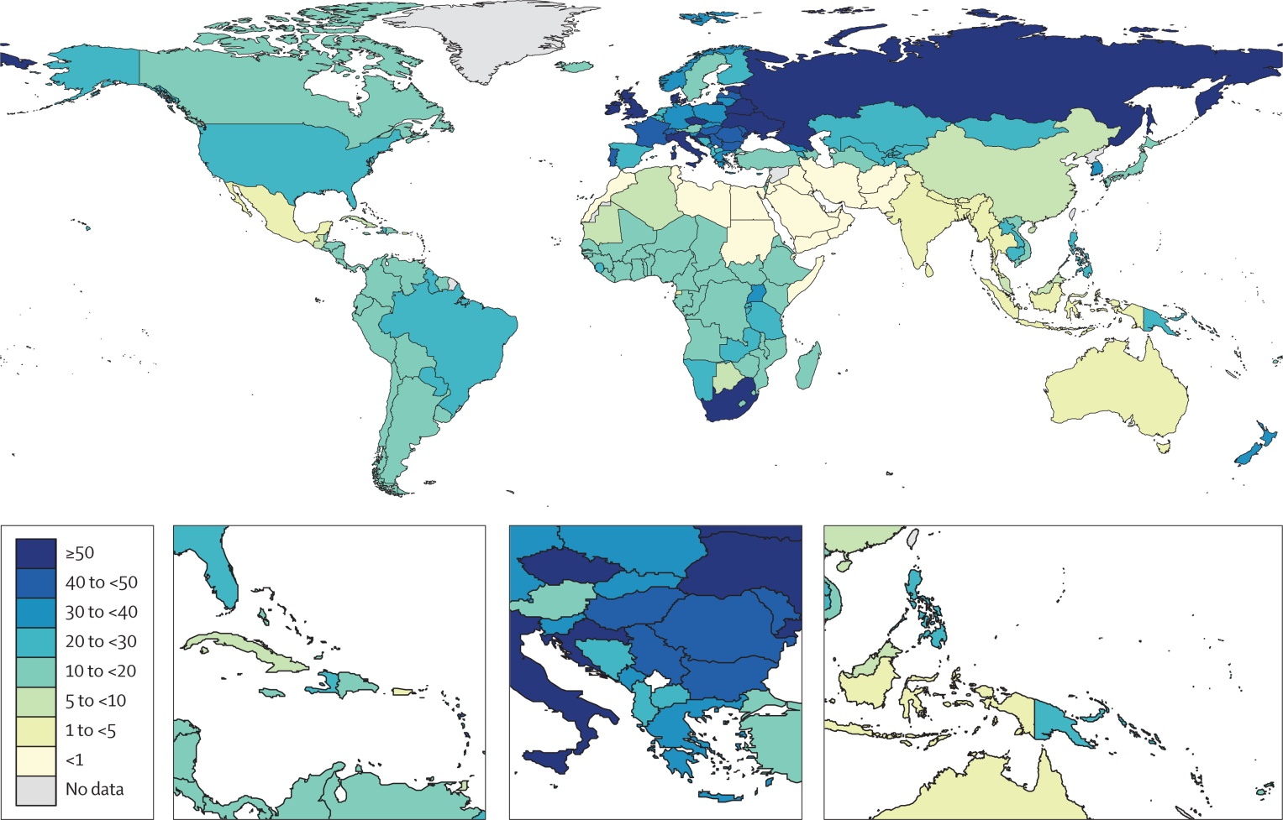
Global prevalence (per 10 000 people) of FAS among the general population in 2012
Figure 4
The Lancet Global Health DOI: (10.1016/S2214-109X(17)30021-9)
Popova et al 2017 The Lancet Global Health Open Access article
Notes:
Global prevalence (per 10 000 people) of FAS among the general population in 2012

Slide 6
Diagnostic Criteria
Based on four measures;
1) Growth
        Short in length
        Light in weight
        Smaller than normal head circumference
2) Facial features
3) Brain
4) Maternal Drinking History
www.cdc.gov/fasd

Slide 7
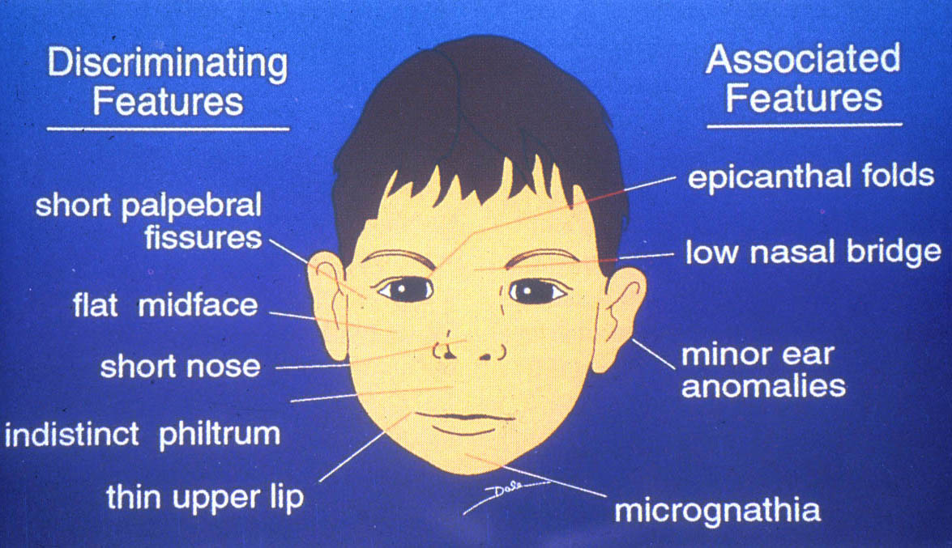
FAS FACIAL FEATURES
Streissguth, 1994

Slide 8
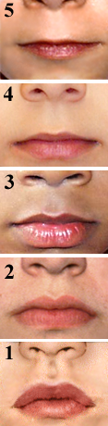
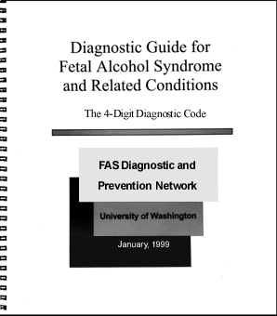
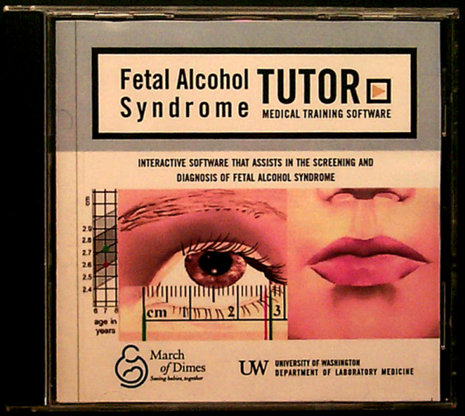
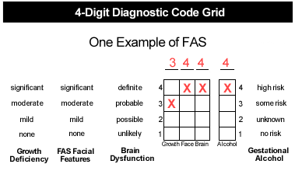
FAS Diagnostic Guide and CD-ROM

Slide 9
DSM-5 - bad news and good news
Bad news Neuro-Developmental Disorders Pre-natal Alcohol Exposure (ND-PAE) failed to be listed in the DSM-5.
Good news It is included in the appendix as “conditions needing further study” (page 798).
Good news is that ND-PAE is used as an example for “Other Specified Neurodevelopmental Disorder,” code 315.8 (page 86).
American Psychiatric Association (2013) Diagnostic and statistical manual of mental disorders (5th ed). Arlington, VA: American Psychiatric Publishing.

Slide 10
Simple View of Causation
    An individual child’s risks of FASD are influenced by;
    Quantity of alcohol consumed by mother during pregnancy.
    Pattern of alcohol consumption.
    Frequency (how often) the mother drinks.
    Timing of drinking in relation to period of gestation.
(Goodlet Horn and Zhou 2005)

Slide 11
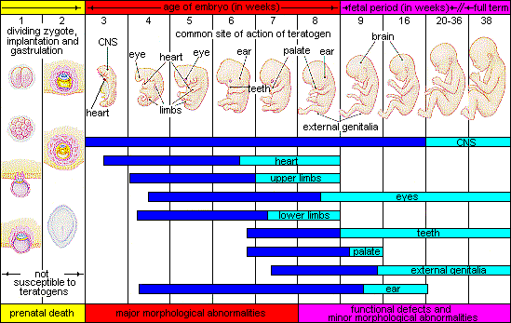
Critical Periods of Human Development
Moore et al 1988

Slide 12
Behavioural Aspects by Age

Slide 13
Birth to 36 months
May have been diagnosed as “failure to thrive” (one of many diagnoses given over time).
Difficulties with feeding.
Difficulties in establishing a regular sleeping pattern.
Irritability very active/hyperactive.
Frequent bouts of illness.
Delay in reaching milestones.
Indiscriminate, people are interchangeable.
FAS/FAE Support Network
Vancouver

Slide 14
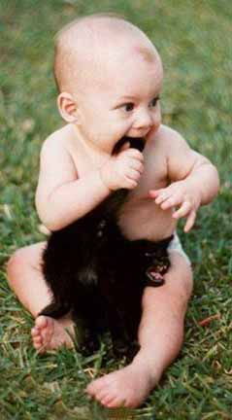
Failure to grasp
cause and effect

Slide 15
Three to Five Years
Easily overwhelmed.
Frequent lengthy temper tantrums.
May be physically aggressive.
Reacts badly to and resists change.
Unable to learn from experience.
Accident prone.
Fearless/unable to comprehend danger.
        FAS/FAE Support Network
Vancouve r

Slide 16
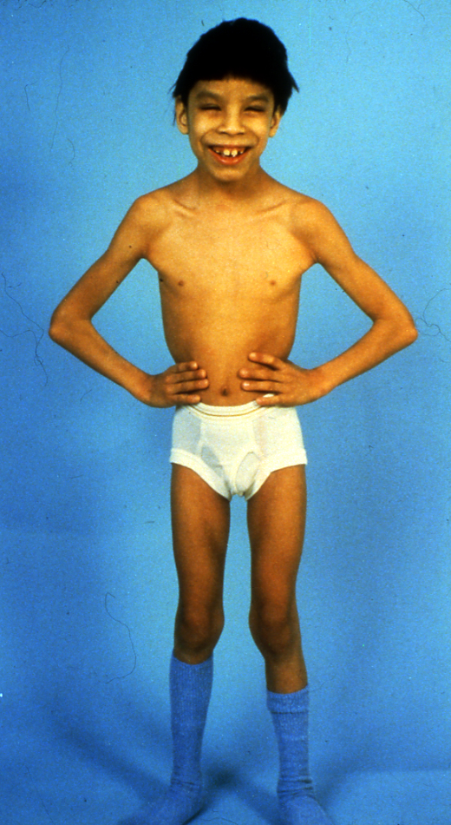
Six to Ten
  Visual memory better than auditory memory.
Information seems to “slip in and out” Remembers today, forgets tomorrow and remembers again next week. Interpreted by teachers?
  Difficulty separating fact from fantasy.
FAS/FAE Support Network
Vancouver
Adam

Slide 17
Eight to Ten Years
Mood swings
Difficulty with self-regulation
Problems with planning and the sequencing needed in a lot of tasks
Needing constant reminders for basic living tasks
Confabulating
Andrew G (2011)”Diagnosis of FASD: An Overview” in Fetal Alcohol Spectrum Disorder: Management and Policy Perspectives of FASD Chapter 5 Riley, Clarren and Weinberg and Jonsson (Eds) Weinheim Wiley-VCH

Slide 18


Slide 19
Ten to Fourteen
Initially may be seen as intelligent based on language skills.
Lots of words but quantity masks quality.
Speech problems e.g. stammering.
Gets lost quickly in conversation and loses interest.
Trouble following directions.
Little understanding of social norms.
Increased risk of drink/drug use.
FAS/FAE Support Network
Vancouver

Slide 20
Fourteen to Eighteen
No sense of personal space or boundaries.
May be sexually inappropriate/does not understand risks.
Overly affectionate with people s/he does not know well.
May be teased or bullied by other adolescents.
May bully or frighten others.
Moves through extremes of behaviour in a short space of time.
May be diagnosed as “Conduct Disorder“.
Burns people out.
FAS/FAE Support Network
Vancouver

Slide 21
Adult
Judgement and critical thinking are poor
Lacks social skills either aggressive or withdrawn
Blames others for own mistakes
Involved in criminal activity
Difficulty in keeping a job
Abusive relationships
Mental health problems Counselling?
    Depressed/ suicide attempts
    Anxious
FAS/FAE Support Network
Vancouver

Slide 22
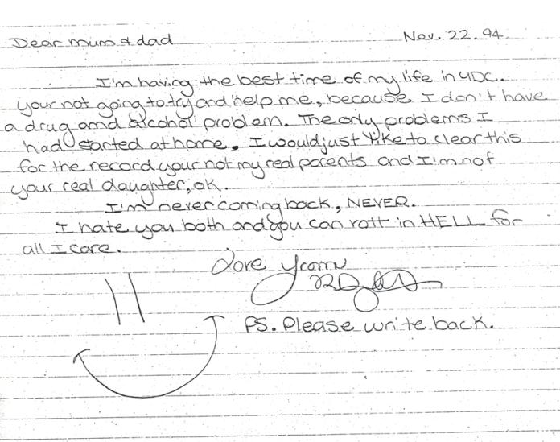

Slide 23
Comorbidity of Fetal Alcohol Spectrum Disorders:
Physical Problems

Slide 24
Comorbidity of Fetal Alcohol Spectrum Disorders
Two studies;
  Systematic search for studies reporting comorbid conditions in individuals with one or more of the an conditions included under the umbrella term FASD.
  A Canadian study describing a survey of adolescents and adults with a diagnosis of pre-natal alcohol exposure.

Slide 25
Comorbidity of FASD
The objectives of the study were to:
Identify the comorbid conditions that occur among individuals with FASD.
Estimate the pooled prevalence of comorbid conditions found to occur among individuals with FAS
Popova, S. et al (2016). Comorbidity of Fetal Alcohol Spectrum Disorder: a systematic review and meta-analysis. The Lancet, 387, 978-8.
Notes:
First, I will present the results of our recently published (in Jan of this year) paper in The Lancet on comorbidity of FASD.
We all know that FASD is associated with many comorbidities (physical and mental disorders) due to the permanent damage of PAE on the fetus.
However, what we did not know is how many diseases, what type of diseases and with what frequencies they occur in the individuals with FASD.

Slide 26
Preliminary Results of A Health Survey of Adults with an FASD
A group of young people began to talk amongst themselves about the physical problems they had
Being young people they thought the best way to do this was using the internet.
With the help of colleagues Profs Joanne Weinberg and Ed Riley designed a questionnaire.
Their aim was to develop the idea of FASD being a “whole body diagnosis”

Slide 27
Preliminary Results of a Health Survey of Adults with an FASD
The survey includes over 260 items in 26 areas including;
    Auto-immune Disorders.
    Immune Problems.
    Heart Problems.
    Problems with Bones, Muscles and Joints.
    Vision/Hearing.
    Endocrine Disorders
      Thyroid
With kind permission of Himmelreich, Lutke & Travis 2016

Slide 28
Preliminary Results of a Health Survey of Adults with an FASD
Sensory Problems.
Seizures.
Sleep Disorders.
Problems with Executive Function.
Mental Health.
With kind permission of Himmelreich, Lutke & Travis 2016

Slide 29
Preliminary Results of a Health Survey of Adults with an FASD
Number of respondents = 356
  Ages:
      16-19 24.4%
      20-30 41.6%
      31-40 20.9%
      41-50 7.6%
      51- 59 3.9%
      Over 60 2.0%
With kind permission of Himmelreich, Lutke & Travis 2016

Slide 30
Preliminary Results Of A Health Survey Of Adults With An FASD
Gender
      Female 53.7%
      Male 44.1%
      Other 1.1%
      Rather not say 1.1%
With kind permission of Himmelreich, Lutke & Travis 2016

Slide 31
Preliminary Results Of A Health Survey Of Adults With An FASD
Diagnosis
  FAS
  pFAS
  ARND
  FAE
  Static
  Encephalopathy
48.6%
9.7%
22.4%
9.7%
9.7%
Each respondent was asked and supplied the name of physician and/or clinic where the diagnosis was made.
With kind permission of Himmelreich , Lutke & Travis 2016

Slide 32
Preliminary Results of a Health Survey of Adults with an FASD
Auto-Immune Disorders
Rheumatoid Arthritis: 12 x higher than general population.
Celiac Disease 4 x higher than general population.
Crohn’s Disease 4 x higher than general population.
With kind permission of Himmelreich , Lutke & Travis 2016

Slide 33
Preliminary Results of a Health Survey of Adults with an FASD
    Immune Problems
    Asthma 4 x higher than general population
    Allergies (any) 1 x higher than general population
    Carrying an Epi-pen 4 x higher than general population
With kind permission of Himmelreich , Lutke & Travis 2016

Slide 34
Preliminary Results of a Health Survey of Adults with an FASD
    Immune Problems
    Chronic Sinusitis: 3 x higher than general population.
    Chest Infections: 2 x higher than general population.
    Chronic Ear Infections (adults): 142 x higher than general population.
With kind permission of Himmelreich , Lutke & Travis 2016

Slide 35
Preliminary Results of a Health Survey of Adults with an FASD
Heart Problems
    Congenital Heart Defects: 23 x higher than general population.
    Child Heart Surgery: 15 x higher than general population.
    Hypertension (ages 18-44 years) 2 x higher than general population.
    Supraventricular Tachycardia 27 x higher than general population.
With kind permission of Himmelreich , Lutke & Travis 2016

Slide 36
Preliminary Results of a Health Survey of Adults with an FASD
Bones, Muscles, Joints
Scoliosis: 7 x higher than general population.
Joints always hurt, “make a noise”: 3 x higher than general population.
Osteoarthritis: 4 x higher than general population.
Gout: 10 x higher than general population.
With kind permission of Himmelreich , Lutke & Travis 2016

Slide 37
Preliminary Results of a Health Survey of Adults with an FASD
Problems with Hearing
Hearing Loss as Children: 75 x higher than general population
Often leading to problems at school
With kind permission of Himmelreich , Lutke & Travis 2016

Slide 38
Preliminary Results of a Health Survey of Adults with an FASD
                Thyroid Disorder
                Hypothyroidism (clinically evident): 160 x higher than general population.
                Hyperthyroidism: 4 x higher than general population.
    With kind permission of Himmelreich , Lutke & Travis 2016

Slide 39
Preliminary Results of a Health Survey of Adults with an FASD
Sensory Problem
Acute Sense of Smell: 55 x higher than general population.
No sense of smell: 9 x higher than general population.
Doesn’t like the texture of food: 54.2%
Do not feel hunger: 35.2%
With kind permission of Himmelreich , Lutke & Travis 2016

Slide 40
Preliminary Results of a Health Survey of Adults with an FASD
          Seizures Disorders: 21 x times higher than the general population
With kind permission of Himmelreich , Lutke & Travis 2016

Slide 41
Preliminary Results of a Health Survey of Adults with an FASD
Sleep Disorders
Problems Falling Asleep: 7-14 x higher than general population.
Problems Staying Asleep: 6-11 x higher than general population.
Sleep Apnoea: 6 x higher than general population.
With kind permission of Himmelreich , Lutke & Travis 2016

Slide 42
Preliminary Results of a Health Survey of Adults with an FASD
Executive Function
Problems with Short Term Memory: 79.80%
Problems with Long Term Memory: 69.30%
Problems Paying Attention: 88.30%
Problems Making Decisions: 86.0%
With kind permission of Himmelreich , Lutke & Travis 2016

Slide 43
Preliminary Results of a Health Survey of Adults with an FASD
Executive Function
Difficulty with judgement 80.7%
Difficulty understanding what people say to you 68.80%
Difficulty understanding what you read 68.30%
With kind permission of Himmelreich , Lutke & Travis 2016

Slide 44
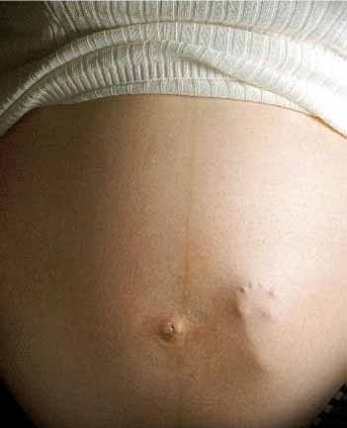
Sensitivity
Emotionally loaded
Carries with it
Moral judgements
A view of women as
nothing more than vehicle
for the next generation
WOMEN DO NOT
GET PREGNANT
ALONE!!!!!!!

Slide 45
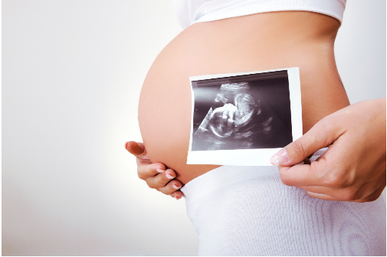
The egg that made you was developing in your mother
when she was a 6 weeks old embryo in your
grandmother.
Not only does prenatal experience count but
pre pre natal experience counts.
Courtesy of Dr Chris Loocke

Slide 46
Contact Details:
Moira.Plant@uwe.ac.uk

