Slide 1
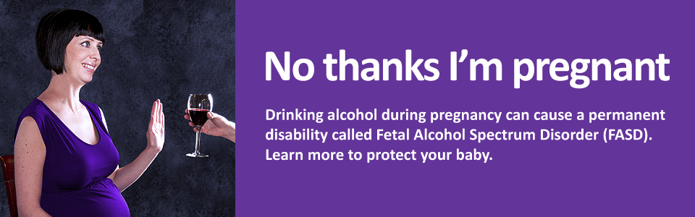
Alcohol Misuse In Pregnancy.
Changing attitudes and developing pathways
Justin Gleeson
Drug Liaison Midwife, HSE Addiction Service.

Slide 2
AIM
Insight into the role Drug Liaison Midwife
Alcohol in pregnancy- An overview
Current management of Alcohol use in pregnancy in Dublin
Case study review

Slide 3
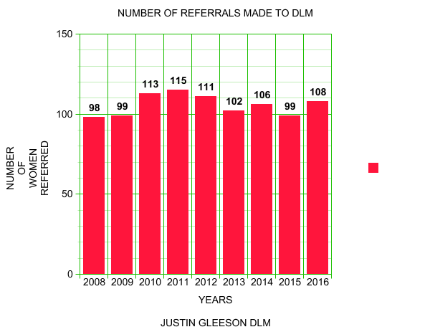
Background
Drug Liaison Midwife- Established in 1999
HSE – ROTUNDA HOSPITAL

Slide 4
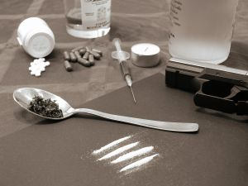
Common Drugs Of Addiction Seen In The Maternity Setting In Dublin
Opiates – Heroin, Morphine, Codeine and Methadone.
Cocaine
Benzodiazepines
Hypnotics
Cannabis
Amphetamines
Alcohol
Tobacco

Slide 5
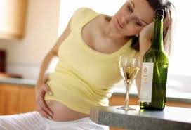
Alcohol In Pregnancy
Alcohol use during pregnancy is one of the leading preventable causes of birth defects and developmental disabilities (Centres of Disease and Prevention 2012).
“Of all the substances of abuse (including cocaine, heroin and marijuana), alcohol produces by far the most serious neurobehavioral effects on the fetus”.Institute of Medicine Report to Congress 1996
Alcohol is a known teratogen

Slide 6
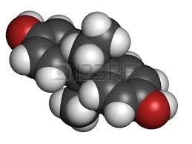
Known Teratogen
Alcohol is a teratogen (poison) that interferes with the normal development of the developing fetus causing cells to die or mutate. Teratogens can cross through the placenta. Other teratogens include:
  - Radiation exposure from x-rays and uranium.
  - Infections such as German Measles (Rubella), and Herpes Simplex virus.
  - Chemicals such as mercury and lead.
  - Drugs such as Thalidomide, Valproic Acid (an anticonvulsant drug), and Alcohol.

Slide 7
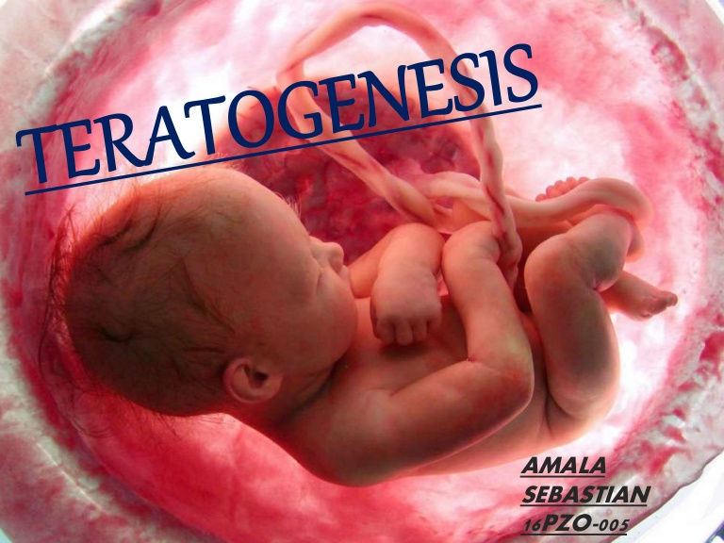
The teratogenic impact of alcohol on the brain
Depends on:
Timing of exposure
Amount of alcohol
Maternal factors (alcohol use history, age)
Fetal susceptibility
Genetic factors
Environmental factors

Slide 8
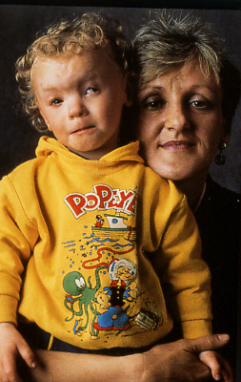
Alcohol can cause permanent damage to a baby before most women even realize they are pregnant.

Slide 9
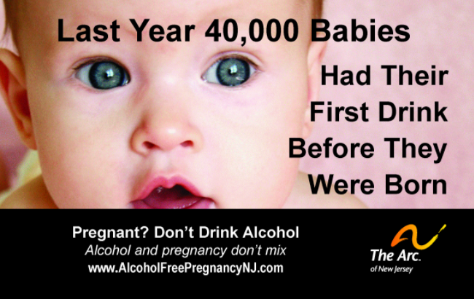
1 in 100 babies are estimated to be born with alcohol-related damage, according to the World Health Organisation, though this figure is higher in several countries.
More than 75% of Irish women’s pregnancies involve exposure to alcohol despite warnings about the health effects of drinking.
British Medical Journal 2015

Slide 10
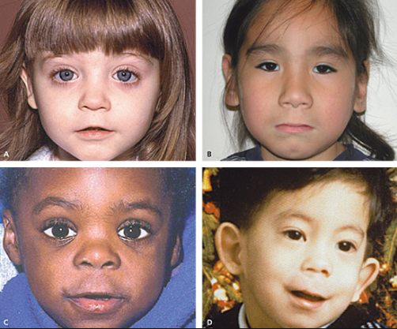
100% PREVENTABLE and 100% IRREVERSIBLE

Slide 11
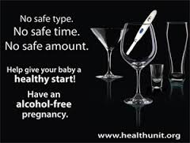
FAS/FASD
Multiple studies have shown that even low levels of prenatal exposure to alcohol can have adverse effects on fetal development.
Professor Peter Hepper Queens University Belfast
The only certain way to avoid the risk of FASD, is to abstain from drinking alcohol during pregnancy.

Slide 12
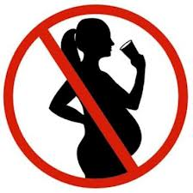
NO ALCOHOL = NO RISK

Slide 13
What Can We Do?
To provide accurate and consistent information.
- Advertisements
- Information Booklets
- www.askaboutalcohol.ie
Antenatal Brief Interventions
Develop pathway to care for women with a history of alcohol misuse and alcohol dependency

Slide 14
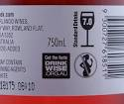
Advertisement campaigns
British Medical Association(2015) call for stricter Government advice and “more explicit” warnings of the risks of alcohol to developing babies.
Became law in France in 2007
In 2013 the Alcohol Beverage Federation of Ireland called for mandatory pregnancy warning labels on all Alcoholic drinks.
Foetal Alcohol Syndrome Aware UK - YouTube
https://youtu.be/kk3i3kl_4yQ

Slide 15

Antenatal Brief Interventions
Studies have produced conflicting evidence with Sheehan et al (2014) reporting that the pregnancy itself acts as an incentive to reduce alcohol use and not the brief intervention.
However BMJ publication indicates otherwise.
HSE-Making Every Contact Count....engaging health
professionals in preventative activities as part of their routine clinical consultations.
SAOR MODEL
Refer to specialist services

Slide 16

Current Management of Alcohol Dependent women
DOVE Clinic Rotunda.
Early booking visits and USS.
Detailed fetal anomaly scanning.
Routine booking bloods
Hepatitis C screening
Assess levels of Drug and Alcohol use
Brief Interventions
Motivational Interviewing
Refer to Inpatient Services if required for those who a alcohol dependent
Refer to Community Services
Educate re possibility of NAS/FASD.
Refer to Medical Social Worker
Child protection

Slide 17
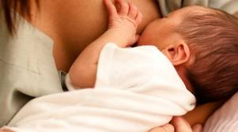
POSTNATAL MANAGEMENT
Separating mother and baby should be avoided if at all possible.
Monitor for withdrawal symptoms.
Inpatient for five days.
Treatment of NAS in NICU.
Observe for signs of FAS.

Slide 18
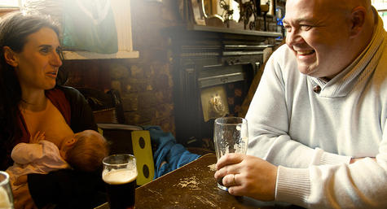
Babies Are Also Vulnerable
While Breastfeeding
• A breastfeeding baby takes in alcohol, too, in the
breast milk of a mother who drinks.
• If a breastfeeding mother has four alcoholic drinks in a day, the alcohol her baby takes in may impair motor development – the baby’s ability to roll over, to sit, to crawl, and to walk.
Advise women to pump and store their milk before having a drink, then feed their baby expressed milk from a bottle.

Slide 19

CHILD PRETECTION
Pre-Birth Case Conferences
Case Conference
Care Orders.

Slide 20
CASE STUDY 1: MARY
Age 37. G3 P1+1
Hx of Alcoholism since aged 28 with long periods of remission-functioning alcoholic.
Relapsed early pregnancy –1 bottle Vodka/day
Family break-up...New partner also drinker
Had 1st trimester Librium detox in Cuan Mhuire and referred to DLM/DOVE Clinic
Complex Obstetric Hx...
Transferred to Ashleigh House in 2nd trimester
Regular antenatal attender
Delivered at 36/40 2.1KG
Returned to Ashleigh House with her baby to complete her programme.
KEY LEARNING: 1st Trimester detox- Structured Rehab Programme- Enabled continued antenatal care

Slide 21
CASE STUDY 2: SHARON
Age 35. G9 P6+2
Required an Em LSCS during previous pregnancy
Hx of Alcholism since aged 23 with short periods of remission.
Reported drinking 16 cans of larger per day at the day of booking visit
Partner also drinker-violent relationship. Little family support
Homeless. Children in foster care.
Also on Methadone Maintenance Therapy..poor attender
Referred to Cuan Dara for immediate detox first trimester.
Refused admission when bed became available
Commenced Librium detox with GP –Daily dispensing from local pharmacy.
Relapsed after three days and increased alcohol intake
Presented to DOVE Apts intoxicated regularly

Slide 22
CASE STUDY 2: SHARON
Referred to Beaumont Hospital as per client’s request
Refused admission to St Michaels Ward when bed became available.
3 Weeks later presented to ER Uterine Rupture at 29/40
Baby RIP 24 Hrs later.
DNA Post natal follow up.
Mother RIP 4/12 Later
KEY LEARNING: Harm Reduction

Slide 23
CASE STUDY 3: JOAN
Age 34. G3 P2
Hx of Alcholism since her early 20’s never accessed treatment services.
Reported drinking 5-6 cans of larger/night with larger amounts over the weekend
Homeless. Children in foster care.
Referred to St Michaels for Inpatient Alcohol detox at 21/40.
Bed offered but refused admission due to concealed benzodiazepines on admission.
Community Librium detox with GP with daily dispensing from pharmacy
Regular antenatal assessments in DOVE Clinic during detox
Referred to Stanhope Centre

Slide 24
Case Study 3: JOAN
Completed Community detox and was admitted into Stanhope Rehabilitation unit.
Completed Stanhope Programme
Attended all antenatal appointments
Delivered at 41+2...3.2KG
Case Conference.
Mother and baby returned home
KEY LEARNING: Multidisciplinary team effort

Slide 25

TAKE HOME MESSAGE
Alcohol is a known teratogen.
Moderate alcohol use is also dangerous
NO ALCOHOL= NO RISK
Immediate referral to specialist services

Slide 26
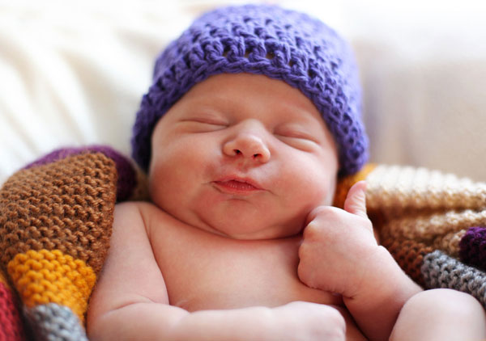
Thank you.
justin.gleeson@hse.ie / 087 2316271

