Slide 1


FASD in Ireland and first steps towards prevention
Prepared for Alcohol & Pregnancy Seminar Galway 26th Sep ‘17
Dr Mary T O’Mahony, Specialist in Public Health Medicine, HSE-S maryt.omahony@hse.ie

Slide 2
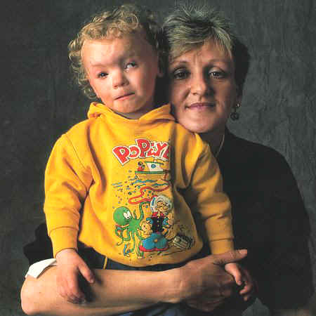
National Geographic Feb 1992
Used for education with the kind permission of George Steinmetz
http://www.faslink.org/national%20geographic%20-%20article%20on%20fetal%20alcohol.htm
Notes:
Give the story
Ask q – do you condemn her?

Slide 3
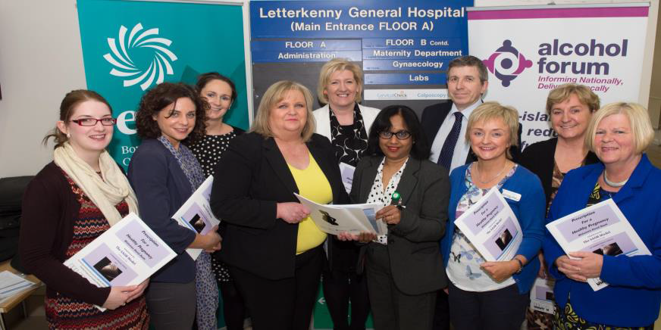
A new 'toolkit' for health professionals was launched in the antenatal clinic in Letterkenny General Hospital. The project, which aims to increase awareness of the health benefits to pregnant mums and unborn children of ceasing alcohol consumption entirely during pregnancy, Photo : L-R: Helen McFarland, ETB; Ciara Doyle, Project Lead, Hidden Harm, HSE/Alcohol Forum; Cora McAleer, Manager, Mental Health Addiction Services; Evelyn Smith, Asst Director of Nursing/Midwifery; Christina McEleney, Coordinator Tutor, University of Limerick Diploma in Drug and Alcohol Studies; Dr. Nandini Ravikumar, Consultant Obstetrician; Sean Murphy, General Manager, Geraldine Hanley, CMM2 Antenatal Education Coordinator; Moira Mills, Alcohol Forum; and Mary Kelly, Health Promotion Officer
From: Saolta-e-Newsletter-July-2015-pdf

Slide 4
MECC: Alcohol & Pregnancy
Sole remit of the GP, Midwife, Obstetrician, maternity service
Alcohol use during pregnancy is a clinical issue
Individual risk assessment
“By the time the woman gets to us, it’s too late”
Never too late to stop drinking during pregnancy
It is too late for an alcohol free pregnancy
Notes:
And an increasing problem

Slide 5
“Safe Limiting” in Pregnancy
- no such thing
FASD: alcohol causal, a co-factor, correlated
No amount of RoH absolutely safe
No amount of RoH absolutely dangerous
A relative risk of harm
Multiple mechanisms direct & indirect action
Fraternal twins with lesser effect in one
Maternal nutrition, maternal metabolism
Stop drinking – 2º prevention
Notes:
Abstain from alcohol entire prenatal period and while trying to conceive
Alcohol use by women is increasing in all socioeconomic groups (SEG), as is binge drinking especially among students and those of lower SEG
Any drink in pregnancy has the potential to reduce the child’s potential
Differing advice on alcohol use in pregnancy is problematic
140430 Medscape No alcohol is safe (wrt cancer)
With adequate nutrition physical features and neuro cognitive behavioural profile can change – moderation
The biological mechanisms that mediate alcohol-related cancer are not fully understood.[1] Alcoholic beverages can contain at least 15 carcinogenic compounds, including acetaldehyde, acrylamide, aflatoxins, arsenic, benzene, cadmium, ethanol, ethyl carbamate, formaldehyde, and lead. Ethanol is the most important carcinogen in alcoholic beverages,[5] and the rate of ethanol metabolism is genetically determined.[6]
The first and most toxic product of alcohol metabolism is acetaldehyde. Ingested ethanol is oxidized by the enzymes alcohol dehydrogenase, cytochrome P4502E1, and catalase to form acetaldehyde.[5] Acetaldehyde also occurs naturally in alcoholic beverages. This metabolite is carcinogenic and genotoxic. Alcohol is a folate antagonist, and an alteration in folate metabolism and folate malabsorption are believed to interact with ethanol to impair DNA methylation.[8]
5. Lachenmeier DW, Przbylski MC, Rehm J. Comparative risk assessment of carcinogens in alcoholic beverages using the margin of exposure approach. Int J Cancer. 2012;131:E995-E1003. Abstract
6. Seitz HK, Becker P. Alcohol metabolism and cancer risk. Alcohol Res Health. 2007;30:38-41, 44-47.
8. Hamid A, Wani NA, Kaur J. New perspectives on folate transport in relation to alcoholism-induced folate malabsorption-association with epigenome stability and cancer development. FEBS J. 2009;276:2175-2191. Abstract

Slide 6
PAE and FASDs
Alcohol crosses the placenta
  Complete pathway of exposure
Foetus swallows and excretes amniotic fluid
  Cycle of exposure
It’s the social norm to drink including when pregnant
  Societal factor
Notes:
Abstain from alcohol entire prenatal period and while breast feeding
Lean build or with adipose tissue
With adequate nutrition physical features and neuro-cognitive behavioural profile can change – moderation
2012 Study Foetal Alcohol Exposure and IQ at age 8 (cognitive score Wechsler intelligence Scale): evidence from a population-based birth-cohort study (4167 children) showed: foetal alcohol exposure influenced by mothers intake but also genetic variants in mother and in foetus (genotype). Four genetic variants (and a risk allele score based ont eh 4 variants) strongly related to lower IQ at age 8 – but only among mothers who drank (1-6 units per week during pregnancy) and not among mothers who abstained from alcohol during pregnancy.
Per allele effect estimates were -1.8 (95% CI = -2.63 to -0.97) probability p=0.00002
2012 J Perinatol Prenatal Alcohol Exposure, blood alcohol concentrations and alcohol elimination rates in the mother, foetus and newborn. “Alcohol elimination from the fetus relies on the mother’s metabolic capacity. Metabolic capacity among pregnant women varies eightfold (from 0.0025 to 0.02g /dl/hr, which may help explain how similar amounts of ethanol consumption during pregnancy results in widely varying phenotypic presentation of FASD. .. FASDs are highly recurrent and younger siblings have increased risk.”
Prenatal alcohol exposure: An important determinant of public health?
Can we reach a consensus?
Is PAE harmful to the foetus?
Is PAE safe for the foetus?
The precautionary principle – late lessons from early warnings.
Criteria for cause

Slide 7
Biological variability / outcome
Rate of breakdown of alcohol varies
  Genetic component to risk
Metabolism of alcohol
  Speed of intake
  On an empty stomach, with food, 2 hours after food
  Body composition
  Frequency of intake
  Amount consumed
  State of health
Notes:
Once it's consumed, alcohol (ethanol) is broken down into acetaldehyde and nicotinamide adenine dinucleotide (NADH) by the enzyme alcohol dehydrogenase (ADH).² The end product of alcohol breakdown is acetyl-CoA

Slide 8
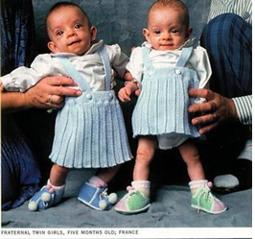
Notes:
Problem with conflicting advice. Given variable outcome conflicting advice is very understandable. Case of Fraternal twins. Identical twins are not born with identical birth weights.

Slide 9
PAE and FASDs: Causal criteria
  Evidence from true experiments in humans
  Association strong. Association consistent from study to study.
  Temporal relationship - cause precedes the effect
  Dose-response gradient
  Does the association make epidemiological sense?
  Does the association make biological sense?
  Is the association specific? FAS
  Is the association analogous to a previously proven causal association? Teratogenicity
Notes:
Absence of evidence isn’t evidence of absence
Teratogen an agent that causes developmental disabilities. National Geographic of February 1992 focused on Fetal Alcohol Syndrome.
The IARC Working Group confirmed that alcoholic beverages are “carcinogenic to humans” (Group 1), and concluded that the occurrence of malignant tumours of the oral cavity, pharynx, larynx, oesophagus, liver,
colorectum, and female breast is causally related to alcohol consumption. For renal-cell cancer and non- Hodgkin lymphoma the Working Group concluded that there is “evidence suggesting lack of carcinogenicity” for alcohol drinking.20

Slide 10
The biological implausibility of the Null Hypothesis
Alcohol declared a carcinogen by the IARC in 1988
Alcohol is a teratogen IOM 1996
Fulfils Causal Criteria*
*Bradford Hill Sir Austin. The Environment and Disease: Association or Causation? Proceedings of the Royal Society of Medicine, Section of Occupational Medicine Meeting January 14 1965.
Notes:
Fetal Alcohol Syndrome. Diagnosis, Epidemiology, Prevention, and Treatment. Kathleen Stratton, Cynthia Howe, and Frederick Battaglia, Editors
Committee to Study Fetal Alcohol Syndrome Division of Biobehavioral Sciences and Mental Disorders
INSTITUTE OF MEDICINE NATIONAL ACADEMY PRESS Washington, D.C. 1996
The committee concludes that FAS, ARBD, and ARND are a completely preventable set of birth defects and neurodevelopmental abnormalities, that FAS is arguably the most common known nongenetic cause of mental retardation, and that FAS, ARBD, and ARND constitute a major public health concern.

Slide 11
DSM-5: ND-PAE
Neurodevelopmental disorder- prenatal alcohol exposure
“Absence of evidence is not evidence of absence”
Wait on the evidence? OR
Apply the precautionary principle
Notes:
The Diagnostic and Statistical Manual of Mental Disorders, Fifth Edition
Dr Raja Mukherjee: Only UK FASD Clinic, Over 50% of clinic patients have a prior diagnosis of ASD

Slide 12
International evidence
Lancet Jan17; JAMA Pediatr Aug17; BMJ Sep17
1 in 67 who consume alcohol in pregnancy give birth to a baby with FAS, noting ratio of FASD to FAS is 9/10 : 1
Ireland featured as one of the five countries with the highest prevalence of FAS
  South Africa, Croatia, Ireland, Italy, Belarus
Estimate: 600 Irish babies are born each year with FAS, > 40,000 Irish persons are living with the condition
“Low alcohol” 32g/wk - precautionary principle recommendation
Popova S, Lange S, Probst C, Gmel G, Rehm J. Estimation of national, regional, and global prevalence of alcohol use during pregnancy and fetal alcohol syndrome: a systematic review and meta-analysis. Lancet Glob Health 2017; published online Jan 12. http://dx.doi.org/10.1016/S2214-109X(17)30021-9
Lange S, Probst C, Gmel G, Rehm J. Burd L, Popova S. Global Prevalence of Fetal Alcohol Spectrum Disorder among Children and Youth. A systematic review and meta-anlaysis JAMA Pediatr 2017. Doi:10.1001/jamapediatrics.2017.1919
Mamluk L, Edwards HB, Savović J, et al. Low alcohol consumption and pregnancy and childhood outcomes: time to change guidelines indicating apparently ‘safe’ levels of alcohol during pregnancy? A systematic review and meta-analyses. BMJ Open 2017;7:e015410. doi:10.1136/ bmjopen-2016-015410

Slide 13
Evidence (Ireland_Aug 2017)
The evidence indicates that:
Four in five of first pregnancies are exposed to alcohol; nearly one in two (45%) are exposed at high-risk levels
two in five pregnancies are unplanned, increasing the chance they will be exposed to alcohol
pregnant women do not consistently receive timely maternity care or support for their Alcohol & Drug issues
health professionals do not consistently provide information on the risks of drinking during pregnancy or routinely screen for alcohol issues
most clinicians lack the capability to diagnose FASD
families of people with FASD struggle to access appropriate support and report a lack of understanding from services, professionals and even other family members
In NZ, FASD affects about 50 percent of children and young people in Child, Youth and Family (CYF) care.

Slide 14
FASD Invisible characteristics:
attention deficits
memory deficits
hyperactivity
difficulty with abstract concepts (e.g. maths, time and money)
poor problem-solving skills
difficulty learning from consequences
poor judgement
immature behaviour
poor impulse control
confused social skills. +/- Physical features
UK Mencap & Nofas. Foetal alcohol spectrum disorder (FASD). Information for parents, carers and professionals
http://www.nofas-uk.org/documents/2011.331%20NOFAS%20Factsheets%20Generic%20Final.pdf

Slide 15
The elephant in the room: to what extent is ASD a manifestation of FASD?
FASD diagnosis requires documented PAE – this limits ascertainment
Do we need an FASD diagnosis?
Document PAE for health promotion?
A pregnant pause: alcohol free pregnancy
Anecdote
Disability Service Transformation Local Implementation parent group
Notes:
Ethyl glucuronide (EtG)
Metabolite of alcohol produced through a reaction with glucuronic acid in the liver.
Can be detected in urine for up to 5 days after a drinking episode
Short detection period.
Validity studies among pregnant women are lacking. Sensitivity among pregnant women has not been established.
Potential for false-positive results as a result of exposure to alcohol-containing hand sanitisers, mouthwashes, cough syrups, and some beauty products. False-negative results also can result from the hydrolysis of EtG by E. coli in patients with urinary tract infections, which are particularly common among pregnant women.
Needs to be expressed relative to the creatinine value to compensate for urine dilution
Anecdote: of 450 registered with St Josephs Association in Charleville, in Co. Cork over 300 on Autism spectrum

Slide 16
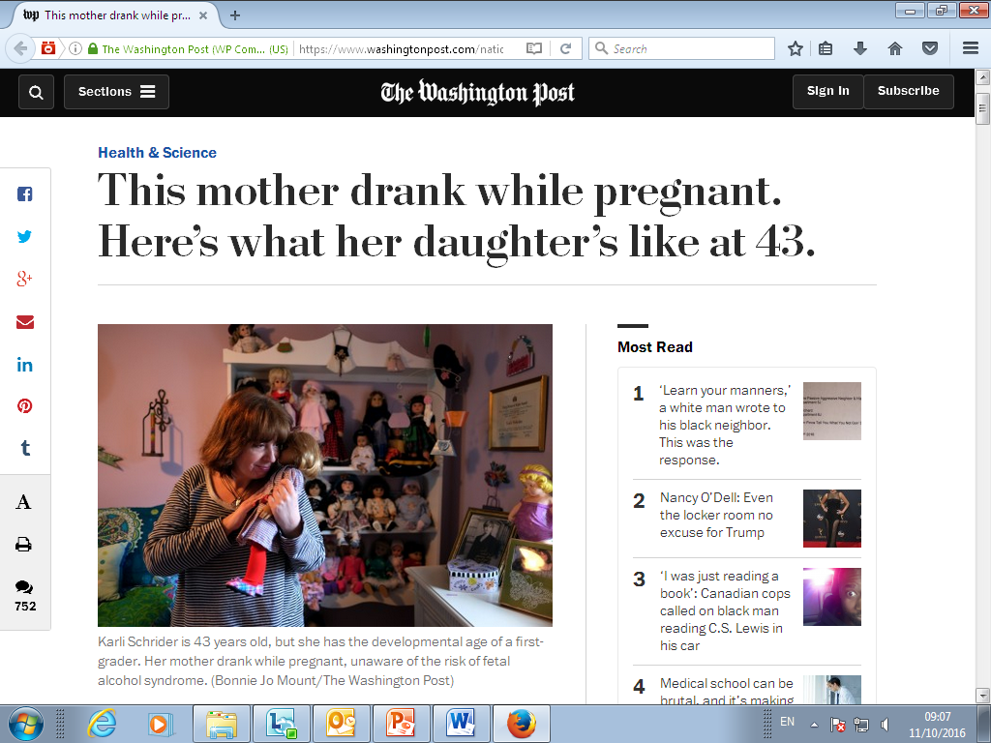
Notes:
A Washington post article from January 2016 featured the story of Kathy Mitchell, Vice President of the National Organization on Fetal Alcohol Syndrome (NOFAS) based in Washington, DC. The article was read by 7.7 million readers over the following week and sparked 823,000 comments to the Washington Post – unprecedented. As reported by Kathy to the recent EUFASD conference held in London September 2016, the vast majority of the comments were negative “driven by hatred”. https://www.washingtonpost.com/national/health-science/this-mother-drank-while-pregnant-heres-what-her-daughters-like-at-43/2016/01/15/32ff5238-9a08-11e5-b499-76cbec161973_story.html During the same week the article prompted four (4) women in need to help to seek the support and help of NOFAS.

Slide 17
Prevention of FASD
Is all our business
Alcohol free pregnancy work starts in school
Lessons learned internationally
Whole of Government
  Policy & implementation, hidden harm
& whole of Society: social norm, support
Effective interventions
  Parent Child Assistance Programme
Notes:
Conflicting advice is a problem
Consistent evidence based message
It’s not about women. It’s about a whole of society, whole of government commitment
Cherishing the next generation, our children, our children’s children
Supporting the women who will bear the next generation on our behalf
Time to improved outcome is only 9 months – pregnancy by pregnancy. Potential gain is substantial

Slide 18
Regional Drugs & Alcohol Taskforce
Work on the societal factor – a big task
All your work to date refers
Change the social norm
  Start the conversation
  Consistent message
  Individually lead by example
It’s a major challenge
Mothers against drink driving (MADD) changed a social norm
Working together it is feasible, we can change another social norm
Notes:
Early intervention
Pre-pregnancy screening and brief intervention
Once a woman is pregnant, a matter for her healthcare team

Slide 19
Alcohol free pregnancy
We are not asking women to stop drinking
We are trying to enable women to have an alcohol free pregnancy
  With full information
  By choice, plan, “informed consent”
  With support, whole of society & government
  Respectful, sensitive
Not all women will manage this

Slide 20
Lessons from Canadian FASD Awareness campaigns
Aim: Helping people to understand the issue and where to get help
One component of a broader strategy
Partnerships key to reach audience
Fear based approaches don’t work but cause anxiety and distress
Successful campaigns focused on large populations & were designed for populations at lower risk
Notes:
Warnings about alcohol use in pregnancy can also be used to raise awareness such as signs in restaurants and bars, on liquor bags, and on cash register receipts- Canadian main findings
Increase knowledge
Link people to further information
Services and
Support

Slide 21
Awareness raising
Target audience: teenagers before they are sexually active, youth groups, schools, families
Start the conversation
How would you plan an alcohol free pregnancy?
Notes:
Health education

Slide 22
Supportive Legislation
Enabling legislation with enforcement
  Licensing laws
  Underage drinking
  Public Health Alcohol Bill
Trans generational aspects
  The cycle of addiction from generation to generation
  Those with FASD at increased risk of addiction to alcohol themselves
  Prevent FASD and break the cycle

Slide 23
Effective interventions in prevention of FASD
PCAP: Parent Child Assistance Programme
  A supportive non-judgmental relationship
  Support to the mother and the target child
  “Wrap around service”
  3 year programme, 2 visits per month
  Relapse is tolerated, start again
  Three objectives
Motivate the women to stop using
If can’t, help women not to get pregnant
Use mandated treatment for alcohol and drug abuse
Notes:
Motivate the women to stop using
If can’t, help women not to get pregnant
Family planning does not mean never having another child but plan family
Effective contraception
Use mandated treatment for alcohol and drug abuse
Use women only treatment
Use service where children can stay
Provide client specific support to addiction service providers as indicated.

Slide 24
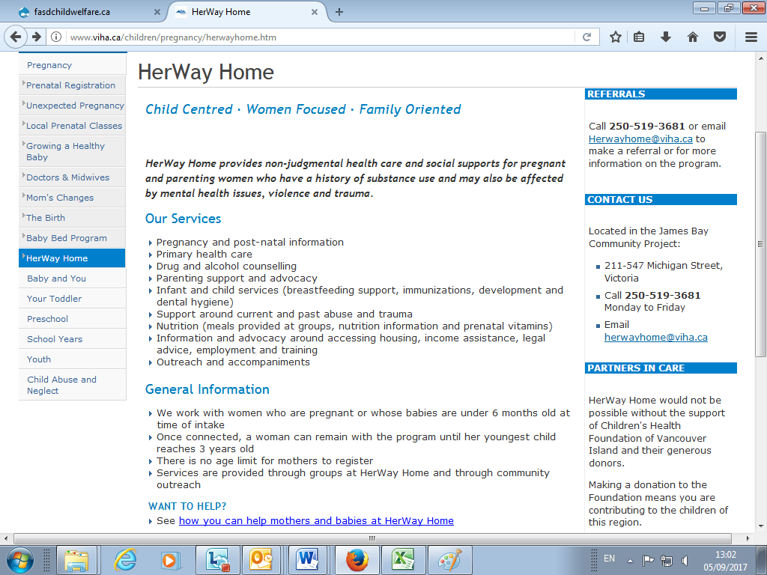
Vancouver Island Health Authority

Slide 25
Why do women continue to drink during pregnancy?
Habit, normal routine. The social norm
*Unplanned pregnancy, not aware of pregnancy
*Didn’t know of potential hidden harm
*Conflicting advice or incorrect advice
Pressurised to drink
Life is difficult
*Addiction
*Zabotka J, Bradley C, Escueta M. “How could I have done this?” Thoughts of mothers of Children with Fetal Alcohol Synbdrome. J Soc work Pract in Addictions. 2017; 00:1-17.
Notes:
Enduring guilt
Stress, poverty, violence, self-medication for mental health issues

Slide 26
Role of fathers
& friends, family
Reduce your drinking or give up for a time
  Alcohol free activities, new routine
Never press a drink on another
When a host provide choice
Support the woman
Life is difficult – from previous slide

Slide 27
HSE FASD subgroup of AIG
Develop the evidence based guidance
The materials: leaflet, posters, website, SPHE
Work with our medical, midwife, and allied health professional colleagues on:
  care pathways for women
  Pre conception care
  Screening & Brief intervention in pregnancy
PCAP
Evaluate interventions

Slide 28
Role of HSE AIG FASD Subgroup
Prevention of new cases of FASD
NOT Diagnosis
NOT Care and intervention for cases and families

Slide 29
Role of Maternity Service in prevention of FASD (i)
Standard
Ask
Record
Test?
Notes:
By all. The first step towards increasing awareness and towards enabling examination of the situation.

Slide 30
Maternity Data items on Alcohol intake for MN-CNS at BOOKING /First ANC visit - first 3 Qs of AUDIT-C
1. | How often do you have a drink containing ALCOHOL (current situation) | Never Monthly or less 2-4 times a month 2-3 times a week 4 or more times a week | 0 1 2 3 4
2 | How many standard drinks (10 grams) do you have on a typical day when drinking? (current situation) | 1-2 drinks 3-4 drinks 5-6 drinks 7-9 drinks 10 or more drinks | 0 1 2 3 4
3 | How often do you have 6 or more drinks (10 grams) on one occasion? (current situation) | Never Less than monthly Monthly Weekly Daily or almost daily | 0 1 2 3 4

Slide 31
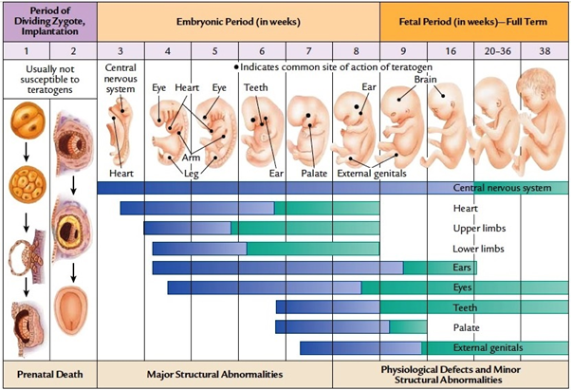
Abstaining from alcohol for the remainder of pregnancy has benefit

Slide 32
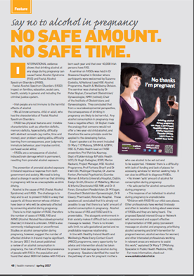
HSE Health Matters Staff Magazine Spring 2017 (p48)

Slide 33
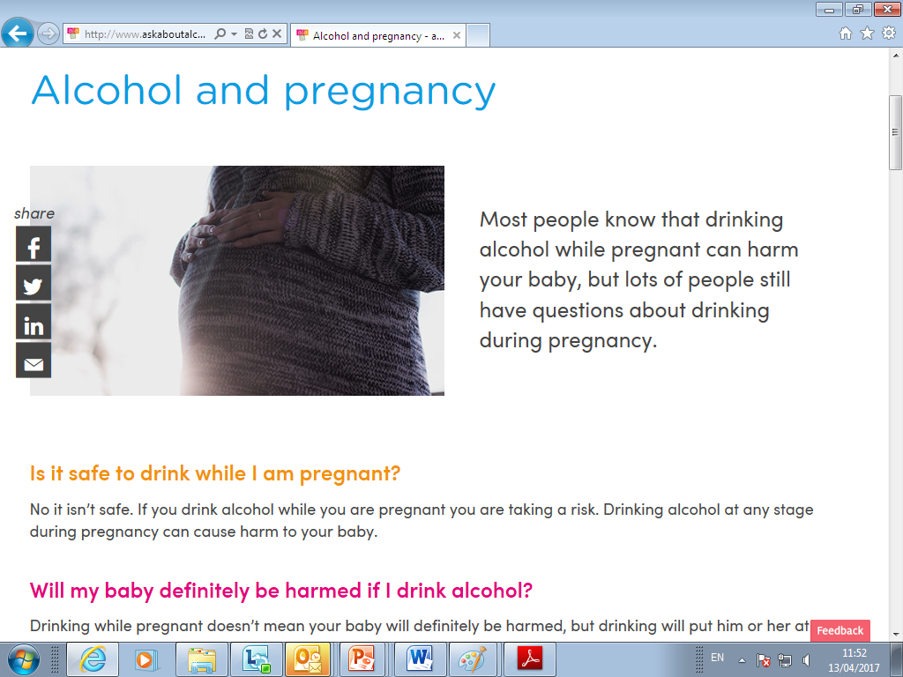
www.askaboutalcohol.ie

Slide 34
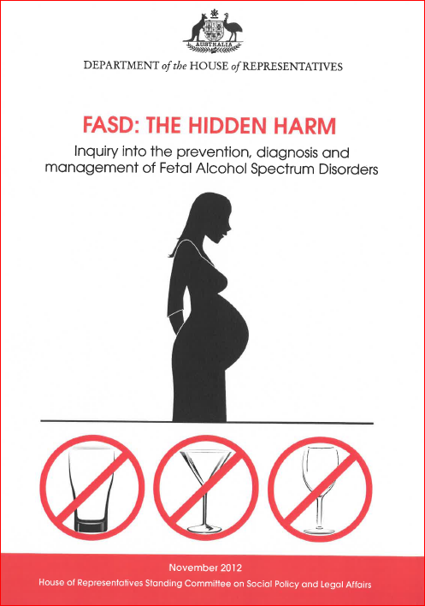
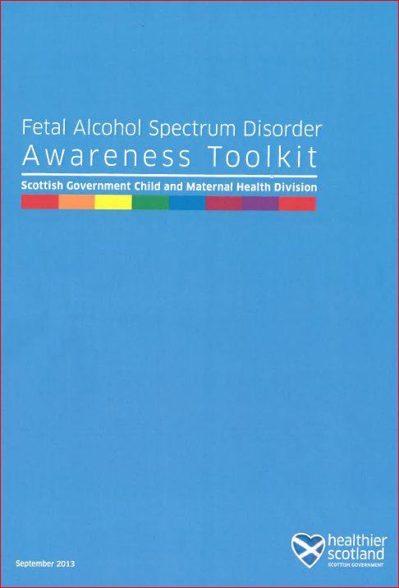
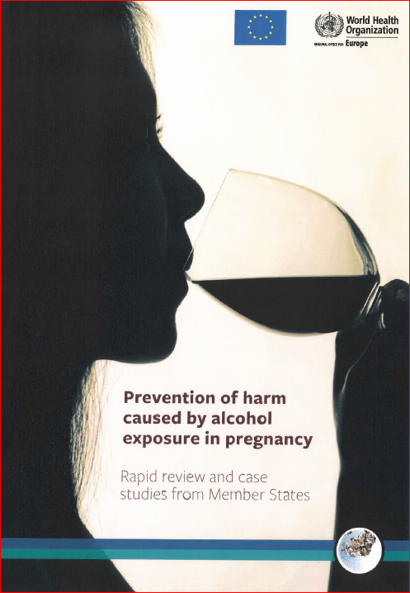

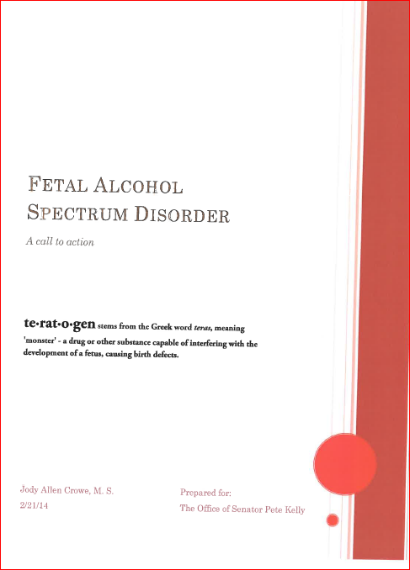
International initiatives (Au, Scotland, EU, Ca, Alaska, NZ)
Notes:
2012 Australian
2013 CPHM Coordinator 0.6WTE in Scotland
2016 WHO European Area Prevention of harm caused by alcohol exposure in pregnancy Rapid review and case studies from Member States
10 Year plan in Alberta Ca, 5 year results reported in 2013; pop 4.5m, 25 MDT networks, estimate 450 pa born with FASD; 45,000 living with FASDs; if prevent 10 cases of FASDs pa it will more than cover cost of treatment services
2014 Alaska
2016 NZ – professional consultation and drafting, public consultation, Action plan 2016-19

Slide 35
“When a million babies are born every year with permanent brain injury from a known and preventable cause, the response ought to be immediate, determined, sustainable and effective”
International Charter on Prevention of FASD (Fetal Alcohol Spectrum Disorder) Edmonton September 23-25, 2013; Lancet March 2014.
Notes:
Increasing evidence that it is an important determinant of public health
It gets scant attention

Slide 36
Practical tools for capacity building
School based education on FASD
Screen women for problematic alcohol use before pregnancy
Treatment to women with alcohol exposed pregnancies –during & after
  Implement existing policy &
  PCAP
Information on FASD at schools, clinics, centres for maternal and child health
Notes:
Conflicting advice is a problem
Consistent evidence based message
It’s not about women. It’s about a whole of society, whole of government commitment
Cherishing the next generation, our children, our children’s children
Supporting the women who will bear the next generation on our behalf

Slide 37
The Irish are not immune to the harmful effects of alcohol
Alcohol is the cause of Foetal Alcohol Syndrome (FAS) and Foetal Alcohol Spectrum disorders (FASD)

