Slide 1
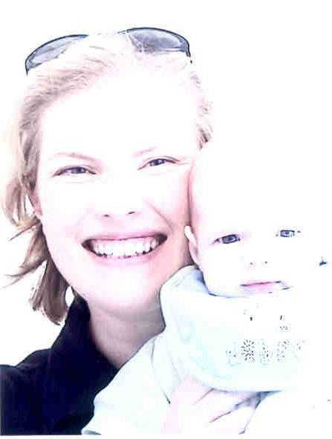
Alcohol in pregnancy & its Impact on Infant Mental Health
Dr. Malie Coyne
Alcohol & Pregnancy Seminar
26/09/2017 ~ WRDATF Galway
www.drmaliecoyne.ie

Slide 2
A bit about me…
HSE Child & Family Primary Care Clinical Psychologist
Lecturer Clinical Psychology Doctorate NUIG
Passionate about promoting wellbeing & positive mental health
Media contributor: Print, radio, TV, public speaking
Mental Health Lead on A Lust for Life Board of Directors
Active member of the Early Years Subcommittee of Galway CYPSC

Slide 3
What to expect…
Setting the context: Infant Mental Health & Attachment
Destigmatizing maternal substance abuse
Impact of maternal alcohol abuse on IMH
How can we best support families?
National & local initiatives
Support services
Resources

Slide 4
Origins of Infant Mental Health
MDT field developed by *Fraiberg in the 1970s in Michigan.
To support social, emotional & cognitive well-being of at-risk babies from conception to age 3, in context of challenged primary caregiving relationships.
IMH must be seen within context of relationship or “attachment” with primary caregiver, usually the mother.
Early intervention framework of support building on baby & parent strengths.

Slide 5
Infant Mental Health definition
The developing capacity of an infant or toddler to:
Experience, express & regulate emotions
Form close & secure relationships
Explore the environment & learn
In context of family, community & cultural expectations for young children

Slide 6
Why is IMH so important?
*Nugent (Brazelton Institute) ~
Revolution has taken place in our understanding of the capacity of babies & workings of their brains
“Critical window of opportunity” in first 1000 days of life.
Brain development radically shaped & structured by experiences & quality of child-parent interactions.
Up to 80% brain growth Formation of brain pathways Positive / challenging experiences have lasting impact.

Slide 7
Origins of Attachment
Most important survival task of infancy (Bowlby, 1969; 1973; 1982)
“The dependency relationship that a child forms with their primary caregivers” (Pearce 2009).
Children exhibit behaviours that encourage caregiver to be present and responsive to their needs (Pearce, 2010)
Emerges during first 6 months & evolves through first 4 years.

Slide 8
Factors impacting attachment
Schore (2002):
“A child’s first relationship acts as a template that permanently moulds their capacity to enter all later emotional relationships”.
Accessibility:
  Infant learns mother is accessible to them when in close proximity or will consistently return to the child after being apart. The origins of trust!
Understanding and Responsiveness:
  Learned when mothers respond appropriately and consistently to physiological and emotional needs e.g. hunger, distress, etc.

Slide 9
Factors impacting attachment
Attunement:
  Emotional connection to mother.
  Mother mirrors child’s own feelings or attunes own feelings to child. (E.g. distress mirrored in facial or body language)
  Mother soothes child when distressed. As child relaxes so too does caregiver (Pearce, 2010)
  In this way it allows mother to help the child to learn how to emotionally regulate themselves and their own arousal.

Slide 10
Destigmatizing maternal substance abuse
*Scotland ~ “We need to value & respect the enormous energy that goes into creating a new mother”
Adjusting to parenthood a time of major psychological and social change.
ALL mothers feel GUILT ~ Response to my IMH article.
Substance abuse most stigmatizing of all health issues.
Belief that substance abuse due to weak willpower & low moral strength – Internalization by mother “I deserve this”.

Slide 11
“Let’s extend our support not our judgement”
Compulsive use in the face of serious negative consequences for mum and baby is not a choice.
Substance abuse causes changes to the brain over time triggering cravings and compulsive behaviour.
Guilt & shame can be a significant barrier preventing mothers from getting support (e.g. Fear of Child Protection services).
Core of issue is pain, low self-belief, life traumas, isolation…

Slide 12
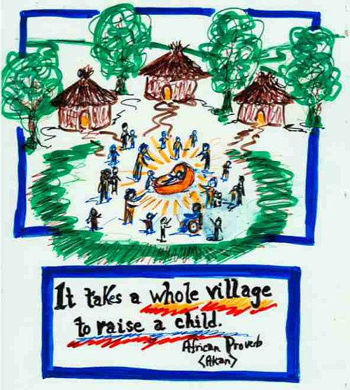

Slide 13
Alcohol use during pregnancy
Despite public health campaigns & improved knowledge:
  Irish women less likely to report drinking during pregnancy
  Growing up in Ireland study: Irish women drank more heavily than UK women
  HRB study: 65-80% surveyed drank at some point in pregnancy
Impact on foetus depends on:
  - Pattern & quantity of alcohol consumed (higher levels >> more risk; bingeing)
  - Stage of development of foetus
  No. of socio-behavioural risk factors (SES; MH comorbidity; DV; polydrug use)
  Impact difficult to substantiate due to correlation with other factors

Slide 14
Impact of alcohol abuse on parenting
Children depend on their primary caregivers to meet their physical, safety, emotional, social and economic needs.
Review of literature (*NACD, 2011) indicates that substance-misusing parents less likely to provide high-quality parenting.
Literature not unequivocal due to inconsistencies in measurement, definitions of parenting & presence of other risk & resilience factors.

Slide 15
Impact of alcohol abuse on parenting
For today, focus on maternal alcohol use during pregnancy not on other drugs or impact of fathers’ misuse.
Most women who misuse alcohol want to be good parents. However substance dependency often encompasses ALL aspects of user’s life.
Needs and wellbeing of other family members can become secondary to an addiction ~ Poor financial & social supports.
Alcohol’s significant role in Irish culture. Questions around ‘safe level’?

Slide 16
Impact of alcohol abuse on parenting
Quality of caregiving environment seriously undermined:
  Affects parent’s judgment & ability to provide care and supervision.
  Can be socially isolated, hence less access to crucial external supports
  Less time spent with kids and often inconsistent, harsh & erratic discipline
  Increases conflict in families & often co-occurs with domestic violence
  Effects of neglect include abandonment, maltreatment, low frustration tolerance & patterns of insecure / disorganized attachments.
  Erratic histories mean that parent can lack foundation for effective parenting
  Co-morbid depression / anxiety or DV decreased parental sensitivity

Slide 17
Impact of alcohol abuse on attachment
Importance of mothers understanding & responding to their baby’s feelings is crucial to their wellbeing & development.
Parenting deficits can lead to “... decreased emotional responsiveness, availability, acceptance and sensitivity”.
  > Same ingredients pivotal in formation of secure attachment!
Especially devastating for infants and young children whose need for close supervision and continuing care is very great.

Slide 18
Impact of alcohol abuse on attachment
“Frightening” behaviour indicative of disorganised attachments.
As primary attachment figure, mother is child’s secure base and haven of safety to which they can retreat during times of distress.
When child’s mother is also source of distress, child faced with a paradoxical dilemma that manifests itself in emotional & behavioural dysregulation.
*NB: Presence of stable adult figure crucial in increasing children’s resilience & mitigating impact of maternal alcohol abuse.

Slide 19
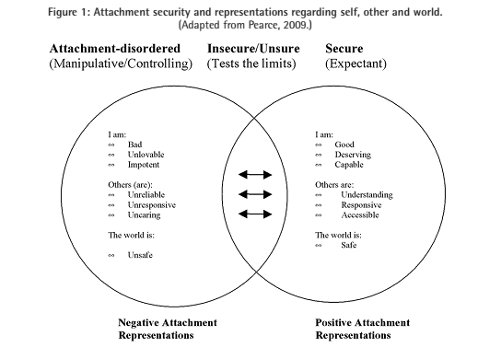

Slide 20
Young Person Quotes
“They do love you but they have to put that (alcohol) first … it’s an illness really … it’s number one, the alcohol is – definitely. That’s something I’ve definitely had to accept to understand anything. However badly you want yourself to be number one to them, it doesn’t happen”. Young person, aged 20
“Sometimes she’s a parent, but then sometimes when she needs to do what she has to do, she’s not there”. Young person, aged 17

Slide 21
Adverse Childhood Experiences (ACE) Study
Study assessed effects of child abuse and other ACEs (e.g. alcohol abuse) on public health.
Physical and mental health and social development are seriously impacted by ACEs such as parental substance misuse, poverty & loss.
As number of ACEs increases, the risk of developing significant health problems increases in a strong & graded fashion.

Slide 22
ACEs: 10 Areas of Trauma
Psychological abuse
Physical abuse
Sexual abuse
Emotional neglect
Physical neglect
Substance abuse
Domestic violence
Mental illness
Parental separation / divorce
Crime

Slide 23
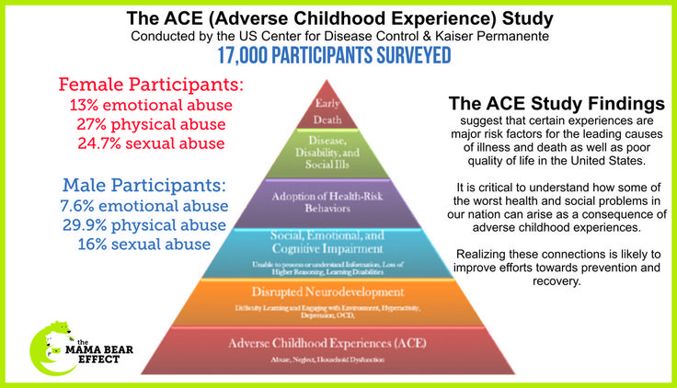

Slide 24
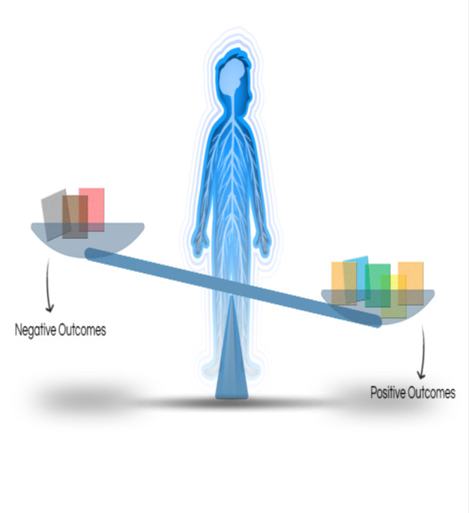
Fostering resilience – a matter of balancing the scales?
According to the National Scientific Council on the Developing Child (2015), child development is like a scales with two sides.
Experiences such as repeated or chronic exposure to violence, poverty, or maltreatment (ACEs), pile on the negative side of the scale.
Positive influences tip the scale the other way.

Slide 25
Is equality is the best form of therapy?
The fulcrum represents individual predispositions, which vary from one child to another.
These variations mean that individual children start with their fulcrums in different places along the scale.
The placement affects how they respond to the weight of experiences they have.
Fulcrum is not fixed or static so there is HOPE!!!

Slide 26
Top ingredients for positive mental health
Secure attachment / ‘Good enough parenting’
Emotional regulation (attunement / boundaries)
Parental self-care
Developing resilience skills
Low incidence of ACEs
Supportive environment
Parents / Family / Community
School / educational opportunities
Accessible community & professional supports
*Maslow’s hierarchy of needs:

Slide 27
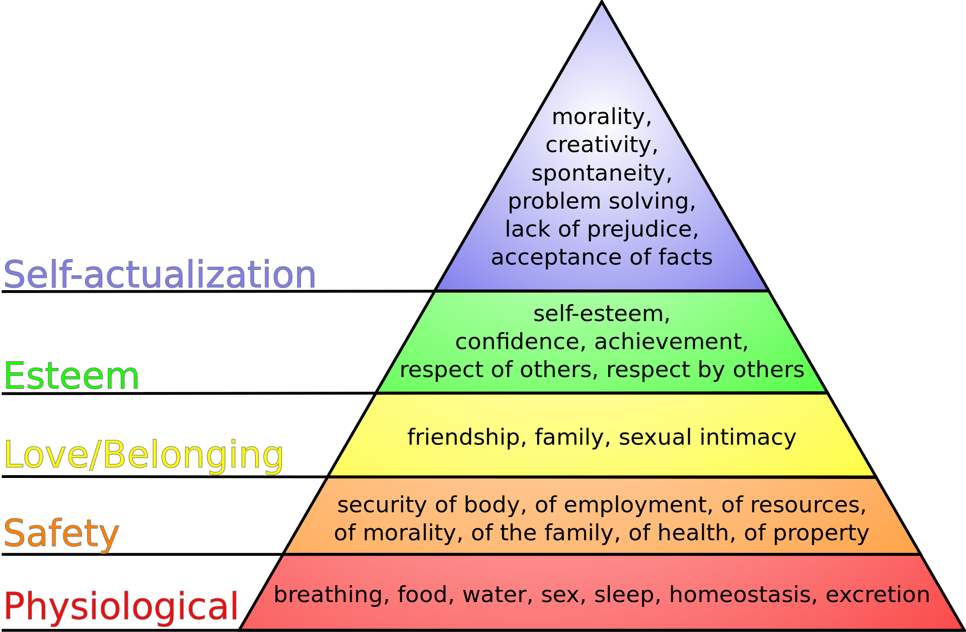
Hierarchy of Needs

Slide 28
How can we support families?
Crucial opportunity to affect change in child’s life due to brain plasticity & ability to work on child-parent attachment
Family initiatives most effective with younger children
Early intervention and prevention & build on resilience factors
Problem is cross-cutting & requires inputs from many services & disciplines
Increase inter-agency linkages like TODAY! (e.g. Addiction services; TUSLA; HSE Primary Care & Mental Health; Childcare; Domestic Violence)

Slide 29
How can we support families?
Role for adult treatment services in flagging parenting issues & child services in flagging addiction / mental health issues
Communal responsibility to protect children (Children First, 2011)
Educational efforts necessary to educate Irish women on adverse effects of alcohol on foetal outcome (www.alcoholforum.org)
#ZeroforNine Because Alcohol and Pregnancy Don’t Mix

Slide 30
Nationally and locally….
Galway City Early Years Health & Wellbeing Plan (2016 – 2020)
Hospital Perinatal Mental Health Group
CYPSC “Parental Mental Health” Subgroup
Irish Association of Infant Mental Health / PSI Interest Group
HSE Nurture Programme
National Maternity Strategy “Creating a Better Future Together”

Slide 31
National Maternity Strategy 2016-2026
3.7 Alcohol
Need for early identification of excess drinking during pregnancy.
National Women & Infants Health Programme to develop consistent approach to informing women about no minimal intake.
Health warning labelling / Alcohol & Pregnancy: A Pocket Guide
3.9 Perinatal Mental Health (PMH)
1. Awareness: Make information on PMH available to all.
2. Screening: Train professionals to identify women at risk.
3. Support: Improve access to supports in a timely fashion.

Slide 32


Slide 33
Early Intervention & Prevention
Tobacco, Alcohol & Drugs √
Provide training for health professionals to develop knowledge and skills to address issues relating to tobacco, alcohol & drug use with parents of 0-3s
2. Develop and promote a clear message in relation to the impact of smoking, alcohol and drug use pre- and post- pregnancy
3. Support the implementation of the Galway City Strategy to Prevent and Reduce Alcohol-Related Harm
HSE - Health Promotion and Improvement, GPs, NUIG, WRDTF, Galway Alcohol Forum and relevant Non-Governmental Organisations

Slide 34
Early Intervention & Prevention
Mental Health and Wellbeing
Deliver training on current best practice & evidence on IMH √
2. Public Awareness Day / Conference on PMH & IMH √
3. Develop Community PMH Care Pathway to identify training needs for gaps in service provision & public information leaflet ~ *Posters
4. Agree on use of an attachment screening tool to inform development of therapeutic support service to improve child-parent relationship
G1: Reflective antenatal classes ~ Baby Bonding Training √

Slide 35
Babies and Families can’t wait!
*Marmot ~
“The foundations for virtually every aspect of human development – physical, intellectual & emotional – are laid in early childhood”
Earliest experiences sets life course in motion & determines lifelong health.
Babies cannot seek help for themselves, they NEED attuned caregivers.
Early intervention Better long-term outcomes.
Childhood emotional wellbeing strongest predictor of a successful & satisfying life in adulthood.

Slide 36
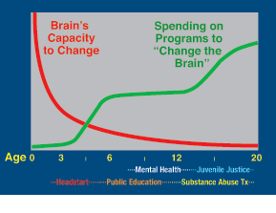

Slide 37
Society can’t wait!
UK - Overall costs of untreated difficulties €10.2 billion, with 70% relating to adverse impacts on children.
Other far reaching societal costs:
- Ongoing intergenerational mental health & Substance misuse difficulties
- Marital and familial breakdown
- Unemployment & social deprivation
*Paul D’Alton ~ “Infant Mental Health is everyone’s business”
*IAIMH ~ “Children are our most previous resource; they are the living messages to a time we will not see”.

Slide 38

Break the Generational Cycle!!!!

Slide 39
Support Services
HSE Drug and Alcohol Helpline 1800 459 459
National Directory of Drugs and Alcohol Services http://www.services.drugs.ie/
HSE West Drugs Service 091 561 299
Advice, information, support, drug and alcohol counselling & family support

Slide 40
Support Services
Al-Anon www.al-anon-Ireland.org
Tusla, Child and Family Agency www.tusla.ie
Family Support Network www.fsn.ie / 01 898 0148
Western Region Drug and Alcohol Task Force http://www.wrdatf.ie/

Slide 41
Resources
Alcohol & Pregnancy: A Pocket Guide (INTERREG IVA)
http://www.westerntrust.hscni.net/pdf/Alcohol_and_Pregnancy.pdf
Alcohol Forum http://www.alcoholforum.org/
Galway Healthy Cities: Galway City Strategy to Prevent and Reduce Alcohol-Related Harm (2013-2017)
http://www.galwayalcoholstrategy.ie/uploadedfiles/Galway%20Alcohol%20Strategy%202013%20-%202017.pdf
http://www.galwayalcoholstrategy.ie/uploadedfiles/FINAL-Galway-City-Alcohol-Survey-Summary.pdf

Slide 42
Resources
National Advisory Committee on Drugs (2011) Parental Substance Misuse: Addressing its Impact on Children. A review of the literature.
http://alcoholireland.ie/download/publications/2011nacdparental_substance_misuse_impact_children_litreview.pdf
WRDATF Family Support Handbook (2016) http://www.wrdatf.ie/uploadedfiles/WRDTF-Family-Support-Handbook.pdf ~ Support services listed.
WRDATF SMART Recovery groups information sessions: www.smartrecovery.org / www.smartrecovery.ie / emmet.major@gretb.ie

Slide 43
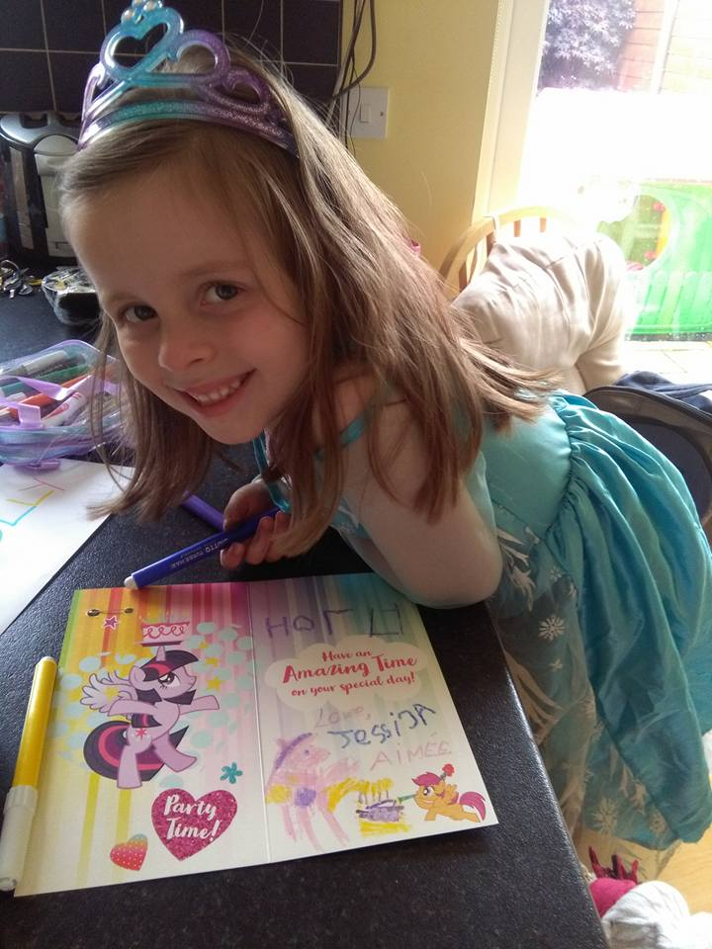

“Working together to give every child the best head start”...

