Slide 1


Alcohol Use in Ireland:
where are we now
Dr Catherine Anne Field
Health Promotion Research Centre
College of Medicine, Nursing and Health Science
National University Ireland Galway
Catherineanne.field@nuigalway.ie

Slide 2
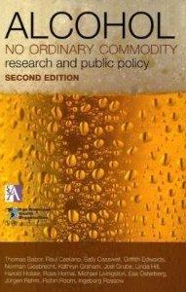
‘… alcohol can be at the same time a food, a drug, and a highly elaborated cultural artefact with important symbolic meanings…’
Heath (1984)

Slide 3
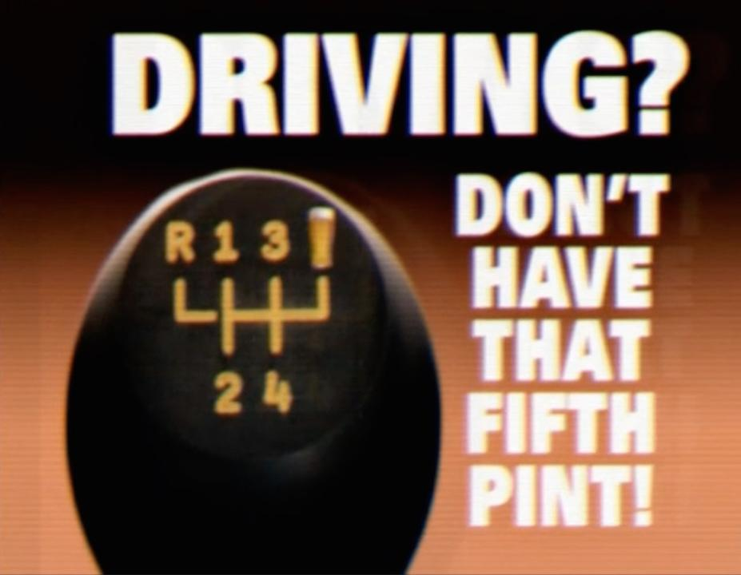

Slide 4
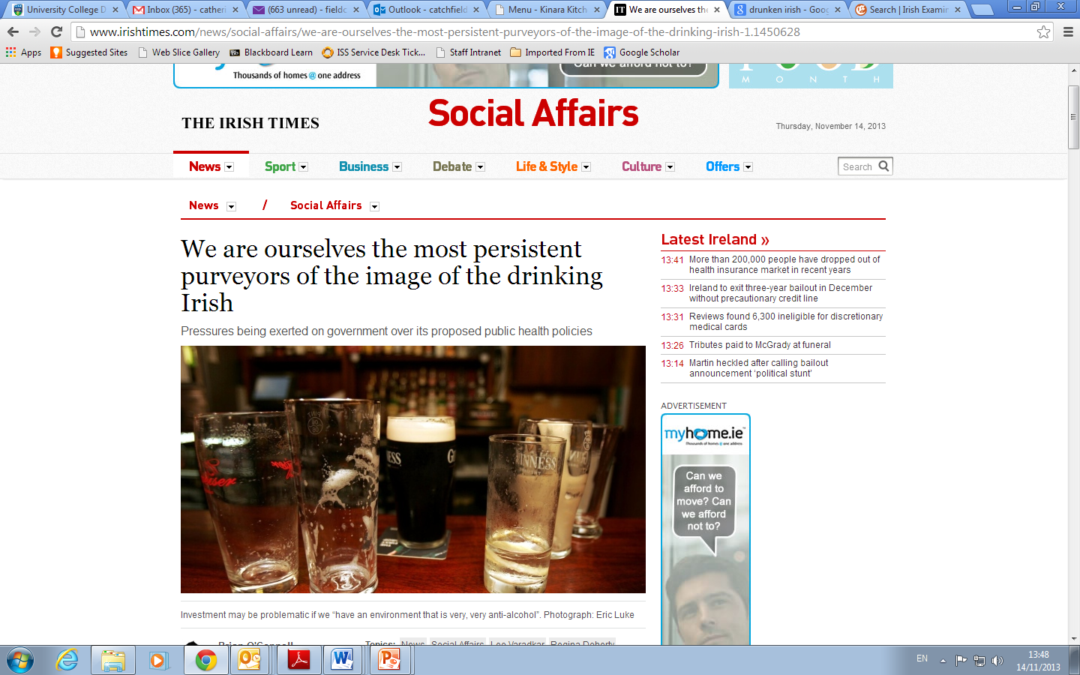
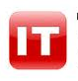
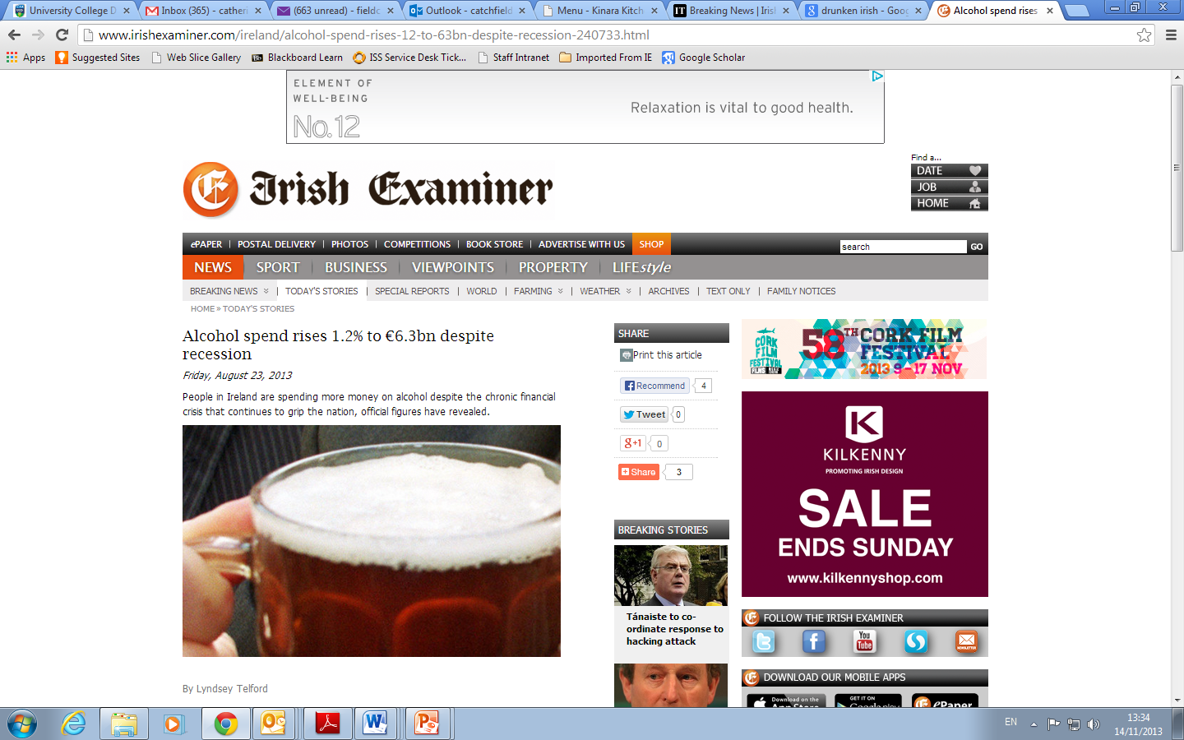
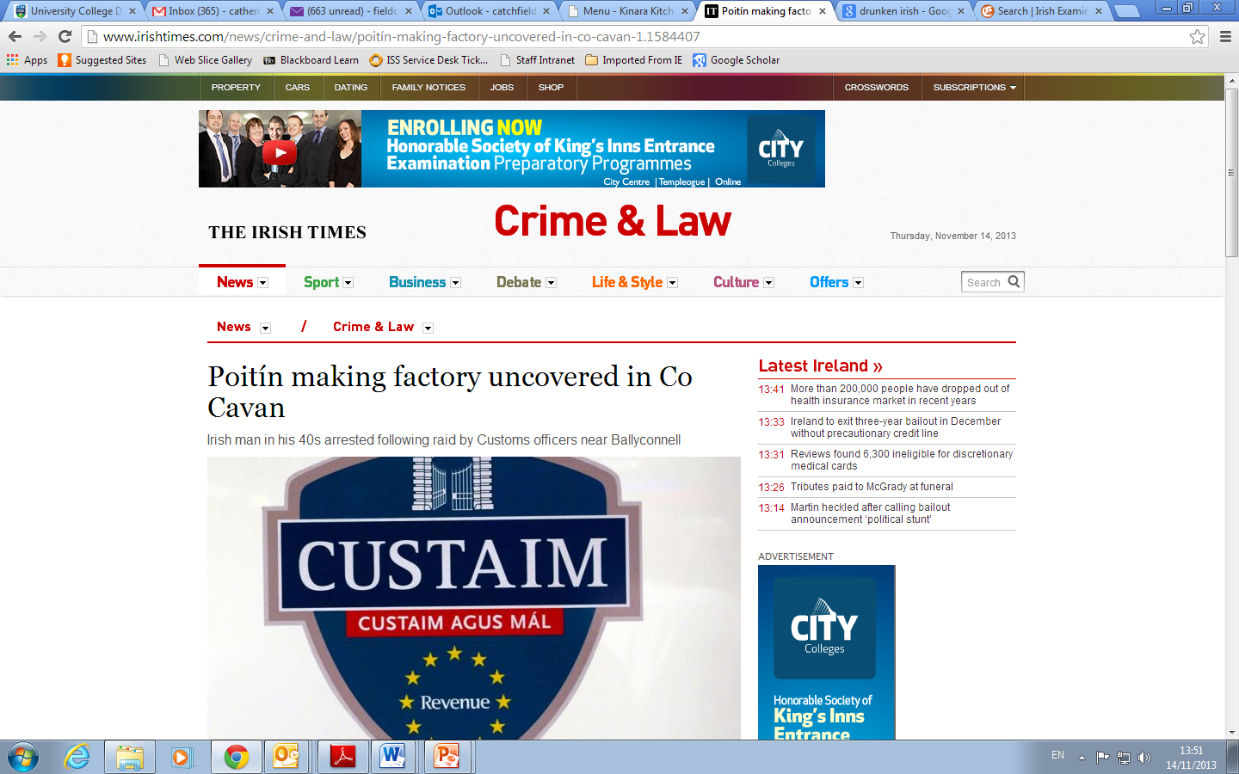
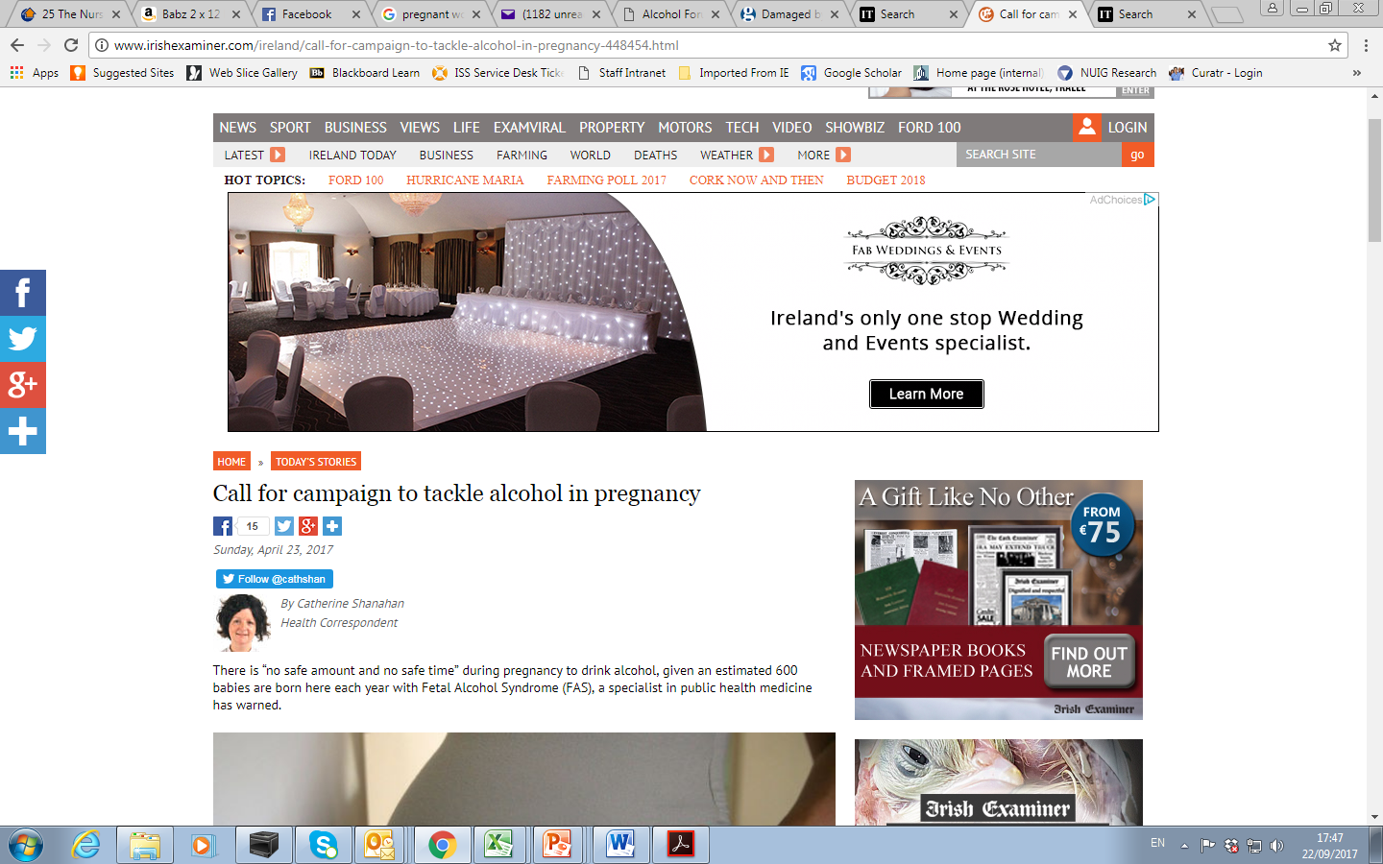
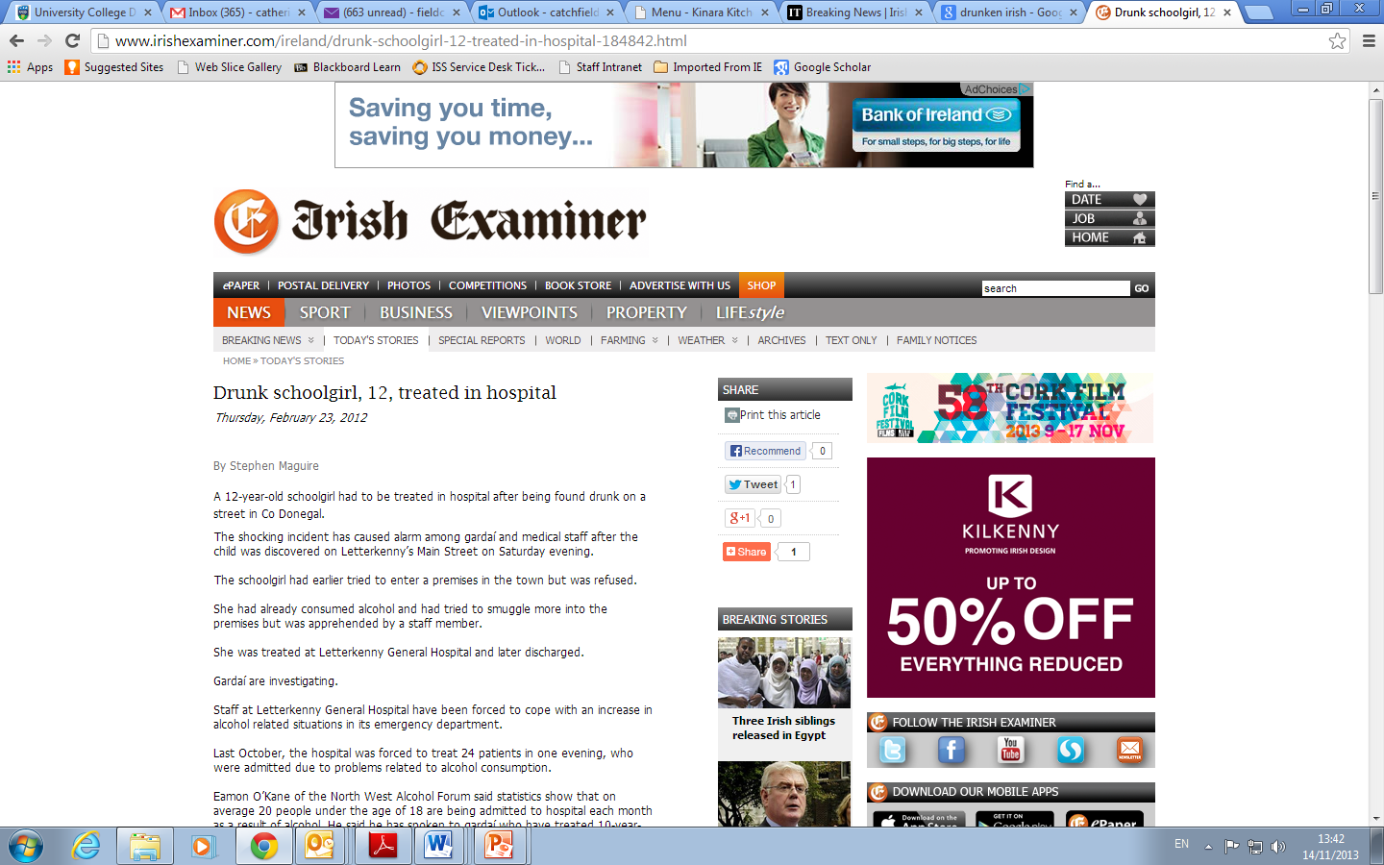

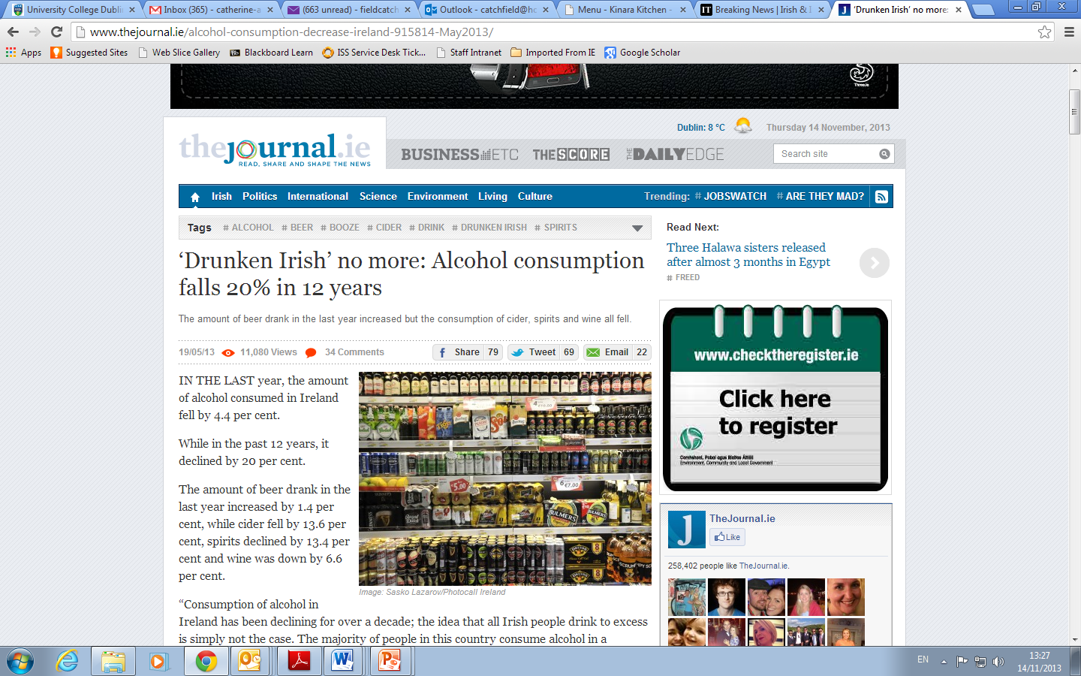
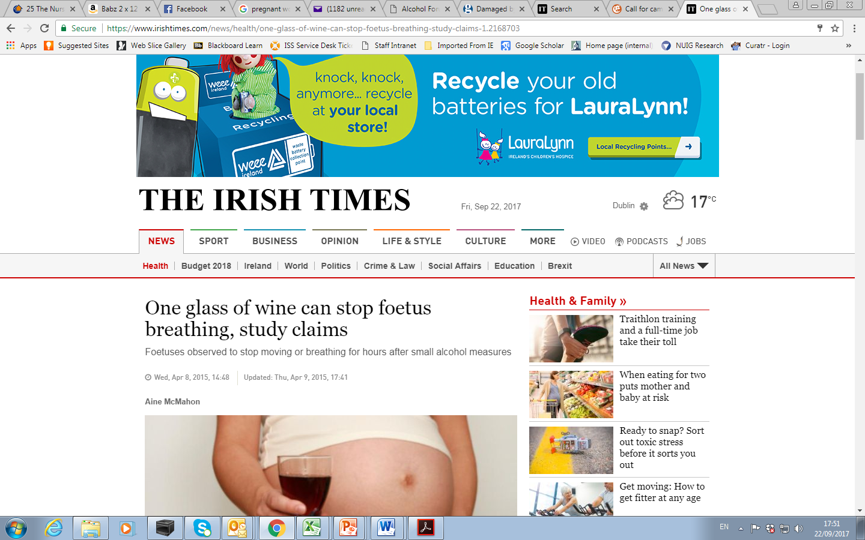

Slide 5
How much are we drinking??

Slide 6
Measurement challenges:
alcohol consumption
  Measure by per capita spend?
    reliability
    Non-drinkers
    no individual data
  Measure individual data?
    Individual may not remember / deny / underestimate

Slide 7
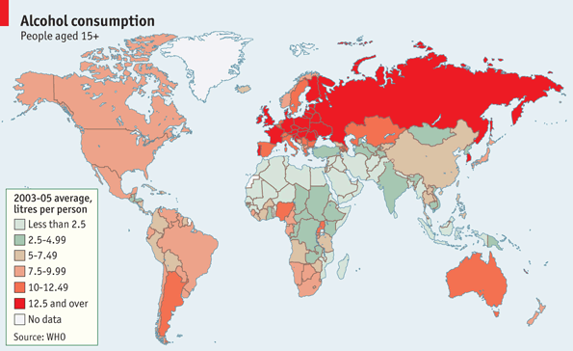
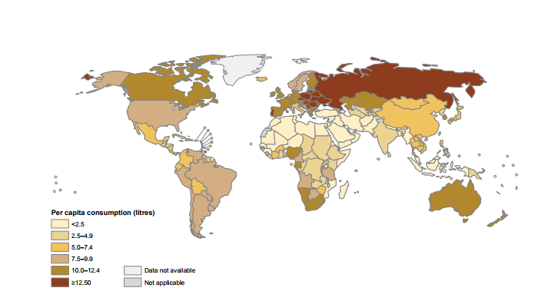

Alcohol Consumption by Country (2010)
Globally
6.2 litres

Slide 8
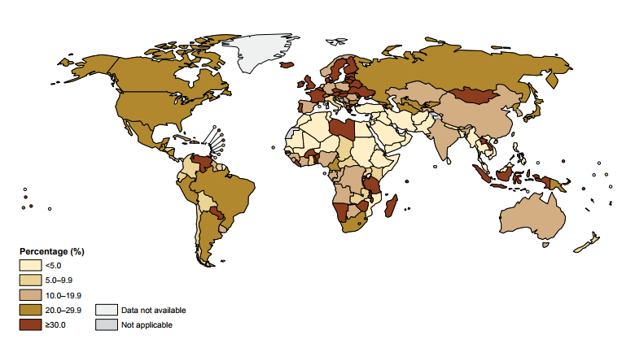
Heavy Episodic Drinking (2010)
Europe 22.9%
European Women 12.6%
Irish Women 25.5%

Slide 9
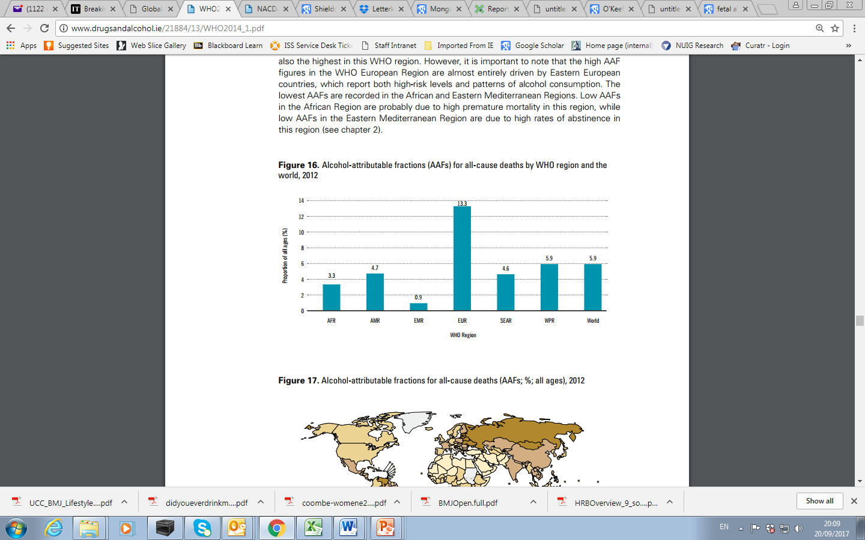
Alcohol Attributable Deaths 2012
3.3 million deaths
5.9% global deaths
139 million DALYS
5% Global burden of disease

Slide 10
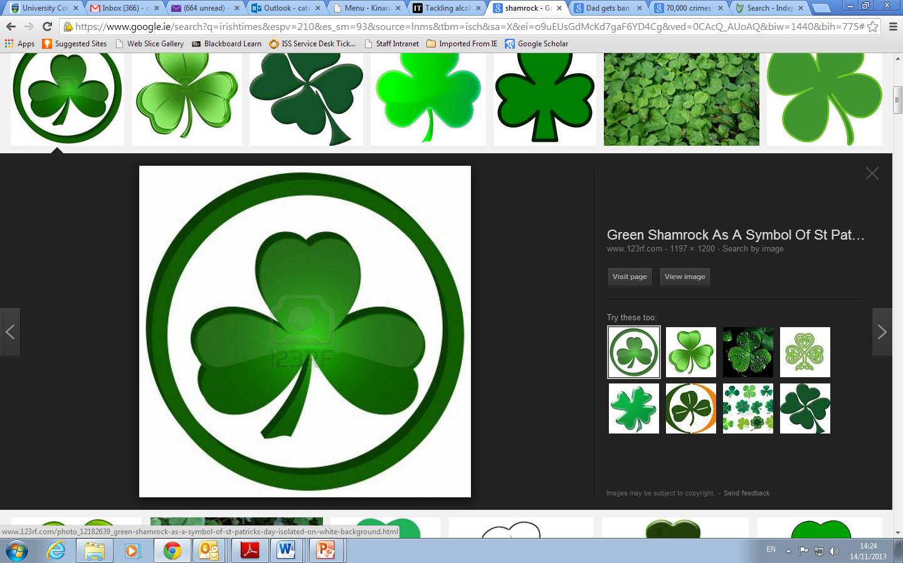
How does Ireland compare?

Slide 11
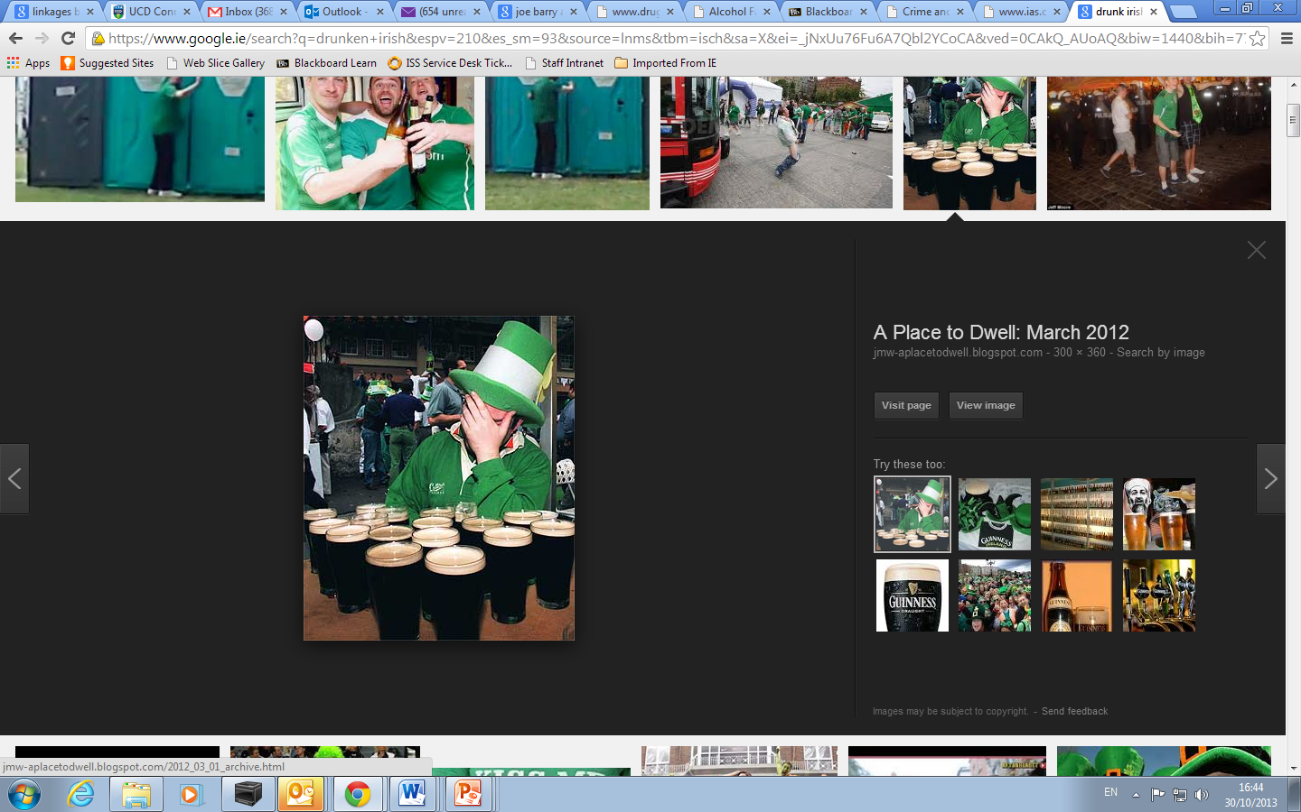
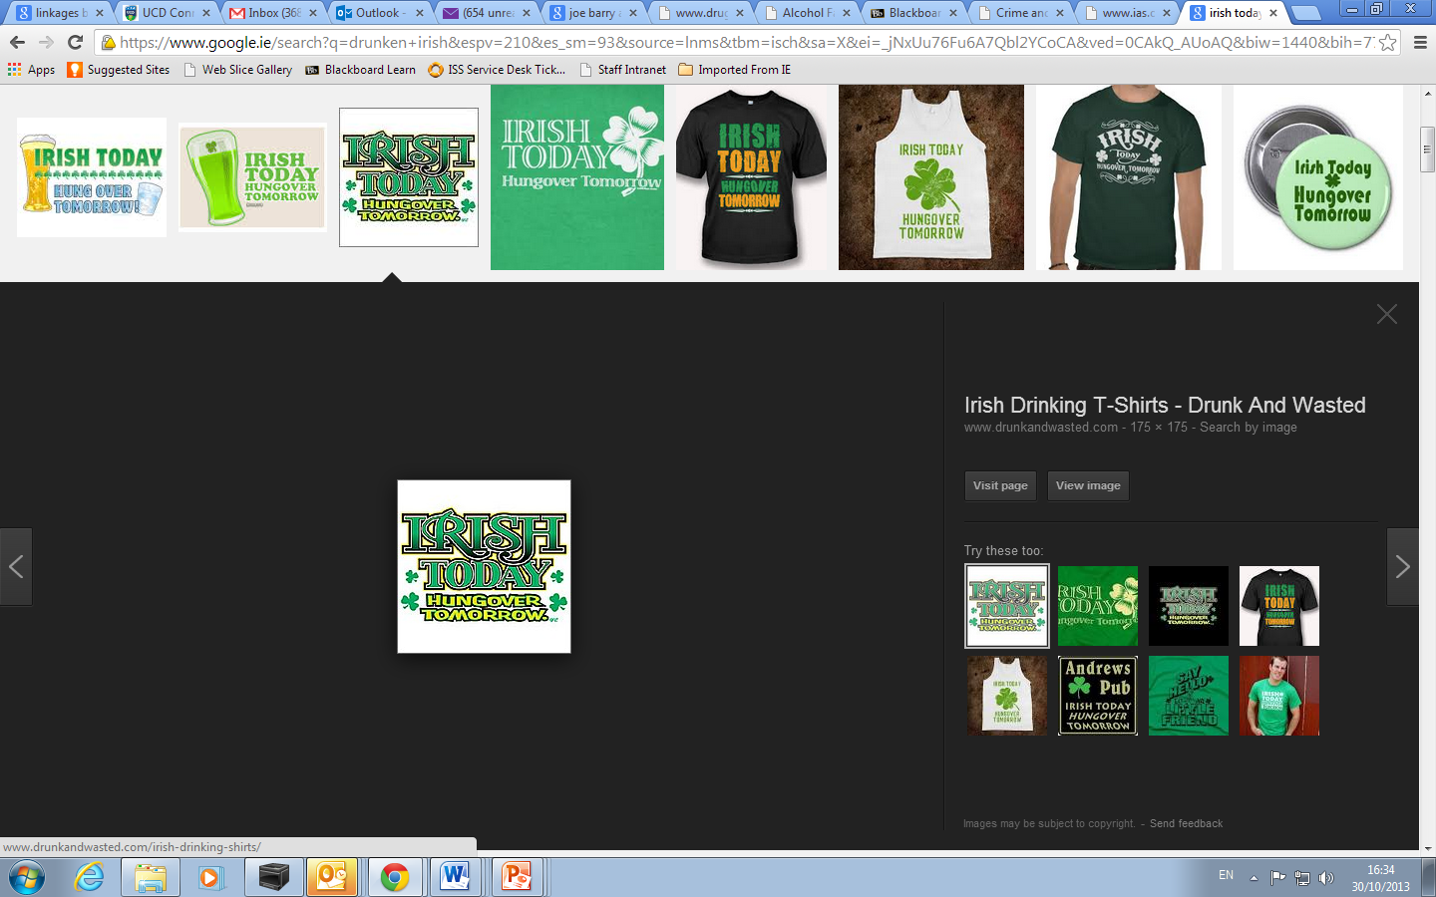
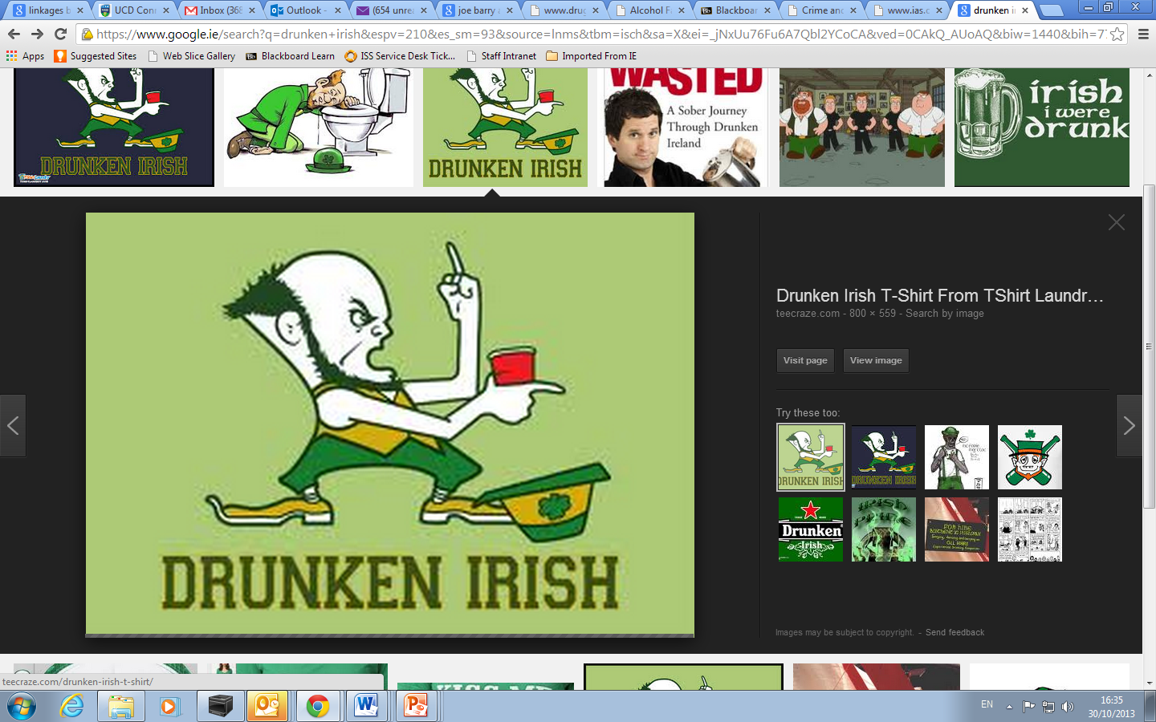
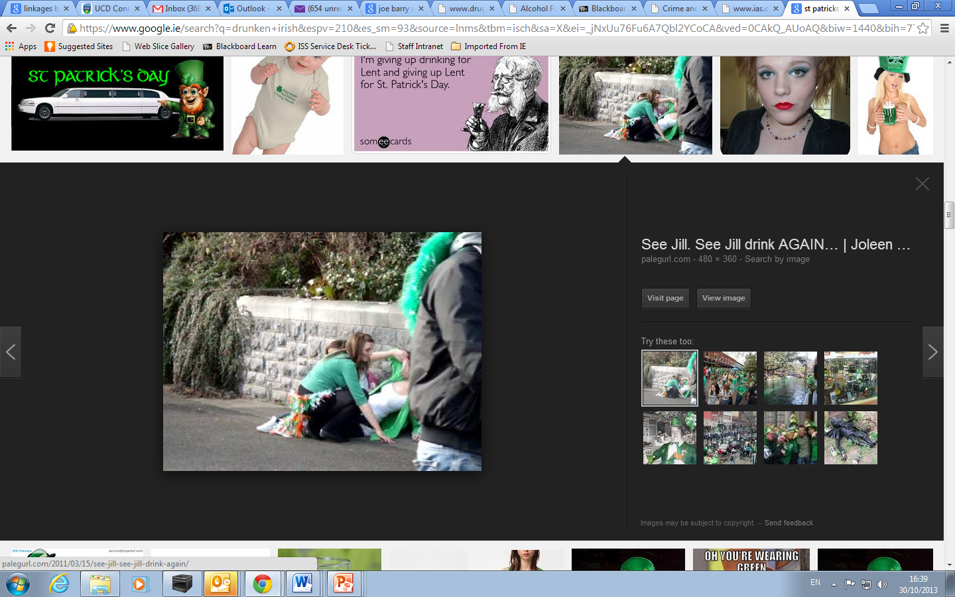
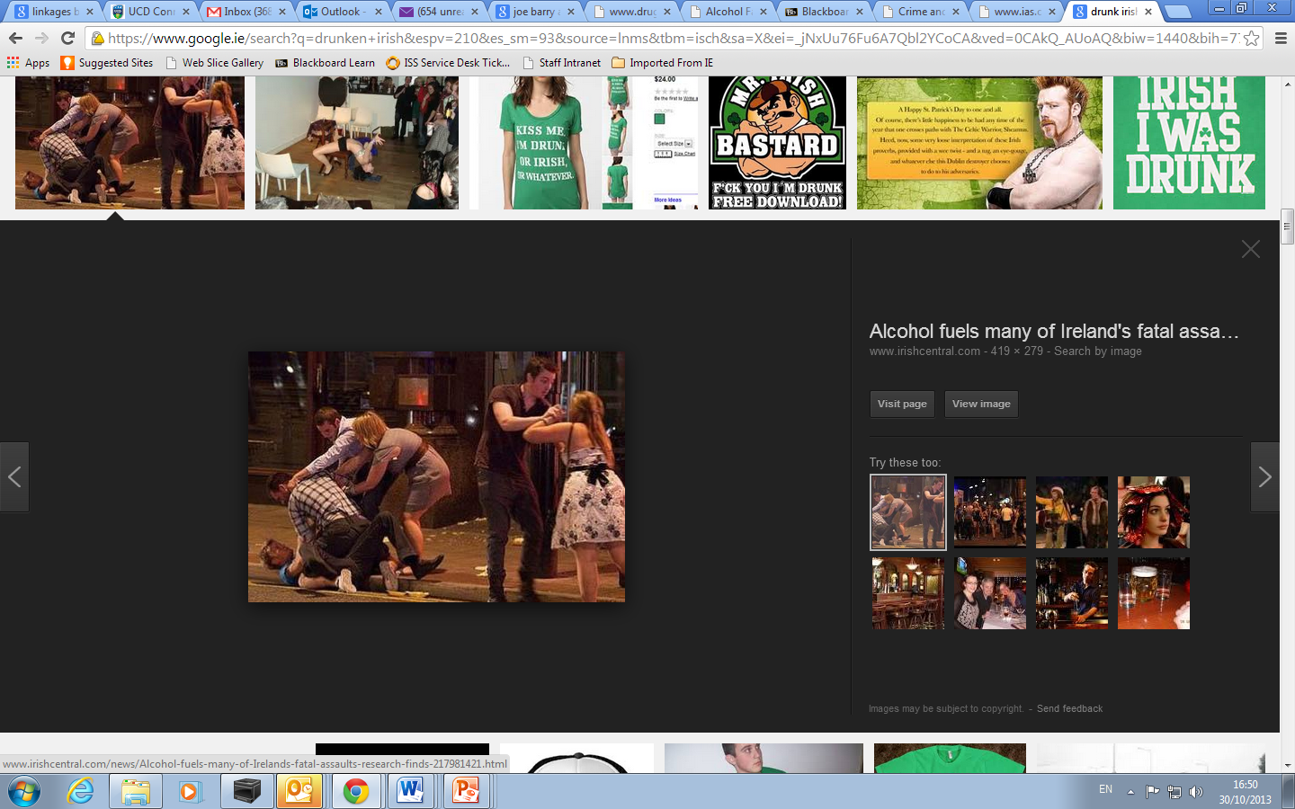
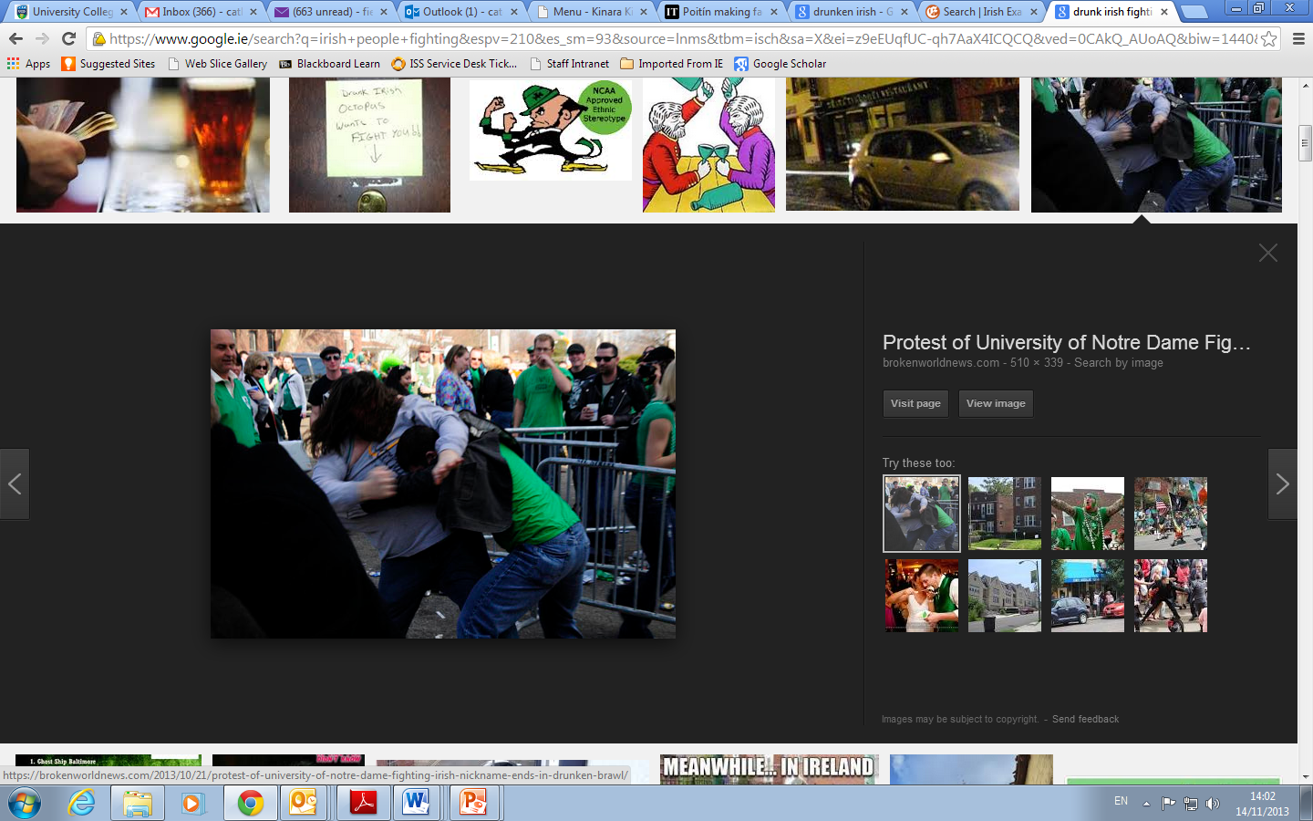
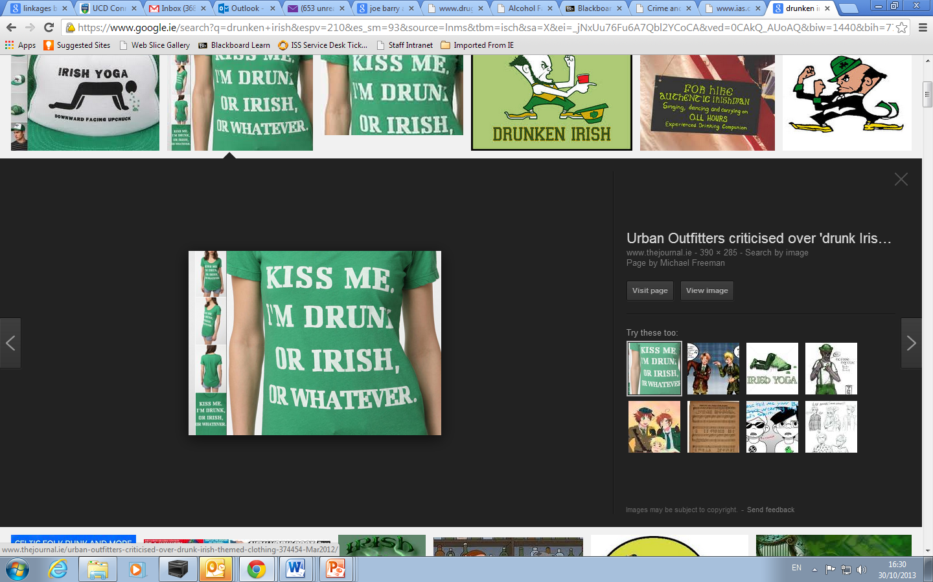
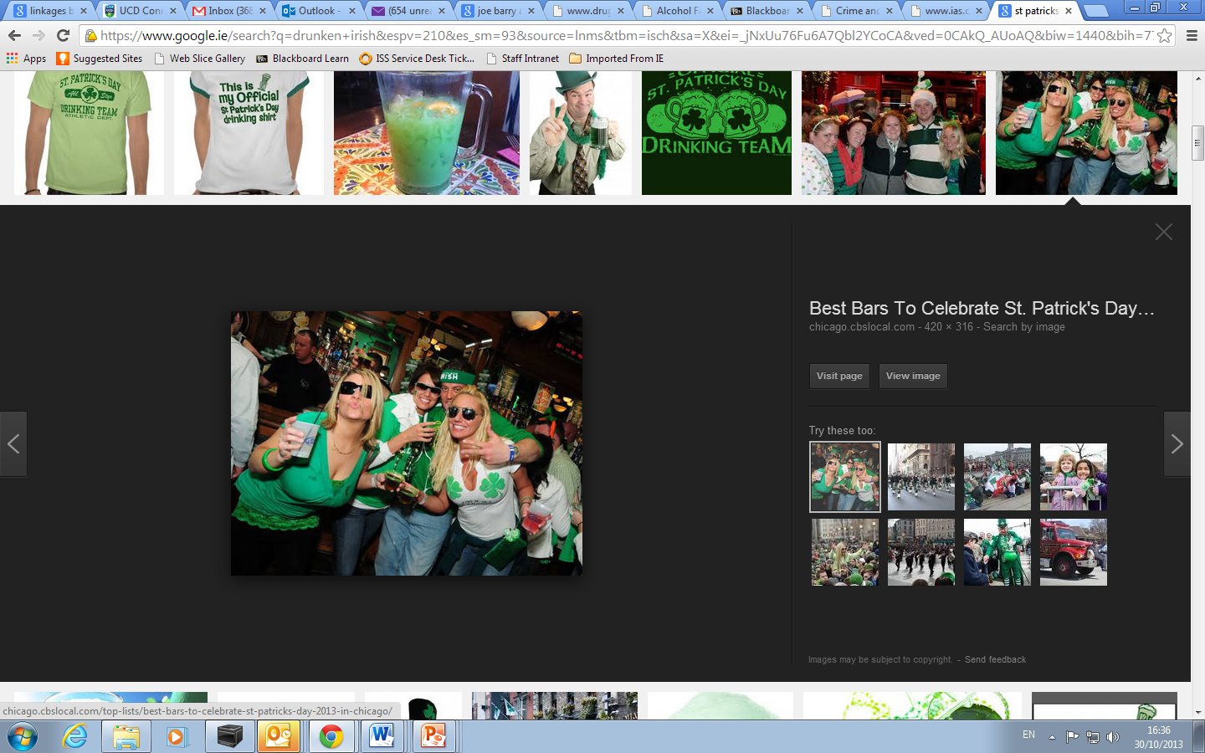

Slide 12
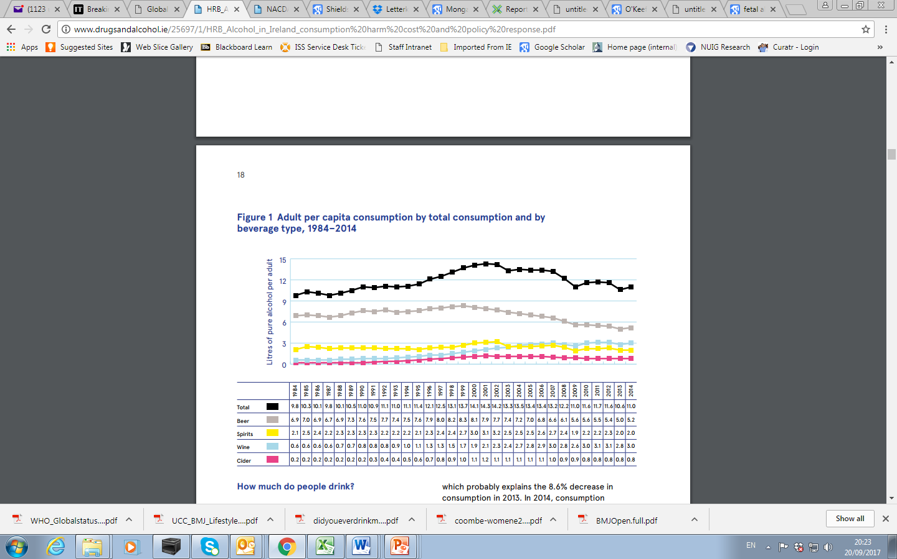

Adult per capita consumption 1984-2014
Mongan, D. & Long, J. 2016

Slide 13
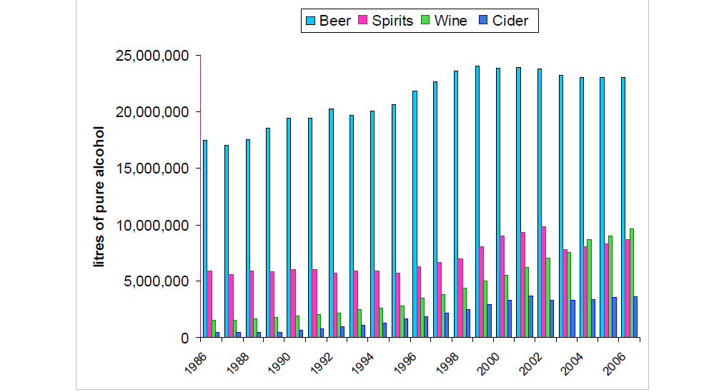
Hope 2006
Notes:
523% incease in wine sales

Slide 14
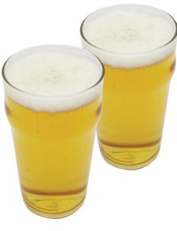
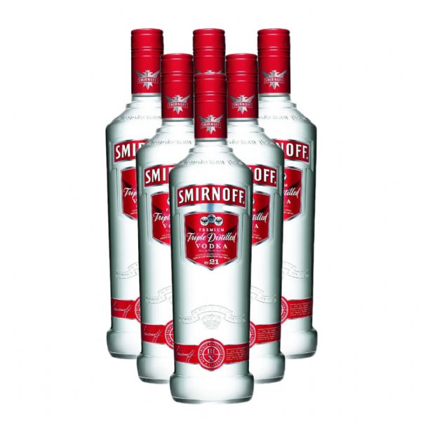
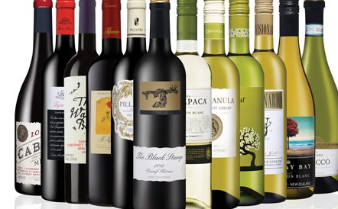
Non-drinkers…?
11 litres of alcohol ????
20%
116 Bottles Wine
445 Pints
41 Bottles
46 Bottles
130 Bottles Wine
498 Pints

Slide 15
Is this too much??

Slide 16
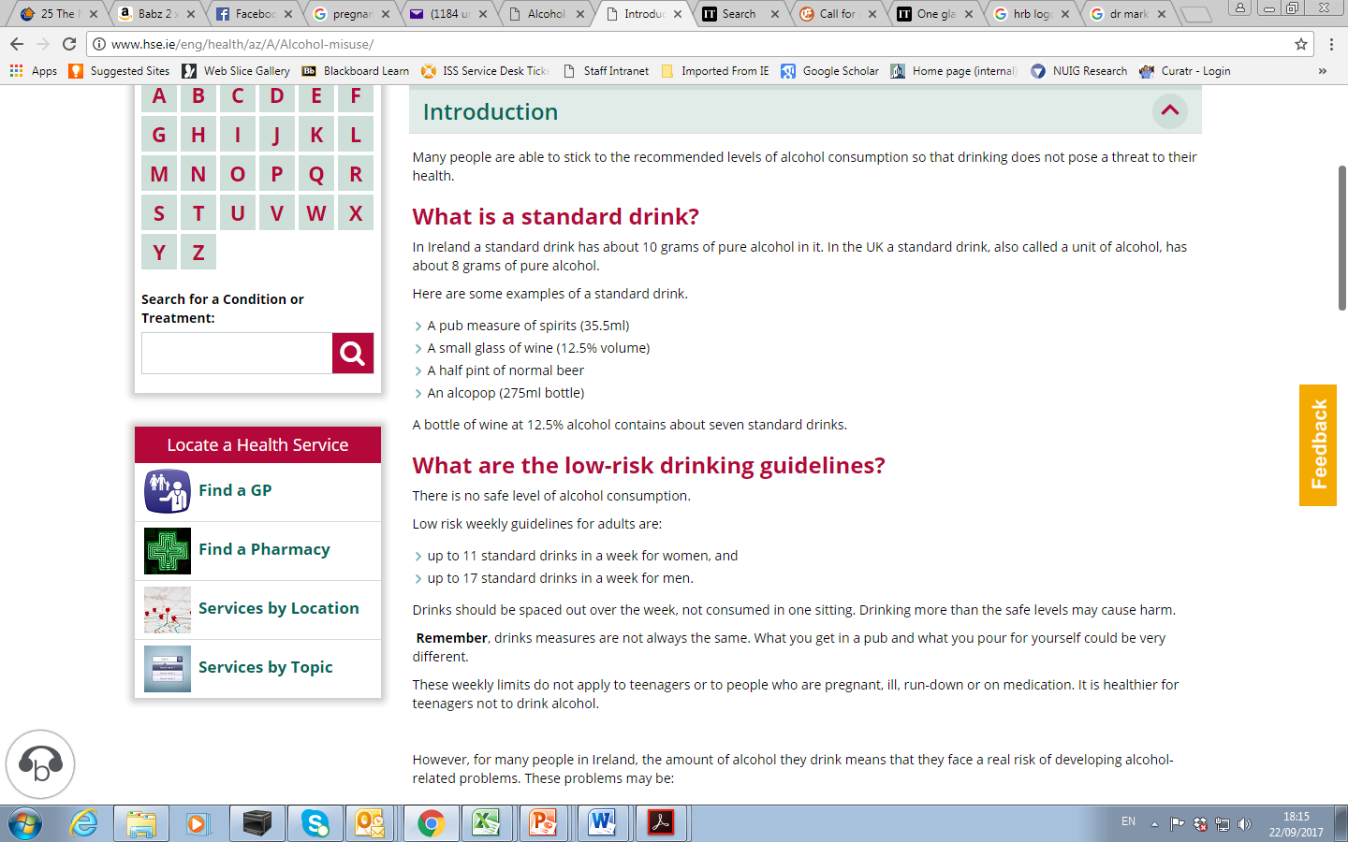

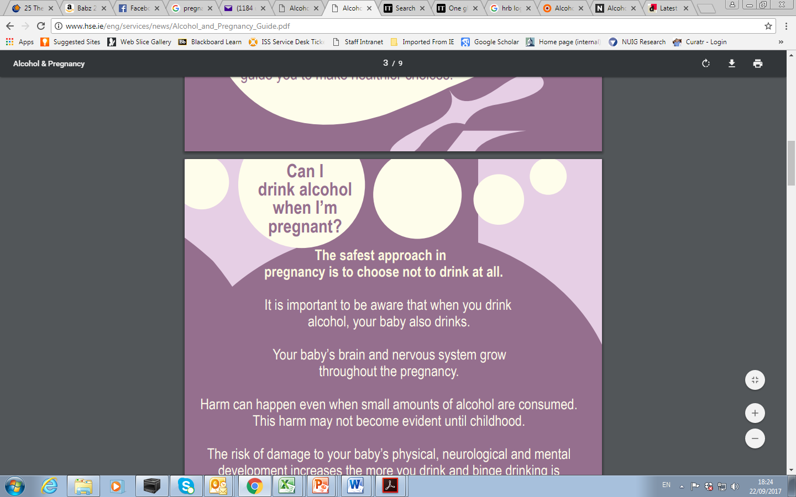

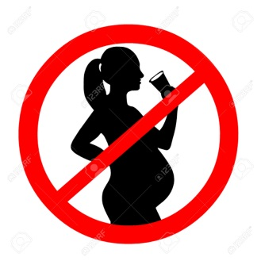
11
17

Slide 17
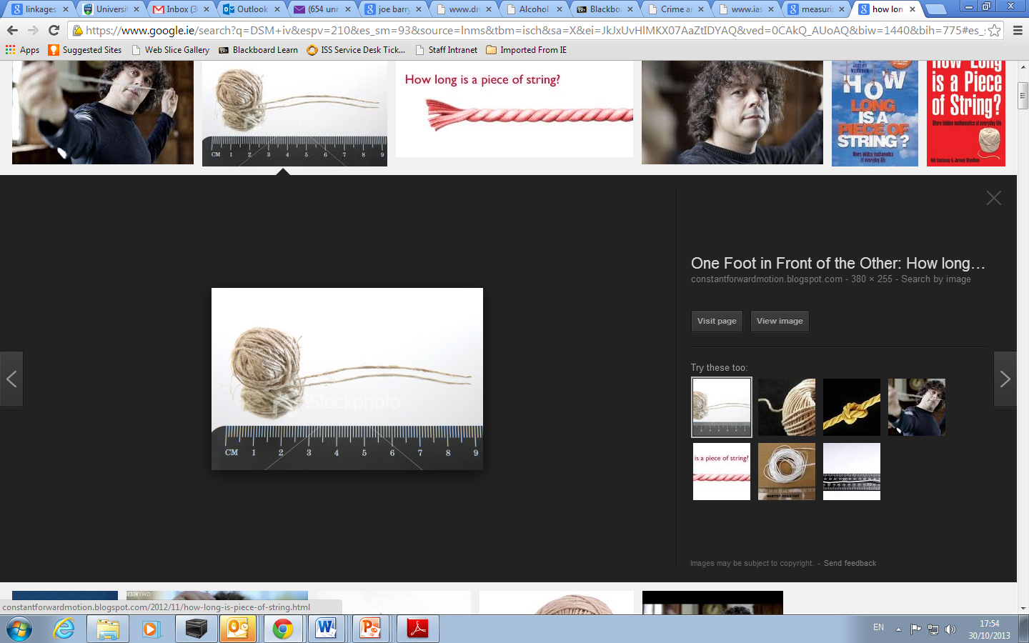
A unit of alcohol….

Slide 18
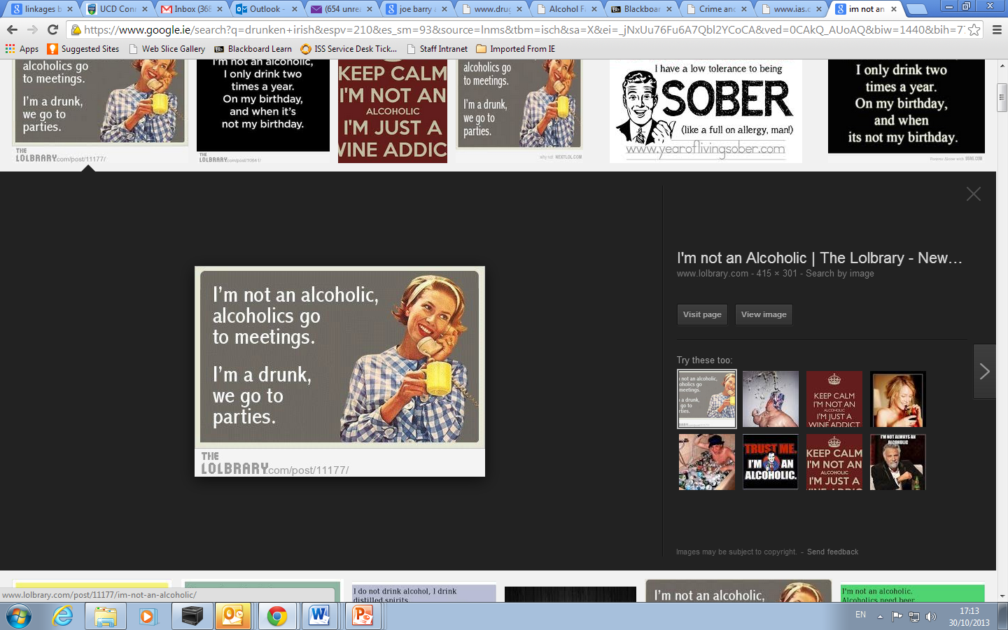

Slide 19
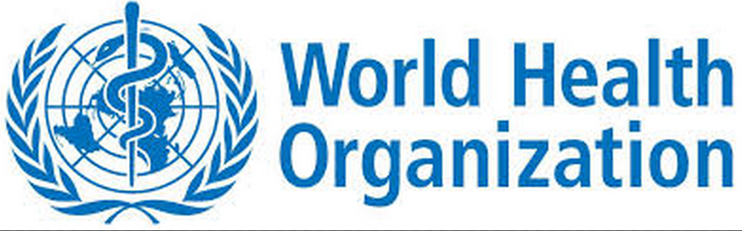
Hazardous drinking
A level of consumption / pattern of drinking which 'is likely to result in harm should present habits persist - potential consequences can be of public health significance despite absence of current harm
Harmful drinking
A pattern of drinking which causes harm to the health (physical or mental) of the individual without the presence of alcohol dependence.57 Commonly but not invariably has adverse social consequences
Dependent drinking
A cluster of cognitive, behavioural and physiological characteristics indicating that the patient continues using alcohol despite significant alcohol-related harms. Medical diagnosis of alcohol use disorders is generally guided ICD-10 and DSM-IV

Slide 20
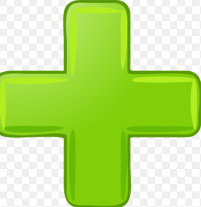
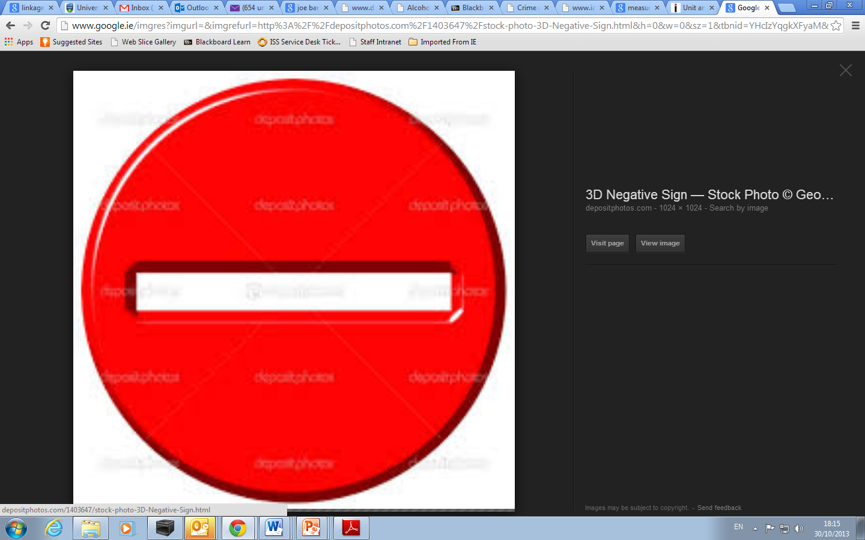
Impacts of alcohol

Slide 21
Alcohol
Health
Social
Family
Education
Employment
Crime
Road Collisons

Slide 22
HEALTH
Cancer
CVD
Psychiatric
GI
ID
Diabetes
Maternal
Perinatal
Injury

Slide 23

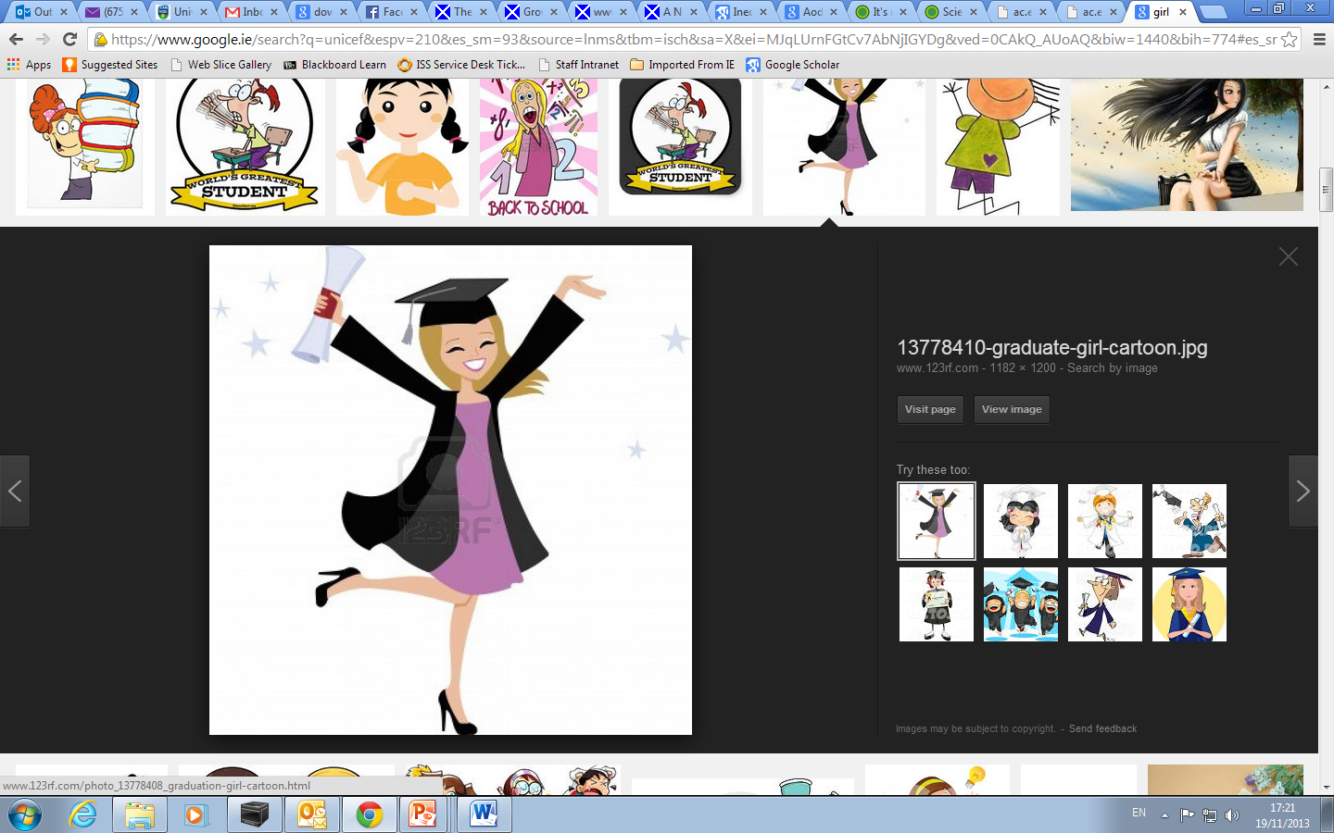

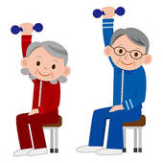




Who?

Slide 24
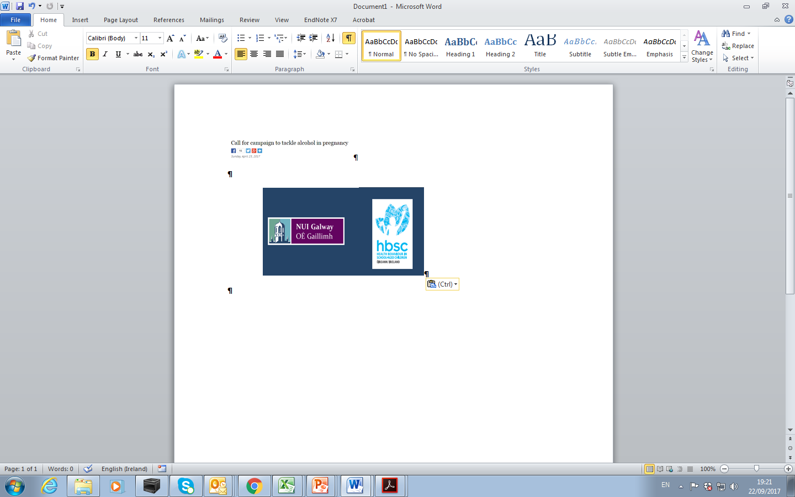
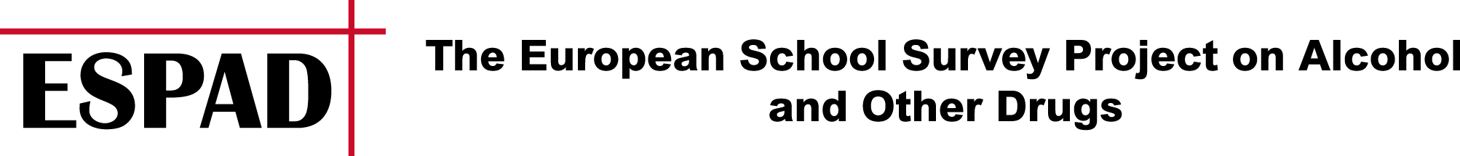
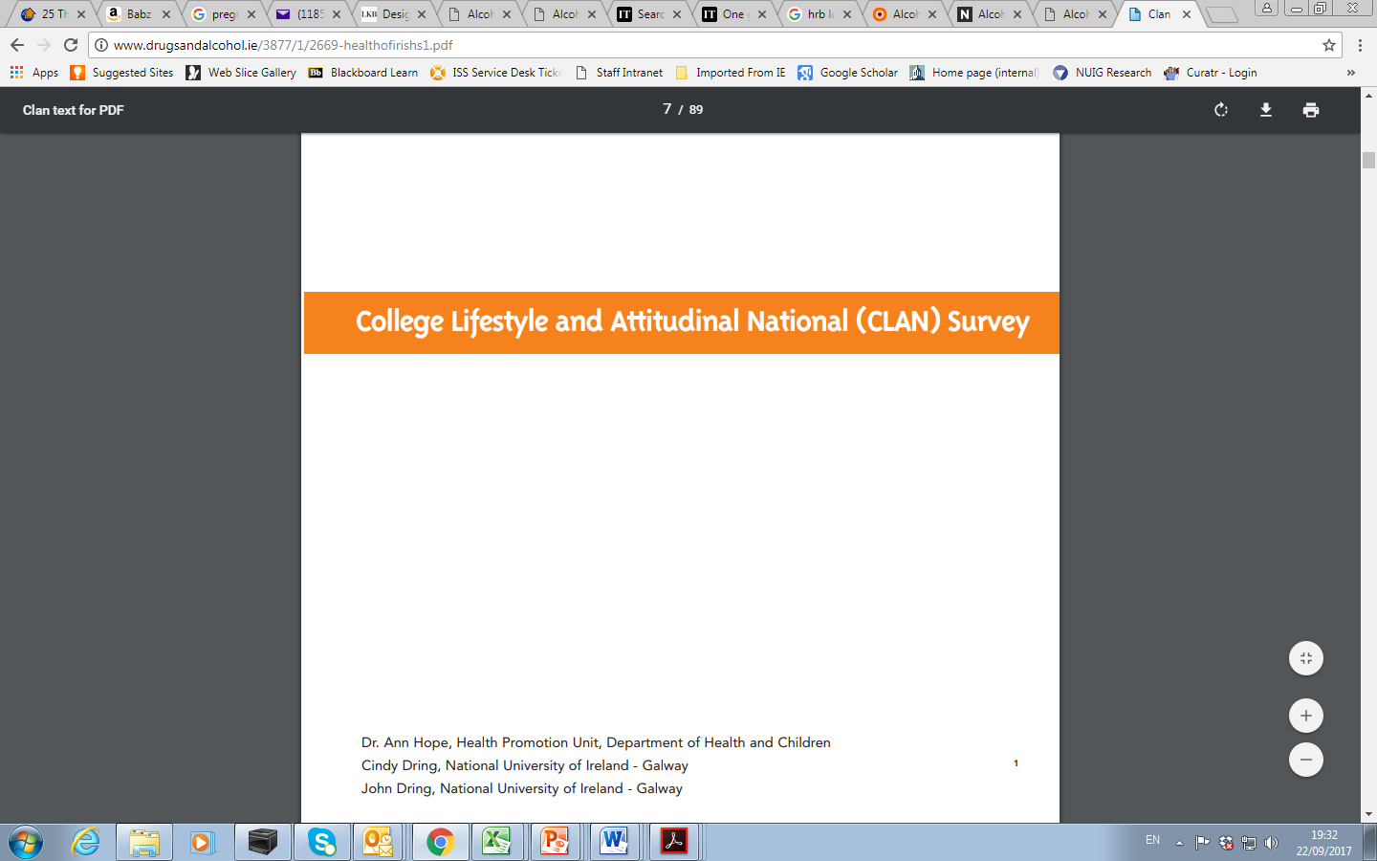
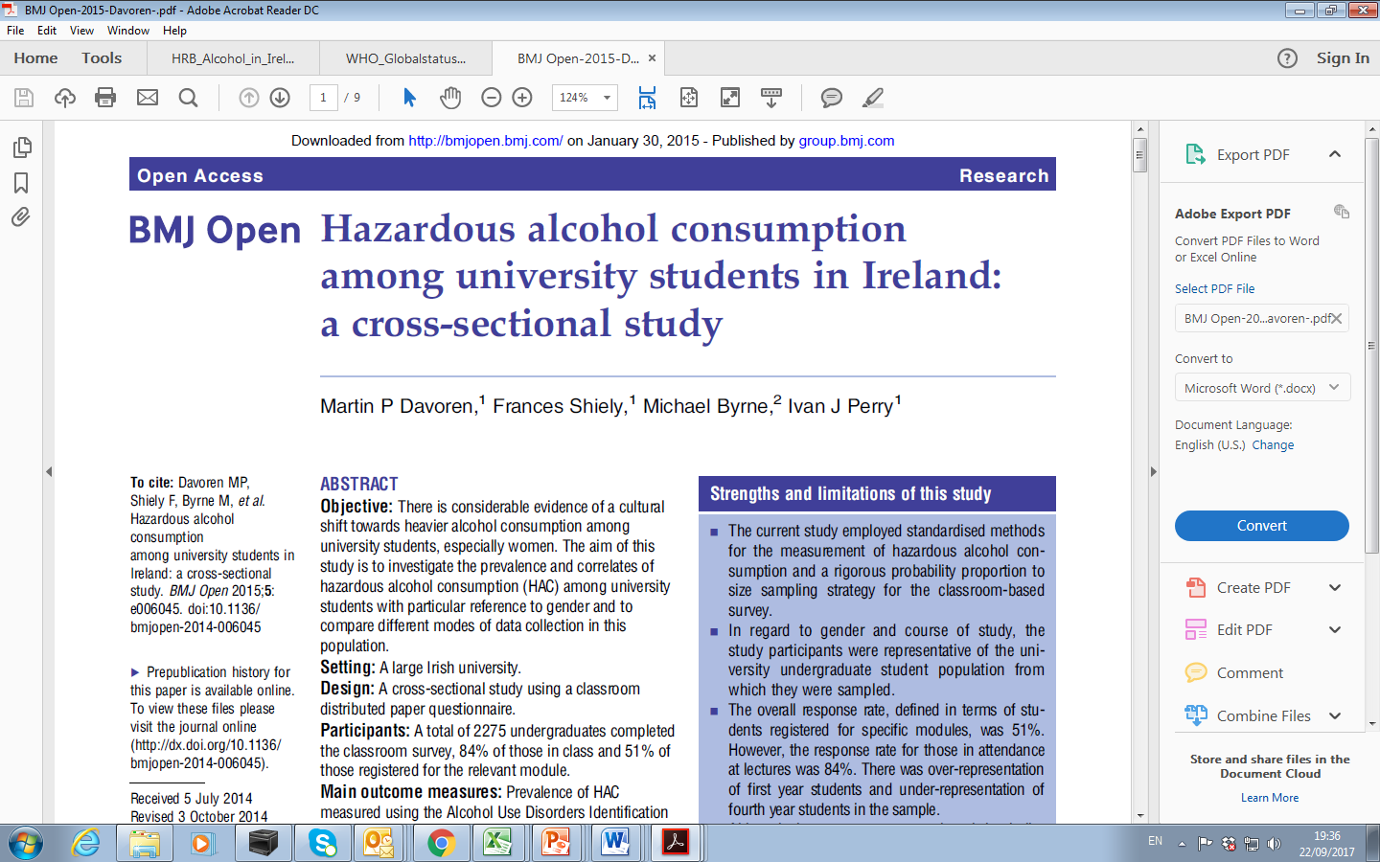
How much?
51% 13-17 years old school children ever drank
26.6% 13-17 years old school children been ‘really drunk’
Irish school children – highest rates of ‘drunkeness’ and ‘binge drinking’ in Europe
Binge drinking 60/100 occasions
Hope, Dring, Dring. (2005)
HAC 66.4% students (65.2% m, 67.3% f)
Davoren et al 2015
Notes:
23.2% of 13 YO → 83.3% of 17 YO
5.7% of 13 YO → 60.5% of 17 YO

Slide 25
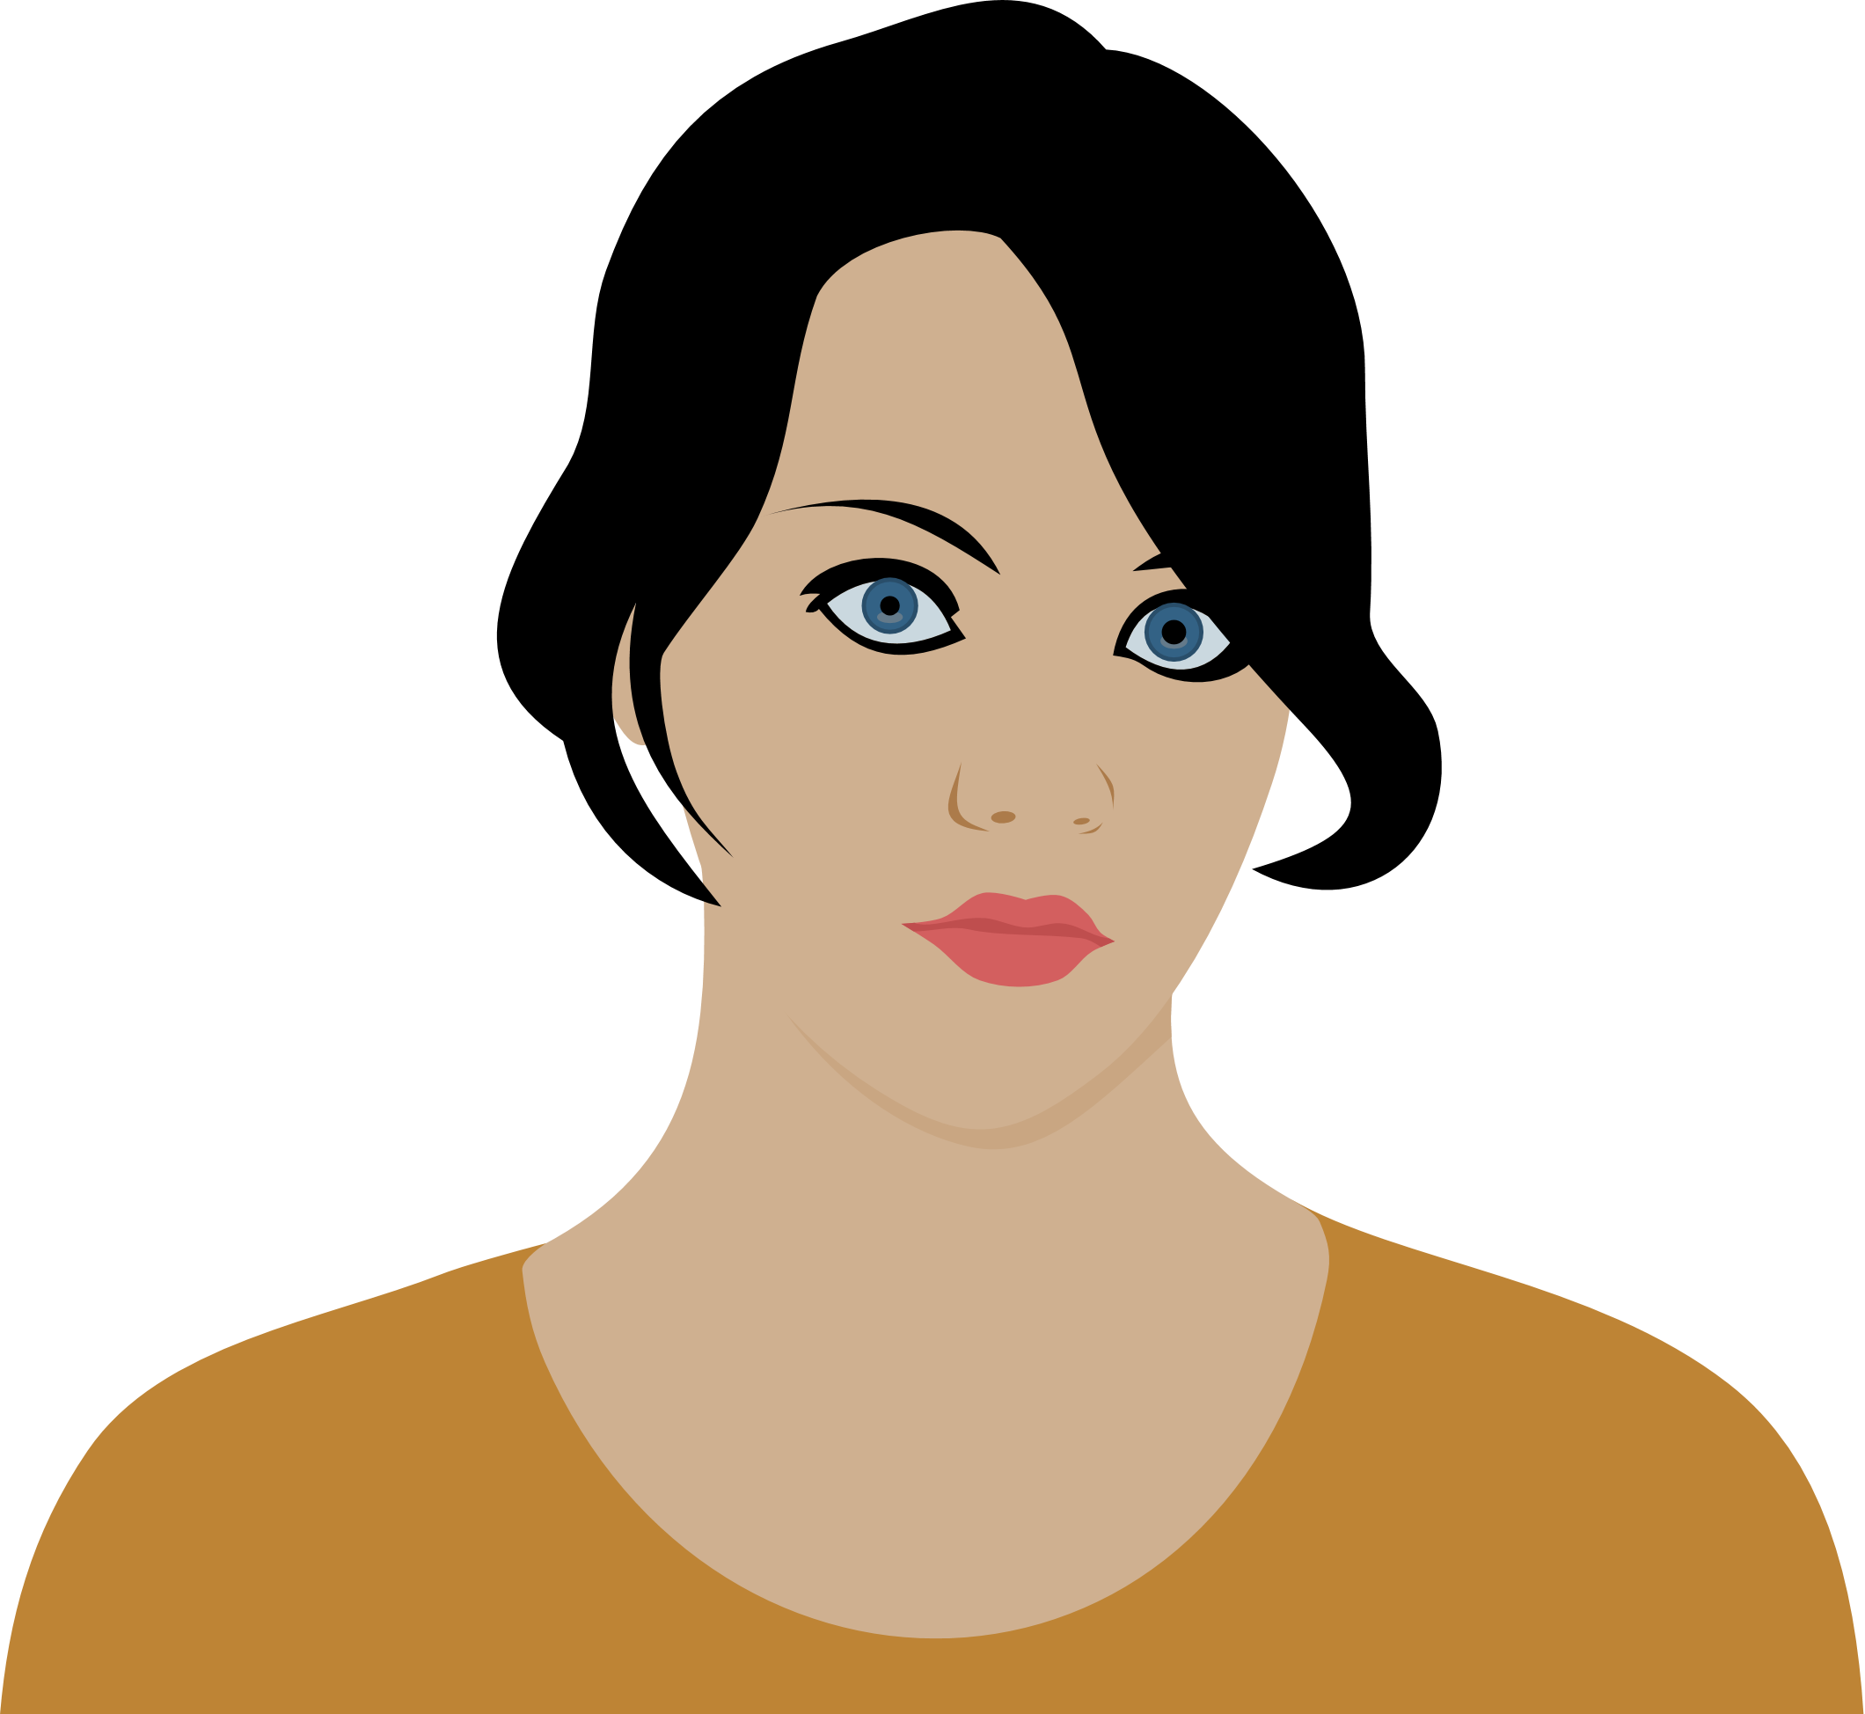
Changing female drinking patterns
Mongan et al. 2007, Mongan & Long 2016
Women > susceptible
/ vulnerable
Mongan & Long 2016, Edwards 2007
Links to breast cancer
Laffoy et al 2013
Hamajam et al 2002
Sexual / Reproductive health risks
Emmanuale et al, 2002, Rundle et al 2004, McBride et al 2010

Slide 26
Alcohol
Pregnancy

Slide 27
FASD
Fetal Alcohol Spectrum Disorder
FAS
Fetal Alcohol Syndrome
FAE
Fetal Alcohol Effects
Umbrella term
Alcohol consumption in pregnancy
Ranges in severity
Physical, cognitive and behaviourial
Facial dysmorphisms
Poor identification and monitoring of FASD
Prevalence estimates (per 1,000 births)
  United States 0.2-1.5
  Europe 0.4-19.8
(CDC 2002, May & Gossage 2001, Lange et al 2017)

Slide 28
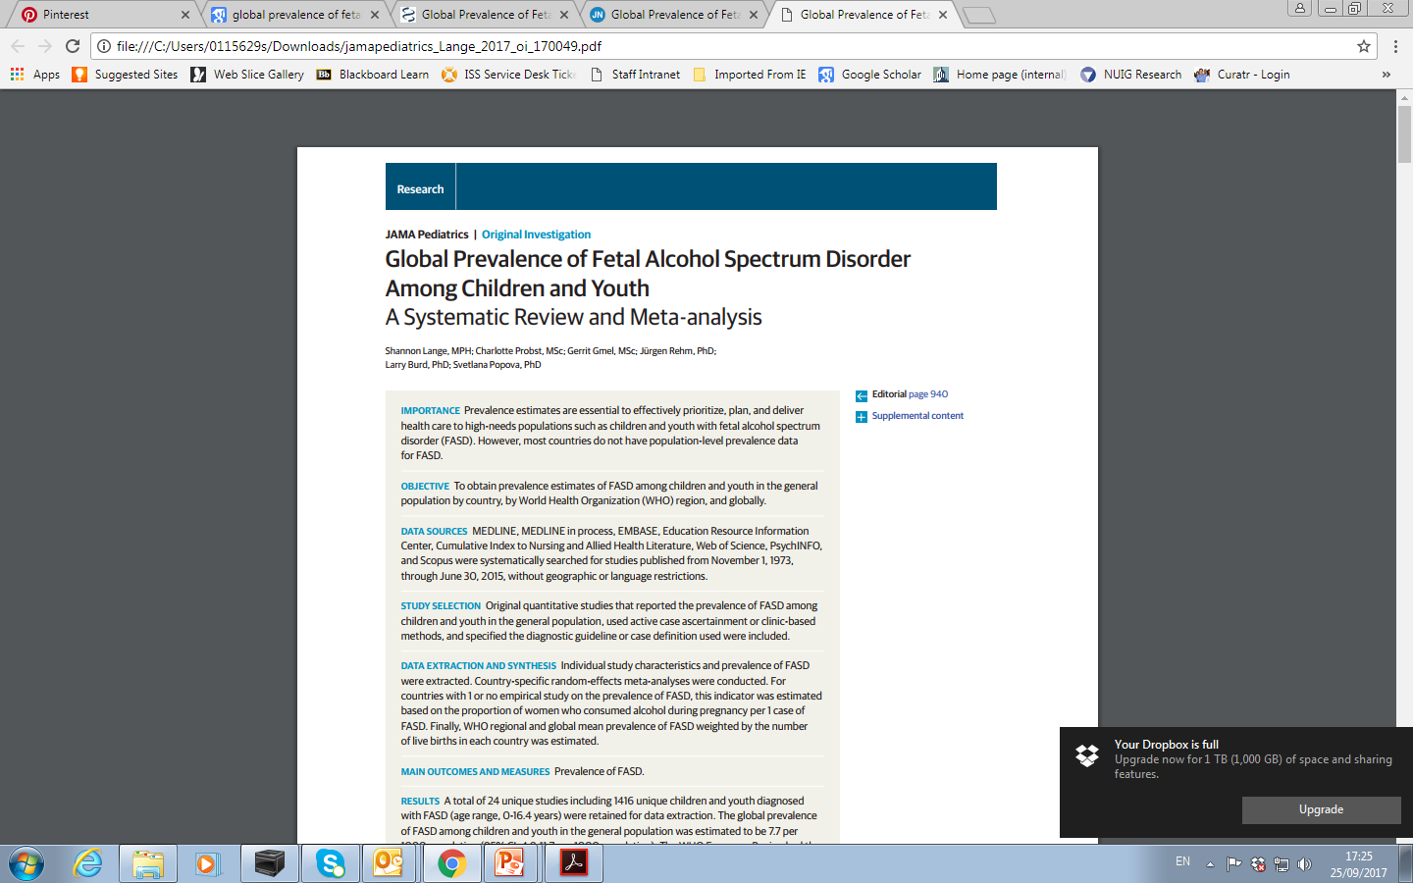
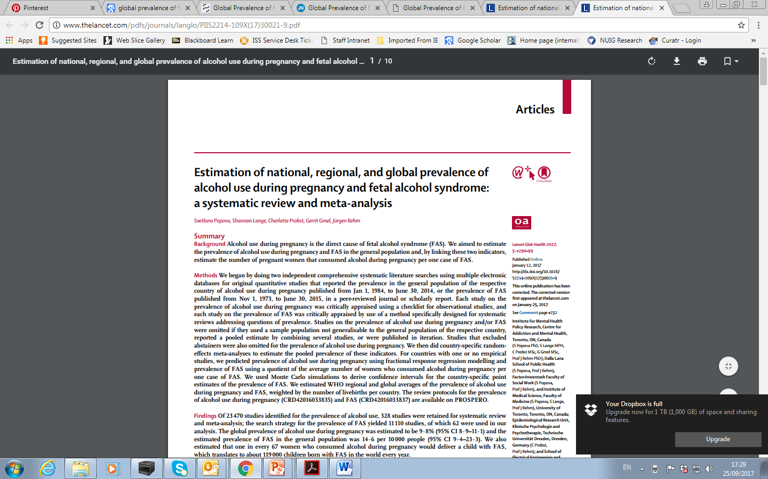
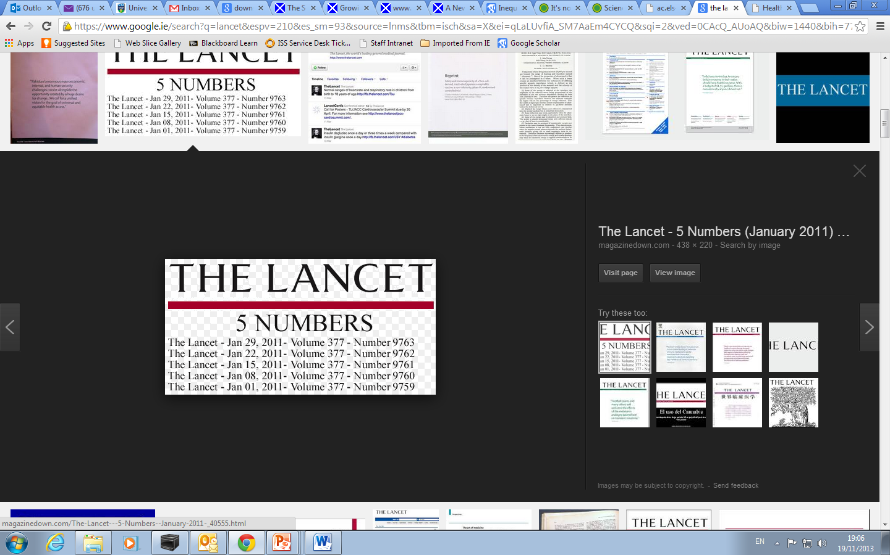
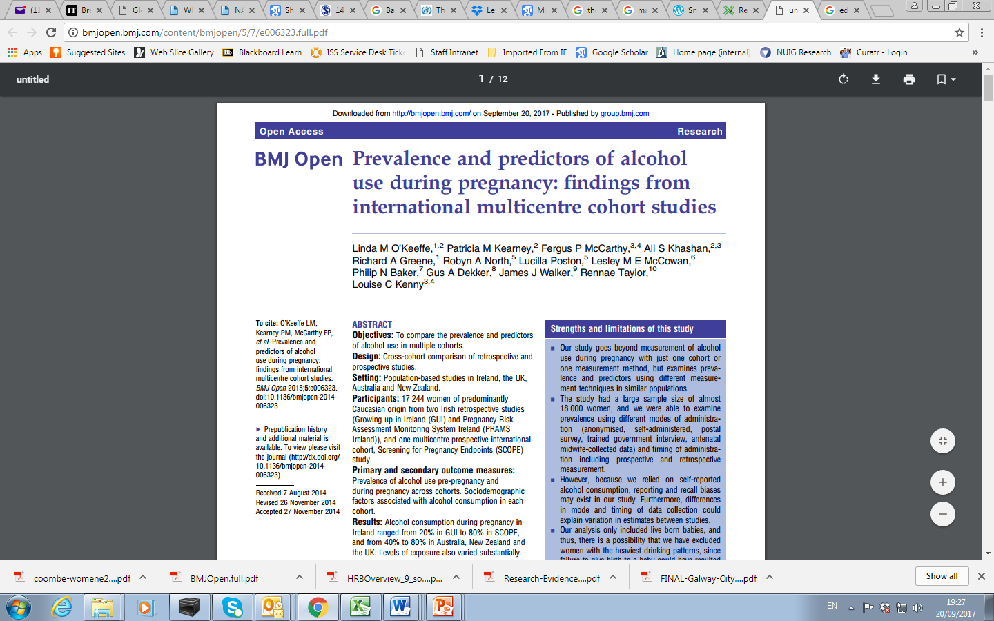
Global 7.7 per 1,000
↑ EU 19.8 per 1,000
> among children in care
> low socioeconomic groups
> people in psychiatric care
Global 14.6 per 1,000
↑ EU 37.4 per 1,000
Prevalence of alcohol use in pregnancy
  Global – 9.8%
  Europe – 25.2%
  Ireland 60.4%
20-80% alcohol during pregnancy
45% binge drink
Smoking > predictor
Notes:
5.2-67.7 > among children in care
23.7 > low socioeconomic groups
18.5 > people in psychiatric care

Slide 29
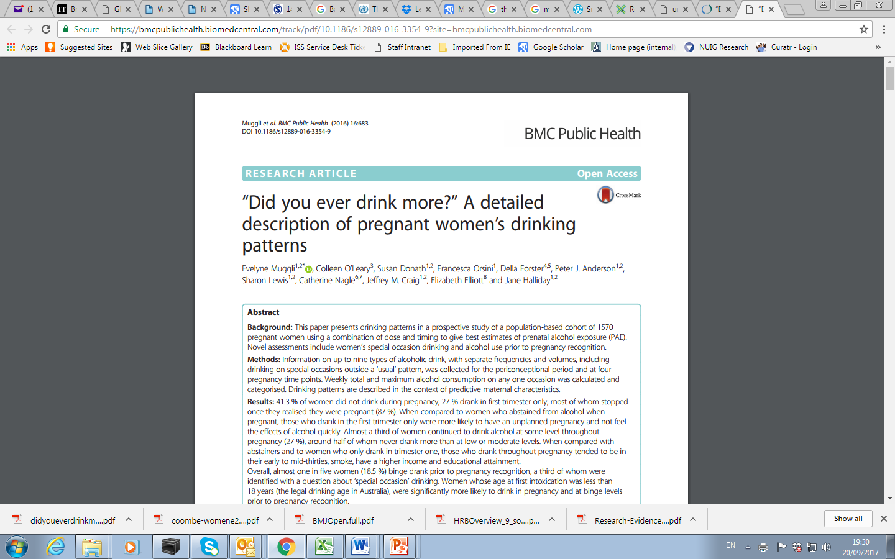
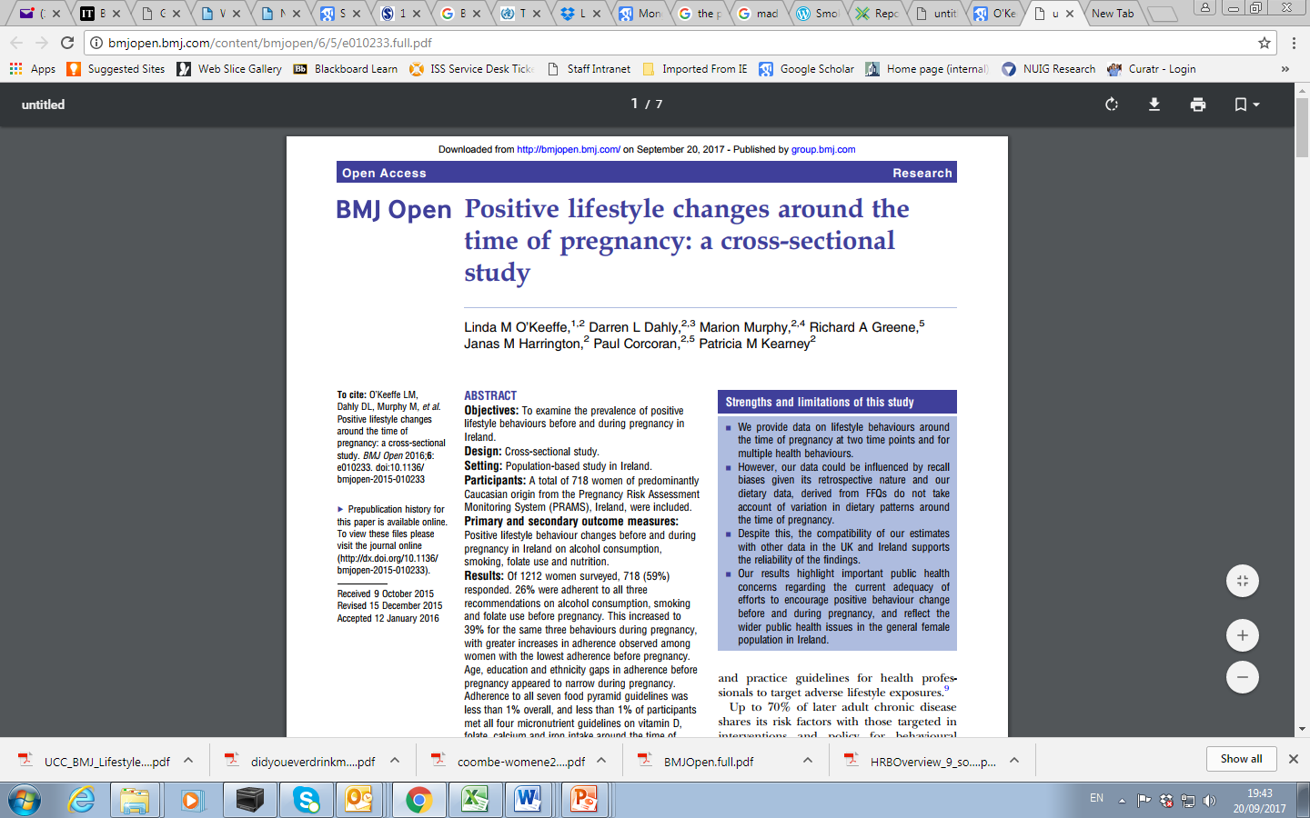
27% first trimester
27% throughout
18.5% binge
Continuous
30yrs+
> Income & education
Adherence to on alcohol, smoking and folate guidelines
  26% pre pregnancy
  39% during pregnancy
Low adherence –
Younger women
Less educated

Slide 30
Irish Studies
Dunney et al 2015
>older, > Irish, > private healthcare
Mullalley et al 2011
.2% heavy drinkers, aged <25 yrs, pre-term births
McCarthy et al 2013
23% binge in <15wks
Barry et al 2007
60% during pregnancy, 2/3s <18, steady increase over years

Slide 31
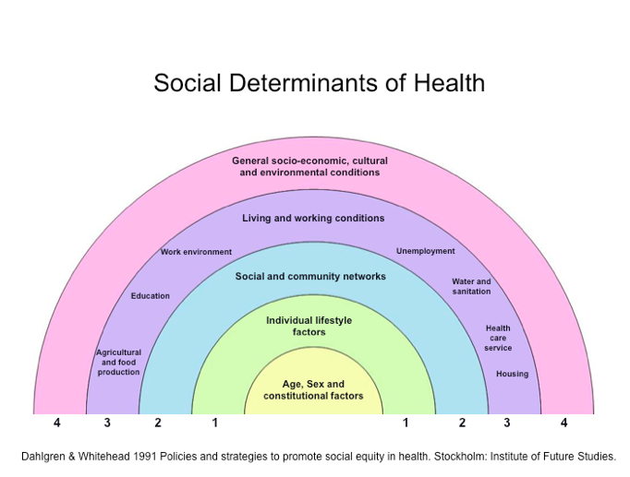

Slide 32

The Health Belief Model
Figure 5.1 The health belief model (original, plus additions in italics)
(Rosenstock, 1966; Becker et al. 1970s, 1980s)

Slide 33



Slide 34


Birth weight and mother’s education

Slide 35

Smoking and pregnancy
a) At any stage of pregnancy b) all three trimesters c) at time of interview when baby was 9 months.

Slide 36

Alcohol and pregnancy
a) At any stage of pregnancy b) all three trimesters c) at time of interview when baby was 9 months.

Slide 37

Ever breastfed by mother’s education and nationality

Slide 38



Slide 39
Social Acceptance
“Around here 20 units a week would be considered a kind of daily consumption… it makes it hard to convince them that their levels are abnormal, when they see all around them people behaving in the same fashion”
Male GP for 29 years
“Alcohol is a very deceptive drug and also because misinformation has being going around about alcohol since the beginning of time… particularly in the Irish culture… It is the culture of drinking”
(Male patient aged 54)

Slide 40
Complex Patients
Unmet need
Homelessness
↑ morbidity / mortality
Physical / sexual abuse
Substance misuse
Low quality of life
Stigma
Domestic violence
Fear of child protection issues
Family problems
Field 2013, De Maeyer 2010, Neale 2002.

Slide 41
Children
“It’s very hard to walk away from your children. I know you’re doing it for them, going into detox, but it’s very, very hard… It would kill me to walk away from my children… I know you’re going in to get better for them and they’d have a better life when you get out, and I know maybe it would be the best for them, but I don’t think I’d have the heart to walk away. It would kill me...”
(female patient aged 35)
Child
Protection
“… if somebody asked me about drugs I would be more ‘Oh my God they might take the kids off me.’ I have been more worried about that in the past… back then when life would have been hectic or erratic… you are obviously worried that someone would think that you weren’t able to cope with your kids”
(Female patient aged 45
Field 2013

Slide 42
Emerging Influences on Weaning Practices
The internet
Baby books
Grandparents
“You take the advice but you’re not actually going to 100% listen to them because…they have to give you that advice but you…you know better.”
Health professionals
“I felt that I was talked….at, instead of talked to, if that makes sense?”
Tully et al 2017
Notes:
Emphasise that these are preliminary themes which have emerged from just one round of coding on part of the data – cannot represent the full picture

Slide 43
Where are we now??

Slide 44


Slide 45



The Tobacco Journey
British Doctors Survey
Doll & Hill 1964

Slide 46


Thank you
Questions??

Slide 47
References
Barry S, Kearney A, Lawlor E, et al. (2007) The Coombe Women’s Hospital study of alcohol, smoking and illicit drug use, 1988-2005. Dublin: Coombe Women’s HospitalDavoren, Martin P., Frances Shiely, Michael Byrne, and Ivan J. Perry. "Hazardous alcohol consumption among university students in Ireland: a cross-sectional study." BMJ Open 5, no. 1 (2015): e006045
De Maeyer, J., W. Vanderplasschen, and E. Broekaert, Quality of life among opiate-dependen individuals: A review of the literature. International journal of drug policy, 2010. 21(5): p. 364-380.
Department of Health (2010) Growing Up in Ireland: National Longitudinal Study of Children. Key findings: infant cohort (at 9 months). Pregnancy and birth. Dublin: Department of Health.
Dunney C, Muldoon K and Murphy DJ, (2015) Alcohol consumption in pregnancy and its implications for breastfeeding. British Journal of Midwifery, 23(2): p.126-134.
Heath D.B. (1984) Cross-cultural studies of alcohol use. In: Galanter M. Recent Developments in Alcoholhism, Vol2, PP405-15. New York: Plenum
Hope A, Dring C, Dring J. College lifestyle and attitudinal national (CLAN) survey. The health of Irish students. Dublin: Health Service Executive, 2005
Hope, A. (2007). Alcohol consumption in Ireland 1986-2006. Health Service Executive – Alcohol Implementation Group.
Long J and Mongan D (2014) Alcohol consumption in Ireland 2013: analysis of a national alcohol diary survey. Dublin: Health Research Board.
McCarthy FP, O’Keeffe LM, Khashan AS, et al., (2013) Association between maternal alcohol consumption in early pregnancy and pregnancy outcomes. Obstet Gynecol, 122(4): p.830-7.
Mongan D, Reynolds S, Fanagan S and Long J (2007) Health-related consequences of problem alcohol use. HRB Overview Series 6. Dublin: Health Research Board.
Mongan D and Long J (2016) Overview of alcohol consumption, alcohol-related harm and alcohol policy in Ireland. HRB Overview Series 10. Dublin: Health Research Board.
Muggli, Evi & O’Leary, Colleen & Donath, Susan & Orsini, Francesca & Forster, Della & J. Anderson, Peter & Lewis, Sharon & Nagle, Catherine & Craig, Jeffrey & Elliott, Elizabeth & Halliday, Jane. (2016). “Did you ever drink more?” A detailed description of pregnant women’s drinking patterns. BMC Public Health. 16. . 10.1186/s12889-016-3354-9.
Mullally A, Cleary BJ, Barry J, et al., (2011) Prevalence, predictors and perinatal outcomes of peri-conceptional alcohol exposure--retrospective cohort study in an urban obstetric population in Ireland. BMC Pregnancy Childbirth, 11: p.27.
Neale, J., Drug users in society. Drug and Alcohol Review, 2002. 21: p. 407-409.
O'Keeffe LM, Kearney PM, McCarthy FP, et al Prevalence and predictors of alcohol use during pregnancy: findings from international multicentre cohort studies BMJ Open 2015;5:e006323. doi: 10.1136/bmjopen-2014-006323
O'Keeffe LM, Dahly DL, Murphy M, et al Positive lifestyle changes around the time of pregnancy: a cross-sectional study BMJ Open 2016;6:e010233. doi: 10.1136/bmjopen-2015-010233
Tully, L., Kearney, PM., Woodside, JV., McKinley, MC., Dean, M., Spyreli, E., Allen-Walker, V. & Kelly, C. (2017). Complementary feeding among parents from disadvantaged backgrounds: design and recruitment. Oral presentation at the Maternal and Infant Nutrition and Nurture Conference 2017: Nutrition and Nurture in Infancy and Childhood: Bio-Cultural Perspectives. Cumbria, 6th-8th June 2017

Slide 48
Alcohol Action Ireland www.alcoholireland.ie
Health Research Board www.hrb.ie
National Documentation Centre on Drug Use www.drugsandalcohol.ie
55. 56. Mullally A, Cleary BJ, Barry J, et al., (2011) Prevalence, predictors and perinatal outcomes of peri-conceptional alcohol exposure--retrospective cohort study in an urban obstetric population in Ireland. BMC Pregnancy Childbirth, 11: p.27.

