Slide 1
Workshop at FSN 5-Step Conference, November 2014
Steps to Cope:
Helping Young People (aged 11-18) affected by Parental Alcohol Misuse

Slide 2
Workshop overview
An introduction to Steps to Cope (StC).
StC in action:
  Thinking about how children & young people can be affected by parental alcohol misuse.
  Thinking about protective factors and resilience.
  Thinking about how children and young people cope.
How Steps to Cope can help children & young people.

Slide 3
What is Steps to Cope?
Structured brief intervention for YP who are living with/affected by parental substance misuse and/or mental health problems.
Adapted from theoretical & evidence based adult 5-Step Method.
Same delivery principles, availability of workbook.
2 pilot projects completed. Current 4 year Big Lottery funded project (focus parental alcohol misuse).
Currently only available in Northern Ireland, and following completion of 2-day training course.

Slide 4






Young people aged 11-18 across Northern Ireland will be better protected from the harm caused by parental alcohol misuse
Aims:
  YP to become more resilient.
  YP better able to deal with impact of PAM.
  Increased competency & effectiveness of practitioners & organisations to respond.

Slide 5
Project components
Train 2 cohorts of people – to be StC practitioners and then to be StC trainers.
  Ongoing training of other StC practitioners.
Use of adapted validation model used in RoI for adult 5-Step work.
StC website – information for children & young people, information for practitioners, online Steps to Cope intervention
  Only within Northern Ireland.
Workbook being revised.
Involvement of young people.

Slide 6
A reminder of the 5 steps
Step 1: What is living with this like for me?
Step 2: What information will I need or will I find helpful?
Step 3: How do I tend to cope or respond?
Step 4: What social support do I have?
Step 5: What further help might I need?

Slide 7
Workshop Exercise 1:
Thinking about parental alcohol misuse
Small group work.
Exercises from workbook.
15 minutes.

Slide 8
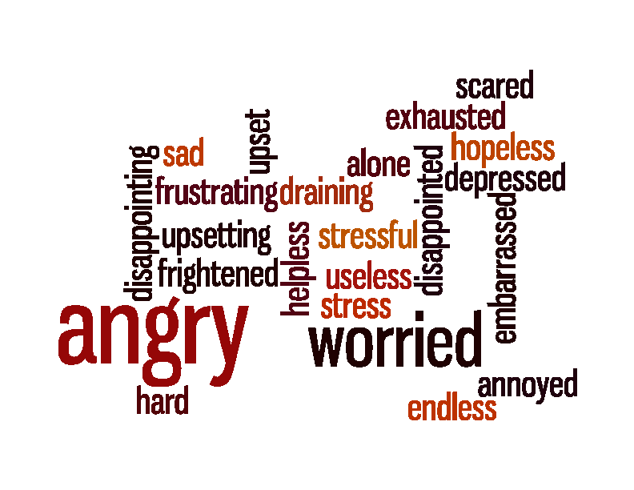
What’s it like to live with someone with these problems?

Slide 9
Girl (14), both parents with alcohol problems and a mother who also had a problem with tranquillisers
“I sometimes feel alone or it is my fault. It’s hard to live with a mum that is addicted to tablets and alcohol”. It is stressful because her mum goes missing sometimes, there is arguing between her parents and sometimes her mum will fake prescriptions to get tablets. YP describes how she is affected by her mum’s behaviour – “she makes promises she can’t keep, she tells lies, she wasn’t always there for us when we needed her most”. YP described how all areas of her life have been affected – she doesn’t eat much and is teased at school because of her weight, she also said that she finds it hard to concentrate at school. YP finds it hard and lonely because she has to care for her younger sibling and “I worried about what the whole family thought about me saying I wanted to leave home. Because I couldn’t cope”. YP described how much she kept to herself – “I felt sad and angry. I used to cry at night in bed on my own. Because I didn’t like what was happening......I found it hard to sleep at night.....family life was hard and lonely....”

Slide 10
Boy (15), maternal alcohol & mental health problems
YP said that it is depressing “seeing mum in that way” and that he feels the pressure and stress from looking after, and worrying about, his younger siblings. YP said “there’s always a drama” and his mum can be irritable and his mum and step-dad fight. YP has considered that perhaps his mum didn’t love him. He is closer to his step-dad but is worried about his siblings and his mum’s health and that his mum won’t wake up. He has missed school because of late nights, can’t concentrate very well and can’t do his homework at home. YP said, “[I’m] worried about mum, sisters and then me last.....[I have] trouble getting to sleep, [I have] tension in [my] stomach [and I’m] tired all the time”

Slide 11
Are all children equally affected?
In short, NO!
Some children are not always as affected by parental alcohol or drug problems as we might expect.
Influenced by a range of variables.
Increased recognition of a set of protective factors and processes (individual, familial and environmental), constituting a dynamic process usually referred to as ‘resilience’, which can buffer children against the negative effects of parental substance misuse and reduce the risk of negative outcomes.
Increasingly part of interventions in this area.

Slide 12
Some definitions
A protective factor or process reduces or prevents the impact of a risk factor by “modify[ing] or transform[ing] responses to adverse events” (Benzies & Mychasiuk, 2009)
A resilience factor or process is something which supports a child to avoid the harms often associated with a risky environment.
Resilience can be defined as “normal development under difficult conditions” (Fonagy et al., 1994) or “a universal capacity which allows a person, group or community to prevent, minimise or overcome the damaging effects of adversity” (Grotberg, 1997 p7 in Sawyer, 2009 p4).

Slide 13
Workshop Exercise 2:
Protective factors & resilience
Small group work.
Flipchart.
10 minutes.
What are some of the individual, family and social/environmental protective factors that might be present?
How might you identify ‘resilience’ in a child/young person?

Slide 14
Protective factors and processes, and evidence of resilience
Presence of a stable adult figure (esp. a non-using parent).
Close positive bond with an adult in a caring role.
Wider, positive, support network incl with peers.
Parenting style and positive family environment.
Individual temperament.
Engagement in a range of activities.
Positive opportunities at times of transition.
Problem short-term / parent seeking help.
Deliberate planning by a child that they will be different.
Self-efficacy, self-esteem, confidence.
A good repertoire of coping responses.
Ability to cope with change.
Problem-solving skills.
Feeling that there are choices and that the child can be in control.

Slide 15
Workshop Exercise 3:
Thinking about coping
Pairs.
Handout cards.
10 minutes.

Slide 16
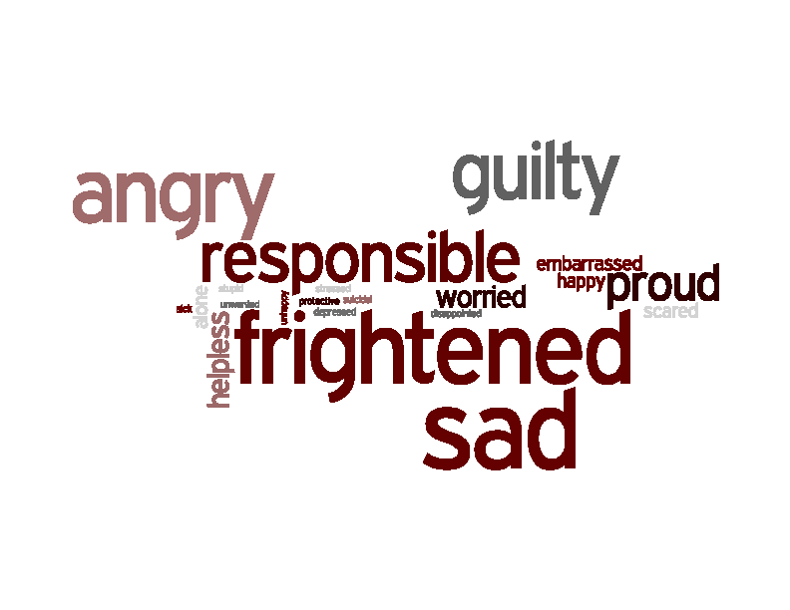
How do you feel about the things you do to cope?

Slide 17
Benefits of Steps to Cope
2 pilot projects (2011-2013).
57 practitioners trained: 20 used StC (1:1 & groups).
43 YP. Roughly half with PAM (majority maternal). Many living with problems for 10+ years.
Encouraging findings – in the short-term it seems that StC can benefit YP in a range of areas in line with the steps.
Benefits also for practitioners – not explored here.

Slide 18
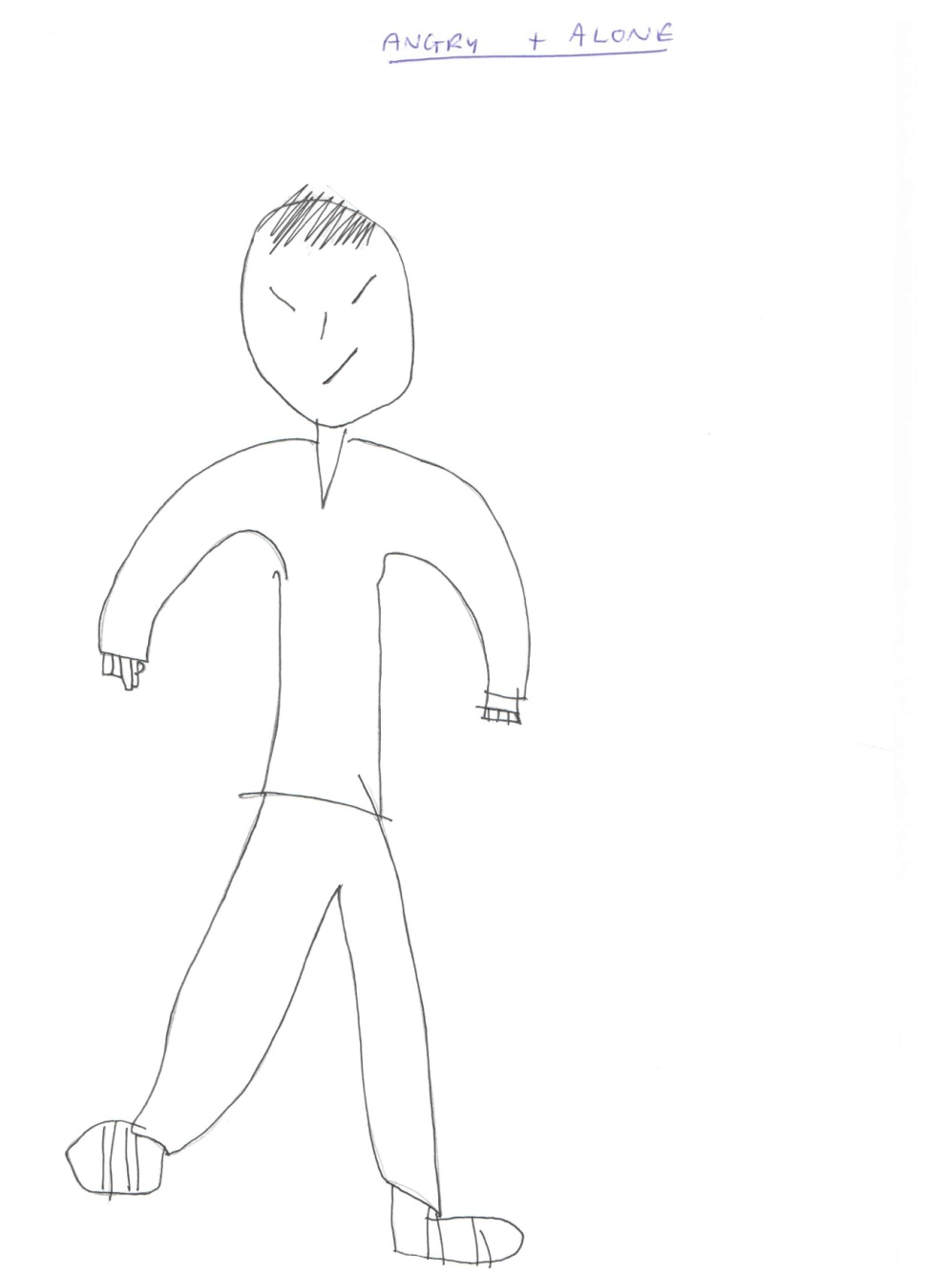
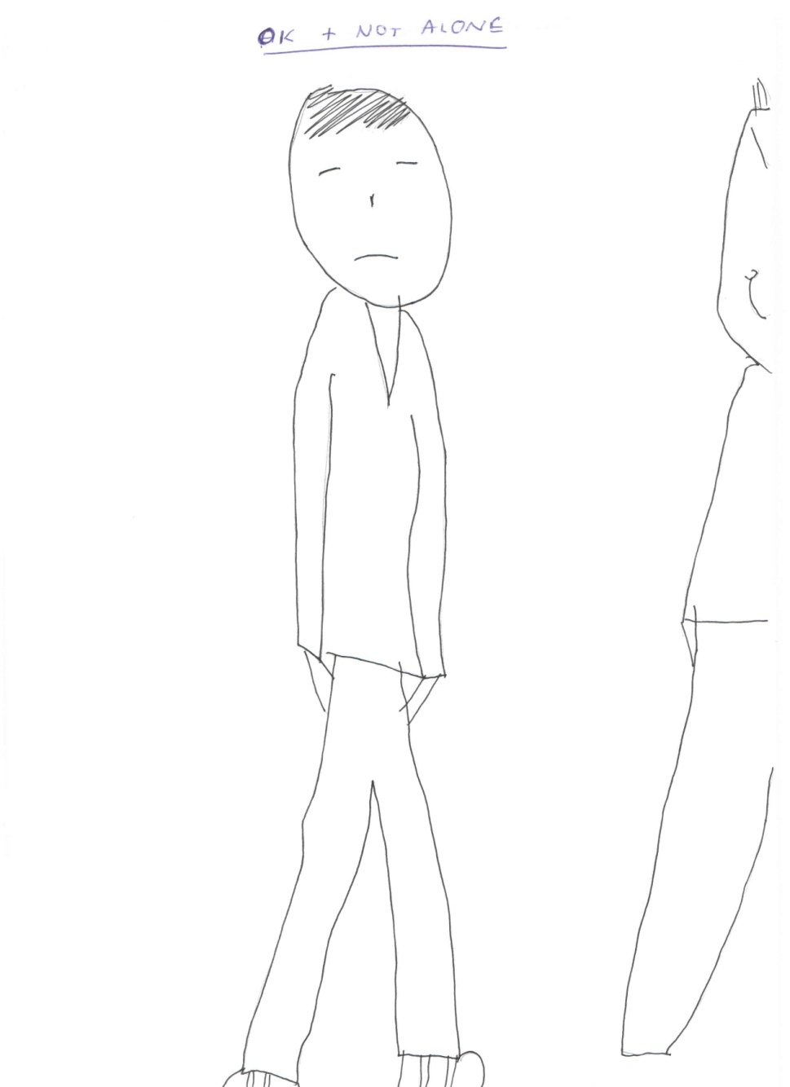
Notes:
18

Slide 19
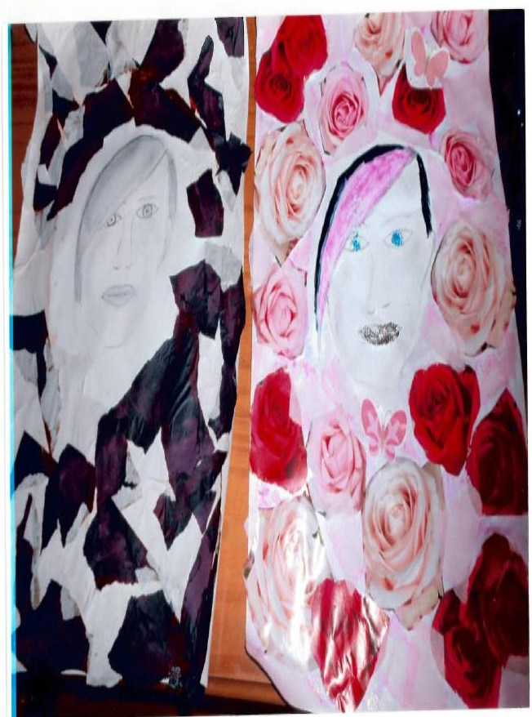
In her own words – girl aged 14

Slide 20
In her own words – girl aged 14
“Before I started meeting with [Jane], I didn’t like talking about any problems I had and often bottled my issues up, this always ended up in the same result. I would end up breaking down and often didn’t realise why I was so upset as I was used to blocking things out. I found it hard trusting people, including friends which had quite a negative impact but I [saw] this as a way of protecting myself, as I was always used to people letting me down”
BEFORE
“Since I’ve started working with [Jane] I’ve become more open. I know that I have to learn to trust people because not everyone is going to let me down. I can talk about my problems more easily and this has had a very positive impact on my life. I have also learnt to sort out my problems because avoiding them does not help the situation. I think the booklet is the main reason I have progressed so much, in my own state of mind”
NOW

Slide 21
Wider benefits from Steps to Cope
Young Person
“....we talked about it together which we had never done before, like in other things it was just by ourselves separate [where with] this we got to talk together....we went through the book together so my mum understood how I was feeling.....it was a bit weird because we’d never done that before but I think it was a good thing....I guess [she responded] the best way that she could’ve....she was telling me that it’s not my fault and stuff like that....and she wouldn’t want me to do it...she just understands now how I was feeling”
Practitioner
“....today was just a great opportunity for the young person to be able to say how she felt, and she felt safe in doing that, that it wasn’t something that couldn’t be talked about.....they found it very useful and they could all say how they were affected...then mum was then saying look nothing I do, it’s not your fault at all, I am responsible for my drinking.......she has an idea of how possibly she could be affected, to actually hear that and sit down together was very powerful, and I think her thinking has changed even in relation to trying to control her alcohol use”

Slide 22
Reviewing goals (N=17)
Goal | Response
I do not feel so alone I am feeling it’s not my fault I am not feeling so embarrassed or ashamed I understand more about addiction or mental health issues I am coping better I have someone who can help me | 15 14 10 17 13 17

Slide 23
Finding out more
See Alcohol Research UK website for summary and report from 2nd StC pilot project.
Templeton & Sipler (2014) – academic paper published in Drugs and Alcohol Today.
08002545123
aislinn@ascert.biz
www.ascert.biz
LTempleton72@googlemail.com
Acknowledgements: Ed Sipler, other members of AFINet UK, Steps to Cope partners/team in Northern Ireland, Big Lottery (funders of current project), participants in StC projects, Simon for idea of how to adapt the coping exercise.

Slide 24
Feedback on Workshop
What do you consider the TWO most positive outcomes to be achieved from working with young people in this way?
What barriers might present in working with young people in this way? - Prioritise maximum TWO and suggest solutions

