Slide 1


Adapting an Adult Model for Children and Young People
The Opportunities and Challenges
Ed Sipler
11/11/14

Slide 2
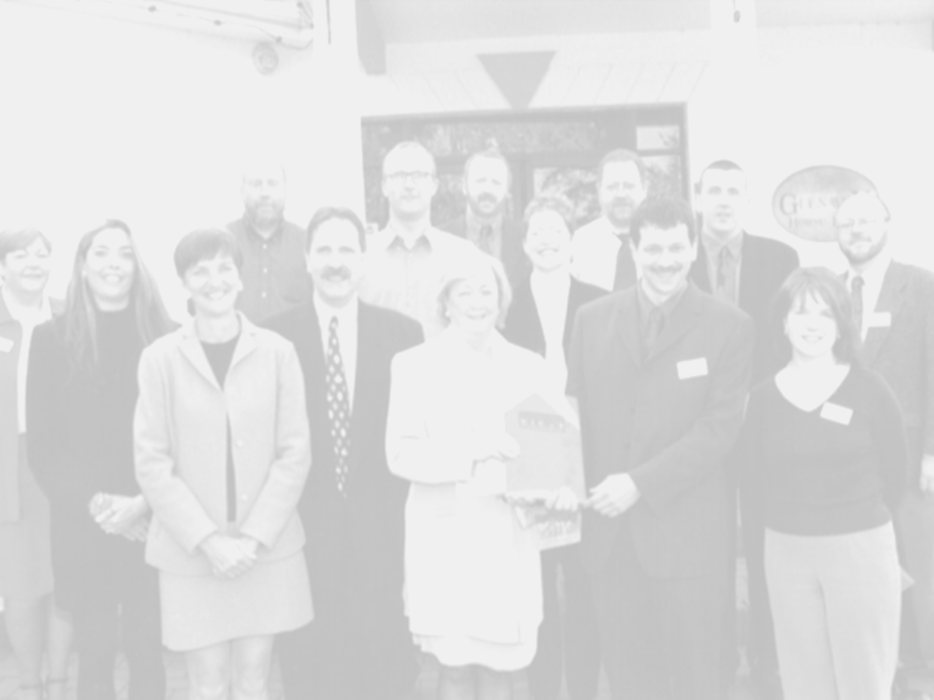
We have been following the development of the 5 Step Method for a long time
Have you ever gone to a conference and heard a good idea? ( We first heard of 5 Step work in 2001 & 2002 )
So you hear about an intervention can you just use it for a different group it was designed for?

Slide 3


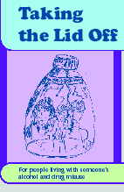
It did shape how we responded to NICE Guidelines
Provide verbal and written information and advice on the impact of drug misuse on service users, families and carers.
Where the needs of families and carers of people who misuse drugs have been identified staff should offer guided self-help, typically consisting of a single session with the provision of written material.
Provide information about, and facilitate contact with, support groups, such as self-help groups specifically focused on addressing families’ and carers’ needs.
Drug misuse: psychosocial interventions, Guidance CG51, NICE 2008

Slide 4
But NICE say to do more
  If they need more
  provide information and education about drug misuse
  help to identify sources of stress related to drug misuse
  explore and promote effective coping behaviours
  This work normally consists of at least five weekly sessions.
What we are talking about here is the
5 – Step Method

Slide 5
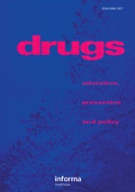
March 2010, Another conference and hearing about the evolution of 5 Step work
It was also when a supplement in Drugs: Education, Prevention, and Policy was dedicated to research on the Five Step Method (Volume 17, Number s1 (2010)
It was that at this conference the relationship/ partnership with the Taking the Lid Off Partnership (ASCERT, Barnardos, South Eastern H&SCT) and the UK Alcohol Drugs and the Family Research Group began.

Slide 6
Why do we need an intervention for young people in their own right?
‘I felt sad and angry. I used to cry at night in bed on my own.
Because I didn’t like what was happening......I found it hard to
sleep at night.....family life was hard and lonely'
At least 18 000 children aged 11-18 in Northern Ireland are living with parental substance misuse
Alcohol plays a part in a third of known cases of child abuse and is a feature in a majority of domestic violence offences
40% of children on the child protection register are there as a direct result of parental substance misuse.
70% of our “Looked After Children” are living away from home as a direct result of parental substance misuse.
Because of the very definition on “Hidden Harm” . The serious negative consequence on children and young people.

Slide 7
Developing 5 Step work for young people
Research warns against the straight translation of an adult service for young people (E.g. Crome, 2006)
Are there exclusion criteria?
Harwin(2010) suggested brief intervention type work may not be enough for at risk young people
Lorna (who you get to meet) challenged us to think of the creative ways to meet the needs of young people(2010)
Parental consent versus Gillick competence

Slide 8
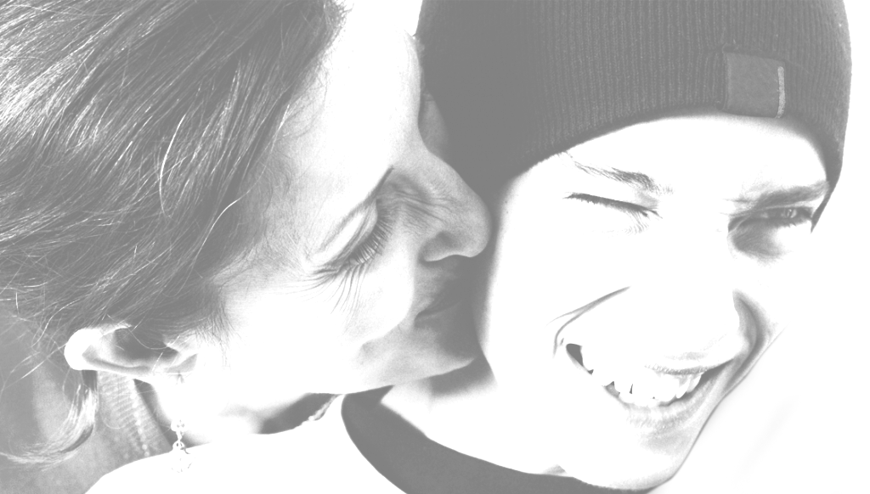
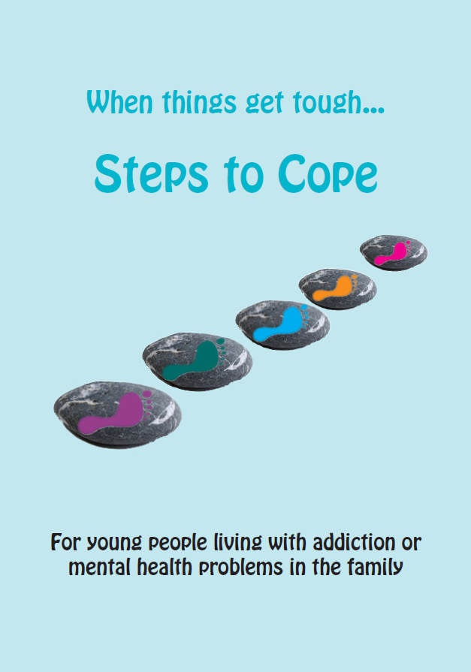
The Challenges of Developing an Intervention for Young People From an Adult Model
Styles of coping are different for young people compared to adults
Materials have to be suitable for young people
Engaging young people in a structured intervention can be difficult but it may be just what they need.
Make sure you take time to engage the young person on their level.
Safeguarding issues
You need to test the intervention and listen to the feedback from young people

Slide 9
What Our Pilots Told Us
Pilot studies funded by the Regional Hidden Harm Quality Assurance Group (PHA/HSCB) and Alcohol Research UK
2 pilot projects (2011-2013)
Added Parental mental health
57 practitioners trained:
20 used StC (1:1 & groups).
43 YP. Many living with problems for 10+ years.
Encouraging findings
Benefits also for practitioners ; Those who did the work valued the structure of the intervention.
It did have its challenges:
Large degree of attrition
Practitioners who wanted to be supportive of young people but did not have capacity to deliver even a brief intervention like Steps to Cope
Keeping practitioners to fidelity of the intervention
Workers seeing the value in quantitative tools

Slide 10

Some of the things young people told us about how their parents drinking affects them
Worries 'I worry all the time about Mum & family‘ 'Scared mum will die‘ 'Worried about everything‘ 'That I am so alone' | Health 'Always wake up during the night, feel drained‘ 'No food in the house and I got really hungry‘ 'Sometimes won’t get up, drink a lot, hide away‘ 'Lots of bad memories’
Feelings Sad, depressed, angry, helpless, despairing, anxious, nervous, always watching & waiting for something to happen, (always) worried, scared, embarrassed, lonely/alone, can’t win, annoyed, cry a lot, confused, distressed/lost, numb
'I don’t know how I’m feeling, sometimes I think I want to help her, other times she makes me so angry.‘

Slide 11
How STC Helps Young People
Think and talk about their experiences and understand their feelings – many had not done this before, or had ever been asked.
Feeling less alone and understanding that these are common problems which affect a large number of children and young people.
Learning and understanding about addiction
Increased recognition that the problems are not the young person’s fault.
Thinking about coping, and making changes to coping which the young person feels are more helpful.
Thinking about support networks and who the young person can turn to for help.
“I think he feels a bit better from having been
able to talk about it.....and be believed”

Slide 12
The Challenge: What We are Working on to Take it Forward
To get started:
Funding
Clear outcomes
Policy context
Regional buy in
Now that we are started:
How the project is managed
Support pathways
Design and web based plat form
Young people’s involvement
Training and validation process
Training for trainers process
Regional practitioner network
Evaluation
Sustainability

Slide 13

Project Funding and Outcomes
.
Young people will be more resilient and be better protected from harm from parental alcohol misuse
Young people will be more able to deal with the impact parental alcohol misuse has on their lives
Relevant organisations' and practitioners will be more competent and effective in addressing needs of young people living with parental alcohol misuse

Slide 14

The Steps to Cope Project Targets
Raise awareness of as many young people as possible about parental alcohol misuse and getting support (mainly through schools and social media)
Provide a web platform for young people to get information and support. 4000 young people will access self-administered intervention, electronic or face to face support
Provide direct support to 1992 young people via face to face intervention using a network of steps to cope practitioners
Train 30 trainers who will then train 519 practitioners across organisations in NI to support young people living with Parental Alcohol Misuse
Involve young people in the planning, development and delivery of the project

Slide 15
Policy Context
NI Hidden Harm Action Plan advocated:
Raise awareness of hidden harm
Identify young people living with hidden harm
Create spaces for young people to talk
Provide a range of supports
Greater interagency co-ordination
Develop the skills of the workforce

Slide 16
Did we get buy-in for the project?
Public Health Policy Branch DHSSPS
Public Health Agency
Addiction Services in 5 Trusts
Children’s Services in 5 Trusts
YJA, PBNI, ELB’s, Schools and Colleges
All Drug and Alcohol Youth Treatment providers
Existing hidden harm services
It is more to say yes that is a good idea.
It is making a commitment and investment from your organisation.
Notes:
Accord
Action for Children
Action Mental Health
Aisling Centre
Al-Anon Family Groups
Ballyclare Family Focus
Blossom Sure Start
Bogside & Brandwell Health Forum
Breakthru
Brook
Bryson Future Skills
Building Community Pharmacy Partnership
Carrickfergus Drug and Alcohol Group
Causeway Rural & Urban Network
Contact
Cookstown and Western Shores Area Network
CRUSE
Customized Training Services
Derry Bytes
Derry City Council
Derry Healthy Cities
Dunlewey Substance Advice Centre
Dunluce Family Centre
Everton Trauma Centre
EXTERN
Falls Community Council
FASA
Foyle Child Contact Centre
Glendurragh Childcare
Homestart Newcastle Co.Down
Home-Start South and East Belfast
HURT
L.C.D.I.
Learning Support
Limavady Borough Council
Lisburn Downtown Centre
Manor Street/Cliftonville Community Group
Meningitis Trust
MindWise
Network Personnel
New Life Counselling
Nexus Institute
NHSCT
NHSCT PAL
NHSCT social services
NSPCC
Opportunity Youth
Pips Newry and Mourne
PSNI
SEELB behavioural support
SELB School-aged Mothers Programme
SET Adult mental health
SET Autism Team
SET Connect
SET Residential Unit
SET Social services
SHSCT
SHSCT Social Services
Springwell Centre, Lurgan
St Bernadette’s Primary School, Belfast
Star Neighbourhood Centre
Surestart Edenballymore
The Cedar Foundation
The Family Centre
The Link Family and Community Centre
TIPSA
WAVE Trauma Centre
WHSCT School Nursing
Youth Action Northern Ireland
Youth Justice Agency
Zest:Healing the hurt ltd

Slide 17
Steps to Cope –The 5 Steps
one
Listen, reassure and explore concerns
two
Provide relevant, specific and targeted information
three
Explore coping responses
four
Explore and enhance social support
five
Discuss and explore further needs
“… actually breaking down at the start what it was actually like for him,
I don’t think anyone had ever asked him that before.....”
“....as we worked through the steps...she was able to see that it wasn’t her fault, she had a better understanding”
“I’ve seen a big change in her....she was able to see that her methods of coping weren’t appropriate....she was able to .....come up with alternatives.....”

Slide 18
How are we going to manage the
project?
ASCERT
Project Management
Group
ASCERT, Barnardos, SEHSCT, ADF
Young People’s Regional Reference Group
STC Service Manager
STC Project Worker
STC Project Worker
STC Project Worker
Project Administrator

Slide 19
Steps to Cope Support Pathway
Young Person
Steps to Cope
Web Platform
Network of organisations with Steps to Cope Practitioners
Signposting
Direct support
Steps to Cope
Project Team
Referral

Slide 20


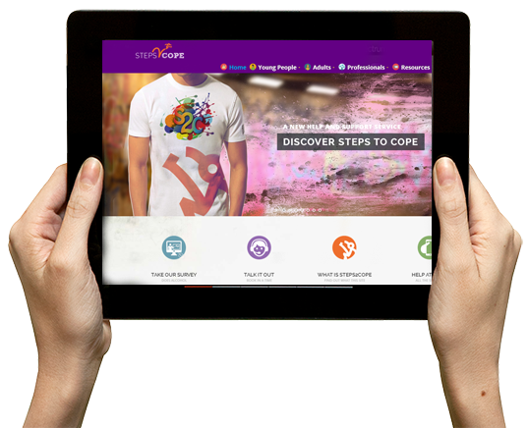


STC Web Platform
Young people can get information about PAM and how it may be affecting them or their family
Signposting to services that can support them including those that can provide the STC intervention
Young people can be guided through the steps to cope intervention on the website
Direct contact with STC staff by phone, email or instant message

Slide 21
Regional STC Practitioner Network
Develop a network of trainers to cascade training to a network of practitioners in organisations across NI
Provide practice support to practitioners and share practice
Practitioners provide direct support to young people that access their organisations or are referred by STC team
Champions identified to roll out and embed STC beyond life of project
Train Trainers
30 trainers
Train Practitioners
519 practitioners
Develop Champions
12 + champions
70 organisations across NI already interested in having 129 practitioners trained in year 1

Slide 22
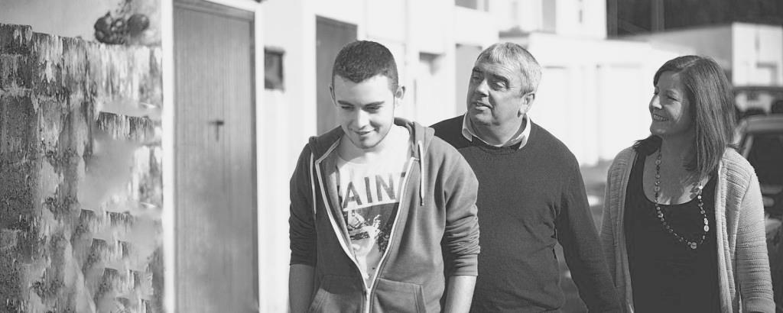
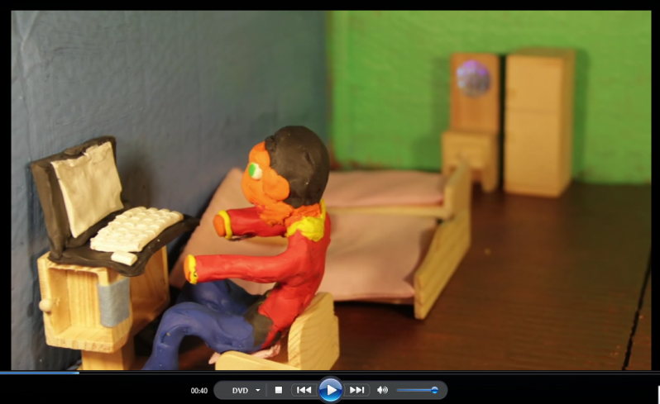
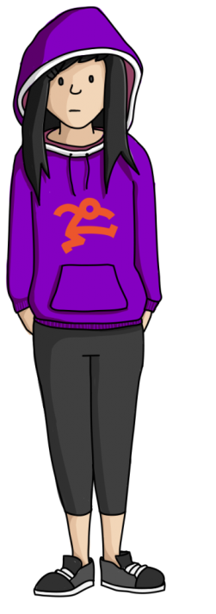
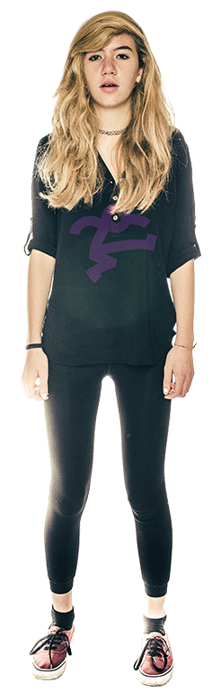
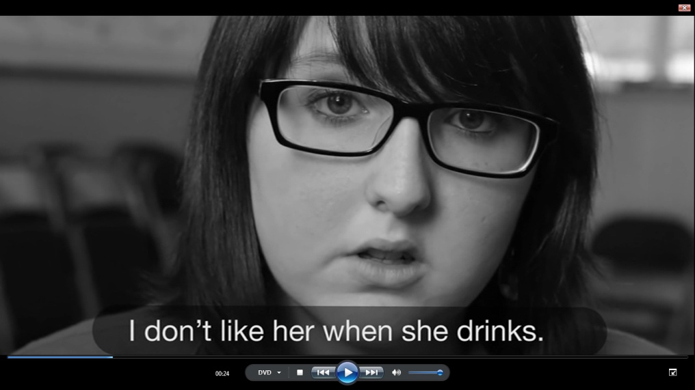
Involving Young People in
Inform the design of website and resources
Input to project management
Share experiences and advocate the project to other young people
Ensure project is relevant to young people
Young People’s Regional Reference Group
Participation Groups in each Trust area

Slide 23
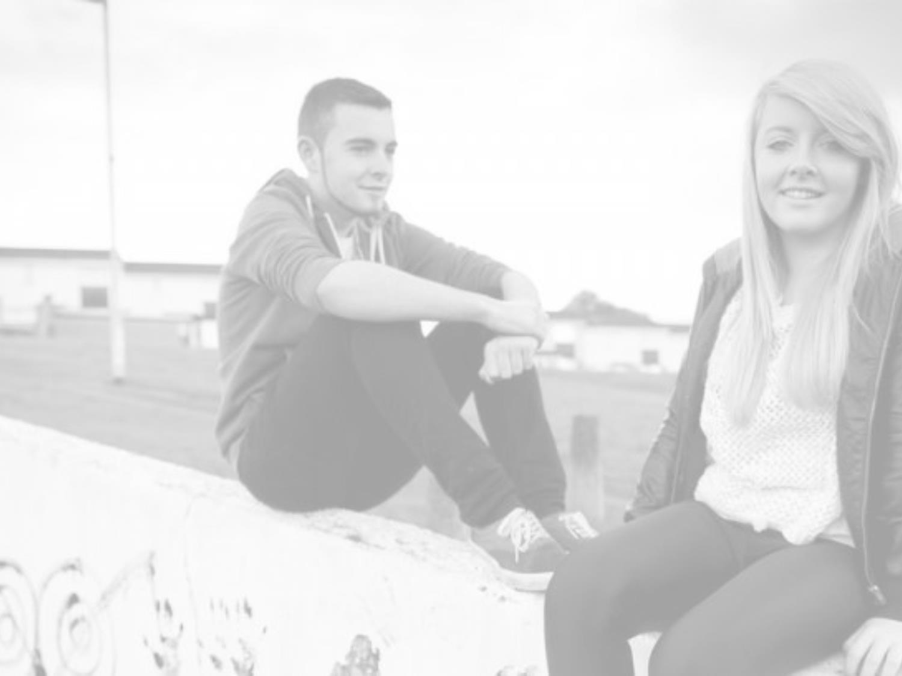
Reaching Young People
Awareness Sessions
Literature
3rd Party Education Programmes
STC
Schools
Youth and Family Services
Local Impact of alcohol
Young People
Social Media
Peer networks
3rd Party websites
Literature
Website links
Meetings/presentations
Literature
Website links
Meetings/presentations

Slide 24
Sustainability
A network of skilled practitioners across NI to support young people
Organisations across NI skilled to work with hidden harm as core work
A network of trainers to carry on future training
Champions across sectors to take the work forward and embed it
A web platform that could be transferred to other providers or sustained with some resource.
Strengthened evidence base

Slide 25
Most Important Safe Practice
Safeguarding issues are at the forefront of practice
The general website will be open to all and contain information
The intervention area and discussion areas will be moderated

Slide 26
Evaluation
We will be using two quantitative tools to measure impact
Resilience Scale for Adolescents; READ
(1) personal competence, 2) social competence, 3) structured style, 4) family cohesion, 5) social resources.
A designed questionnaire based on the 5 steps
The Advisory Group is considering what useful information a small external evaluation could tell us

Slide 27
Strengthening the Evidence Base
We will be doing some additional work in other areas to build upon the evidence through evaluation
We are only getting started
What else can further evaluation tell us?

Slide 28
Fearfulness/Self Protection
Confrontation/Self Destruction
Fearful Inaction
Terrified
Emotional Attack
Tried to show him up make jealous
Protective Action
Hide money, took special care of own possessions
Discord
Rows arguments
Fear of the Future
Afraid for the family
Action against self
Gets drunk, makes self sick, hurts self
Unemotional' or Indifferent to Pain
Stoicism, put on a brave face, pretend all is well
Detachment/Internalising/
Help Seeking
Involvement
Anti Drink
Pours down sink
Avoidance
Refused to talk, stayed in the bedroom
Indulgence
Gave him drink, make comfortable
Switched off
Built shell around self, day dreamed
Self Blame
Felt guilty, blames self
Help seeking
Sought help from neighbour relative

Slide 29

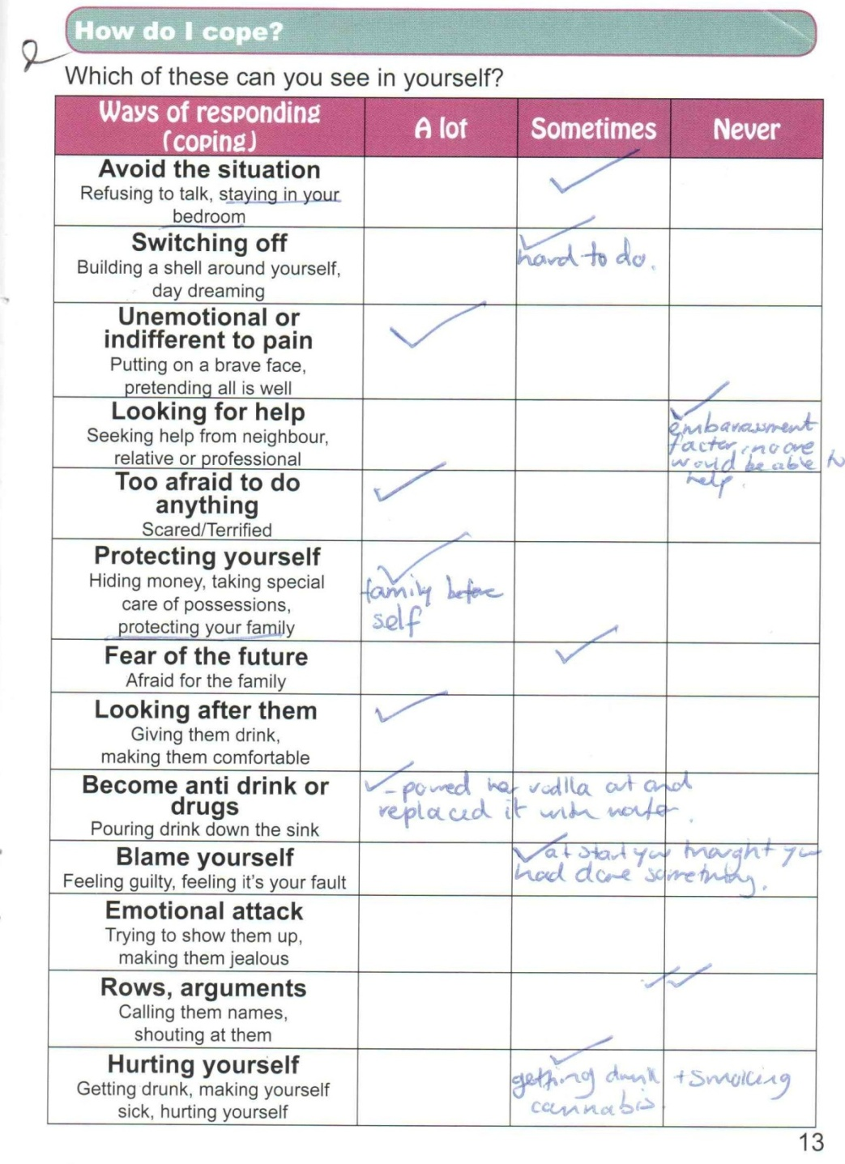
Thinking About
Coping
Notes:
29

Slide 30
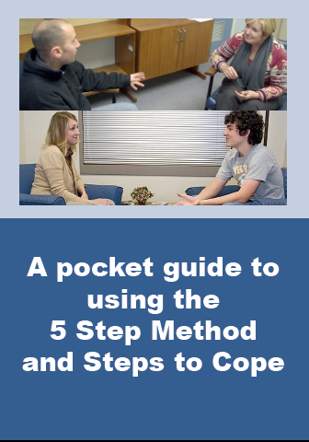
Next Steps
Learning from your experience of accreditation
Getting our trainers accredited
________ ___ ___ ____
________ __________ _________
Networking providers
Insuring we get young people’s views in the content and design of the workbook and website
Launching the web site
Training managers

Slide 31
ed.sipler@setrust.hscni.net
Thanks for having me
Any Questions?

