Slide 1


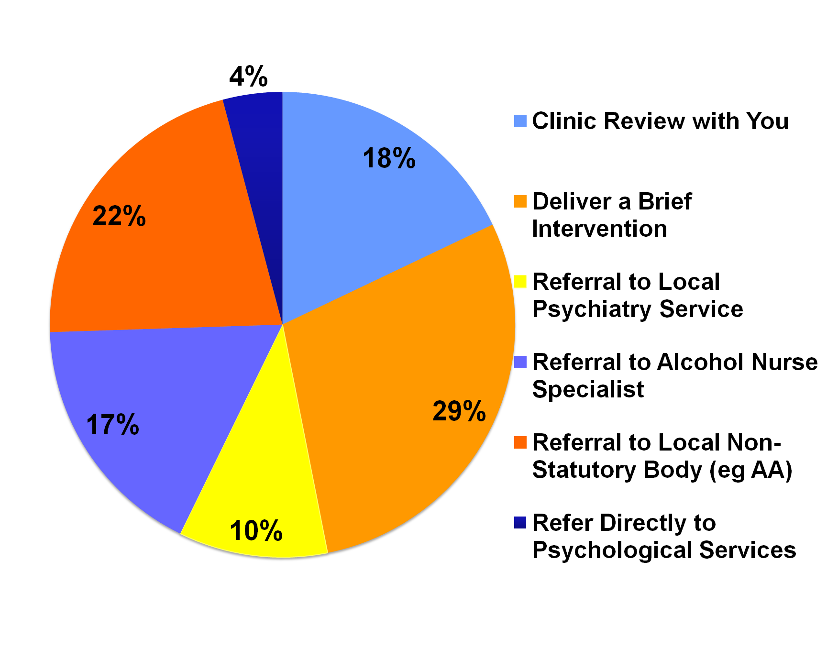
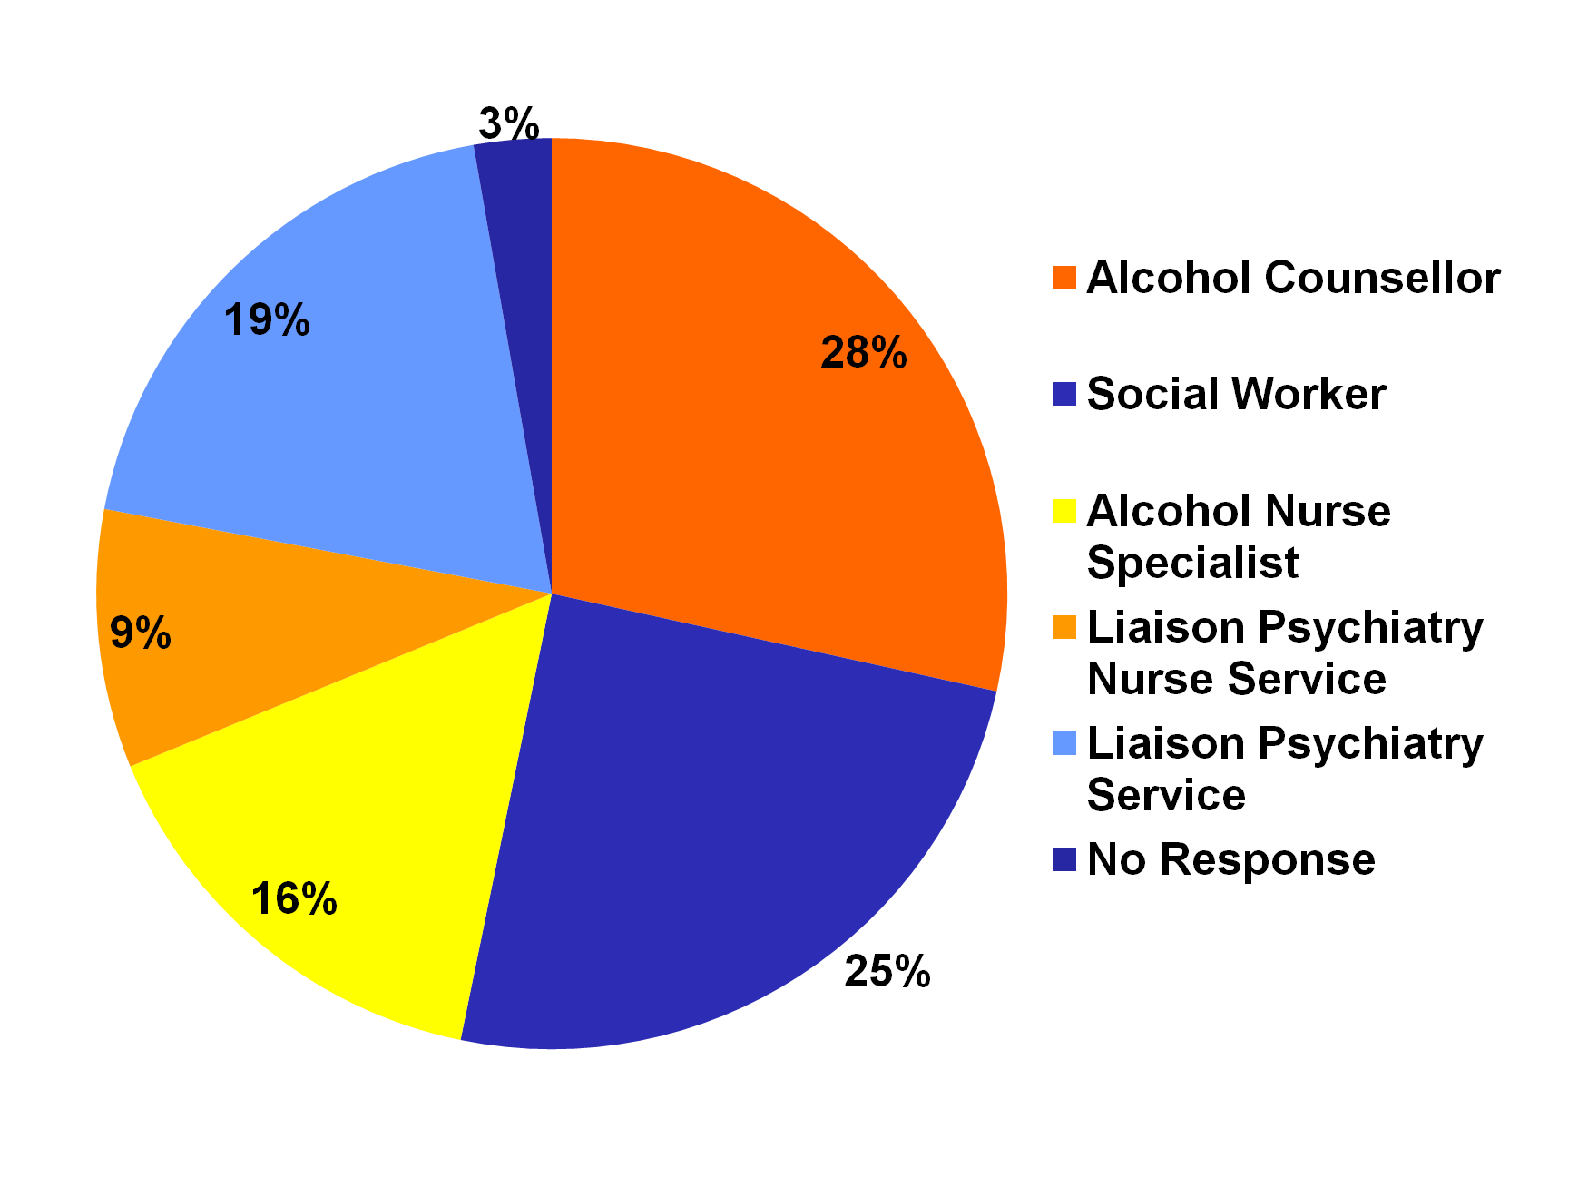
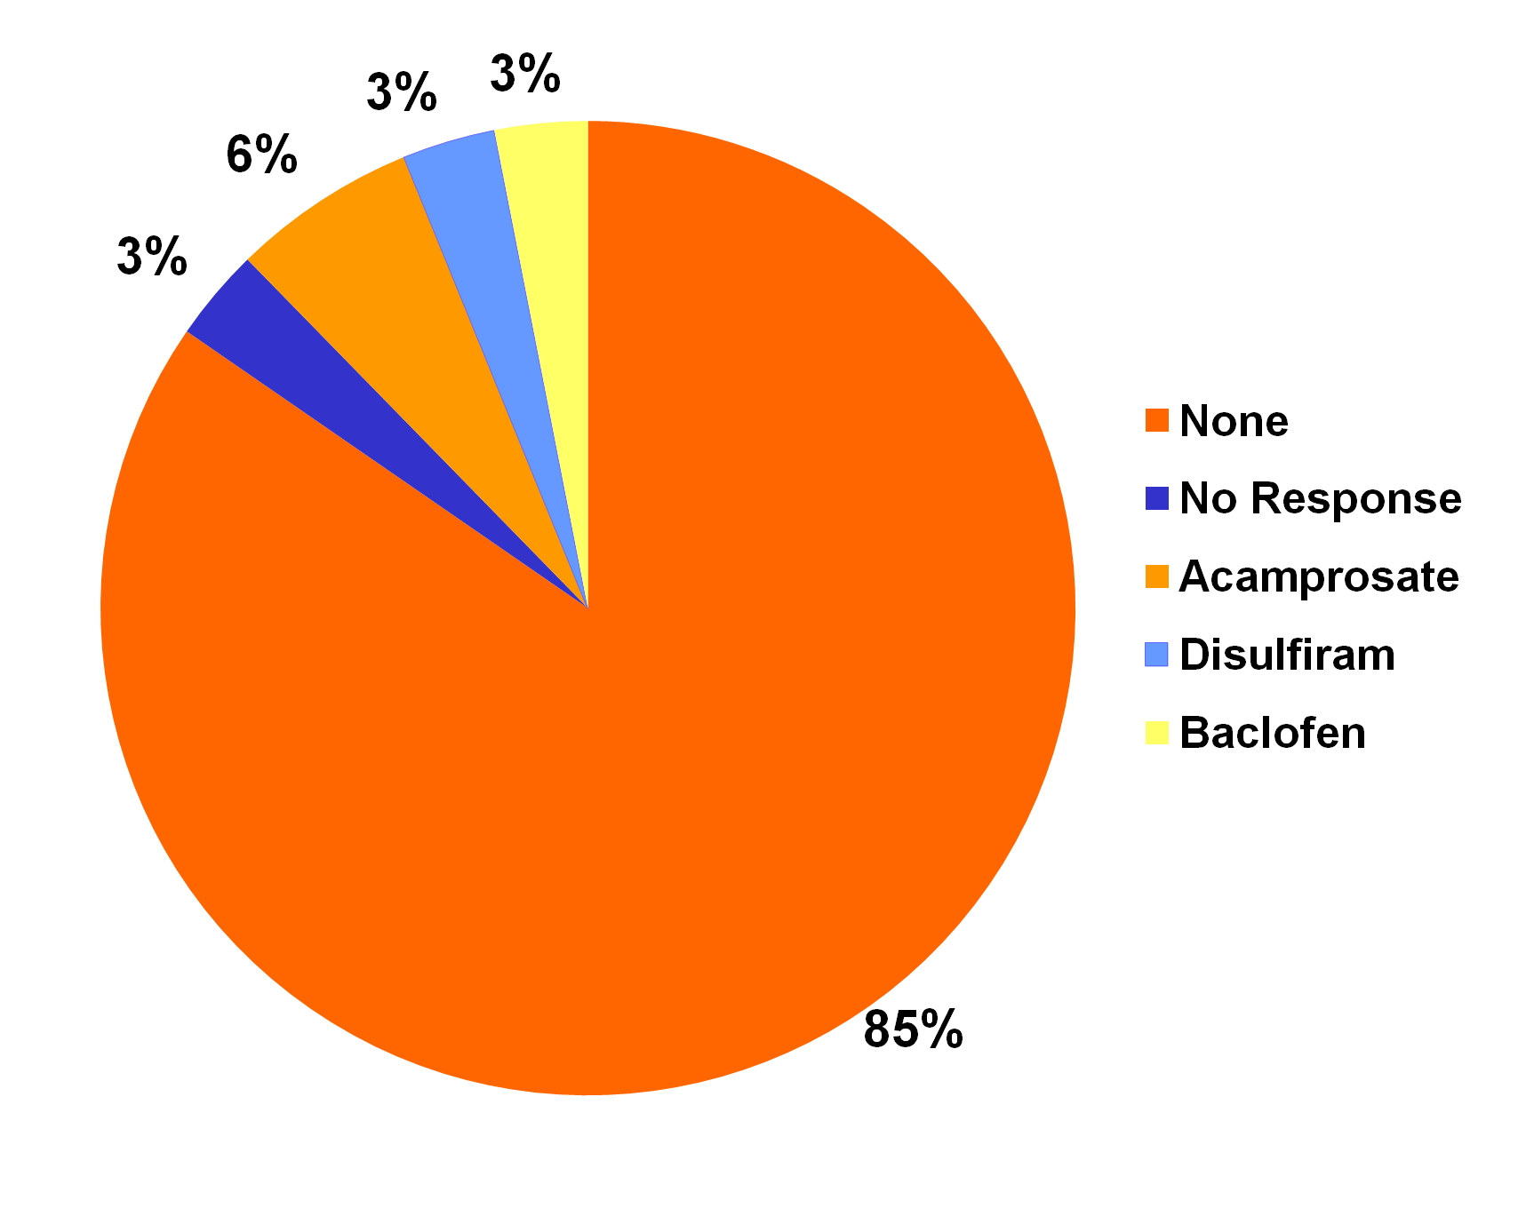
Assessment and Treatment of Hazardous and Harmful Alcohol Drinkers
in Ireland: A Survey of Irish Gastroenterologists
Audrey Dillon, Stephen Stewart
Centre for Liver Disease, Mater Misericordiae University Hospital, Dublin, Ireland
Introduction
Results
Results
Alcohol-related mortality in Ireland is rising, particularly in the young. In April, the Royal College of Physicians of Ireland (RCPI) convened a policy group on alcohol which produced recommendations for Government and for those caring for patients with alcohol-related problems. These will rely on knowledge of and access to local services for these patients.
Currently there is very little known about what services are available to, and used by, Irish clinicians dealing with harmful and hazardous drinkers.
Tool | Number (%)
Clinical Judgement | 37 (57%)
CAGE | 20 (31%)
No Formal Tool | 5 (8%)
AUDIT | 3 (4%)
Table 1. Most Common Mode of Assessment.
Validated tools, CAGE and AUDIT, are used by only 35% of gastroenterologists.
Figure 3. Referral to Services Within Institution.
Nearly half of referrals are to general psychiatry and social work services, not to specialist alcohol services.
Aims
The aim of this study was to survey Irish gastroenterologists to determine access to services in the management of harmful and hazardous drinkers.
Summary
Methods
There is a paucity of services used by Irish gastroenterologists in the treatment of harmful and hazardous drinkers.
The majority of gastroenterologists do not use validated tools for the screening of hazardous drinkers nor use pharmacotherapy in their treatment.
Only 20% of gastroenterologists can refer patients for outpatient detoxification.
In particular, only half of gastroenterologists refer to specialised alcohol counselling services within their institution.
A short survey was designed to identify the types of interventions and services currently in use by clinicians treating harmful and hazardous drinkers. The survey included the use of screening tools, treatments including pharmacotherapy and access to referral services. An online survey tool, www.surveymonkey.com, was emailed to all members of the Irish Society of Gastroenterology. A reminder email was sent 1 month later.
Results
Figure 1. Interventions Offered.
The most common were; deliver a brief intervention, refer to non-statutory bodies like Alcoholics Anonymous (AA), refer to an alcohol nurse specialist and to offer a return review at clinic. Only 4% had access to refer directly for specific psychological services.
There were 65 respondents. 45 (69%) of the respondents were consultants in gastroenterology / general medicine, 14 (22%) were gastroenterology registrars and 3 (5%) were surgeons.
The survey had 5 questions:
Question 1: If you suspect a patient may be a hazardous, harmful or dependent drinker, which mode of assessment would you most commonly use? Results in Table 1.
Question 2: Having established that a patient is a hazardous drinker, what are the interventions you offer? Results in Figure 1.
Question 3: What pharmacotherapy do you regularly prescribe for hazardous drinkers? Results in Figure 2.
Question 4: Do you regularly refer patients to any of the following services within your institution? Results in Figure 3.
Question 5: Have you access to refer patients to an outpatient detoxification programme?
80% of gastroenterologists have no access to refer to an outpatient detoxification programme.
Conclusion
This survey shows that gastroenterologists do not access services for treatment of hazardous drinkers. It is not clear if this is because the services are not available, or not accessed.
Gastroenterologists in Ireland may benefit from education in the use of formal screening tools and pharmacotherapy in the management of harmful or hazardous drinkers.
Institutions need to have clear pathways for the screening and management of harmful and hazardous drinkers and this should be delivered by appropriately trained staff. Clear links between community and hospital alcohol treatment services need to be developed, and there needs to be a greater access to outpatient detoxification programmes.
Gastroenterologists require greater access to psychological treatments, that remains the mainstay of alcohol treatment.
Figure 2. Pharmacotherapy Prescribed.
The vast majority of gastroenterologists do not use pharmacotherapy in the management of hazardous drinkers.
References
1. RCPI Policy Group on Alcohol Reducing Alcohol Health Harm. 2013.

