Slide 1
Tobacco - the story so far
Proof change is possible
Kathleen O’Meara
Irish Cancer Society

Slide 2
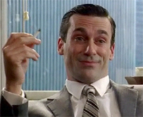
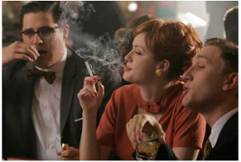
Where we’ve come from
Notes:
50 years ago most men and almost half of women smoked
Nowadays, only 1 in 5 people smoke
Smoking is not normal
How have we achieved a cultural and social shift away from smoking?

Slide 3
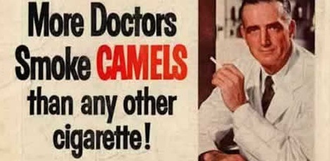
Where we’ve come from
Notes:
50 years ago most men and almost half of women smoked
Nowadays, only 1 in 5 people smoke
Smoking is not normal
How have we achieved a cultural and social shift away from smoking?

Slide 4
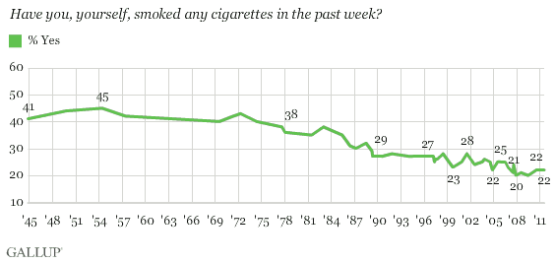
A success story
U.S. rate fallen from 45% in 1954 to 22% in 2011
Notes:
Cigarette consumption in Western Europe has dropped from 50% to somewhere around 25% in the last 40 years.

Slide 5
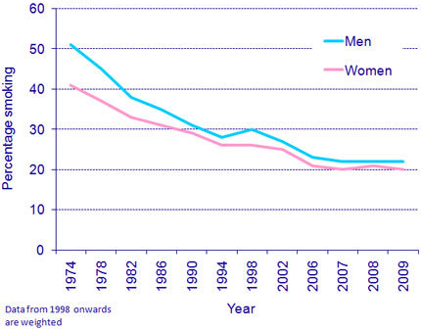
A success story
U.K. rate fallen from 52% in 1974 to 22% in 2009
Notes:
Cigarette consumption in Western Europe has dropped from 50% to somewhere around 25% in the last 40 years.

Slide 6
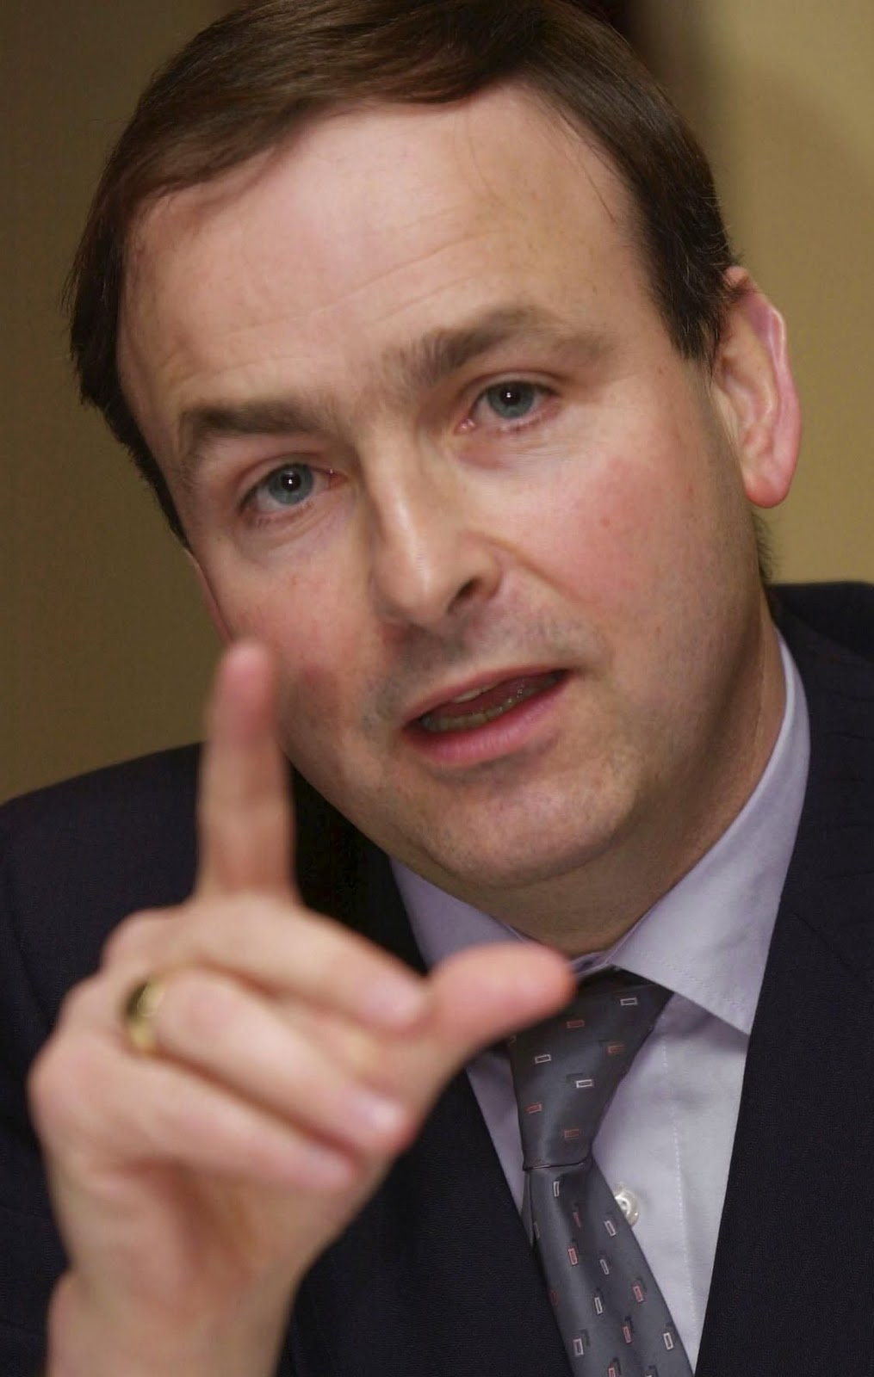
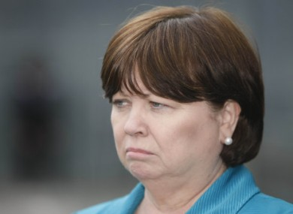
In Ireland smoking rate fallen to 24% thanks to…
…And stakeholders working together
Notes:
Cigarette consumption in Western Europe has dropped from 50% to somewhere around 25% in the last 40 years.

Slide 7
But…poor, young women smoke more
Notes:
Cigarette consumption in Western Europe has dropped from 50% to somewhere around 25% in the last 40 years.

Slide 8
The road to success
Prioritisation of Public Health Policy
Legislation
Coalition Building
Political Champions
New Ideas

Slide 9
Legislation
Ban on smoking in workplaces
Display ban
10-packs banned
Graphic warnings
And more….

Slide 10
Global victories
WHO FCTC
Plain packaging
Global coalitions built
Tobacco Products Directive…maybe

Slide 11
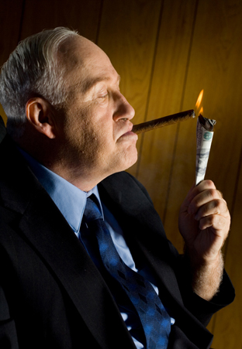
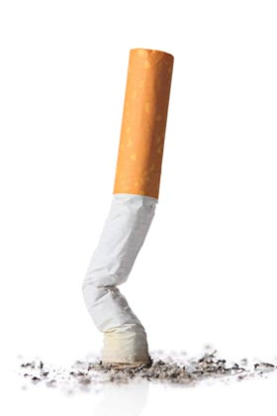
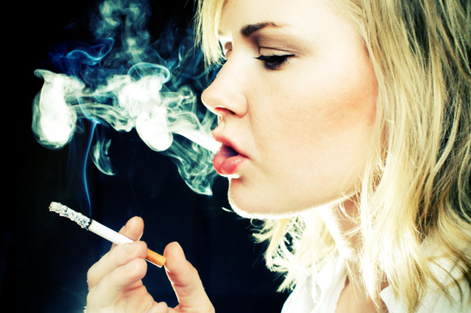
Challenges
Tobacco industry
profits
Departments not working together
Tobacco industry tactics
No National Tobacco Strategy
Quit support
Female smokers

Slide 12
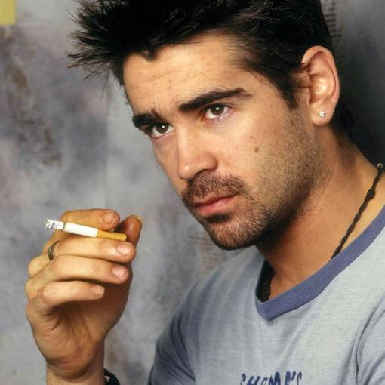
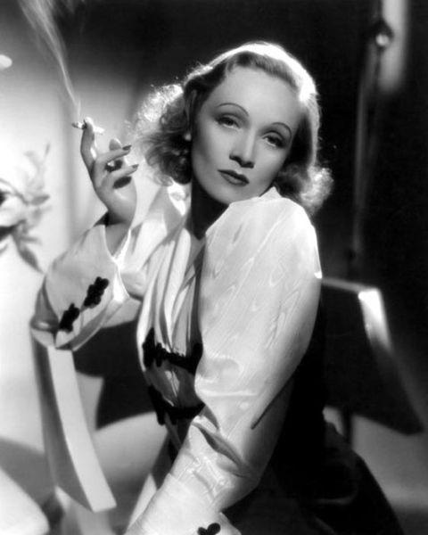
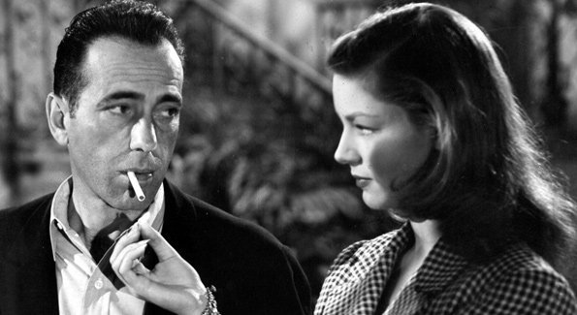
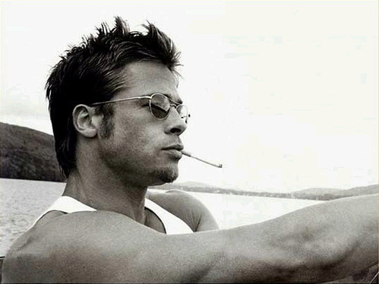
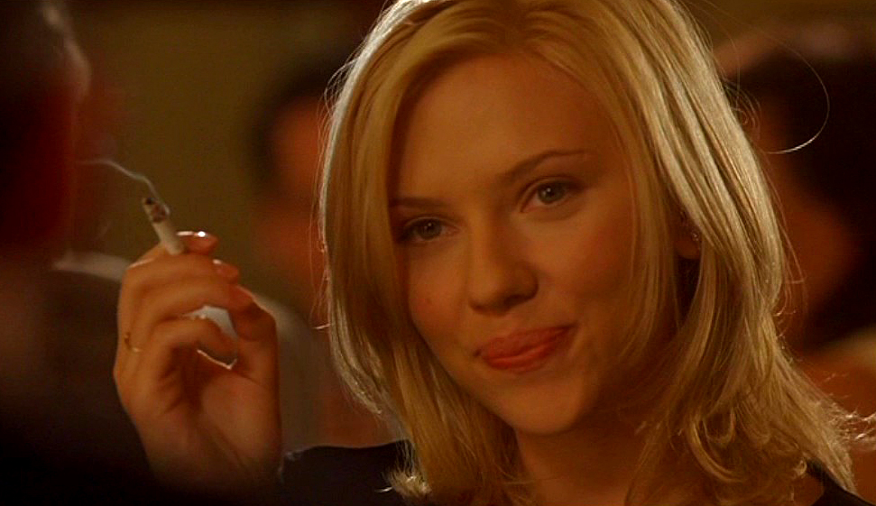
Notes:
Glamour and attractiveness linked to smoking

Slide 13
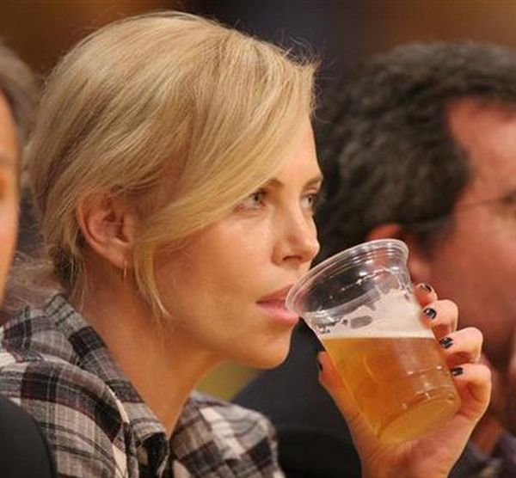
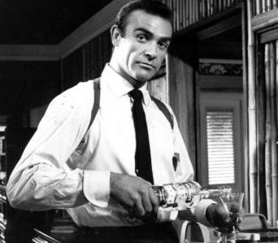
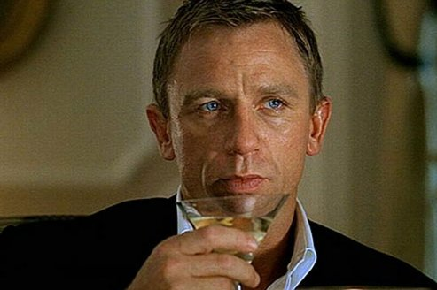
Not unlike…

Slide 14
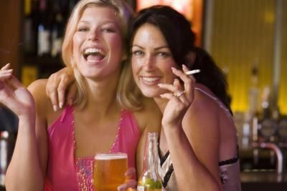
Parallels between smoking and alcohol
Glamour, attractive, cool
National heritage and culture
Political connections
Economic arguments
Front groups
‘Social’ smokers / drinkers

Slide 15
See and be the change
Change is possible

Slide 16
Thank you

