Slide 1
Evidence Based Policy Works It is Worth Fighting For
Dr Declan Bedford
Alcohol Action Ireland Conference
Royal College of Physicians of Ireland
1st November 2012

Slide 2
This Presentation
Introduction of random breath testing 2006
Lowering the legal alcohol limits for driving 2011
A public health advocacy model a useful framework

Slide 3
Context and background

Slide 4
Road Deaths per Million Population 2005
Holland | 4.6
Norway | 4.8
Sweden | 4.9
Great Britain | 5.5
Switzerland | 5.5
Denmark | 6.1
Germany | 6.5
Finland | 7.2
Northern Ireland | 7.8
Ireland | 9.6

Slide 5
Per Capita (age 15+) Consumption of Alcohol Ireland and OECD countries

Slide 6
Road Safety Strategy 2004-2006
“There is no clear measure of the level of intoxicated driving in Ireland”
Crashes between 9PM and 3 AM used as a substitute measure

Slide 7
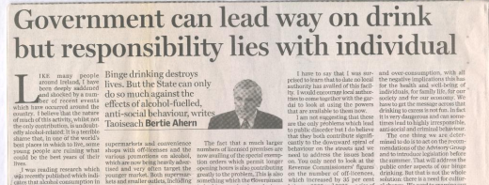

Slide 8
Labour Party Transport Spokeswoman Roisin Shorthall TD 2005
“You can’t blame people for being cynical for the Government’s failure to act on this, because of the fact there are so many publicans in the Dail and because of the close ties in particular between Fianna Fáil and publicans.”

Slide 9
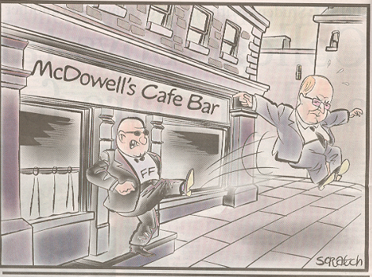

Slide 10
Random Breath Testing
Not recommended in Road Safety Strategy 1998-2002
“Possible negative implications for public attitudes to and cooperation with the Gardaí”
Recommended in
Strategic Task Force 2002
Road Safety Strategy 2004-2006

Slide 11
Drink Driving Convictions
Hard to get
Based on initial Garda opinion
Most contested
Argument put forward that random breath testing “unconstitutional”

Slide 12
Mr Eddie Shaw, Chairman of the National Safety Council 23rd November 2005
“I do not know if we will ever get the legislation we need to enable drink driving to be detected and prosecuted. It seems that the protection our constitution provides is indirectly exchanged for about 140 lives every year”

Slide 13
RSA formally established on 1st September 2006
Gay Byrne unveiled as Chairman Designate of RSA 27th March 2006

Slide 14
Random Breath Testing implemented in July 2006

Slide 15
Important factors in getting RBT implemented
Leadership
Evidence
Provision of a credible rational
Champions and allies identified to use as credible opinion formers
Lobbying
Opposition tackled based on the facts
Information campaign
Conferences
Mobilised public opinion
Organisation of resources
Persistence

Slide 17
Components of Model
Provide Strategic Leadership
Core Activities
Support Activities

Slide 18
Provide Strategic Leadership
Making sure the issue is relevant to society
RBT testing works and saves lives and injuries
Preventing tangential diversions

Slide 19
Core Activities
Building a coalition of support
Organise
Media coverage
Briefings
Lobbying

Slide 20
Support Activities
Gather information and evidence
Evidence from other countries
Any alcohol impairs driving
RBT testing works and saves lives and injuries
Role of alcohol in road deaths in Ireland

Slide 21
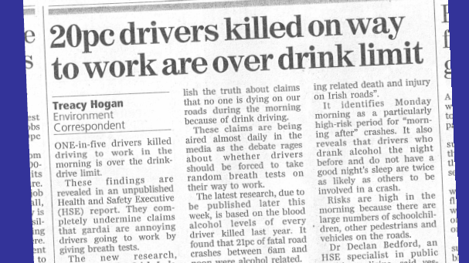

Slide 22
Support Activities
Creating public awareness
Conduct opinion polls

Slide 23
Alcohol Action Ireland Survey 2005
87% in favour of the introduction of RBT

Slide 24
Drink Driving
Over 8 out of 10 drivers surveyed rated drinking and driving as extremely shameful
More shameful than adultery and tax evasion
RSA 2006

Slide 25
Support Activities
Acting ethically
Played the ball not the man

Slide 26
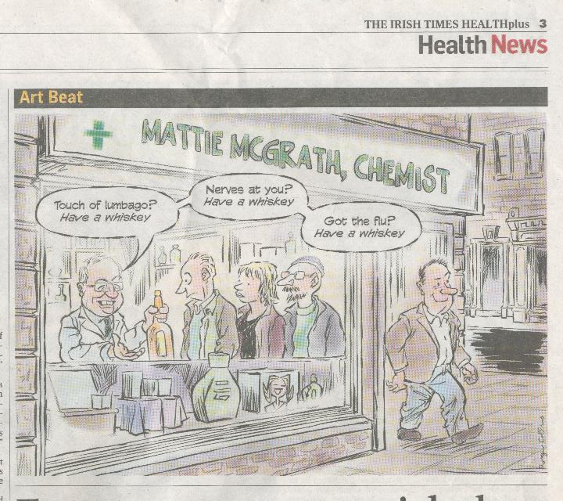

Slide 27
Random Breath Testing implemented in July 2006
Lower limits for alcohol in 2011

Slide 28
Deaths on Irish Roads 1961-2011
RBT

Slide 29
Deaths on Irish Roads 1961-2011
RBT

Slide 30
Deaths on Irish Roads 1961-2011
Blood alcohol reduced to 80 mg/ml
RBT
Blood alcohol reduced to 100 mg/ml
1st Road safety strategy
3rd Road safety Strategy
2nd Road safety strategy

Slide 31
RBT effective because
It is evidence based
Not a code of practice
Not just a campaign
Based on legislation

Slide 32
Conclusion
The implementation of RBT and lower alcohol limits demonstrates that major barriers can be overcome
Implementing evidence based policies reduces alcohol related harm
May take a long time but worth it in the end

