Slide 1
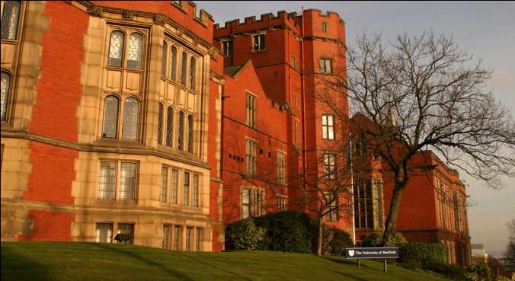
The impact of minimum pricing:
Evidence from the Sheffield Alcohol Policy Model
Dr. John Holmes
Prof. Alan Brennan
Prof Petra Meier
Dr Yang Meng
Dr Robin Purshouse
School of Health and Related Research
University of Sheffield
Email: john.holmes@sheffield.ac.uk
Funders: Department of Health, National Institute of Health and Clinical Excellence, Scottish Government. Medical Research Council, Economic and Social Research Council. The views expressed are not necessarily those of the funders.
© The University of Sheffield

Slide 2
The Sheffield Alcohol Policy Model

Slide 3
Introduction to the model
Appraises the effectiveness and cost-effectiveness of alcohol policies
Pricing policies examined for Scotland:
  Minimum prices from 25p to 70p per unit
  Total off-trade discount ban (not multibuy)
  Minimum price + off-trade discount ban

Slide 4
Introduction to the model
Provides estimates of:
  Changes in consumption
  Changes in levels of harm
    Health
    Crime
    Workplace
  Changes in the cost of harms
  Changes in consumer spending
  Change in revenue to the exchequer

Slide 5
Structure and evidence base
2-stage model:
  Price change to consumption change
  Consumption change to rates of alcohol-related harm
Price to consumption:
  Econometric analysis to generate price elasticities
  Based on UK data on individuals’ spending and alcohol prices
Consumption to harm:
  Uses risk functions and alcohol attribution levels
  Based on best available published evidence
Scotland adaptations:
  Uses Scottish data where available (see reports for details)

Slide 6
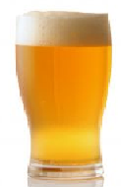
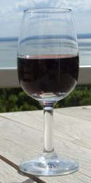

1 unit = 10ml of pure ethanol
Beer (4% ABV)
1 pint ≈ 2 units
Wine (12% ABV)
175ml glass ≈ 2 units
750ml bottle ≈ 9 units
Whiskey (40% ABV)
25ml measure ≈ 1 unit
Drinker type | Units per week
 | Men | Women
Moderate | Less than 21 | Less than 14
Hazardous | 21 – 50 | 14 – 35
Harmful | 50+ | 35+

Slide 7
The key evidence

Slide 8
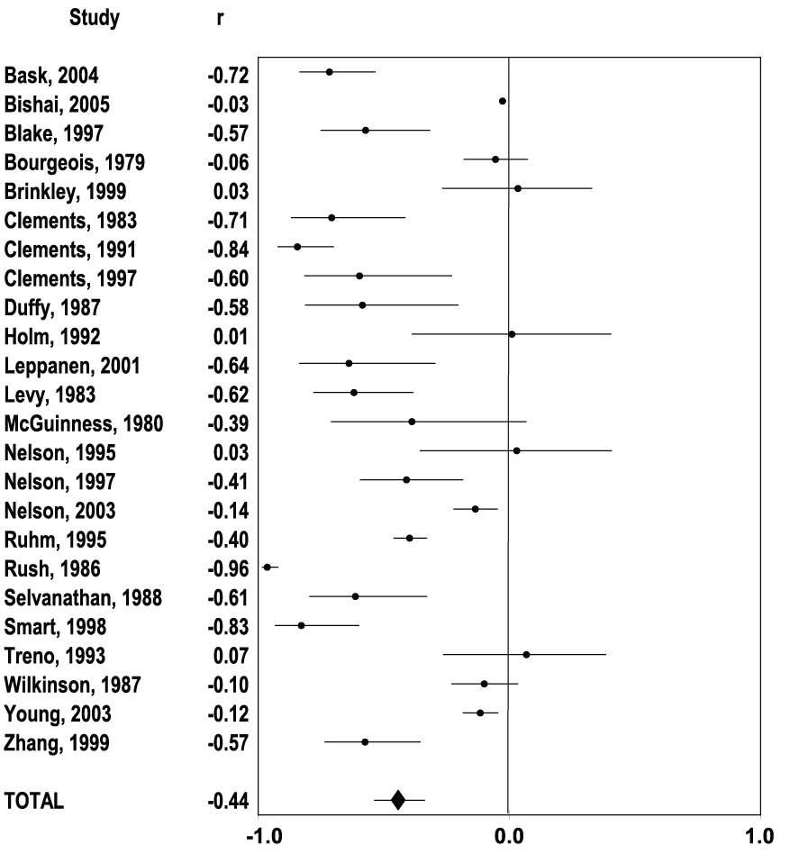
Effects of Price on Alcohol Consumption:
A meta-analysis of 112 studies
Found significant effects for:
Total alcohol & individual beverages
Younger & older drinkers
Moderate & binge drinkers
Example: Average effect of a price increase on the consumption of all beverages
Source: Wagenaar et al. (2009) ‘Effects of beverage alcohol tax and price levels on drinking: a meta-analysis of 1003 estimates from 112 studies’. Addiction, 104, pp.179-90

Slide 9
Conclusions - Morbidity & Mortality
Doubling the alcohol price was associated with
  35% reduction in alcohol-related mortality
  11% reduction in traffic crash deaths
  6% reduction in sexually transmitted diseases
  2% reduction in violence
  1% reduction in crime
Source: Wagenaar et al. (2010) ‘Effects of alcohol tax and price policies on morbidity and mortality: A systematic review’, American Journal of Public Health, 100(11), pp.2270-8

Slide 10
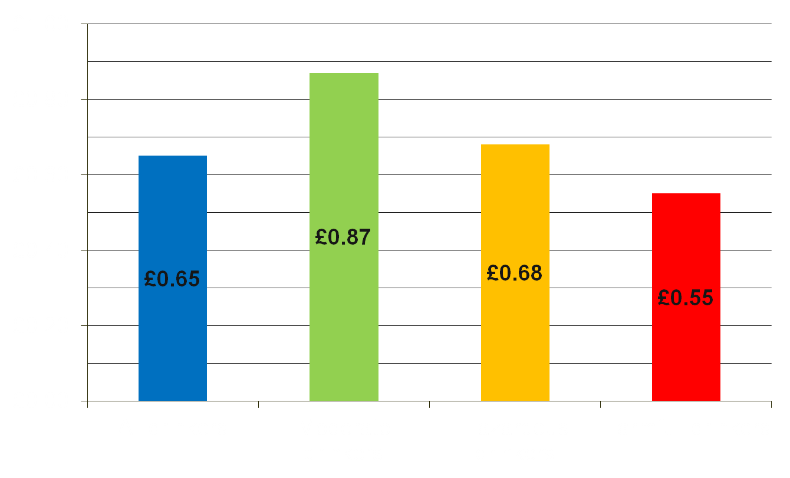
Average price paid per unit of alcohol in England
Source: Analysis of Expenditure and Food Survey 2005/6

Slide 11
Recent Canadian evidence
Different minimum price policies in different provinces
  Beverage-specific price per unit
  Beverage-specific minimum price
Studies conducted in BC and Saskatchewan
When minimum prices are increased by 10%, consumption falls by:
  8% in Saskatchewan
  3.4% in BC
Sources: Stockwell et al.(2012) ‘Does minimum pricing reduce alcohol consumption? The experience of a Canadian province’, Addiction, 107, pp.912-20
Stockwell et al.(2012) ‘The raising of minimum alcohol prices in Saskatchewan, Canada: Impacts on consumption and implications for public health’, American Journal of Public Health, doi:10.2105/AJPH.2012.301094

Slide 12
The findings

Slide 13
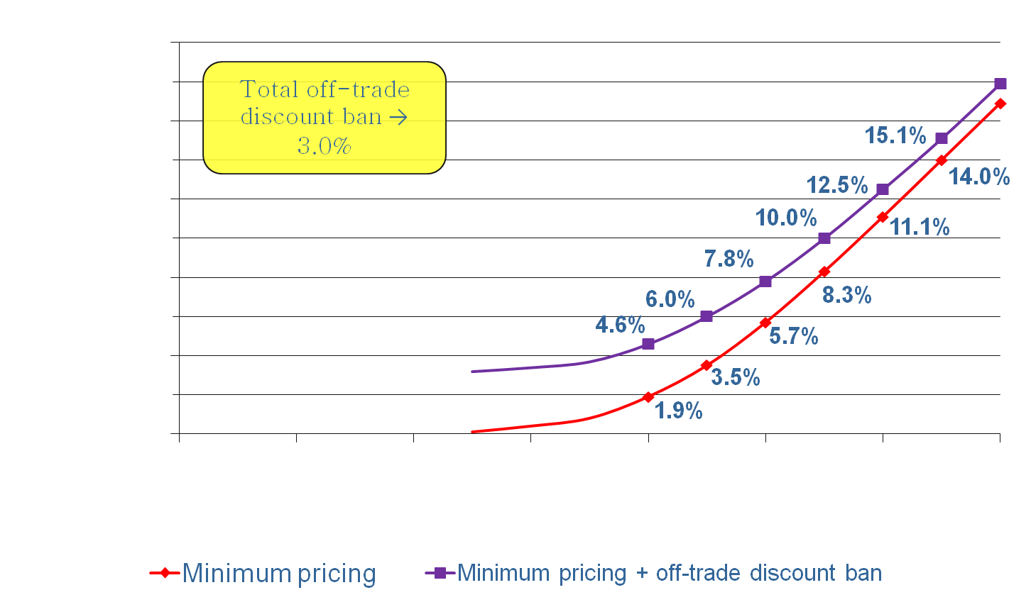
Price policy effects:
% change in consumption
Notes:
Minimum unit price starts to have substantial effects above 40p per unit.
Stopping off-trade discounting is only has a modest effect

Slide 14
Estimated effects of minimum pricing
50p minimum price per unit
Overall reduction in consumption | 5.7%
Annual health savings in year 10
Deaths | 318
Hospital admissions | 6,500
Annual savings
Crimes | 3,500
Days absent | 32,300
Unemployed persons | 1,300
10 year cost reduction
Health | £114m (direct) | £492m (QALY)
Crime | £24m (direct) | £20m (QALY)
Work | £292m
Total | £942m
Revenue changes
Retailers | +£68.3m (off) | +£29.3m (on)
Duty + VAT | -£20.6m (off) | +£10.1m (on)

Slide 15
Price policy effects on drinker types’ consumption in England
Source: http://guidance.nice.org.uk/PHG/21/EconomicModellingReport/pdf/English
Notes:
Harm reduction from pricing policies is seen for all drinker types but greatest effects are seen for hazardous and harmful drinkers.
Pricing policies set at too low a level have minimal benefit even for those drinking at harmful levels.

Slide 16
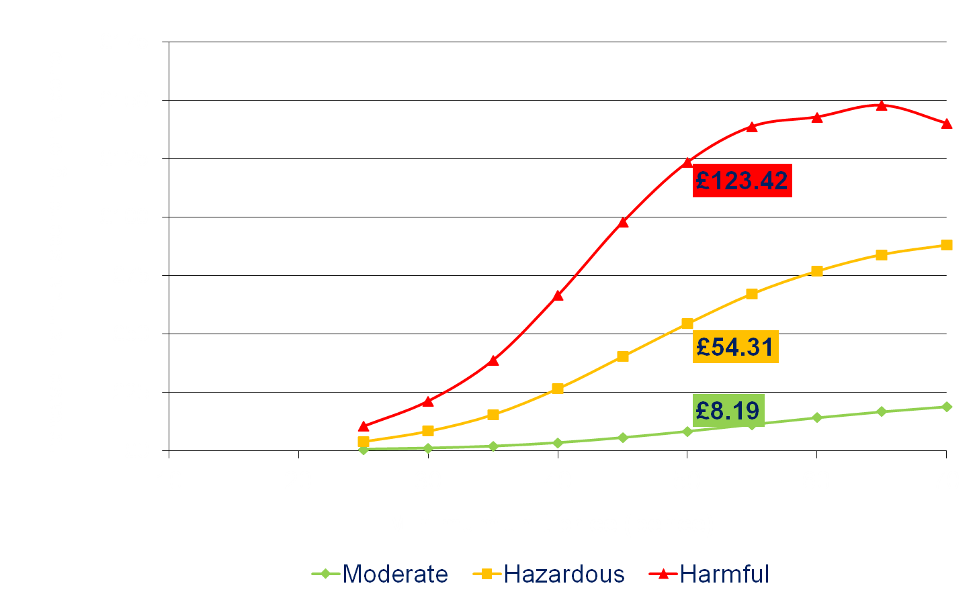
The cost of minimum pricing to drinkers
Notes:
Minimum unit price starts to have substantial effects above 40p per unit.
Stopping off-trade discounting is only has a modest effect

Slide 17
For further information
John.holmes@sheffield.ac.uk
http://www.shef.ac.uk/scharr/sections/ph/research/alpol
Unless otherwise indicated, all figures in this presentation are taken from: Meng, Y. et al. (2012) 'Model-based appraisal of alcohol minimum pricing and off-licensed trade discount bans in Scotland using the Sheffield Alcohol Policy Model (v.2): Second update based on newly available data' ScHARR, University of Sheffield

